Slide 1

SOA-C02
SYSOPS
MASTER TRAINER SLIDES · WSQ
AWS Certified SysOps Administrator - Associate (SOA-C02)
WSQ Course Code: TGS-2024051413
Conducted by Tertiary Infotech Academy Pte Ltd · UEN 201200696W
Version v4 · 30 July 2026
© 2026 Tertiary Infotech Academy Pte Ltd. All rights reserved. · www.tertiarycourses.com.sg

Slide 2
It is mandatory for you to take both AM, PM and Assessment digital attendance for WSQ funded courses.
• The trainer or administrator will show you the digital attendance QR code generated from SSG portal.
• Please scan the QR code from your mobile phone camera and submit your attendance.
• Digital Attendance
AWS Certified SysOps Administrator - Associate (SOA-C02) · TGS-2024051413
© 2026 Tertiary Infotech Academy Pte Ltd
1

Slide 3
About the Trainer
• About the Trainer
AWS Certified SysOps Administrator - Associate (SOA-C02) · TGS-2024051413
© 2026 Tertiary Infotech Academy Pte Ltd
2

Slide 4
ICE-BREAKER
Let's Know Each Other
• Your name and organisation / role.
• Your experience with AWS or systems operations (if any).
• What you want to monitor, automate, or troubleshoot on AWS after this course.
AWS Certified SysOps Administrator - Associate (SOA-C02) · TGS-2024051413
© 2026 Tertiary Infotech Academy Pte Ltd
3

Slide 5
Ground Rules
• Set your mobile phone to silent mode
• Participate actively in the class. No question is stupid.
• Mutual respect. Agree to disagree.
• One conversation at one time.
• Be punctual. Back from breaks on time.
• Exit the class silently if you need to step out for phone call, toilet break etc.
• 75% attendance is required
AWS Certified SysOps Administrator - Associate (SOA-C02) · TGS-2024051413
© 2026 Tertiary Infotech Academy Pte Ltd
4

Slide 6
Lesson Plan
• Day 1
• Digital Attendance (AM)
• Trainer and Learners Introduction
• Learning Outcomes
• Course Outline
• Topic 1: ….
• Lunch Break
• Digital Attendance (PM)
• Topic 2: ….
• End of Day 1
AWS Certified SysOps Administrator - Associate (SOA-C02) · TGS-2024051413
© 2026 Tertiary Infotech Academy Pte Ltd
5

Slide 7
Lesson Plan
• Day 2
• Digital Attendance (AM)
• Topic 3 …
• Lunch Break
• Digital Attendance (PM)
• Revision
• Course Feedback and TRAQOM Survey
• Digital Attendance (Assessment)
• Final Assessment
• End of Class
AWS Certified SysOps Administrator - Associate (SOA-C02) · TGS-2024051413
© 2026 Tertiary Infotech Academy Pte Ltd
6

Slide 8
Skills Framework
TSC Title: Cloud Computing Application
TSC Code: LOG-TEM-3007-1.1
1
2
AWS Certified SysOps Administrator - Associate (SOA-C02) · TGS-2024051413
© 2026 Tertiary Infotech Academy Pte Ltd
7

Slide 9
TSC Abilities:
• A1 Implement data loading, security, performance monitoring and tuning, capacity planning, backup and recovery
• A2 Implement performance diagnostics and troubleshooting at scale in live environment
• A3 Maintain availability and performance of cloud computing operations and to ensure secure services with no unplanned downtime
• A4 Analyse processing issues and data anomalies and identify solutions
• A5 Implement and release cloud computing operations changes
• A6 Implement IT risk management measures for business continuity and disaster recovery
• A7 Implementation of service quality standards
• TSC Knowledge:
• K1 Cloud computing infrastructure components and technologies
• K2 Installation, configuration and troubleshooting of cloud computing infrastructures
• K3 Installation, configuration and troubleshooting of software packages supporting cloud computing infrastructures
• K4 Design, configuration, maintenance and troubleshooting of cloud computing applications
• K5 Virtualisation technologies
• Skills Framework TSC
AWS Certified SysOps Administrator - Associate (SOA-C02) · TGS-2024051413
© 2026 Tertiary Infotech Academy Pte Ltd
8

Slide 10
Learning Outcomes
• LO1: Maintain business continuity of AWS cloud operations to ensure stable service delivery.
• LO2: Implement secure AWS cloud infrastructure setup such as data loading and performance monitoring
• LO3: Apply service quality standards to ensure security and compliance of AWS cloud operations.
• LO4: Analyze and resolve processing issues to ensure continuity and disaster recovery in AWS cloud applications.
• LO5: Troubleshoot networking performance issues at scale for optimal AWS infrastructure operation.
AWS Certified SysOps Administrator - Associate (SOA-C02) · TGS-2024051413
© 2026 Tertiary Infotech Academy Pte Ltd
9

Slide 11
LU1: Reliability and Business Continuity
• Topic 1 EC2 for SysOps
• Topic 2 Amazon Machine Image (AMI)
• Topic 3 Managing EC2 at Scale - Systems Manager (SSM)
• Topic 4 EC2 High Availability and Scalability
• Topic 5 Elastic Beanstalk for SysOps
• LU2: Deployment, Provisioning, and Automation
• Topic 6 CloudFormation for SysOps
• Topic 7 EC2 Storage and Data Management - EBS and EFS
• Topic 8 Amazon S3
• Topic 9 Advanced Amazon S3 and Athena
• Topic 10 Advanced Storage
• Topic 11 CloudFront
• Topic 12 Database for SysOps
• Course Outline
AWS Certified SysOps Administrator - Associate (SOA-C02) · TGS-2024051413
© 2026 Tertiary Infotech Academy Pte Ltd
10

Slide 12
LU3: Security and Compliance
• Topic 13 Amazon S3 Security
• Topic 14 Security and Compliance for SysOps
• Topic 15 Identity
• LU4: Monitoring, Logging, and Remediation
• Topic 16 Monitoring, Auditing and Performance
• Topic 17 AWS Account Management
• Topic 18 Disaster Discovery
• LU5: Networking and Content Delivery
• Topic 19 Networking - Route 53
• Topic 20 Networking VPC
• Course Outline
AWS Certified SysOps Administrator - Associate (SOA-C02) · TGS-2024051413
© 2026 Tertiary Infotech Academy Pte Ltd
11

Slide 13
Final Assessment
• Written Assessment (SAQ) - 1 hr
• Practical Performance (PP) - 1 hr
• Assessment format: Open Book
• Open book assessment ONLY includes Slides, Learner Guide or any approved materials.
• Appeal process
AWS Certified SysOps Administrator - Associate (SOA-C02) · TGS-2024051413
© 2026 Tertiary Infotech Academy Pte Ltd
12

Slide 14
Briefing for Assessment
Place phones & other materials under the table or on the floor
No photos or recording of assessment scripts
No discussion during assessment
1
2
3
Use black/blue pen for assessment [hard copies]
No usage of liquid paper or correction tape
Assessment scripts will be collected when the time is up
4
5
6
AWS Certified SysOps Administrator - Associate (SOA-C02) · TGS-2024051413
© 2026 Tertiary Infotech Academy Pte Ltd
13

Slide 15
Criteria for Funding
Minimum attendance rate of 75% based on SSG Digital Attendance record.
Complete the assessment and be assessed as ‘Competent
1
2
AWS Certified SysOps Administrator - Associate (SOA-C02) · TGS-2024051413
© 2026 Tertiary Infotech Academy Pte Ltd
14

Slide 16
Access AWS Skills Builder
• https://skillbuilder.aws/
• Builder ID Login:
• training@tertiaryinfotech.com
• training2@tertiaryinfotech.com
• training3@tertiaryinfotech.com
• training4@tertiaryinfotech.com
• training5@tertiaryinfotech.com
• PW: Tertiary@888
• https://skillbuilder.aws/
• Builder ID Login:
• training6@tertiaryinfotech.com
• training7@tertiaryinfotech.com
• training8@tertiaryinfotech.com
• training9@tertiaryinfotech.com
• training10@tertiaryinfotech.com
• PW: Tertiary@888
AWS Certified SysOps Administrator - Associate (SOA-C02) · TGS-2024051413
© 2026 Tertiary Infotech Academy Pte Ltd
15

Slide 17
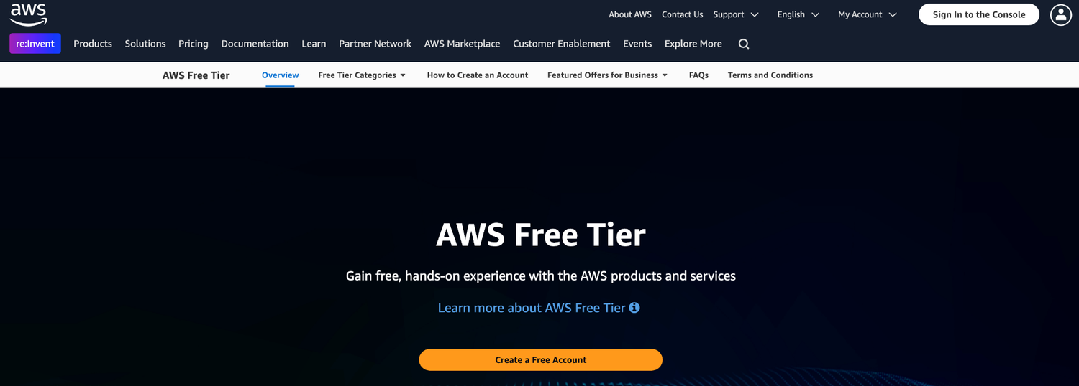
Sign Up Free Trial AWS Account
https://aws.amazon.com/free/
AWS Certified SysOps Administrator - Associate (SOA-C02) · TGS-2024051413
© 2026 Tertiary Infotech Academy Pte Ltd
16

Slide 18
Download Sample Codes
• Download the sample codes use for this course below
• https://drive.google.com/drive/folders/15Ol6kzinWR7dUIXG3t3rOUOFBeGUWNwq
AWS Certified SysOps Administrator - Associate (SOA-C02) · TGS-2024051413
© 2026 Tertiary Infotech Academy Pte Ltd
17

Slide 19
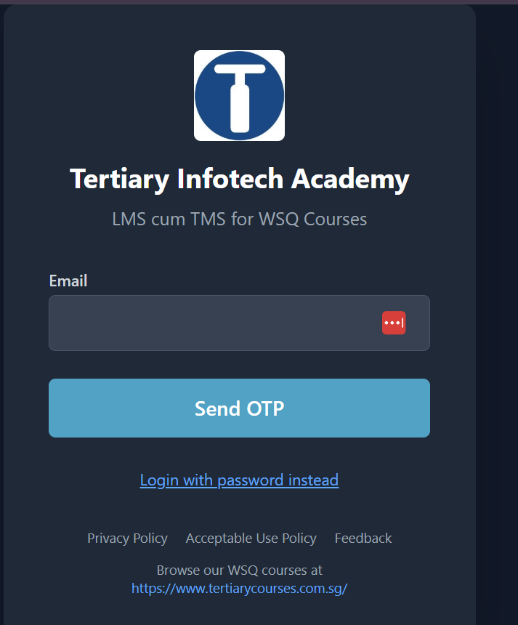
LMS/TMS
https://lms-tms.tertiaryinfotech.com
AWS Certified SysOps Administrator - Associate (SOA-C02) · TGS-2024051413
© 2026 Tertiary Infotech Academy Pte Ltd
18

Slide 20
TOPIC 1
EC2 for SysOps
AWS Certified SysOps Administrator - Associate (SOA-C02) · TGS-2024051413
© 2026 Tertiary Infotech Academy Pte Ltd
19

Slide 21

TOPIC 1
Reference
AWS Certified SysOps Administrator - Associate (SOA-C02) · TGS-2024051413
© 2026 Tertiary Infotech Academy Pte Ltd
20

Slide 22
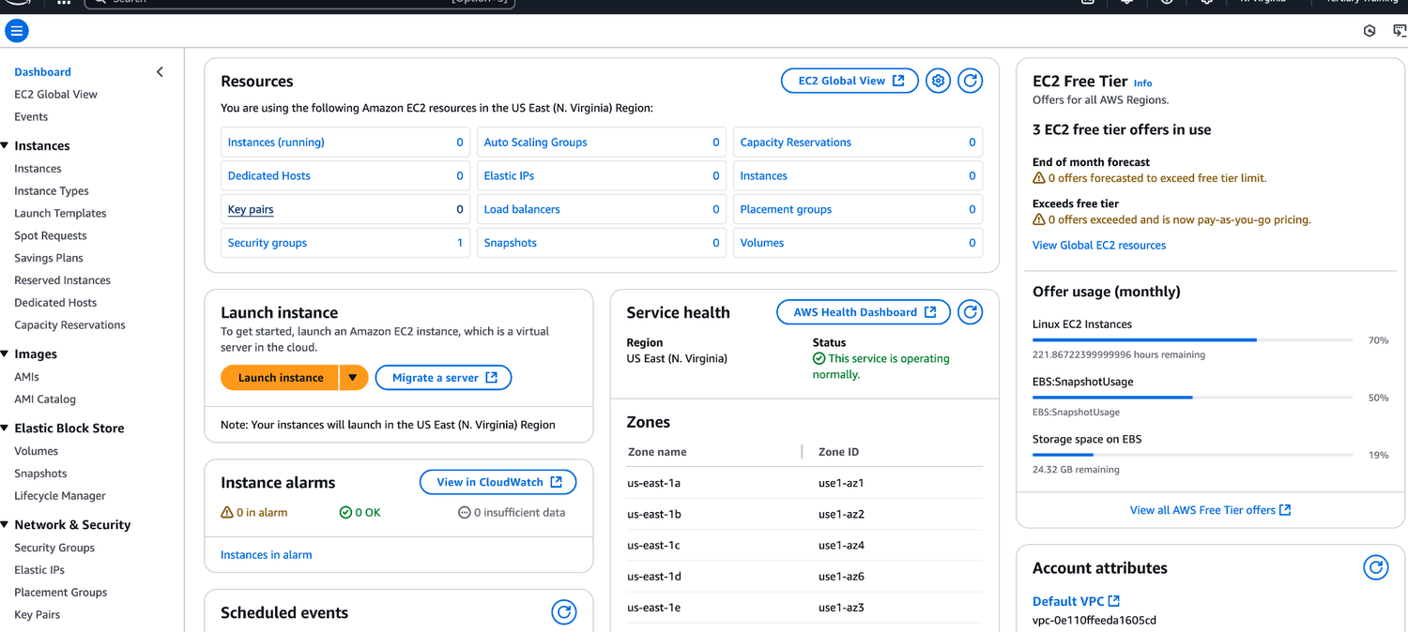
TOPIC 1
EC2 Interface
AWS Certified SysOps Administrator - Associate (SOA-C02) · TGS-2024051413
© 2026 Tertiary Infotech Academy Pte Ltd
21

Slide 23
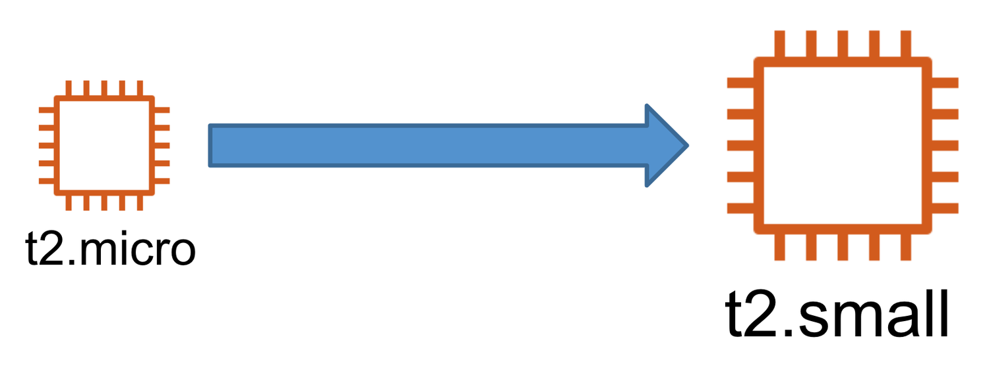
TOPIC 1
EC2 Changing Instance Type
This only works for EBS backed instances
AWS Certified SysOps Administrator - Associate (SOA-C02) · TGS-2024051413
© 2026 Tertiary Infotech Academy Pte Ltd
22

Slide 24
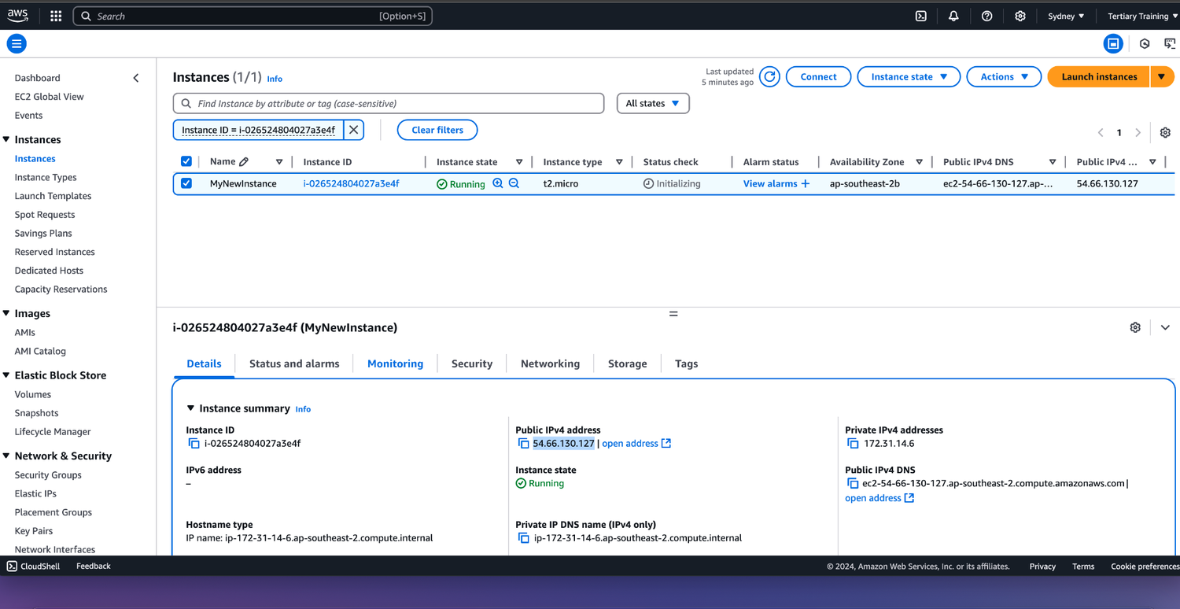
TOPIC 1
Activity: Launching a EC2 Instance
AWS Certified SysOps Administrator - Associate (SOA-C02) · TGS-2024051413
© 2026 Tertiary Infotech Academy Pte Ltd
23

Slide 25
TOPIC 1
Enhanced Networking
• EC2 Enhanced Networking (SR-IOV)
• Higher bandwidth, higher PPS (packet per second), lower latency
• Option 1: Elastic Network Adapter (ENA) up to 100 Gbps
• Option 2: Intel 82599 VF up to 10 Gbps – LEGACY
• Works for newer generation EC2 Instances
• Elastic Fabric Adapter (EFA)
• Improved ENA for HPC, only works for Linux
• Great for inter-node communications, tightly coupled workloads.
• Leverages Message Passing Interface (MPI) standard
• Bypasses the underlying Linux OS to provide low-latency reliable transport
AWS Certified SysOps Administrator - Associate (SOA-C02) · TGS-2024051413
© 2026 Tertiary Infotech Academy Pte Ltd
24

Slide 26
TOPIC 1
Placement Groups
• Sometimes you want control over the EC2 Instance placement strategy
• That strategy can be defined using placement groups
• When you create a placement group, you specify one of the following strategies for the group:
• Cluster—clusters instances into a low-latency group in a single Availability Zone
• Spread—spreads instances across underlying hardware (max 7 instances per group per AZ) – critical applications
• Partition—spreads instances across many different partitions (which rely on different sets of racks) within an AZ. Scales to 100s of EC2 instances per group (Hadoop, Cassandra, Kafka)
AWS Certified SysOps Administrator - Associate (SOA-C02) · TGS-2024051413
© 2026 Tertiary Infotech Academy Pte Ltd
25

Slide 27
TOPIC 1
Same AZ
• Placement Groups Cluster
• Placement group Cluster
• Low latency
• 10 Gbps network
• Pros: Great network (10 Gbps bandwidth between instances with Enhanced Networking enabled - recommended)
• Cons: If the AZ fails, all instances fails at the same time
• Use case:
• Big Data job that needs to complete fast
• Application that needs extremely low latency and high network throughput
AWS Certified SysOps Administrator - Associate (SOA-C02) · TGS-2024051413
© 2026 Tertiary Infotech Academy Pte Ltd
26

Slide 28
TOPIC 1
Us-east-1a
• Hardware 1
• Placement Groups Spread
• EC2
• Hardware 2
• EC2
• Us-east-1b
• Hardware 3
• EC2
• Hardware 4
• EC2
• Us-east-1c
• Hardware 5
• EC2
• Hardware 6
• EC2
• Pros:
• Can span across Availability Zones (AZ)
• Reduced risk is simultaneous failure
• EC2 Instances are on different physical hardware
• Cons:
• Limited to 7 instances per AZ per placement group
• Use case:
• Application that needs to maximize high availability
• Critical Applications where
• each instance must be isolated from failure from each other
AWS Certified SysOps Administrator - Associate (SOA-C02) · TGS-2024051413
© 2026 Tertiary Infotech Academy Pte Ltd
27

Slide 29
TOPIC 1
Placements Groups Partition
• us-east-1a
• Partition 1
• EC2
• EC2
• EC2
• EC2
• Partition 2
• EC2
• EC2
• EC2
• EC2
• Partition 3
• EC2
• EC2
• EC2
• EC2
• us-east-1b
• Up to 7 partitions per AZ
• Can span across multiple AZs in the same region
• Up to 100s of EC2 instances
• The instances in a partition do not
• share racks with the instances in the other partitions
• A partition failure can affect many EC2 but won’t affect other partitions
• EC2 instances get access to the partition information as metadata
• Use cases: HDFS, HBase, Cassandra, Kafka
AWS Certified SysOps Administrator - Associate (SOA-C02) · TGS-2024051413
© 2026 Tertiary Infotech Academy Pte Ltd
28

Slide 30
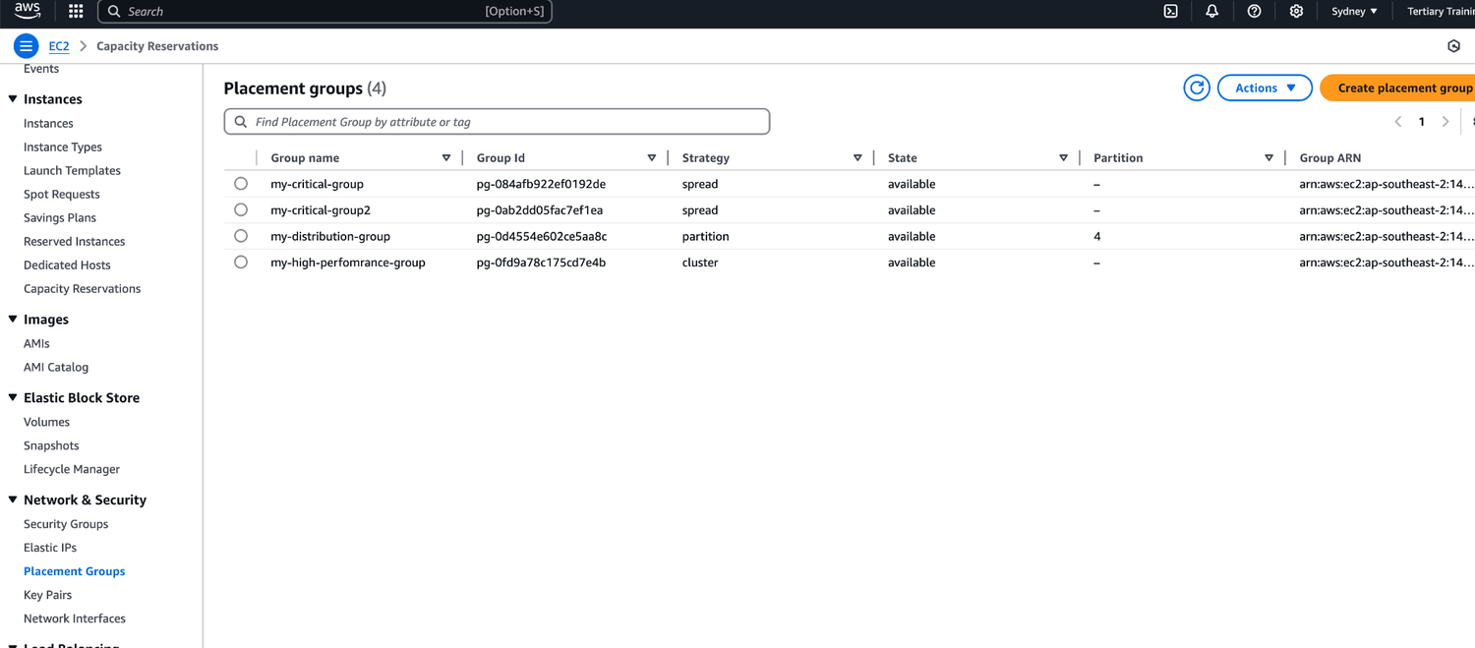
TOPIC 1
Activity: Placement Group
Goto Placement Group
AWS Certified SysOps Administrator - Associate (SOA-C02) · TGS-2024051413
© 2026 Tertiary Infotech Academy Pte Ltd
29

Slide 31
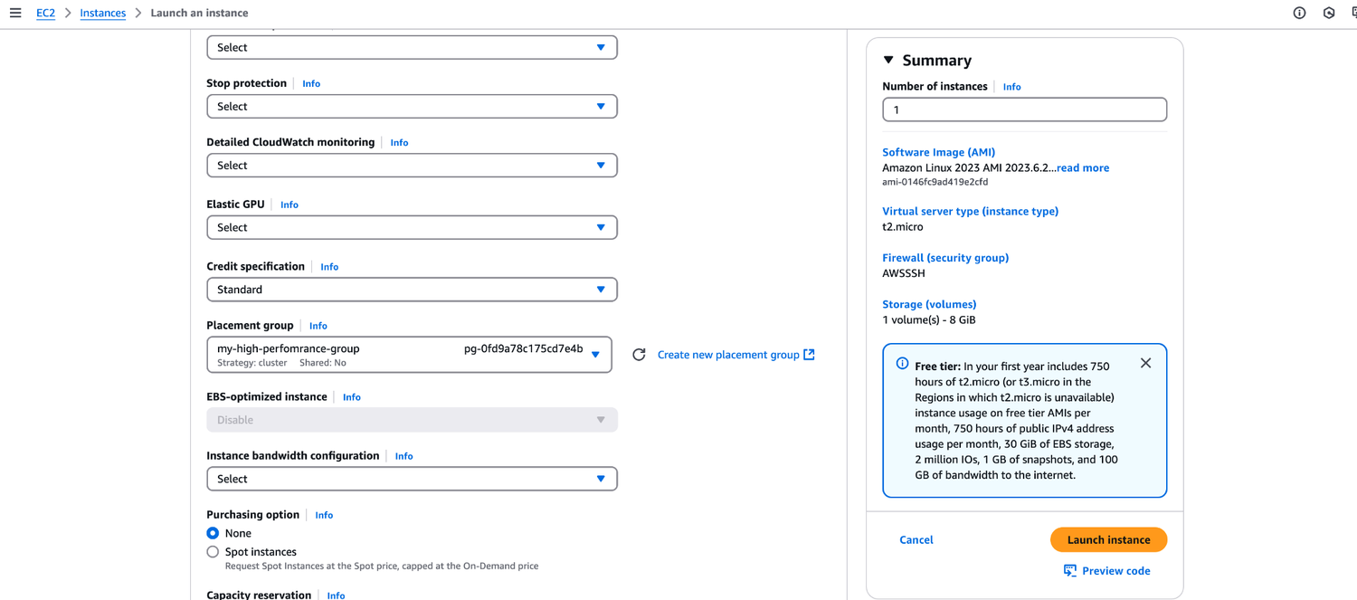
TOPIC 1
Activity: Placement Group
Launch a new t2.micro instance
AWS Certified SysOps Administrator - Associate (SOA-C02) · TGS-2024051413
© 2026 Tertiary Infotech Academy Pte Ltd
30

Slide 32
TOPIC 1
Shutdown Behaviour: How should the instance react when shutdown is done using the OS?
• Stop (default)
• Terminate
• This is not applicable when shutting down from AWS console.
• CLI Attribute:
• InstanceInitiatedShutdownBehavior
• Shutdown Behavior
• EC2 Instance (running)
• OS shutdown
• Shutdown Behavior
• Stop
• Terminate
• EC2 Instance (stopped)
• $ shutdown
AWS Certified SysOps Administrator - Associate (SOA-C02) · TGS-2024051413
© 2026 Tertiary Infotech Academy Pte Ltd
31

Slide 33
TOPIC 1
Termination Protection
• Enable termination protection:
• To protect against accidental termination in AWS Console or CLI
• Exam Tip:
• We have an instance where shutdown behavior = terminate and enable terminate protection is ticked
• We shutdown the instance from the OS, what will happen? The instance will still be terminated!
AWS Certified SysOps Administrator - Associate (SOA-C02) · TGS-2024051413
© 2026 Tertiary Infotech Academy Pte Ltd
32

Slide 34
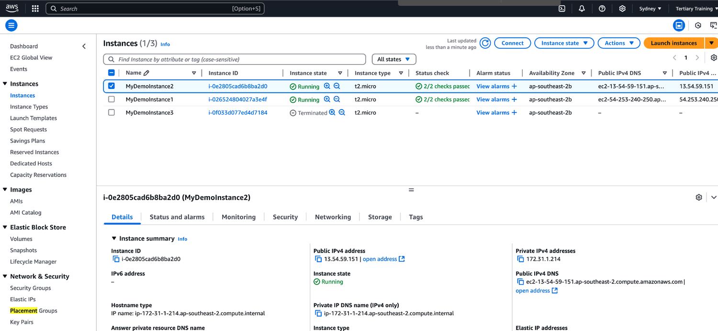
TOPIC 1
Activity: Shutdown Behavior
Launch a new t2.micro instance
AWS Certified SysOps Administrator - Associate (SOA-C02) · TGS-2024051413
© 2026 Tertiary Infotech Academy Pte Ltd
33

Slide 35
TOPIC 1
EC2 Launch Troubleshooting
• # InstanceLimitExceeded if you get this error, it means that you have reached your limit of max number of vCPUs per region
• On-Demand instance limits are set on a per-region basis
• Example: If you run on-demand (A, C, D, H, I, M, R,T, Z) instance types you’ll have 64 vCPUs (default)
• Resolution: Either launch the instance in a different region or request AWS to increase your limit of the region
• NOTE: vCPU-based limits only apply to running On-Demand instances and Spot instances
AWS Certified SysOps Administrator - Associate (SOA-C02) · TGS-2024051413
© 2026 Tertiary Infotech Academy Pte Ltd
34

Slide 36
TOPIC 1
EC2 Launch Troubleshooting
• # InsufficientInstanceCapacity: if you get this error, it means AWS does not have that enough On-Demand capacity in the particular AZ where the instance is launched.
• Resolution :
• Wait for few mins before requesting again.
• If requesting more than 1 requests, break down the requests. If you need 5 instances, rather than a single request of 5, request one by one.
• If urgent, submit a request for a different instance type now, which can be resized later.
• Also, can request the EC2 instance in a different AZ
AWS Certified SysOps Administrator - Associate (SOA-C02) · TGS-2024051413
© 2026 Tertiary Infotech Academy Pte Ltd
35

Slide 37
TOPIC 1
EC2 Launch Troubleshooting
• # Instance Terminates Immediately (goes from pending to terminated)
• You've reached your EBS volume limit.
• An EBS snapshot is corrupt.
• The root EBS volume is encrypted and you do not have permissions to access the KMS key for decryption.
• The instance store-backed AMI that you used to launch the instance is missing a required part (an image.part.xx file).
• To find the exact reason, check out the EC2 console of AWS - instances - Description tab, note the reason next to the State transition reason label.
AWS Certified SysOps Administrator - Associate (SOA-C02) · TGS-2024051413
© 2026 Tertiary Infotech Academy Pte Ltd
36

Slide 38
TOPIC 1
EC2 SSH troubleshooting
• Make sure the private key (pem file) on your linux machine has 400 permissions, else you will get "Unprotected private key file" error
• Make sure the username for the OS is given correctly when logging via SSH,
• else you will get "Host key not found, "Permission denied", or "Connection closed by [instance] port 22" error
• Possible reasons for "Connection timed out" to EC2 instance via SSH:
• SG is not configured correctly
• NACL is not configured correctly
• Check the route table for the subnet (routes traffic destined outside VPC to IGW)
• Instance doesn’t have a public IPv4
• CPU load of the instance is high
AWS Certified SysOps Administrator - Associate (SOA-C02) · TGS-2024051413
© 2026 Tertiary Infotech Academy Pte Ltd
37

Slide 39
TOPIC 1
SSH vs. EC2 Instance Connect
• Connect using SSH Connect using EC2 Instance Connect
• Inbound Rules
• User
• (IPv4: 1.2.3.4)
• User
• (IPv4: 5.6.7.8)
• blocked
• User
• (IPv4: 1.2.3.4)
• {
• "ip_prefix": "18.206.107.24/29", "region": "us-east-1",
• "service": "EC2_INSTANCE_CONNECT",
• "network_border_group": "us-east-1"
• }
• https://ip-ranges.amazonaws.com/ip-ranges.json
• EC2 Instance Connect API
• push one-time SSH public key (valid for 60 secs)
• EC2 Console,
• EC2 Instance Connect CLI
• Allows AWS IP Range
AWS Certified SysOps Administrator - Associate (SOA-C02) · TGS-2024051413
© 2026 Tertiary Infotech Academy Pte Ltd
38

Slide 40
TOPIC 1
EC2 Instances Purchasing Options
• On-Demand Instances - short workload, predictable pricing, pay by second
• Reserved (1 & 3 years)
• Reversed Instances - long workloads
• Convertible Reserved Instances - long workloads with flexible instances
• Savings Plans (1 & 3 years) - commitment to an amount of usage, long workload
• Spot Instances - short workloads, cheap, can lose instances (less reliable)
• Dedicated Hosts - book an entire physical server, control instance placement
• Dedicated Instances - no other customers will share your hardware
• Capacity reservations - reserve capacity in a specific AZ for any duration
AWS Certified SysOps Administrator - Associate (SOA-C02) · TGS-2024051413
© 2026 Tertiary Infotech Academy Pte Ltd
39

Slide 41
TOPIC 1
EC2 On Demand
• Pay for what you use:
• Linux or Windows - billing per second, after the first minute
• All other operating systems - billing per hour
• Has the highest cost but no upfront payment
• No long-term commitment
• Recommended for short term and un-interrupted workloads, where you can't predict how the application will behave
AWS Certified SysOps Administrator - Associate (SOA-C02) · TGS-2024051413
© 2026 Tertiary Infotech Academy Pte Ltd
40

Slide 42
TOPIC 1
Up to 72% discount compared to On-demand
• You reserve a specific instance attributes (Instance Type, Region, Tenancy, OS)
• Reservation Period - 1 year (+discount) or 3 years (+++discount)
• Payment options - No Upfront (+), Partial Upfront (++), All Upfront (+++)
• Reserved Instance's Scope - Regional or Zonal (reserve capacity in an AZ)
• Recommended for steady-state usage applications (think database)
• You can buy and sell in the Reserved Instance Marketplace
• Convertible Reserved Instance
• Can change the EC2 instance type, instance family, OS, scope and tenancy
• Up to 66% discount
• EC2 Reserved Instances
• Note: the % discounts are different from the video as AWS change them over time – the exact numbers are not needed for the exam. This is just for illustrative purposes ©
AWS Certified SysOps Administrator - Associate (SOA-C02) · TGS-2024051413
© 2026 Tertiary Infotech Academy Pte Ltd
41

Slide 43
TOPIC 1
EC2 Savings Plans
• Get a discount based on long-term usage (up to 72% - same as RIs)
• Commit to a certain type of usage ($10/hour for 1 or 3 years)
• Usage beyond EC2 Savings Plans is billed at the On-Demand price
• Locked to a specific instance family & AWS region (e.g., M5 in us-east-1)
• Flexible across:
• Instance Size (e.g., m5.xlarge, m5.2xlarge)
• OS (e.g., Linux, Windows)
• Tenancy (Host, Dedicated, Default)
AWS Certified SysOps Administrator - Associate (SOA-C02) · TGS-2024051413
© 2026 Tertiary Infotech Academy Pte Ltd
42

Slide 44
TOPIC 1
EC2 Spot Instances
• Can get a discount of up to 90% compared to On-demand
• Instances that you can “lose” at any point of time if your max price is less than the current spot price
• The MOST cost-efficient instances in AWS
• Useful for workloads that are resilient to failure
• Batch jobs
• Data analysis
• Image processing
• Any distributed workloads
• Workloads with a flexible start and end time
• Not suitable for critical jobs or databases
AWS Certified SysOps Administrator - Associate (SOA-C02) · TGS-2024051413
© 2026 Tertiary Infotech Academy Pte Ltd
43

Slide 45
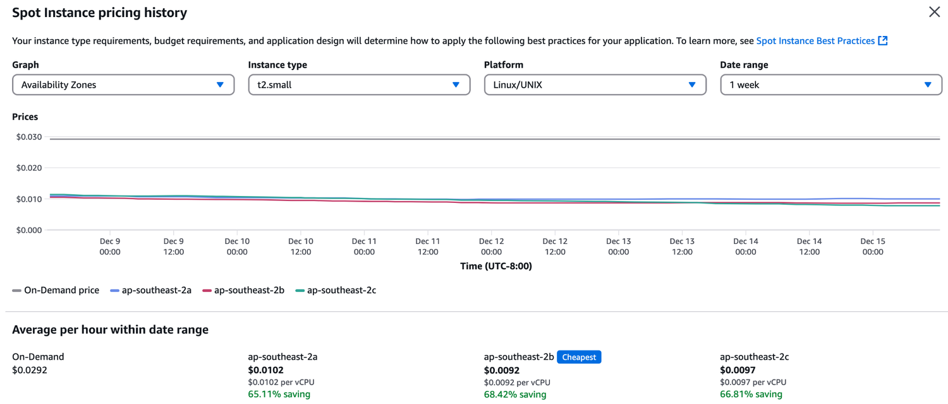
TOPIC 1
EC2 Spot Instance Pricing History
AWS Certified SysOps Administrator - Associate (SOA-C02) · TGS-2024051413
© 2026 Tertiary Infotech Academy Pte Ltd
44

Slide 46
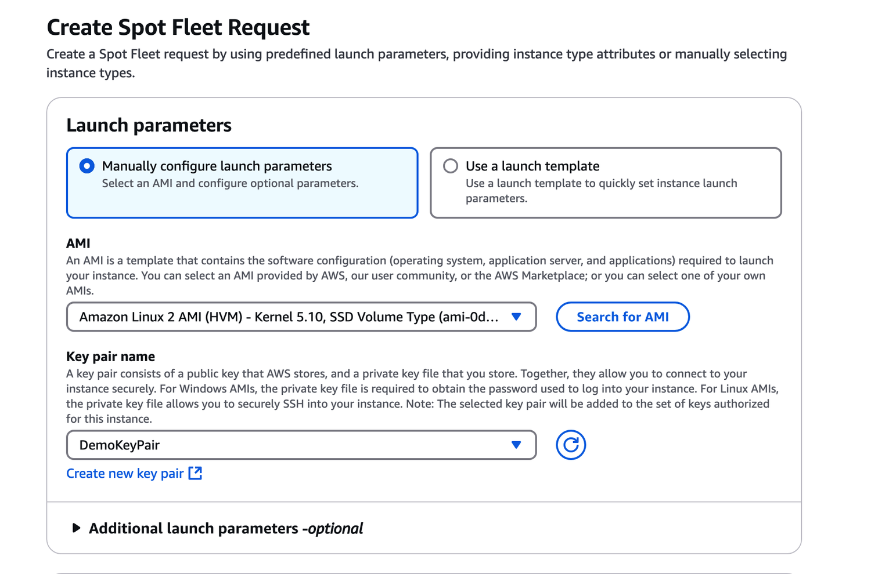
TOPIC 1
Activity: Request Spot Instance
AWS Certified SysOps Administrator - Associate (SOA-C02) · TGS-2024051413
© 2026 Tertiary Infotech Academy Pte Ltd
45

Slide 47
TOPIC 1
EC2 Dedicated Hosts
• A physical server with EC2 instance capacity fully dedicated to your use
• Allows you address compliance requirements and use your existing server - bound software licenses (per-socket, per-core, pe—VM software licenses)
• Purchasing Options:
• On-demand - pay per second for active Dedicated Host
• Reserved - 1 or 3 years (No Upfront, Partial Upfront, All Upfront) The most expensive option
• Useful for software that have complicated licensing model (BYOL – Bring Your Own License)
• Or for companies that have strong regulatory or compliance needs
AWS Certified SysOps Administrator - Associate (SOA-C02) · TGS-2024051413
© 2026 Tertiary Infotech Academy Pte Ltd
46

Slide 48
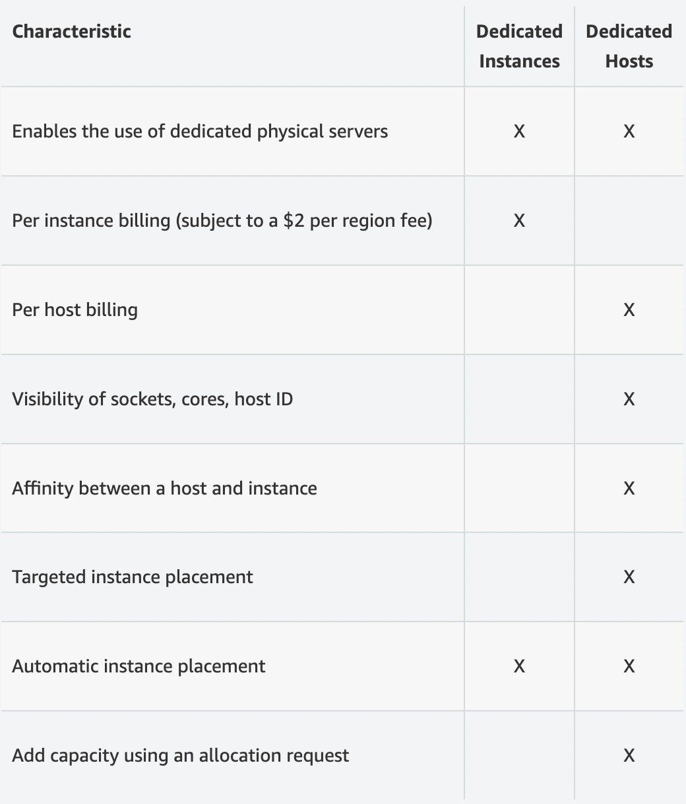
TOPIC 1
EC2 Dedicated Instances
Instances run on hardware that’s dedicated to you
AWS Certified SysOps Administrator - Associate (SOA-C02) · TGS-2024051413
© 2026 Tertiary Infotech Academy Pte Ltd
47

Slide 49
TOPIC 1
EC2 Capacity Reservations
• Reserve on-Demand instances capacity in a specific AZ for any duration
• You always have access to EC2 capacity when you need it
• No time commitment (create/cancel anytime), no billing discounts Combine with Regional Reserved Instances and Savings Plans to benefit from billing discounts
• You’re charged at On-Demand rate whether you run instances or not
• Suitable for short-term, uninterrupted workloads that needs to be in a specific AZ
AWS Certified SysOps Administrator - Associate (SOA-C02) · TGS-2024051413
© 2026 Tertiary Infotech Academy Pte Ltd
48

Slide 50

TOPIC 1
Which purchasing option is right for me?
On demand: coming and staying in resort whenever we like, we pay the full price
AWS Certified SysOps Administrator - Associate (SOA-C02) · TGS-2024051413
© 2026 Tertiary Infotech Academy Pte Ltd
49

Slide 51
TOPIC 1
Price Comparison
• Example – m4.large – us-east-1
AWS Certified SysOps Administrator - Associate (SOA-C02) · TGS-2024051413
© 2026 Tertiary Infotech Academy Pte Ltd
50

Slide 52
TOPIC 1
AWS charges for IPv4 addresses
• IPv4 created in your account
• $0.005 per hour of Public IPv4 (~ $3.6 per month)
• For new accounts in AWS, you have a free tier for the EC2 service: 750 hours of Public IPv4 per month for the first 12 months
• For all other services there is no free tier
• Public IP
• Starting February 1st 2024, there’s a charge for all Public
• EC2 Instance
• EC2 Instance
• Public IP
• Free until 750 hours/month of usage
• Load Balancer
• One Public IPv4
• per AZ, no Free Tier
• RDS Database
• One Public IPv4 No Free Tier
AWS Certified SysOps Administrator - Associate (SOA-C02) · TGS-2024051413
© 2026 Tertiary Infotech Academy Pte Ltd
51

Slide 53
TOPIC 1
AWS charges for IPv4 addresses
• What about IPv6?
• Unfortunately, many Internet Service Provider (ISP) around the world don’t support IPv6, so the course would not work for some of you
• You can test IPv6 by going to https://test-ipv6.com/
• If you use IPv6 in this course, you’re on your own (security groups, networking…) but you can do it!
• How to troubleshoot charges?
• Go into your AWS Bill
• Look into the AWS Public IP Insights service
• Nice article here:
• https://repost.aws/articles/ARknH_OR0cTvqoTfJrVGaB8A/why-am-i-seeing-charges-for-public-ipv4-addresses-when-i-am-under-the-aws-free-tier
AWS Certified SysOps Administrator - Associate (SOA-C02) · TGS-2024051413
© 2026 Tertiary Infotech Academy Pte Ltd
52

Slide 54
TOPIC 1
EC2 Spot Instance Requests
• Can get a discount of up to 90% compared to On-demand
• Define max spot price and get the instance while current spot price < max
• The hourly spot price varies based on offer and capacity
• If the current spot price > your max price you can choose to stop or terminate your instance with a 2 minutes grace period.
• Other strategy: Spot Block
• “block” spot instance during a specified time frame (1 to 6 hours) without interruptions
• In rare situations, the instance may be reclaimed
• Used for batch jobs, data analysis, or workloads that are resilient to failures.
• Not great for critical jobs or databases
AWS Certified SysOps Administrator - Associate (SOA-C02) · TGS-2024051413
© 2026 Tertiary Infotech Academy Pte Ltd
53

Slide 55
TOPIC 1
EC2 Spot Instances Pricing
https://console.aws.amazon.com/ec2sp/v1/spot/home?region=us-east-1#
User-defined max price
1
2
AWS Certified SysOps Administrator - Associate (SOA-C02) · TGS-2024051413
© 2026 Tertiary Infotech Academy Pte Ltd
54

Slide 56
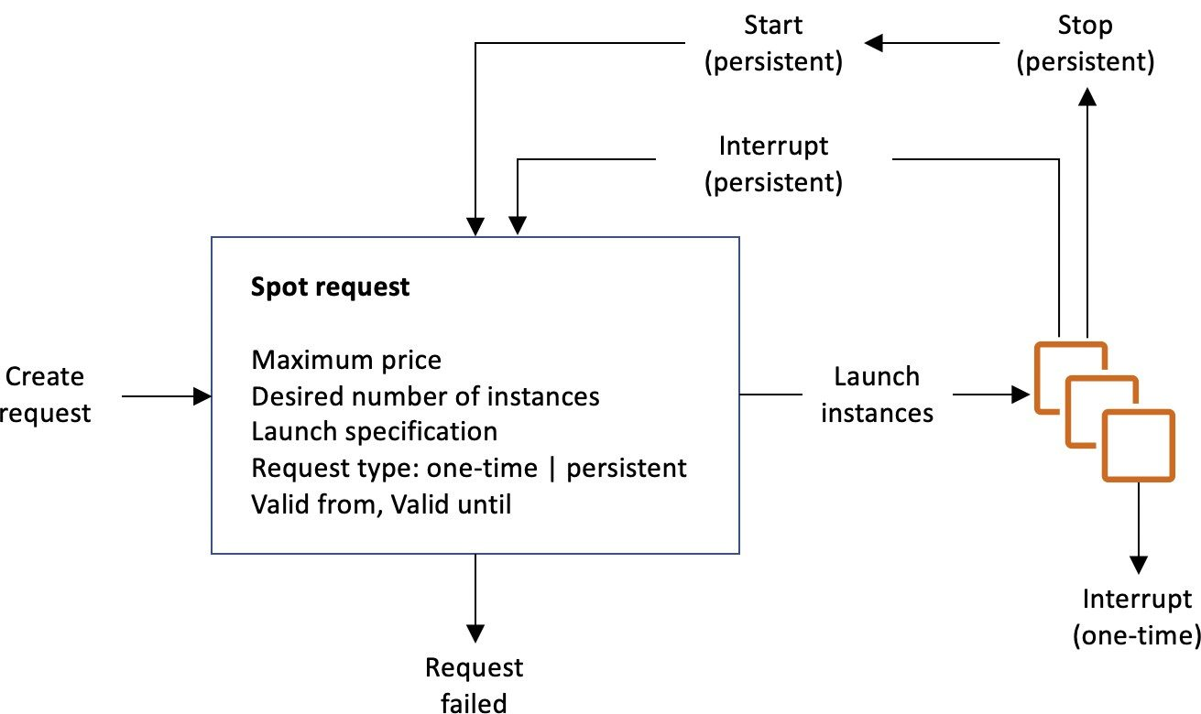
TOPIC 1
How to terminate Spot Instances?
https://docs.aws.amazon.com/AWSEC2/latest/UserGuide/spot-requests.html
AWS Certified SysOps Administrator - Associate (SOA-C02) · TGS-2024051413
© 2026 Tertiary Infotech Academy Pte Ltd
55

Slide 57
TOPIC 1
Spot Fleets
• Spot Fleets = set of Spot Instances + (optional) On-Demand Instances
• The Spot Fleet will try to meet the target capacity with price constraints
• Define possible launch pools: instance type (m5.large), OS, Availability Zone
• Can have multiple launch pools, so that the fleet can choose
• Spot Fleet stops launching instances when reaching capacity or max cost
• Strategies to allocate Spot Instances:
• lowestPrice: rom the pool with the lowest price (cost optimization, short workload)
• diversified: distributed across all pools (great for availability, long workloads)
• capacityOptimized: pool with the optimal capacity for the number of instances
• priceCapacityOptimized (recommended): pools with highe
• st capacity available, then select the pool with the lowest price (best choice for most workloads)
• Spot Fleets allow us to automatically request Spot Instances with the lowest price
AWS Certified SysOps Administrator - Associate (SOA-C02) · TGS-2024051413
© 2026 Tertiary Infotech Academy Pte Ltd
56

Slide 58
TOPIC 1
Burstable Instances (T2/T3)
• AWS has the concept of burstable instances (T2/T3 machines)
• Burst means that overall, the instance has OK CPU performance.
• When the machine needs to process something unexpected (a spike in load for example), it can burst, and CPU can be VERY good.
• If the machine bursts, it utilizes “burst credits”
• If all the credits are gone, the CPU becomes BAD
• If the machine stops bursting, credits are accumulated over time
AWS Certified SysOps Administrator - Associate (SOA-C02) · TGS-2024051413
© 2026 Tertiary Infotech Academy Pte Ltd
57

Slide 59
TOPIC 1
Burstable Instances (T2/T3)
• Burstable instances can be amazing to handle unexpected traffic and getting the insurance that it will be handled correctly
• If your instance consistently runs low on credit, you need to move to a different kind of non-burstable instance
• Credit usage
• Credit balance
AWS Certified SysOps Administrator - Associate (SOA-C02) · TGS-2024051413
© 2026 Tertiary Infotech Academy Pte Ltd
58

Slide 60
TOPIC 1
CPU Credits
• CPU Credits
AWS Certified SysOps Administrator - Associate (SOA-C02) · TGS-2024051413
© 2026 Tertiary Infotech Academy Pte Ltd
59

Slide 61
TOPIC 1
What happens when credit ar exhausted?
Experiment: run a CPU stress command (to peak at 100%)
After the credits are exhausted, the measured CPU utilization drops
100% CPU Utilization
1
2
3
Credit Usage
Credit exhaustion
Lowered CPU Utilization
4
5
6
AWS Certified SysOps Administrator - Associate (SOA-C02) · TGS-2024051413
© 2026 Tertiary Infotech Academy Pte Ltd
60

Slide 62
TOPIC 1
T2/T3 Unlimited
• It is possible to have an “unlimited burst credit balance”
• You pay extra money if you go over your credit balance, but you don’t lose in performance
• If average CPU usage over a 24-hour period exceeds the baseline, the instance is billed for additional usage per vCPU/hour
• Be careful, costs could go high if you’re not monitoring the CPU health of your instances
• https://aws.amazon.com/blogs/aws/new-t2-unlimited-going-beyond-the-burst-with-high-performance/
AWS Certified SysOps Administrator - Associate (SOA-C02) · TGS-2024051413
© 2026 Tertiary Infotech Academy Pte Ltd
61

Slide 63
TOPIC 1
Public subnet
• Elastic IPs
• When you stop and then start an EC2 instance, it changes its public IP
• If you need to have a fixed public IP, you need an Elastic IP
• An Elastic IP is a public IPv4 you own as long as you don’t delete it
• You can attach it to one instance at a time
• You can remap it across instances\
• You don’t pay for the Elastic IP if it’s attached to a server
• You pay for the Elastic IP if it’s not attached to a server
• VPC
• EC2 Instance
• EIP
• (IPv4: 1.2.3.4)
• http://1.2.3.4
• Users
AWS Certified SysOps Administrator - Associate (SOA-C02) · TGS-2024051413
© 2026 Tertiary Infotech Academy Pte Ltd
62

Slide 64
TOPIC 1
Elastic IPs
• With an Elastic IP address, you can mask the failure of an instance or software by rapidly remapping the address to another instance in your account.
• You can only have 5 Elastic IP in your account (you can ask AWS to increase that).
• How you can avoid using Elastic IP:
• Always think if other alternatives are available to you
• You could use a random public IP and register a DNS name to it
• Or use a Load Balancer with a static hostname
AWS Certified SysOps Administrator - Associate (SOA-C02) · TGS-2024051413
© 2026 Tertiary Infotech Academy Pte Ltd
63

Slide 65
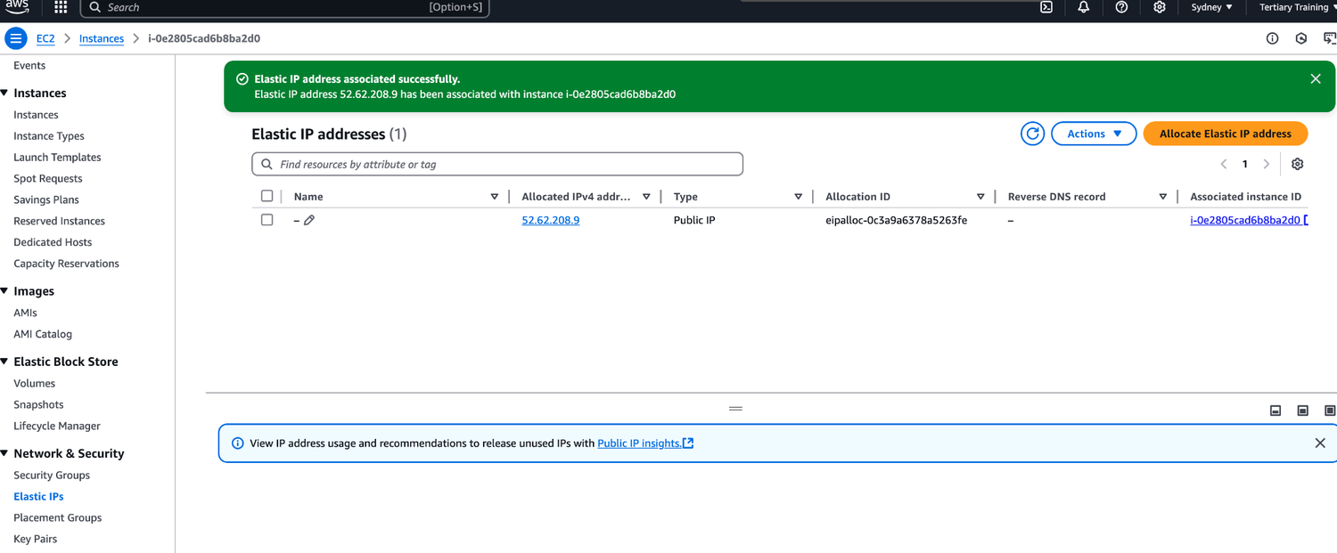
TOPIC 1
Activity: Elastic IPs
Create two instances.
AWS Certified SysOps Administrator - Associate (SOA-C02) · TGS-2024051413
© 2026 Tertiary Infotech Academy Pte Ltd
64

Slide 66
TOPIC 1
CloudWatch Metrics for EC2
• AWS Provided metrics (AWS pushes them):
• Basic Monitoring (default): metrics are collected at a 5 minute internal
• Detailed Monitoring (paid): metrics are collected at a 1 minute interval
• Includes CPU, Network, Disk and Status Check Metrics
• Custom metric (yours to push):
• Basic Resolution: 1 minute resolution
• High Resolution: all the way to 1 second resolution
• Include RAM, application level metrics
• Make sure the IAM permissions on the EC2 instance role are correct !
AWS Certified SysOps Administrator - Associate (SOA-C02) · TGS-2024051413
© 2026 Tertiary Infotech Academy Pte Ltd
65

Slide 67
TOPIC 1
EC2 included metrics
• CPU: CPU Utilization + Credit Usage / Balance
• Network: Network In / Out
• Status Check:
• Instance status = check the EC2 VM
• System status = check the underlying hardware
• Attached EBS status = check attached EBS volumes
• Disk: Read / Write for Ops / Bytes (only for instance store)
• RAM is NOT included in the AWS EC2 metrics
AWS Certified SysOps Administrator - Associate (SOA-C02) · TGS-2024051413
© 2026 Tertiary Infotech Academy Pte Ltd
66

Slide 68
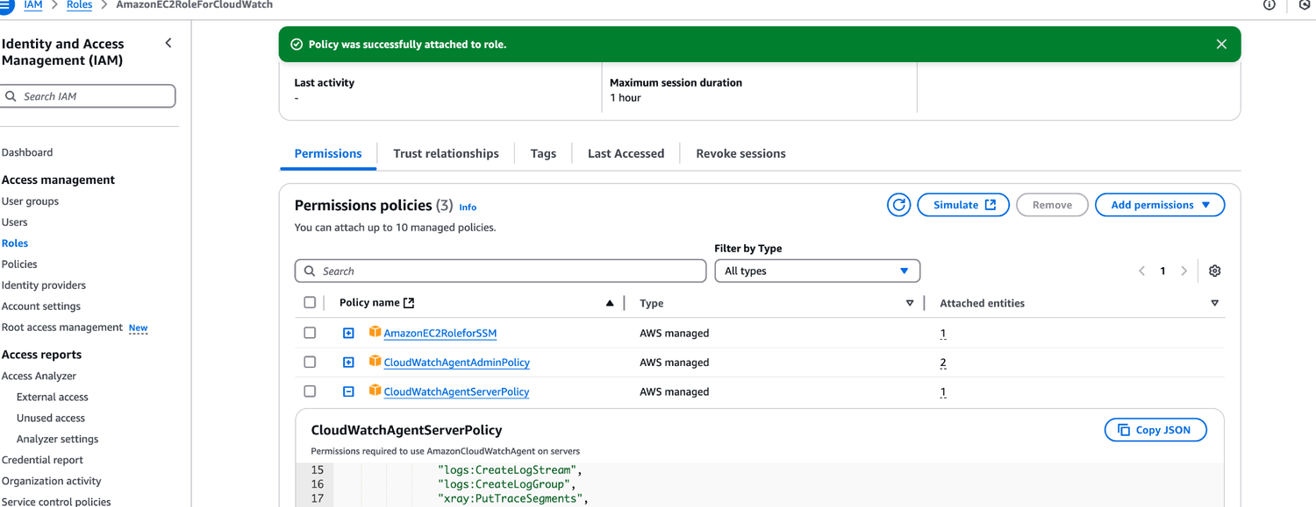
TOPIC 1
Activity: Create IAM Role For Cloudwatch
AWS Certified SysOps Administrator - Associate (SOA-C02) · TGS-2024051413
© 2026 Tertiary Infotech Academy Pte Ltd
67

Slide 69
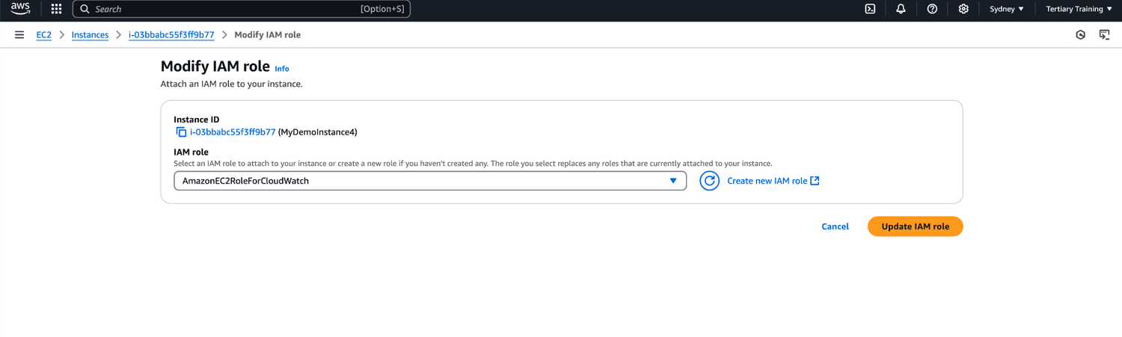
TOPIC 1
Activity: Assign IAM Role To Instance
AWS Certified SysOps Administrator - Associate (SOA-C02) · TGS-2024051413
© 2026 Tertiary Infotech Academy Pte Ltd
68

Slide 70
TOPIC 1
Unified CloudWatch Agent
• For virtual servers (EC2 instances, on-premises servers, …)
• Collect additional system-level metrics such as RAM, processes, used disk space, etc.
• Collect logs to send to CloudWatch Logs
• No logs from inside your EC2 instance will be sent to CloudWatch Logs without using an agent
• Centralized configuration using SSM Parameter Store
• Make sure IAM permissions are correct
• Default namespace for metrics collected by the Unified CloudWatch agent is CWAgent (can be configured/changed)
• Corporate Data Center
• CloudWatch
• Server with Unified CW Agent
• EC2 Instance with Unified CW Agent
• push logs
• +
• push metrics
AWS Certified SysOps Administrator - Associate (SOA-C02) · TGS-2024051413
© 2026 Tertiary Infotech Academy Pte Ltd
69

Slide 71
TOPIC 1
Unified CloudWatch Agent – procstat Plugin
• Collect metrics and monitor system utilization of individual processes
• Supports both Linux and Windows servers
• Example: amount of time the process uses CPU, amount of memory the process uses, …
• Select which processes to monitor by
• pid_file: name of process identification number (PID) files they create
• exe: process name that match string you specify (RegEx)
• pattern: command lines used to start the processes (RegEx)
• Metrics collected by procstat plugin begins with "procstat" prefix (e.g., procstat_cpu_time, procstat_cpu_usage, …)
AWS Certified SysOps Administrator - Associate (SOA-C02) · TGS-2024051413
© 2026 Tertiary Infotech Academy Pte Ltd
70

Slide 72
TOPIC 1
Status Checks
• Automated checks to identify hardware and software issues
• System status Checks
• Monitors problems with AWS systems (software/hardware issues on the physical host, loss of system power, …)
• Check Personal Health Dashboard for any scheduled critical maintenance by AWS to your instance’s host
• Resolution: stop and start the instance (instance migrated to a new host)
• Instance Status Checks
• Monitors software/network configuration of your instance (invalid network configuration, exhausted memory, …)
• Resolution: reboot the instance or change instance configuration
• Attached EBS Status Checks
• Monitors EBS volumes attached to your instance (reachable & complete I/O Operations)
• Resolution: reboot the instance or replace affected EBS volumes
• Host 1
• Host 2
• Stop & Start
• Hardware failure
• migrate
• User
AWS Certified SysOps Administrator - Associate (SOA-C02) · TGS-2024051413
© 2026 Tertiary Infotech Academy Pte Ltd
71

Slide 73
TOPIC 1
Status Checks - CW Metrics & Recovery
• CloudWatch Metrics (1 minute interval)
• StatusCheckFailed_System
• StatusCheckFailed_Instance
• StatusCheckFailed_AttachedEBS
• StatusCheckFailed (for any)
• Option 1: CloudWatch Alarm
• Recover EC2 instance with the same private/public IP, EIP, metadata, and Placement Group
• Send notifications using SNS
• Option 2: Auto Scaling Group
• Set min/max/desired 1 to recover an instance but won't keep the same private and elastic IP
• EC2 Instance
• CloudWatch
• monitor
• (StatusCheckFailed_System)
• CloudWatch Alarm
• trigger
• Amazon SNS
• send notification
• Action: recover
• Auto Scaling group
• launch new instance
AWS Certified SysOps Administrator - Associate (SOA-C02) · TGS-2024051413
© 2026 Tertiary Infotech Academy Pte Ltd
72

Slide 74
TOPIC 1
EC2 Hibernate
• We know we can stop, terminate instances
• Stop - the data on disk (EBS) is kept intact in the next start
• Terminate - any EBS volumes (root) also set-up to be destroyed is lost
• On start, the following happens:
• First start: the OS boots & the EC2 User Data script is run
• Following starts: the OS boots up
• Then your application starts, caches get warmed up, and that can take time!
AWS Certified SysOps Administrator - Associate (SOA-C02) · TGS-2024051413
© 2026 Tertiary Infotech Academy Pte Ltd
73

Slide 75
TOPIC 1
EC2 Hibernate
• Introducing EC2 Hibernate:
• The in-memory (RAM) state is preserved
• The instance boot is much faster! (the OS is not stopped / restarted)
• Under the hood: the RAM state is written to a file in the root EBS volume
• The root EBS volume must be encrypted
• Use cases:
• Long-running processing
• Saving the RAM state
• Services that take time to initialize
• RAM
• EC2 Instance
• Root EBS
• Volume
• (Encrypted)
• RAM
• RAM
• RAM
• RAM
• Running
• Stopping
• Stopped
• Running
• Hibernate
• Shutdown
• Start
• Hibernation
AWS Certified SysOps Administrator - Associate (SOA-C02) · TGS-2024051413
© 2026 Tertiary Infotech Academy Pte Ltd
74

Slide 76
TOPIC 1
EC2 Hibernate – Good to know
• Supported Instance Families - C3, C4, C5, I3, M3, M4, R3, R4,T2,T3, …
• instance RAM Size - must be less than 150 GB.
• Instance Size - not supposed for bare metal instances.
• AMI - Amazon Linux 2, Linux AMI, Ubuntu, RHEL, CentOS & Windows…
• Root Volume - must be EBS, encrypted, not instance store, and large.
• Available for On-Demand, Reserved and Spot Instances.
• An instance can NOT be hibernated for more than 60 days.
AWS Certified SysOps Administrator - Associate (SOA-C02) · TGS-2024051413
© 2026 Tertiary Infotech Academy Pte Ltd
75

Slide 77
TOPIC 2
Amazon Machine Image (AMI)
AWS Certified SysOps Administrator - Associate (SOA-C02) · TGS-2024051413
© 2026 Tertiary Infotech Academy Pte Ltd
76

Slide 78
TOPIC 2
AMI Overview
• AMI = Amazon Machine Image
• AMI is a customization of an EC2 instance
• You add your own software, configuration, operating system, monitoring…
• Faster boot / configuration time because all your software is pre-packaged
• AMI are built for a specific region (and can be copied across regions)
• You can launch EC2 instances from:
• A Public AMI: AWS provided
• Your own AMI: you make and maintain them yourself
• An AWS Marketplace AMI: an AMI someone else made (and potentially sells)
AWS Certified SysOps Administrator - Associate (SOA-C02) · TGS-2024051413
© 2026 Tertiary Infotech Academy Pte Ltd
77

Slide 79
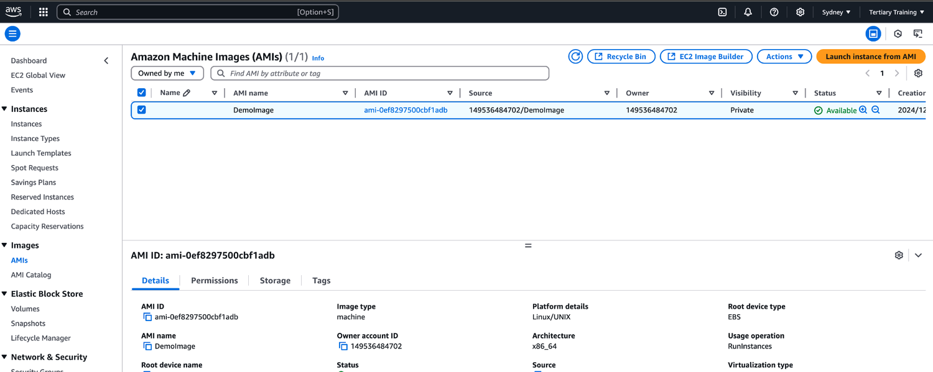
TOPIC 2
Activity: Create AMI
AWS Certified SysOps Administrator - Associate (SOA-C02) · TGS-2024051413
© 2026 Tertiary Infotech Academy Pte Ltd
78

Slide 80
TOPIC 2
AMI Process (from an EC2 instance)
• Start an EC2 instance and customize it
• Stop the instance (for data integrity)
• Build an AMI – this will also create EBS snapshots
• Launch instances from other AMIs
• US-EAST-1A
• US-EAST-1B
• Custom AMI
• Create AMI
• Launch from AMI
AWS Certified SysOps Administrator - Associate (SOA-C02) · TGS-2024051413
© 2026 Tertiary Infotech Academy Pte Ltd
79

Slide 81
TOPIC 2
AMI No-Reboot Option
• Enables you to create an AMI without shutting down your instance
• By default, it’s not selected (AWS will shut down the instance before creating an AMI to maintain the file system integrity)
• With No-Reboot Disabled (default)
• EC2 Instance (running)
• Attached EBS Volume
• EBS Snapshot
• AMI
• EC2 Instance (stopped)
• Attached
• EBS Volume
• shut down
• create image
• snapshot
• (running)
• With No-Reboot Enabled
• EC2 Instance
• Attached
• EBS Volume
• EBS Snapshot
• AMI
• Note: OS Buffers are not flushed to disk before the snapshot is created
• create
• snapshot image
AWS Certified SysOps Administrator - Associate (SOA-C02) · TGS-2024051413
© 2026 Tertiary Infotech Academy Pte Ltd
80

Slide 82
TOPIC 2
AWS Backup Plans to create AMI
• AWS Backup doesn't reboot the instances while taking EBS snapshots (no-reboot behavior)
• This won't help you to create an AMI that guarantees file system integrity since you need to reboot the instance
• To maintain integrity you need to provide the reboot parameter while taking images (EventBridge
• + Lambda + CreateImage API with reboot)
• AMI
• Create AMI
• --no-reboot
• Amazon EC2 (rebooting)
• AMI
• Create AMI
• --reboot
• EventBridge Rule (schedule)
• Lambda Function
• invoke
• Amazon EC2
• AWS Amazon
AWS Certified SysOps Administrator - Associate (SOA-C02) · TGS-2024051413
© 2026 Tertiary Infotech Academy Pte Ltd
81

Slide 83
TOPIC 2
EC2 Instance Migration between AZ
• us-east-1
• us-east-1a
• us-east-1b
• EC2 Instance
• EBS Volume
• EC2 Instance
• EBS Volume
• create image launch/restore
• AMI
AWS Certified SysOps Administrator - Associate (SOA-C02) · TGS-2024051413
© 2026 Tertiary Infotech Academy Pte Ltd
82

Slide 84
TOPIC 2
Cross-Account AMI Sharing
• You can share an AMI with another AWS account
• Sharing an AMI does not affect the ownership of the AMI
• You can only share AMIs that have unencrypted volumes and volumes that are encrypted with a customer managed key
• If you share an AMI with encrypted volumes, you must also share any customer managed keys used to encrypt them.
• Account A
• Source AMI
• Account B
• Share with Account B
• EC2 Instance
• (AMI: Source AMI)
AWS Certified SysOps Administrator - Associate (SOA-C02) · TGS-2024051413
© 2026 Tertiary Infotech Academy Pte Ltd
83

Slide 85
TOPIC 2
AMI Sharing with KMS Encryption
• Account A
• Custom AMI
• us-east-1
• EBS
• Snapshot
• (encrypted)
• CMK - A
• Source
• Account B
• Target
• IAM Permissions
• kms:DescribeKey kms:CreateGrant kms:Decrypt kms:GenerateDataKey kms:ReEncrypt
• share
• us-east-1
• EC2 Instance
• (AMI: Custom AMI)
AWS Certified SysOps Administrator - Associate (SOA-C02) · TGS-2024051413
© 2026 Tertiary Infotech Academy Pte Ltd
84

Slide 86
TOPIC 2
Cross-Account AMI Copy
• If you copy an AMI that has been shared with your account, you are the owner of the target AMI in your account
• The owner of the source AMI must grant you read permissions for the storage that backs the AMI (EBS Snapshot)
• If the shared AMI has encrypted snapshots, the owner must share the key or keys with you as well
• Can encrypt the AMI with your own CMK while copying
• Account A
• Source AMI
• EBS Snapshot
• Account B
• Copy of Source AMI
• EBS Snapshot
• IAM Permissions (read snapshot)
• copy image
AWS Certified SysOps Administrator - Associate (SOA-C02) · TGS-2024051413
© 2026 Tertiary Infotech Academy Pte Ltd
85

Slide 87
TOPIC 2
AMI Copy with KMS Encryption
• Custom AMI
• EBS
• Snapshot
• (encrypted)
• CMK - A
• Custom AMI
• EBS
• Snapshot
• (encrypted)
• IAM Permissions
• kms:DescribeKey kms:CreateGrant kms:Decrypt
• CMK - B
• share
• copy to
• us-east-1
• Decrypt: CMK – A Encrypt: CMK – B
• Cross-Region / Cross-Account Encrypted AMI Copy
• Source Target
• Account A Account B
• us-east-1 us-east-1
AWS Certified SysOps Administrator - Associate (SOA-C02) · TGS-2024051413
© 2026 Tertiary Infotech Academy Pte Ltd
86

Slide 88
TOPIC 2
EC2 Image Builder
• Used to automate the creation of Virtual Machines or container images
• => Automate the creation, maintain, validate and test EC2 AMIs
• Can be run on a schedule (weekly, whenever packages are updated, etc…)
• Free service (only pay for the underlying resources)
• Builder EC2 Instance
• create
• Build Components applied (customize software on instance)
• New AMI
• create
• Test EC2 Instance
• Test suite is run
• (is the AMI working, secure?)
• AMI is distributed
• (can be multiple regions)
• EC2 Image Builder
AWS Certified SysOps Administrator - Associate (SOA-C02) · TGS-2024051413
© 2026 Tertiary Infotech Academy Pte Ltd
87

Slide 89
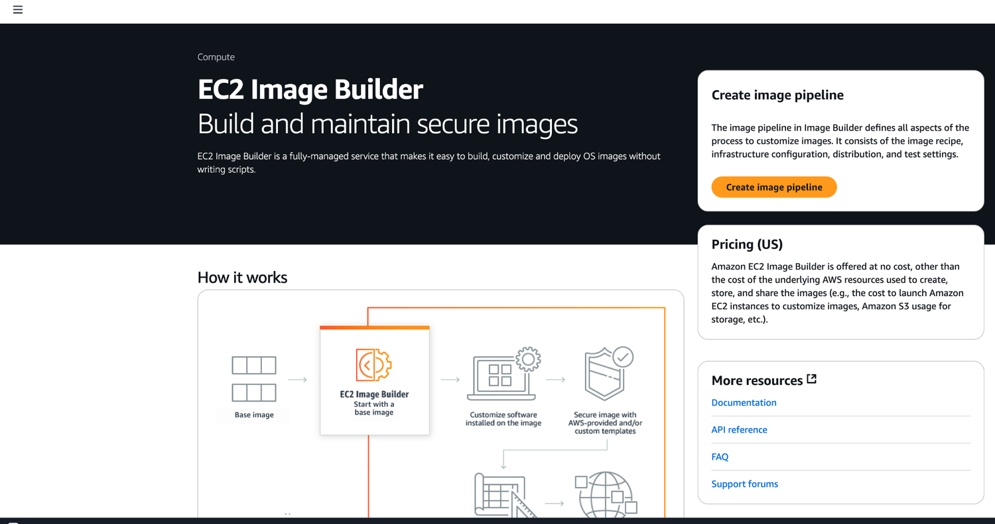
TOPIC 2
Image Builder
AWS Certified SysOps Administrator - Associate (SOA-C02) · TGS-2024051413
© 2026 Tertiary Infotech Academy Pte Ltd
88

Slide 90
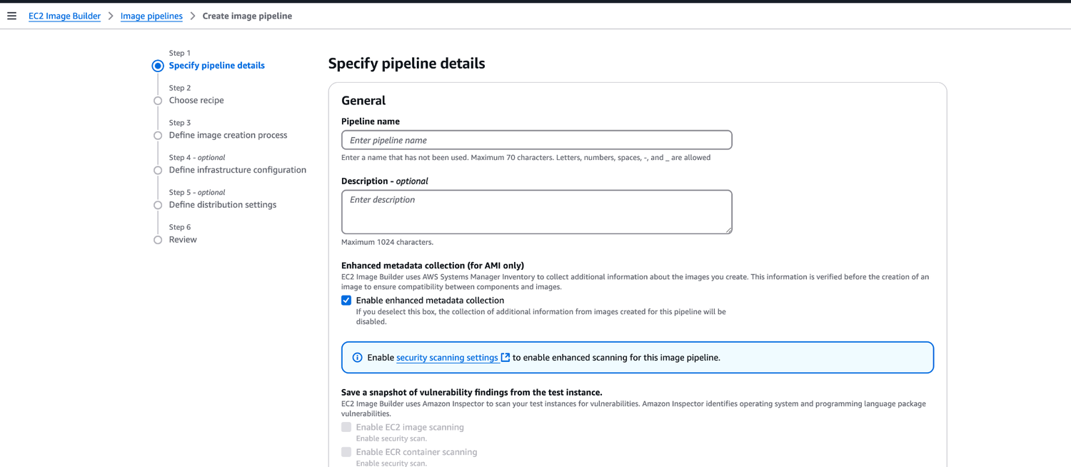
TOPIC 2
Activity: Image Builder
AWS Certified SysOps Administrator - Associate (SOA-C02) · TGS-2024051413
© 2026 Tertiary Infotech Academy Pte Ltd
89

Slide 91
TOPIC 2
AMI in Production
• You can force users to only launch EC2 instances from pre-approved AMIs (AMIs tagged with specific tags) using IAM policies
• Combine with AWS Config to find non- compliant EC2 instance (instances launched with non-approved AMIs)
• AMI
• (not approved)
• AMI
• (approved)
• launch
• IAM Permissions
• {
• … "Condition": {
• "StringEquals": {
• "ec2:ResourceTag/Environment": "Prod"
• }
• }
• }
• AMI
• (approved)
• AWS Config
• launch
• AMI
• (not approved)
• launch
• monitor
• NON_COMPLIANT
• COMPLIANT
• EC2 Instance
• EC2 Instance
• Tags
AWS Certified SysOps Administrator - Associate (SOA-C02) · TGS-2024051413
© 2026 Tertiary Infotech Academy Pte Ltd
90

Slide 92
TOPIC 3
Management of EC2 at Scale Systems Manager
AWS Certified SysOps Administrator - Associate (SOA-C02) · TGS-2024051413
© 2026 Tertiary Infotech Academy Pte Ltd
91

Slide 93
TOPIC 3
AWS Systems Manager Overview
• Helps you manage your EC2 and On-Premises systems at scale
• Get operational insights about the state of your infrastructure
• Easily detect problems
• Patching automation for enhanced compliance
• Works for both Windows and Linux OS
• Integrated with CloudWatch metrics / dashboards
• Integrated with AWS Config
• Free service
AWS Certified SysOps Administrator - Associate (SOA-C02) · TGS-2024051413
© 2026 Tertiary Infotech Academy Pte Ltd
92

Slide 94
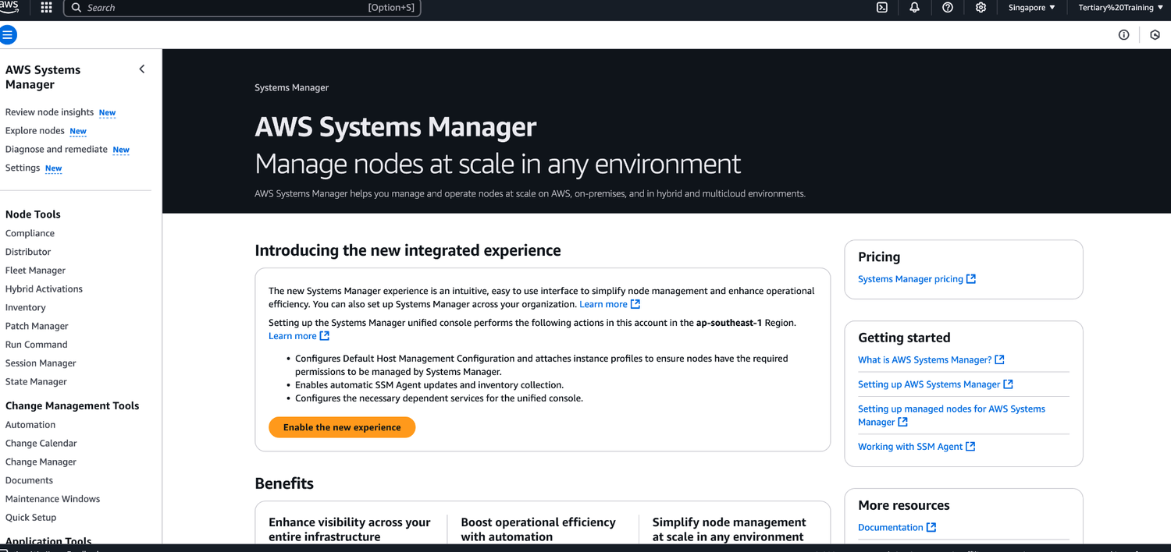
TOPIC 3
AWS Systems Manager
AWS Certified SysOps Administrator - Associate (SOA-C02) · TGS-2024051413
© 2026 Tertiary Infotech Academy Pte Ltd
93

Slide 95
TOPIC 3
AWS Systems Manager Features
• Resource Groups
• Operations Management
• Explorer
• OpsCenter
• CloudWatch Dashboard
• PHD
• Incident Manager
• Shared Resources
• Documents
• Change Management
• Change Manager
• Automation
• Change Calendar
• Maintenance Windows
• Application Management
• Application Manager
• AppConfig
• Parameter store
• Node Management
• Fleet Manager
• Compliance
• Inventory
• Hybrid Activations
• Session Manager
• Run Command
• State Manager
• Patch Manager
• Distributer
AWS Certified SysOps Administrator - Associate (SOA-C02) · TGS-2024051413
© 2026 Tertiary Infotech Academy Pte Ltd
94

Slide 96
TOPIC 3
How Systems Manager works
• We need to install the SSM agent onto the systems we control
• Installed by default on Amazon Linux 2 AMI & some Ubuntu AMI
• If an instance can’t be controlled with SSM, it’s probably an issue with the SSM agent!
• Make sure the EC2 instances have a proper IAM role to allow SSM actions
• EC2 Instance
• (SSM Agent)
• AWS Systems Manager
• (SSM Agent)
• EC2 Instance On-premise
• Server/VM
• (SSM Agent)
• IAM Permissions
AWS Certified SysOps Administrator - Associate (SOA-C02) · TGS-2024051413
© 2026 Tertiary Infotech Academy Pte Ltd
95

Slide 97
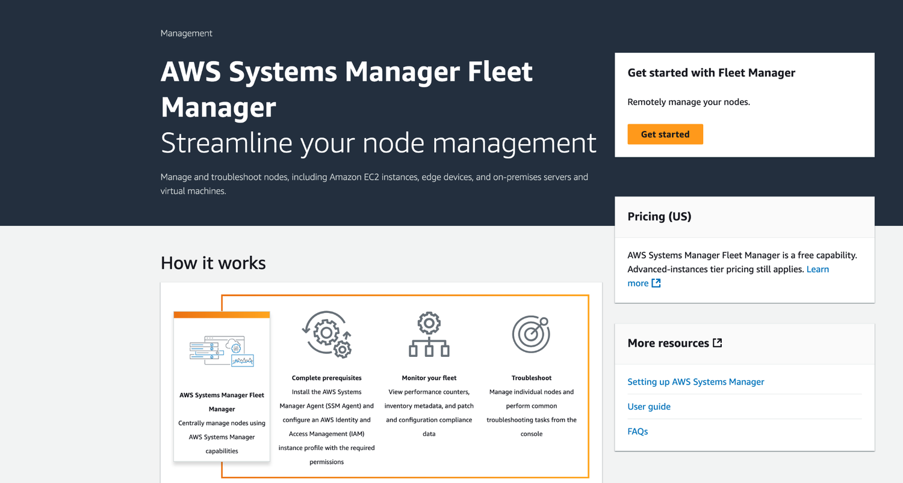
TOPIC 3
Fleet Manager
AWS Certified SysOps Administrator - Associate (SOA-C02) · TGS-2024051413
© 2026 Tertiary Infotech Academy Pte Ltd
96

Slide 98
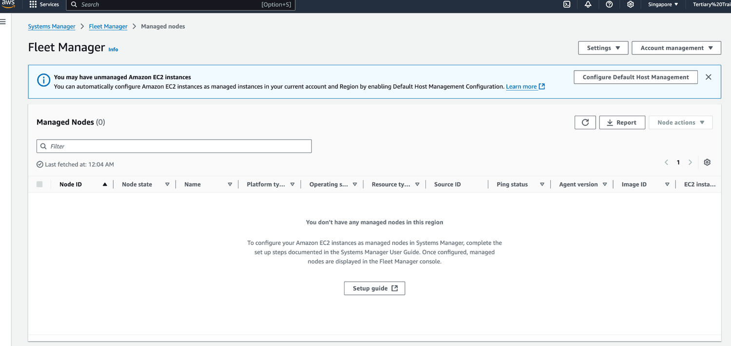
TOPIC 3
Activity: Fleet Manager
AWS Certified SysOps Administrator - Associate (SOA-C02) · TGS-2024051413
© 2026 Tertiary Infotech Academy Pte Ltd
97

Slide 99
TOPIC 3
AWS Tags
• You can add text key-value pairs called Tags to many AWS resources
• Commonly used in EC2
• Free naming, common tags are Name, Environment,Team …
• They’re used for
• Resource grouping
• Automation
• Cost allocation
• Better to have too many tags than too few!
AWS Certified SysOps Administrator - Associate (SOA-C02) · TGS-2024051413
© 2026 Tertiary Infotech Academy Pte Ltd
98

Slide 100
TOPIC 3
Resource Groups
• Create, view or manage logical group of resources thanks to tags
• Allows creation of logical groups of resources such as
• Applications
• Different layers of an application stack
• Production versus development environments
• Regional service
• Works with EC2, S3, DynamoDB, Lambda, etc…
• EC2 Instances
• Resource Group Environment = Dev
AWS Certified SysOps Administrator - Associate (SOA-C02) · TGS-2024051413
© 2026 Tertiary Infotech Academy Pte Ltd
99

Slide 101
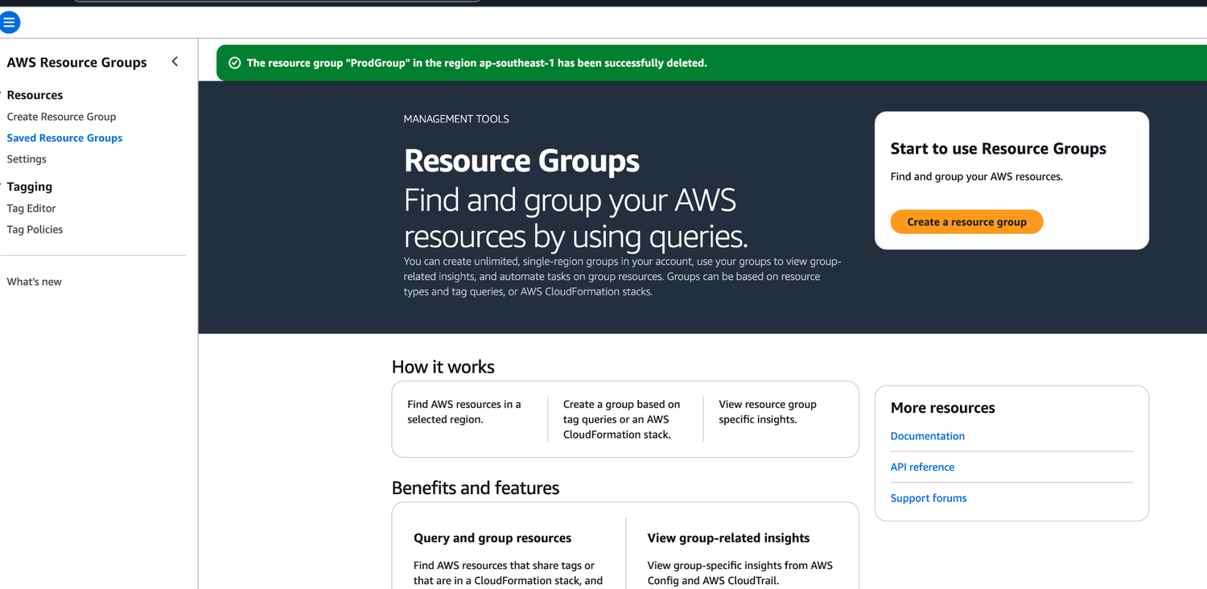
TOPIC 3
Resource Groups
AWS Certified SysOps Administrator - Associate (SOA-C02) · TGS-2024051413
© 2026 Tertiary Infotech Academy Pte Ltd
100

Slide 102
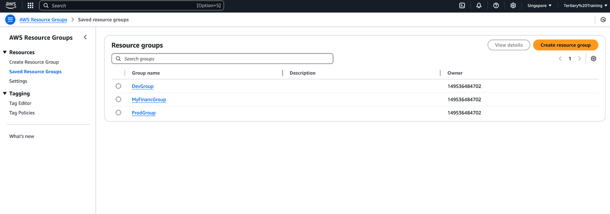
TOPIC 3
Activity: Resource Groups
AWS Certified SysOps Administrator - Associate (SOA-C02) · TGS-2024051413
© 2026 Tertiary Infotech Academy Pte Ltd
101

Slide 103
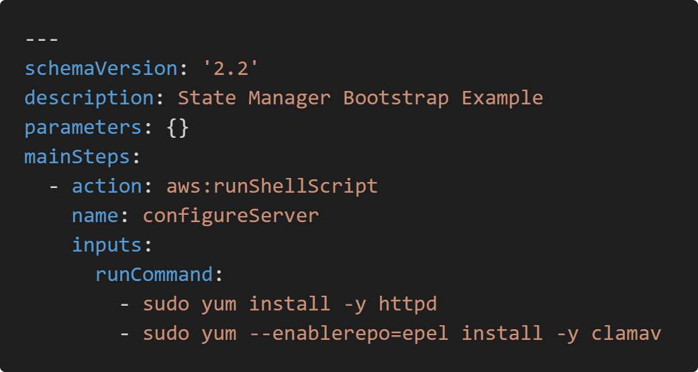
TOPIC 3
SSM - Documents
Documents can be in JSON or YAML
AWS Certified SysOps Administrator - Associate (SOA-C02) · TGS-2024051413
© 2026 Tertiary Infotech Academy Pte Ltd
102

Slide 104
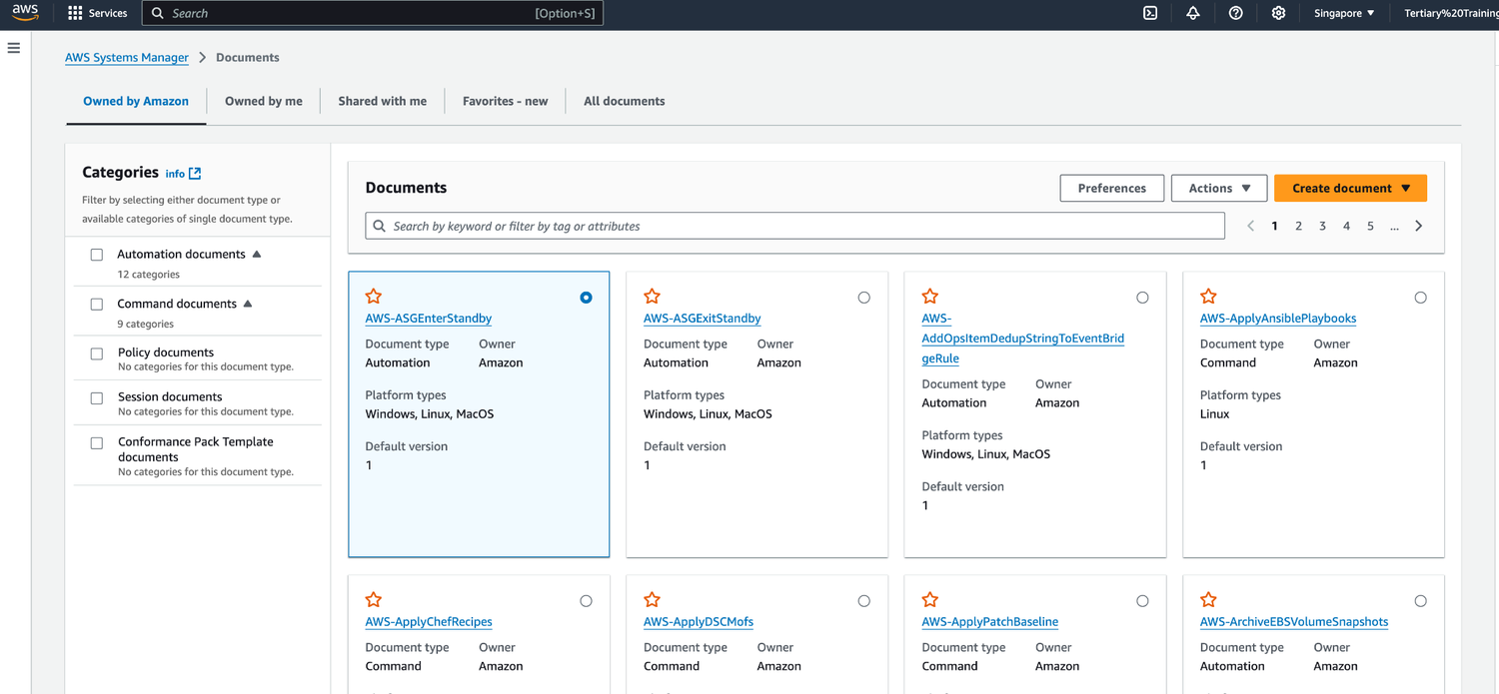
TOPIC 3
Activity: Document
AWS Certified SysOps Administrator - Associate (SOA-C02) · TGS-2024051413
© 2026 Tertiary Infotech Academy Pte Ltd
103

Slide 105
TOPIC 3
SSM – Run Command
• Execute a document (= script) or just run a command
• Run command across multiple instances (using resource groups)
• Rate Control / Error Control
• Integrated with IAM & CloudTrail
• No need for SSH
• Command Output can be shown in the Console, sent to S3 bucket or CloudWatch Logs
• Send notifications to SNS about command statues (In progress, Success, Failed, …)
• Can be invoked using EventBridge
• EventBridge
• Event
• Run Command
• Amazon S3
• CloudWatch Logs
• trigger
• output
• Amazon SNS
• notification
AWS Certified SysOps Administrator - Associate (SOA-C02) · TGS-2024051413
© 2026 Tertiary Infotech Academy Pte Ltd
104

Slide 106
TOPIC 3
SSM - Automation
• Simplifies common maintenance and deployment tasks of EC2 instances and other AWS resources
• Example: restart instances, create an AMI, EBS snapshot
• Automation snapbook
• SSM Documents of type Automation
• Defines actions performed on your EC2 instances or AWS resources
• Pre-defined runbooks (AWS) or create custom runbooks
• Can be triggered
• Manually using AWS Console, AWS CLI or SDK
• By Amazon EventBridge
• On a schedule using Maintenance Windows
• By AWS Config for rules remediations
• SSM Automation
• Runbooks (automation documents)
• execute automation
• (AWS-RestartEC2Instance)
• EC2 Instances
• AWS Resources
• EBS
• AMI
• RDS
• …
• execute
• AWS Console AWS SDK Maintenance Amazon AWS Config
• Windows EventBridge Remediation
AWS Certified SysOps Administrator - Associate (SOA-C02) · TGS-2024051413
© 2026 Tertiary Infotech Academy Pte Ltd
105

Slide 107
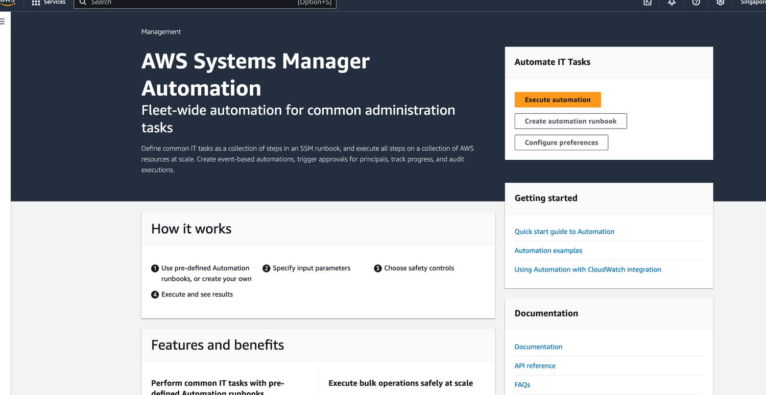
TOPIC 3
SSM - Automation
AWS Certified SysOps Administrator - Associate (SOA-C02) · TGS-2024051413
© 2026 Tertiary Infotech Academy Pte Ltd
106

Slide 108
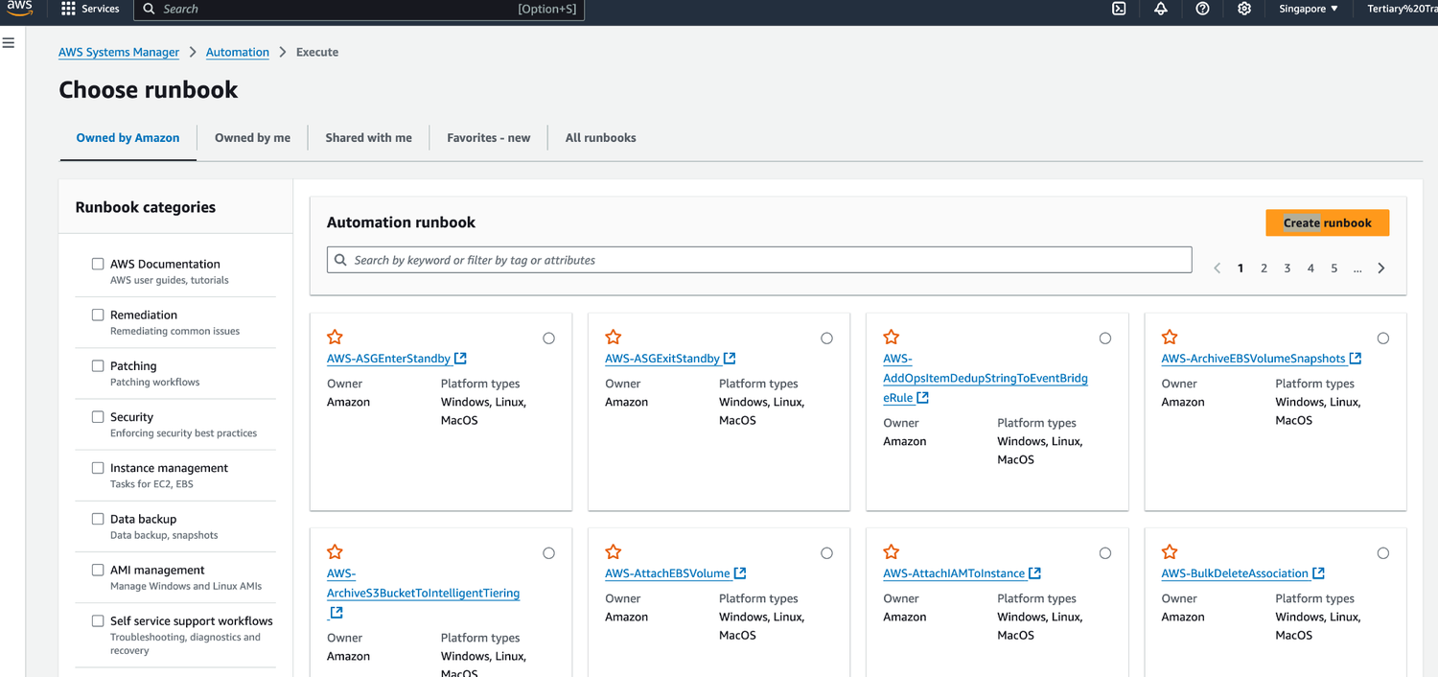
TOPIC 3
Activity: Automation
AWS Certified SysOps Administrator - Associate (SOA-C02) · TGS-2024051413
© 2026 Tertiary Infotech Academy Pte Ltd
107

Slide 109
TOPIC 3
SSM Parameter Store
• Secure storage for configuration and secrets
• Optional Seamless Encryption using KMS
• Serverless, scalable, durable, easy SDK
• Version tracking of configurations / secrets
• Security through IAM
• Notifications with Amazon EventBridge
• Integration with CloudFormation
• SSM Parameter Store
• Applications
• Plaintext configuration
• Encrypted configuration
• Check IAM permissions
• Decryption Service
• AWS KMS
AWS Certified SysOps Administrator - Associate (SOA-C02) · TGS-2024051413
© 2026 Tertiary Infotech Academy Pte Ltd
108

Slide 110
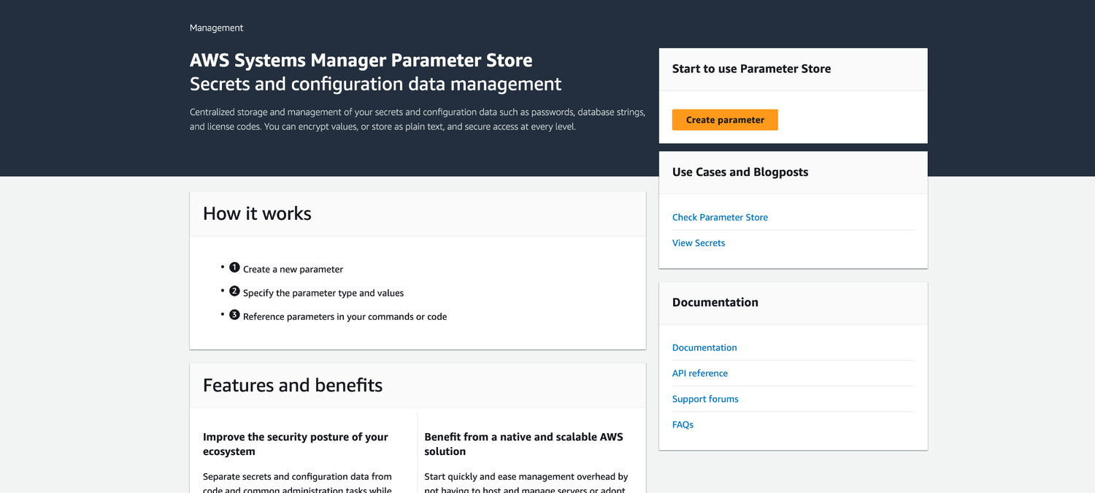
TOPIC 3
SSM Parameter Store
AWS Certified SysOps Administrator - Associate (SOA-C02) · TGS-2024051413
© 2026 Tertiary Infotech Academy Pte Ltd
109

Slide 111
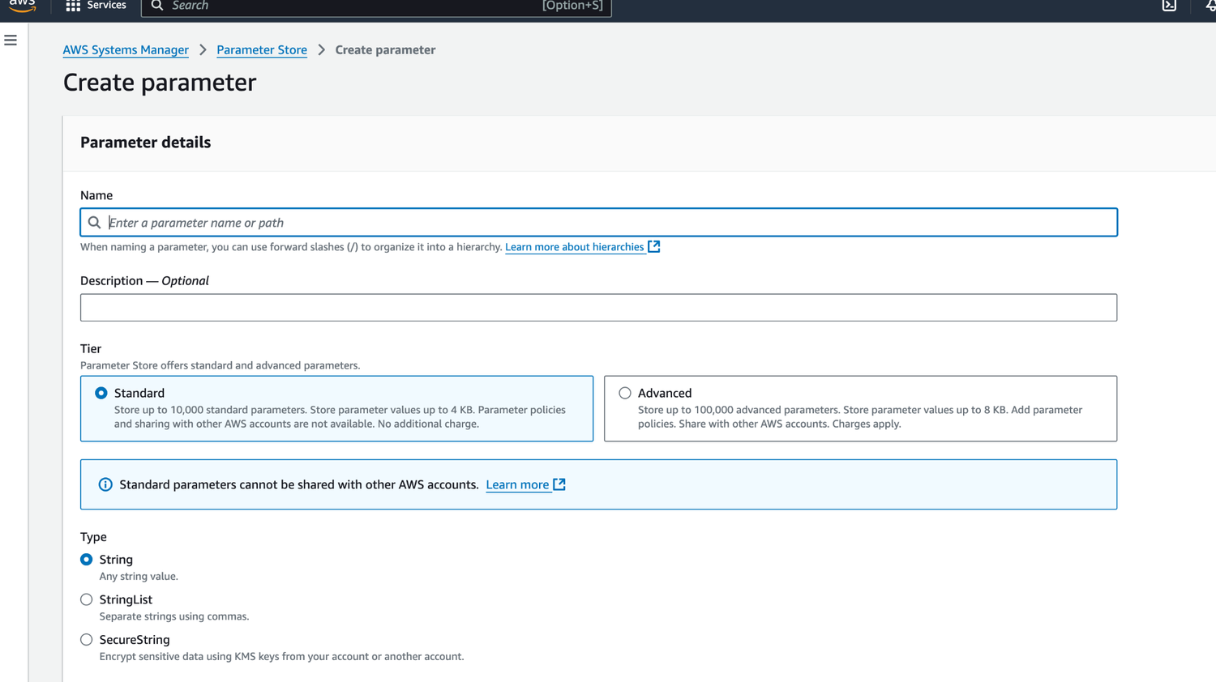
TOPIC 3
Activity: Parameter Store
AWS Certified SysOps Administrator - Associate (SOA-C02) · TGS-2024051413
© 2026 Tertiary Infotech Academy Pte Ltd
110

Slide 112
TOPIC 3
SSM Parameter Store Hierarchy
• /my-department/
• my-app/
• dev/
• db-url
• db-password
• prod/
• db-url
• db-password
• other-app/
• /other-department/
• /aws/reference/secretsmanager/secret_ID_in_Secrets_Manager
• /aws/service/ami-amazon-linux-latest/amzn2-ami-hvm-x86_64-gp2 (public)
• Dev Lambda Function
• GetParameters or GetParametersByPath API
• Prod Lambda Function
AWS Certified SysOps Administrator - Associate (SOA-C02) · TGS-2024051413
© 2026 Tertiary Infotech Academy Pte Ltd
111

Slide 113
TOPIC 3
Standard and advanced parameter tiers
• Standard and advanced parameter tiers
AWS Certified SysOps Administrator - Associate (SOA-C02) · TGS-2024051413
© 2026 Tertiary Infotech Academy Pte Ltd
112

Slide 114
TOPIC 3
Parameters Policies (for advanced parameters)
• Allow to assign a TTL to a parameter (expiration date) to force updating or deleting sensitive data such as passwords
• Can assign multiple policies at a time
• Expiration (to delete a parameter)
• ExpirationNotification (EventBridge)
• NoChangeNotification (EventBridge)
AWS Certified SysOps Administrator - Associate (SOA-C02) · TGS-2024051413
© 2026 Tertiary Infotech Academy Pte Ltd
113

Slide 115
TOPIC 3
SSM - Inventory
• Collect metadata from your managed instances (EC2/On-premises)
• Metadata includes installed software, OS drivers, configurations, installed updates, running services …
• View data in AWS Console or store in S3 and query and analyze using Athena and QuickSight
• Specify metadata collection interval (minutes, hours, days)
• Query data from multiple AWS accounts and regions
• Create Custom Inventory for your custom metadata (e.g., rack location of each managed instance)
AWS Certified SysOps Administrator - Associate (SOA-C02) · TGS-2024051413
© 2026 Tertiary Infotech Academy Pte Ltd
114

Slide 116
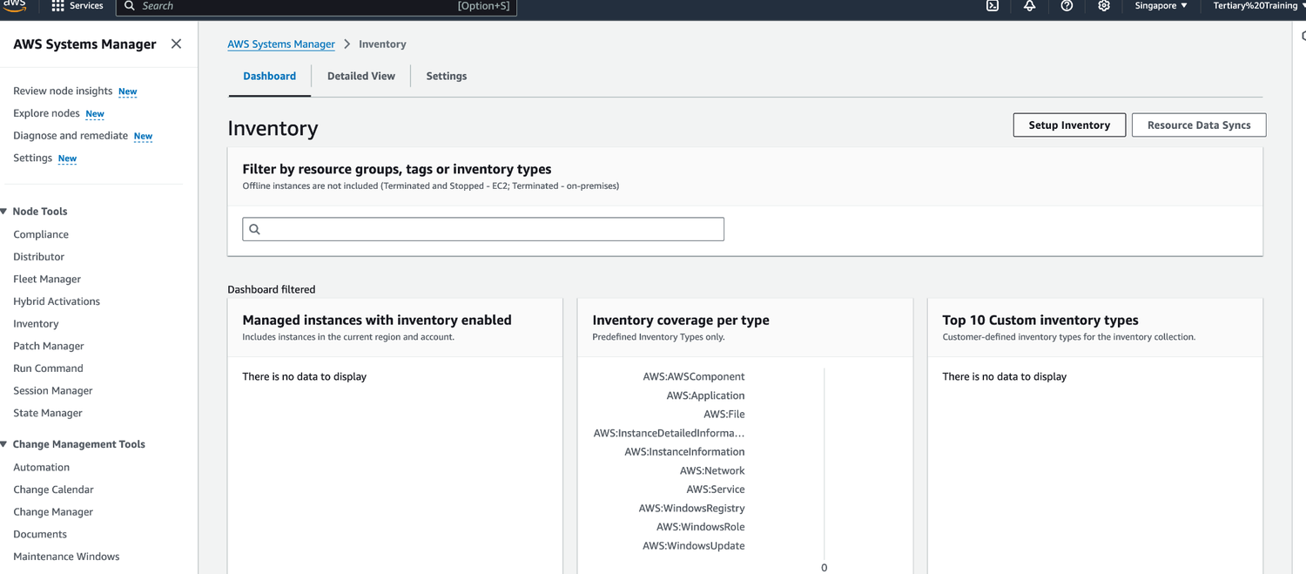
TOPIC 3
Activity: Inventory
AWS Certified SysOps Administrator - Associate (SOA-C02) · TGS-2024051413
© 2026 Tertiary Infotech Academy Pte Ltd
115

Slide 117
TOPIC 3
SSM - State Manager
• Automate the process of keeping your managed instances
• (EC2/On- premises) in a state that you define
• Use cases: bootstrap instances with software, patch OS/software updates on a schedule …
• State Manager Association:
• Defines the state that you want to maintain to your managed instances
• Example: port 22 must be closed, antivirus must be installed …
• Specify a schedule when this configuration is applied
• Uses SSM Documents to create an Association (e.g., SSM Document to configure CW Agent)
AWS Certified SysOps Administrator - Associate (SOA-C02) · TGS-2024051413
© 2026 Tertiary Infotech Academy Pte Ltd
116

Slide 118
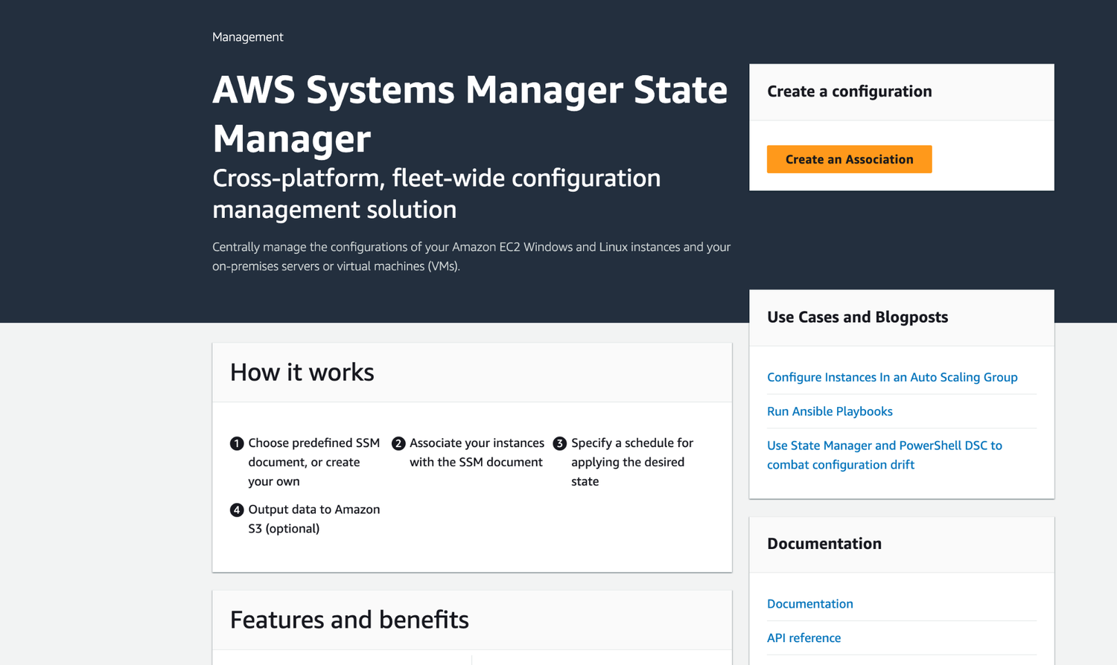
TOPIC 3
SSM - State Manager
AWS Certified SysOps Administrator - Associate (SOA-C02) · TGS-2024051413
© 2026 Tertiary Infotech Academy Pte Ltd
117

Slide 119
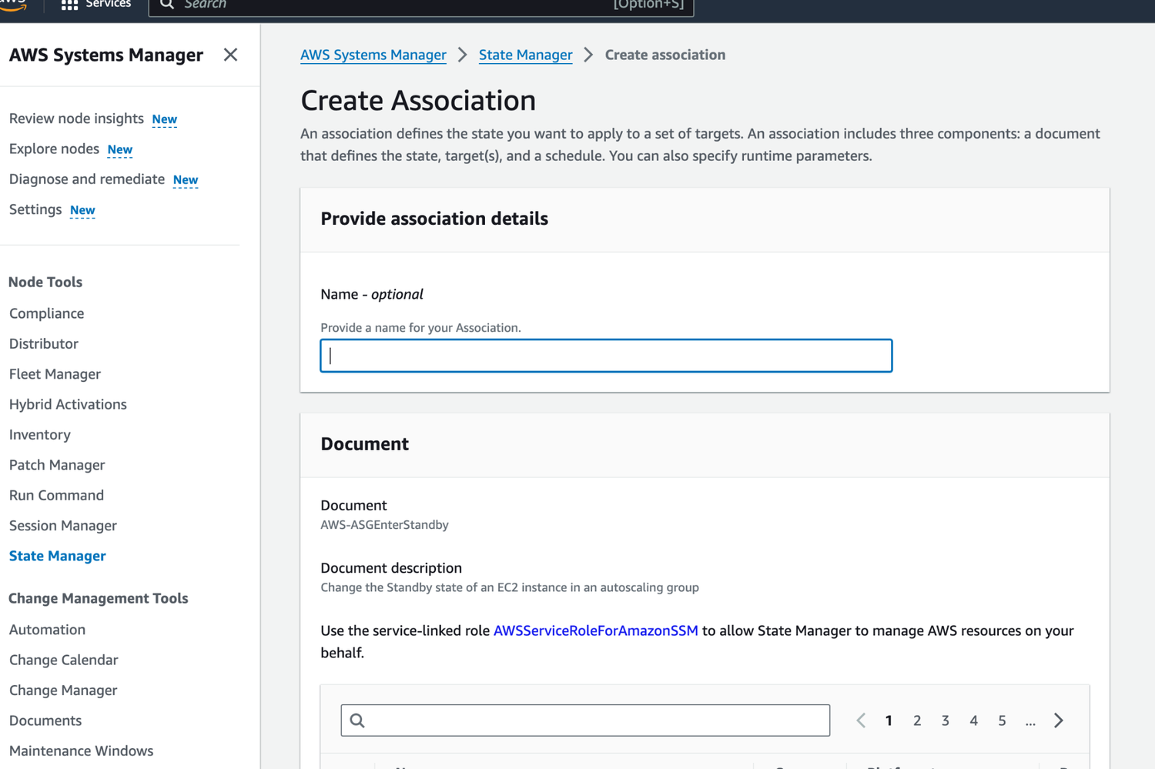
TOPIC 3
Activity: State Manager
AWS Certified SysOps Administrator - Associate (SOA-C02) · TGS-2024051413
© 2026 Tertiary Infotech Academy Pte Ltd
118

Slide 120
TOPIC 3
SSM - Patch Manager
• Automates the process of patching managed instances
• OS updates, applications updates, security updates, …
• Supports both EC2 instances and on-premises servers
• Supports Linux, macOS, and Windows
• Patch on-demand or on a schedule using Maintenance Windows
• Scan instances and generate patch compliance report (missing patches)
• Patch compliance report can be sent to S3
AWS Certified SysOps Administrator - Associate (SOA-C02) · TGS-2024051413
© 2026 Tertiary Infotech Academy Pte Ltd
119

Slide 121
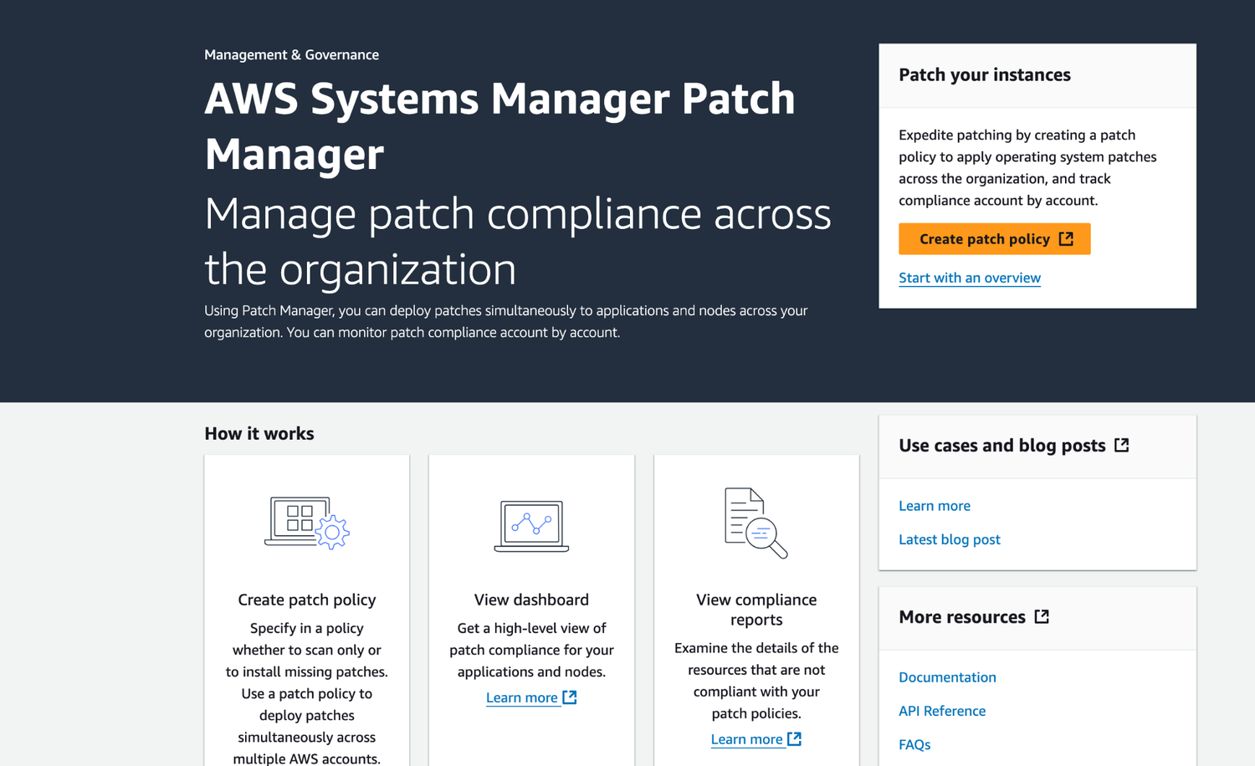
TOPIC 3
SSM - Patch Manager
AWS Certified SysOps Administrator - Associate (SOA-C02) · TGS-2024051413
© 2026 Tertiary Infotech Academy Pte Ltd
120

Slide 122
TOPIC 3
SSM - Patch Manager
• Patch Baseline
• Defines which patches should and shouldn’t be installed on your instances
• Ability to create custom Patch Baselines (specify approved/rejected patches)
• Patches can be auto-approved within days of their release
• By default, install only critical patches and patches related to security
• Patch Group
• Associate a set of instances with a specific Patch Baseline
• Example: create Patch Groups for different environments (dev, test, prod)
• Instances should be defined with the tag key Patch Group
• An instance can only be in one Patch Group
• Patch Group can be registered with only one Patch Baseline
AWS Certified SysOps Administrator - Associate (SOA-C02) · TGS-2024051413
© 2026 Tertiary Infotech Academy Pte Ltd
121

Slide 123
TOPIC 3
SSM - Patch Manager Patch Baselines
• Pre-Defined Patch Baseline
• Managed by AWS for different Operating Systems (can’t be modified)
• AWS-RunPatchBaseline (SSM Document) - apply both operating system and application patches (Linux, macOS, Windows Server)
• Custom Patch Baseline
• Create your own Patch Baseline and choose which patches to auto-approve
• Operating System, allowed patches, rejected patches, …
• Ability to specify custom and alternative patch repositories
AWS Certified SysOps Administrator - Associate (SOA-C02) · TGS-2024051413
© 2026 Tertiary Infotech Academy Pte Ltd
122

Slide 124
TOPIC 3
SSM - Patch Manager
• Run Command
• EC2 Instances (with SSM Agent)
• Tags
• EC2 Instances (with SSM Agent)
• Tags
• EC2 Instances (with SSM Agent)
• Patch Manager
• Default
• Yes
• No
• Patch Baselines
• Patch Baseline ID Patch Group
• pb-0123456789abcdef0
• Default pb-9876543210abcdef0 Dev
• run Document
• AWS-RunPatchBaseline
• SSM Agent query for Batch Baselines
• pb-9876543210abcdef0
• pb-0123456789abcdef0
• pb-0123456789abcdef0
• AWS Console
• AWS SDK
• Maintenance Windows
• Key
• Value
• OS
• Windows
• Key
• Value
• OS
• Windows
• Patch Group
• Prod
• When using Maintenance Windows, use Rate Control to specify the
• max. number/percentage of targets allowed to run in parallel
• Tags
• Key
• Value
• OS
• Windows
• Patch Group
• Dev
AWS Certified SysOps Administrator - Associate (SOA-C02) · TGS-2024051413
© 2026 Tertiary Infotech Academy Pte Ltd
123

Slide 125
TOPIC 3
SSM - Maintenance Windows
• Defines a schedule for when to perform actions on your instances
• Example: OS patching, updating drivers, installing software, …
• Maintenance Window contains
• Schedule
• Duration
• Set of registered instances
• Set of registered tasks
AWS Certified SysOps Administrator - Associate (SOA-C02) · TGS-2024051413
© 2026 Tertiary Infotech Academy Pte Ltd
124

Slide 126
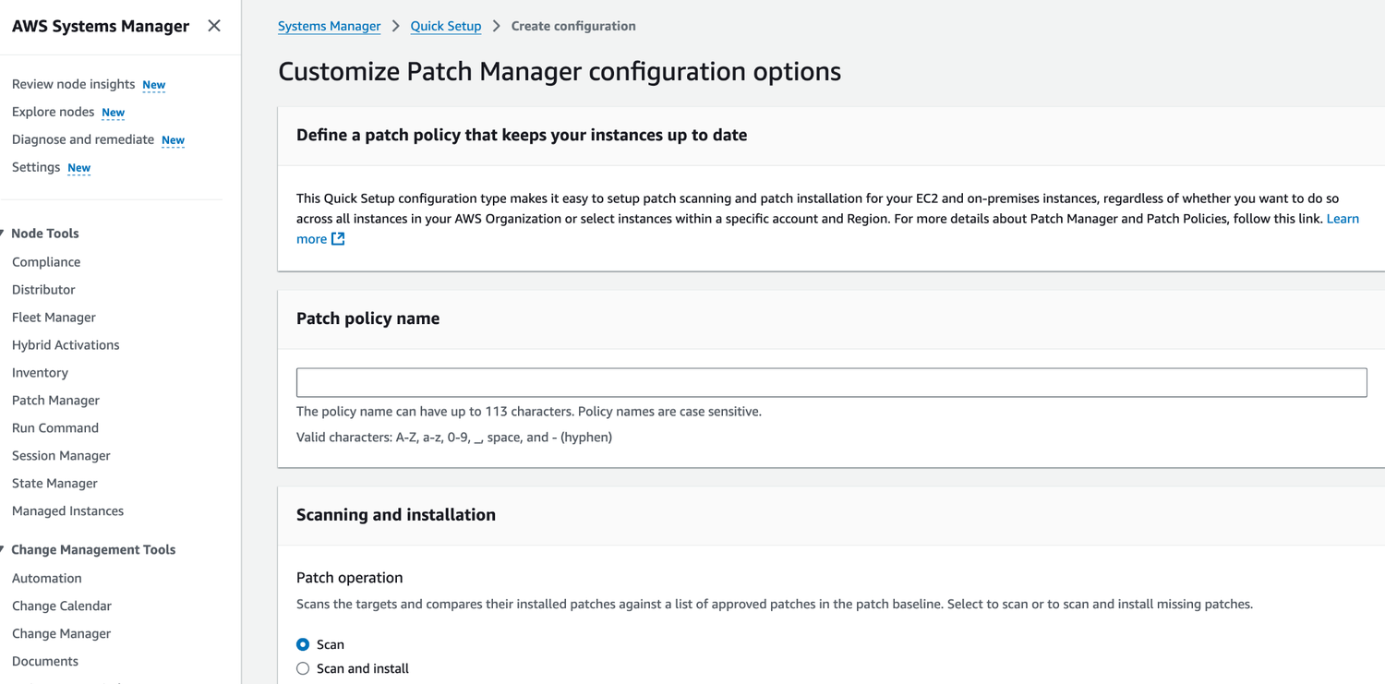
TOPIC 3
Activity: Patch Manager
AWS Certified SysOps Administrator - Associate (SOA-C02) · TGS-2024051413
© 2026 Tertiary Infotech Academy Pte Ltd
125

Slide 127
TOPIC 3
SSM - Session Manager
• Allows you to start a secure shell on your EC2 and on-premises servers
• Access through AWS Console, AWS CLI, or Session Manager SDK
• Does not need SSH access, bastion hosts, or SSH keys
• Supports Linux, macOS, and Windows
• Log connections to your instances and executed commands
• Session log data can be sent to S3 or CloudWatch Logs
• CloudTrail can intercept startsession events
• EC2 Instance
• (SSM Agent)
• User
• IAM
• Permissions
• Execute commands
• Session Manager
AWS Certified SysOps Administrator - Associate (SOA-C02) · TGS-2024051413
© 2026 Tertiary Infotech Academy Pte Ltd
126

Slide 128
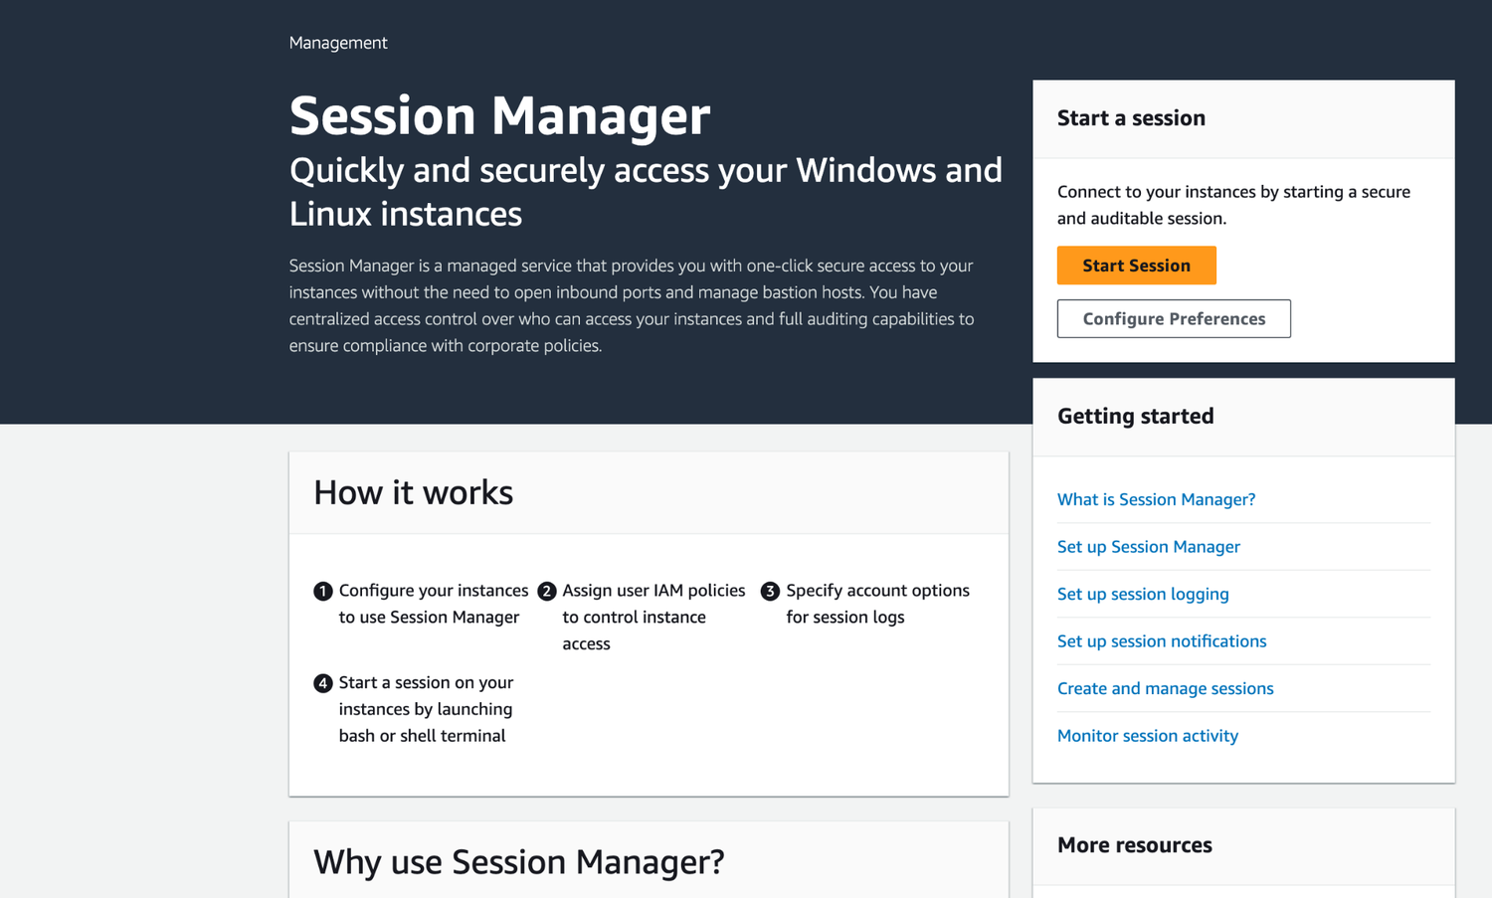
TOPIC 3
SSM - Session Manager
AWS Certified SysOps Administrator - Associate (SOA-C02) · TGS-2024051413
© 2026 Tertiary Infotech Academy Pte Ltd
127

Slide 129
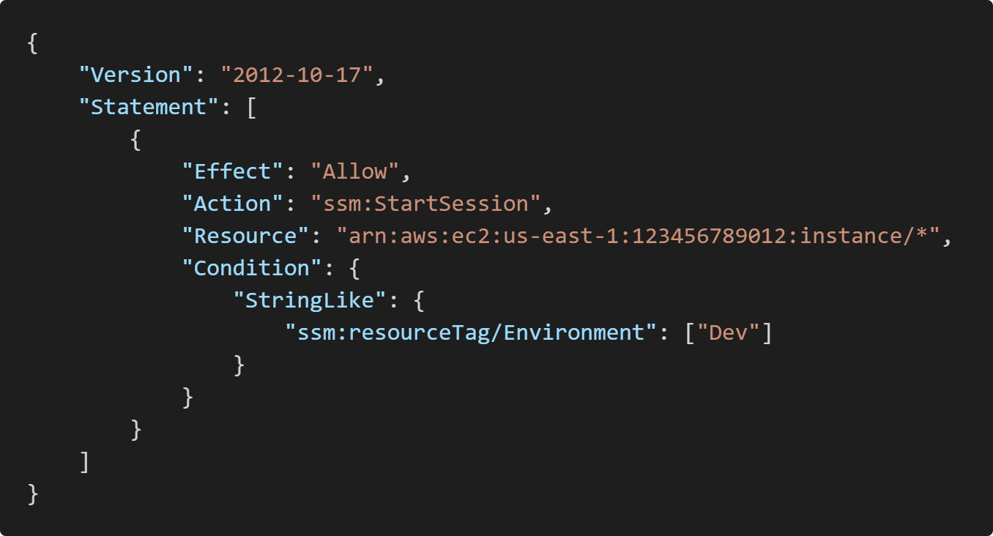
TOPIC 3
SSM - Session Manager
IAM Permissions
AWS Certified SysOps Administrator - Associate (SOA-C02) · TGS-2024051413
© 2026 Tertiary Infotech Academy Pte Ltd
128

Slide 130
TOPIC 3
SSH vs. SSM Session Manager
• Inbound Rules
• User
• (IPv4: 1.2.3.4)
• EC2 Instance
• (SSM Agent)
• Inbound Rules
• User
• Session Manager
• AWS Console, AWS CLI,
• or Session Manager SDK
• Security Group
• IAM Instance Profile
• Connect using SSH Connect using SSM Session Manager
• AmazonSSMManagedInstanceCore
• IAM
• Permissions
• CloudWatch Logs
• Amazon S3
• session log data
AWS Certified SysOps Administrator - Associate (SOA-C02) · TGS-2024051413
© 2026 Tertiary Infotech Academy Pte Ltd
129

Slide 131
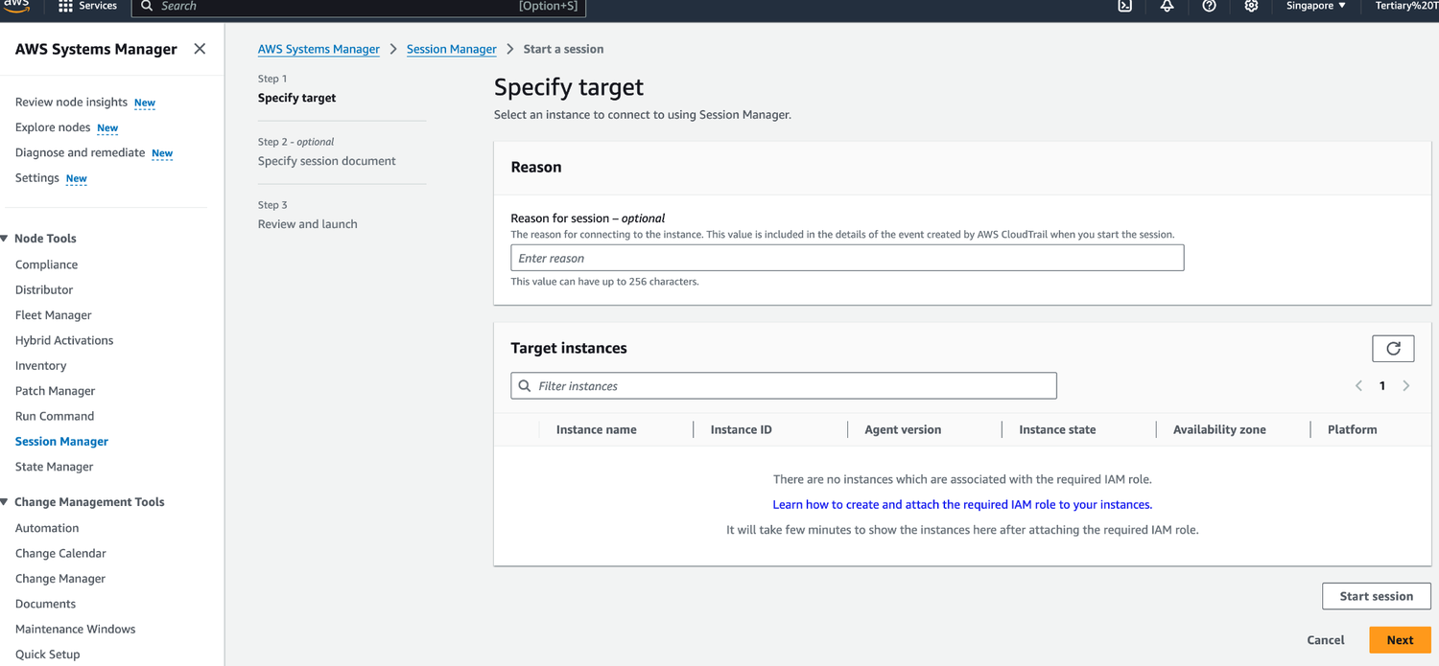
TOPIC 3
Activity: Session Manager
AWS Certified SysOps Administrator - Associate (SOA-C02) · TGS-2024051413
© 2026 Tertiary Infotech Academy Pte Ltd
130

Slide 132
TOPIC 4
High Availability & Scalability
AWS Certified SysOps Administrator - Associate (SOA-C02) · TGS-2024051413
© 2026 Tertiary Infotech Academy Pte Ltd
131

Slide 133
TOPIC 4
Scalability and High Availability Section
• Load Balancers:
• Troubleshooting
• Advanced options and logging
• CloudWatch integrations
• Auto Scaling
• Troubleshooting
• Advanced options and logging
• CloudWatch integrations
AWS Certified SysOps Administrator - Associate (SOA-C02) · TGS-2024051413
© 2026 Tertiary Infotech Academy Pte Ltd
132

Slide 134
TOPIC 4
Scalability & High Availability
• Scalability means that an application / system can handle greater loads by adapting.
• There are two kinds of scalability:
• Vertical Scalability
• Horizontal Scalability (= elasticity)
• Scalability is linked but different to High Availability
• Let’s deep dive into the distinction, using a call center as an example
AWS Certified SysOps Administrator - Associate (SOA-C02) · TGS-2024051413
© 2026 Tertiary Infotech Academy Pte Ltd
133

Slide 135
TOPIC 4
Vertical Scalability
• Vertically scalability means increasing the size of the instance
• For example, your application runs on a t2.micro
• Scaling that application vertically means running it on a t2.large
• Vertical scalability is very common for non distributed systems, such as a database.
• RDS, ElastiCache are services that can scale vertically.
• There’s usually a limit to how much you can vertically scale (hardware limit)
• junior operator
• senior operator
AWS Certified SysOps Administrator - Associate (SOA-C02) · TGS-2024051413
© 2026 Tertiary Infotech Academy Pte Ltd
134

Slide 136
TOPIC 4
Horizontal Scalability
• Horizontal Scalability means increasing the number of instances / systems for your application
• Horizontal scaling implies distributed systems.
• This is very common for web applications / modern applications
• It’s easy to horizontally scale thanks the cloud offerings such as Amazon EC2
• operator
• operator
• operator
• operator
• operator
• operator
AWS Certified SysOps Administrator - Associate (SOA-C02) · TGS-2024051413
© 2026 Tertiary Infotech Academy Pte Ltd
135

Slide 137
TOPIC 4
second building in San Francisco
• first building in New York
• High Availability
• High Availability usually goes hand in hand with horizontal scaling
• High availability means running your
• application / system in at least 2 data centers (== Availability Zones)
• The goal of high availability is to survive a data center loss
• The high availability can be passive (for RDS Multi AZ for example)
• The high availability can be active (for horizontal scaling)
AWS Certified SysOps Administrator - Associate (SOA-C02) · TGS-2024051413
© 2026 Tertiary Infotech Academy Pte Ltd
136

Slide 138
TOPIC 4
High Availability & Scalability For EC2
• Vertical Scaling: Increase instance size (= scale up / down)
• From: t2.nano - 0.5G of RAM, 1 vCPU
• To: u-12tb1.metal – 12.3 TB of RAM, 448 vCPUs
• Horizontal Scaling: Increase number of instances (= scale out / in)
• Auto Scaling Group
• Load Balancer
• High Availability: Run instances for the same application across multi-AZ
• Auto Scaling Group multi-AZ
• Load Balancer multi-AZ
AWS Certified SysOps Administrator - Associate (SOA-C02) · TGS-2024051413
© 2026 Tertiary Infotech Academy Pte Ltd
137

Slide 139
TOPIC 4
What is load balancing?
• Elastic Load Balancer
• EC2 Instance
• EC2 Instance
• EC2 Instance
• Load Balances are servers that forward traffic to multiple servers (e.g., EC2 instances) downstream
AWS Certified SysOps Administrator - Associate (SOA-C02) · TGS-2024051413
© 2026 Tertiary Infotech Academy Pte Ltd
138

Slide 140
TOPIC 4
Why use a load balancer?
• Spread load across multiple downstream instances
• Expose a single point of access (DNS) to your application
• Seamlessly handle failures of downstream instances
• Do regular health checks to your instances
• Provide SSL termination (HTTPS) for your websites
• Enforce stickiness with cookies
• High availability across zones
• Separate public traffic from private traffic
AWS Certified SysOps Administrator - Associate (SOA-C02) · TGS-2024051413
© 2026 Tertiary Infotech Academy Pte Ltd
139

Slide 141
TOPIC 4
Why use an Elastic Load Balancer?
• An Elastic Load Balancer is a managed load balancer
• AWS guarantees that it will be working
• AWS takes care of upgrades, maintenance, high availability
• AWS provides only a few configuration knobs
• It costs less to setup your own load balancer but it will be a lot more effort on your end
• It is integrated with many AWS offerings / services
• EC2, EC2 Auto Scaling Groups, Amazon ECS
• AWS Certificate Manager (ACM), CloudWatch
• Route 53, AWS WAF, AWS Global Accelerator
AWS Certified SysOps Administrator - Associate (SOA-C02) · TGS-2024051413
© 2026 Tertiary Infotech Academy Pte Ltd
140

Slide 142
TOPIC 4
Health Checks
• Health Checks are crucial for Load Balancers
• They enable the load balancer to know if instances it forwards traffic to are available to reply to requests
• The health check is done on a port and a route (/health is common)
• If the response is not 200 (OK), then the instance is unhealthy
• Elastic Load Balancer
• EC2 Instance
• Health Checks
• Protocol: HTTP Port: 4567 Endpoint: /health
AWS Certified SysOps Administrator - Associate (SOA-C02) · TGS-2024051413
© 2026 Tertiary Infotech Academy Pte Ltd
141

Slide 143
TOPIC 4
Types of load balancer on AWS
• AWS has 4 kinds of managed Load Balancers
• Classic Load Balancers (v1 - old generation) - 2009 - CLB
• HTTP, HTTPS,TCP, SSL (secure TCP)
• Application Load Balancer v2 - new generation) - 2016 - ALB
• HTTP, HTTPS, WebSocket
• Network Load Balancer (v2 - new generation) - 2017 - NLB
• TCP, TLS (secure TCP), UDP
• Gateway Load Balancer - 2020 - GWLB
• Operates at layer 3 (Network layer) - IP Protocol
• Overall, it is recommended to use the newer generation load balancers as they provide more features
• Some load balancers can be setup as internal (private) or external (public) ELB
AWS Certified SysOps Administrator - Associate (SOA-C02) · TGS-2024051413
© 2026 Tertiary Infotech Academy Pte Ltd
142

Slide 144
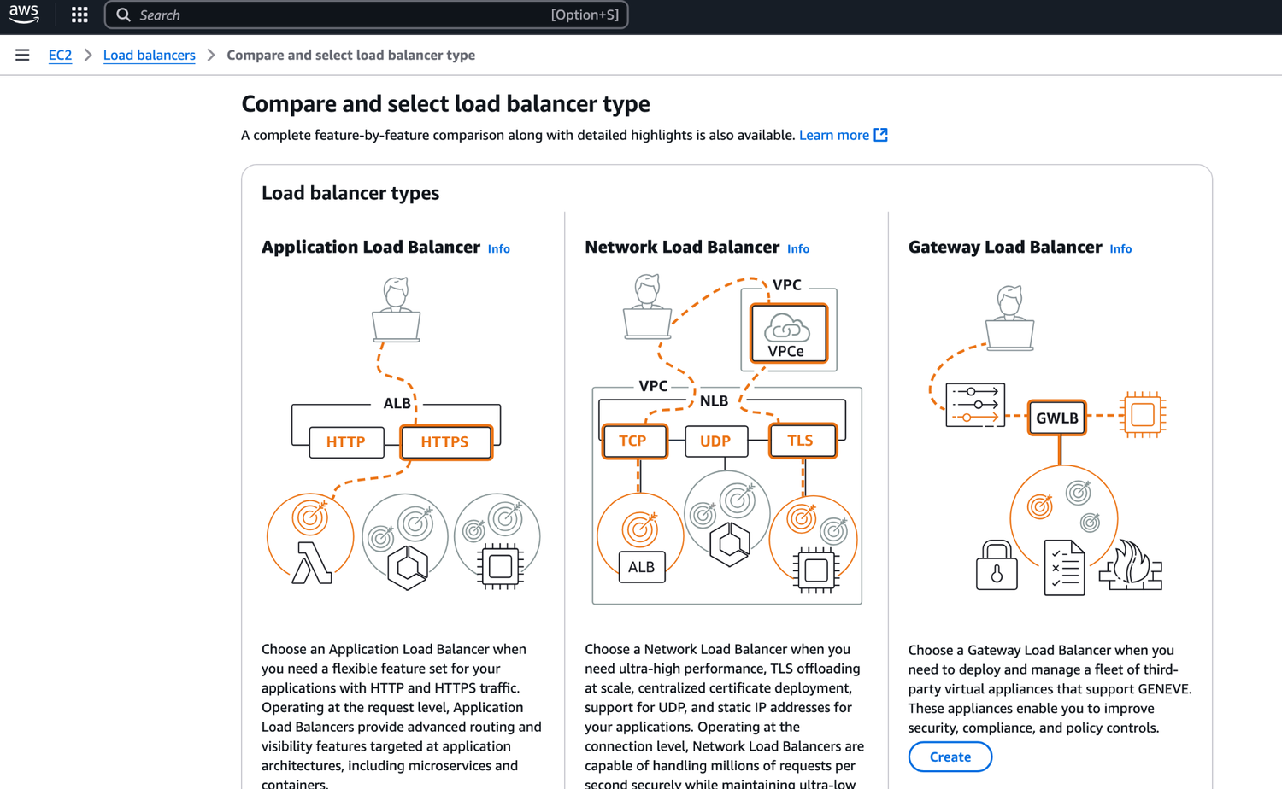
TOPIC 4
Types of load balancer on AWS
AWS Certified SysOps Administrator - Associate (SOA-C02) · TGS-2024051413
© 2026 Tertiary Infotech Academy Pte Ltd
143

Slide 145
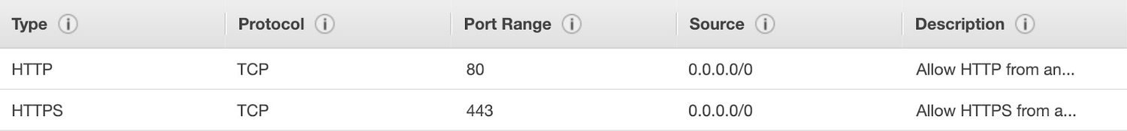
TOPIC 4
Users
HTTPS / HTTP
AWS Certified SysOps Administrator - Associate (SOA-C02) · TGS-2024051413
© 2026 Tertiary Infotech Academy Pte Ltd
144

Slide 146
TOPIC 4
Classic Load Balancers (v1)
• Client
• CLB
• EC2
• listener
• internal
• Supports TCP (Layer 4), HTTP & HTTPS (Layer 7)
• Health checks are TCP or HTTP based
• Fixed hostname XXX.region.elb.amazonaws.com
AWS Certified SysOps Administrator - Associate (SOA-C02) · TGS-2024051413
© 2026 Tertiary Infotech Academy Pte Ltd
145

Slide 147
TOPIC 4
Application Load Balancer (v2)
• Application load balancers is Layer 7 (HTTP)
• Load balancing to multiple HTTP applications across machines (target groups)
• Load balancing to multiple applications on the same machine (ex: containers)
• Support for HTTP/2 and WebSocket
• Support redirects (from HTTP to HTTPS for example)
AWS Certified SysOps Administrator - Associate (SOA-C02) · TGS-2024051413
© 2026 Tertiary Infotech Academy Pte Ltd
146

Slide 148
TOPIC 4
Application Load Balancer (v2)
• Routing tables to different target groups:
• Routing based on path in URL (example.com/users & example.com/posts)
• Routing based on hostname in URL ( & other.example.com)
• Routing based on Query String, Headers (example.com/users? id=123=false)
• ALB are a great fit for micro services & container-based application (example: Docker & Amazon ECS)
• Has a port mapping feature to redirect to a dynamic port in ECS
• In comparison, we’d need multiple Classic Load Balancer per application
AWS Certified SysOps Administrator - Associate (SOA-C02) · TGS-2024051413
© 2026 Tertiary Infotech Academy Pte Ltd
147

Slide 149
TOPIC 4
Target Group for Users application
• Application Load Balancer (v2) HTTP Based Traffic
• External Application Load Balancer (v2)
• HTTP
• WWW
• Route /user
• Target Group for Search application
• HTTP
• WWW
• Route /search
• Health Check
• Health Check
AWS Certified SysOps Administrator - Associate (SOA-C02) · TGS-2024051413
© 2026 Tertiary Infotech Academy Pte Ltd
148

Slide 150
TOPIC 4
Application Load Balancer (v2) Target Groups
EC2 instances (can be managed by an Auto Scaling Group) - HTTP
ECS tasks (managed by ECS itself) - HTTP
Lambda functions - HTTP request is translated into a JSON event
1
2
3
IP Addresses - must be private IPs
ALB can route to multiple target groups
Health checks are at the target group level
4
5
6
AWS Certified SysOps Administrator - Associate (SOA-C02) · TGS-2024051413
© 2026 Tertiary Infotech Academy Pte Ltd
149

Slide 151
TOPIC 4
Target Group 1
• AWS – EC2 based
• Application Load Balancer (v2) Query Strings/Parameters Routing
• External Application Load Balancer (v2)
• ?Platform=Mobile
• WWW
• Requests
• Target Group 2
• On-premises – Private IP routing
• ?Platform=Desktop
AWS Certified SysOps Administrator - Associate (SOA-C02) · TGS-2024051413
© 2026 Tertiary Infotech Academy Pte Ltd
150

Slide 152
TOPIC 4
Application Load Balancer (v2) Good to Know
• Fixed hostname (XXX.region.elb.amazonaws.com)
• The application servers don’t see the IP of the client directly
• The true IP of the client is inserted in the header X-Forwarded-For
• We can also get Port (X-Forwarded-Port) and proto (X-Forwarded-Proto)
• EC2
• Instance
• Client IP 12.34.56.78
• Load Balancer IP (Private IP)
• Connection termination
AWS Certified SysOps Administrator - Associate (SOA-C02) · TGS-2024051413
© 2026 Tertiary Infotech Academy Pte Ltd
151

Slide 153
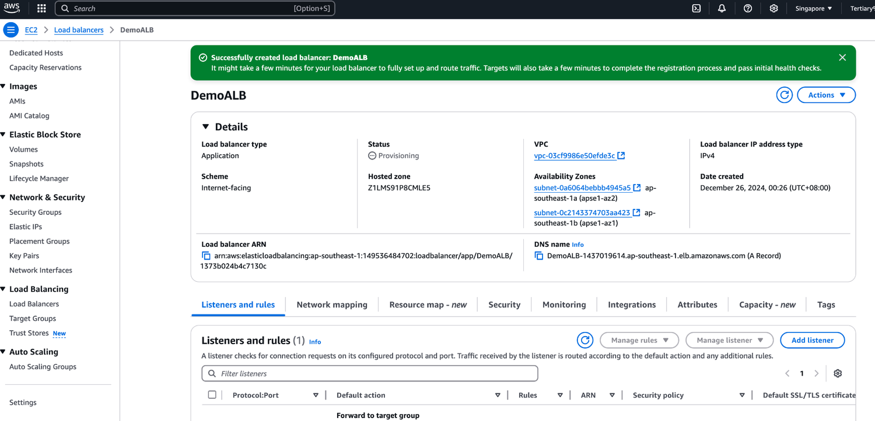
TOPIC 4
Activity: Application Load Balancer
AWS Certified SysOps Administrator - Associate (SOA-C02) · TGS-2024051413
© 2026 Tertiary Infotech Academy Pte Ltd
152

Slide 154
TOPIC 4
Network Load Balancer (v2)
• Network load balancers (Layer 4) allow to:
• Forward TCP & UDP traffic to your instances
• Handle millions of request per seconds
• Ultra-low latency
• NLB has one static IP per AZ and supports assigning Elastic IP
• (helpful for whitelisting specific IP)
• NLB are used for extreme performance,TCP or UDP traffic
• Not included in the AWS free tier
AWS Certified SysOps Administrator - Associate (SOA-C02) · TGS-2024051413
© 2026 Tertiary Infotech Academy Pte Ltd
153

Slide 155
TOPIC 4
Network Load Balancer (v2) TCP (Layer 4) Based Traffic
• Target Group for Users application
• External Network Load Balancer (v2)
• TCP
• WWW
• TCP + Rules
• Target Group for Search application
• HTTP
• WWW
• TCP + Rules
• Health Check
• Health Check
AWS Certified SysOps Administrator - Associate (SOA-C02) · TGS-2024051413
© 2026 Tertiary Infotech Academy Pte Ltd
154

Slide 156
TOPIC 4
Network Load Balancer - Target Groups
• EC2 Instances
• IP Addresses - must be private IPs
• Application Load Balancer
• Health Checks support the TCP, HTTP, HTTPS Protocols
• i-1234567890abcdef0 i-1234567890abcdef0
• Target Group
• (EC2 Instances)
• Network
• Load Balancer
• Target Group
• (IP Addresses)
• 192.168.1.118
• 10.0.4.21
• Network
• Load Balancer
• Target Group
• (Application Load Balancer)
• Network
• Load Balancer
AWS Certified SysOps Administrator - Associate (SOA-C02) · TGS-2024051413
© 2026 Tertiary Infotech Academy Pte Ltd
155

Slide 157
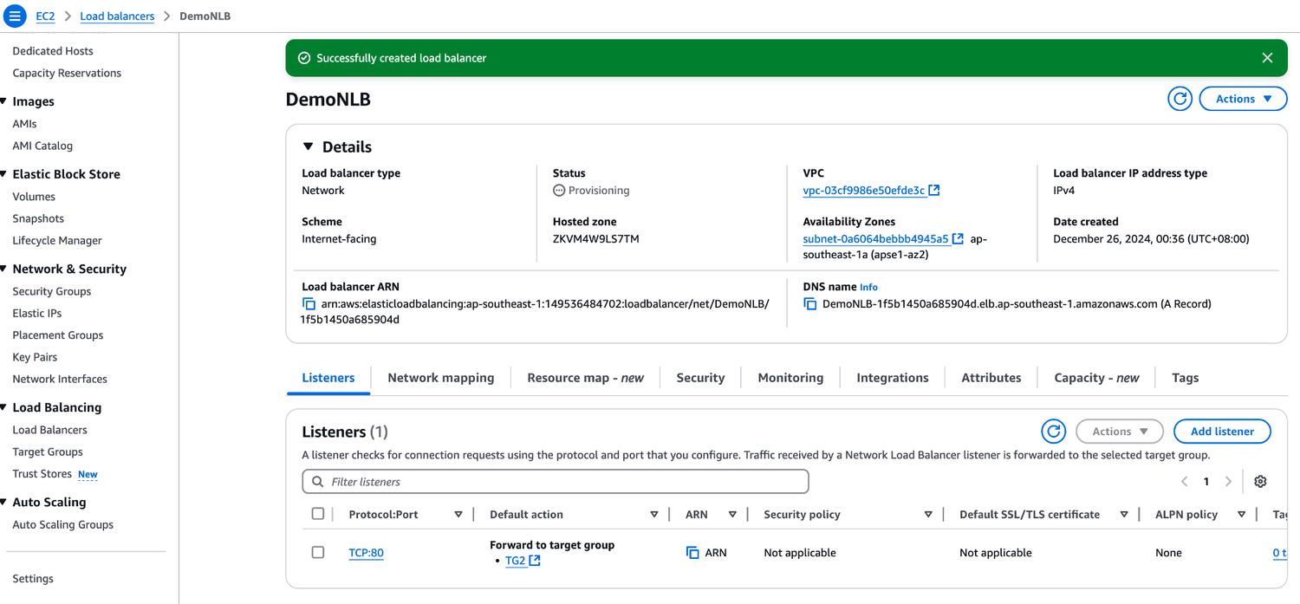
TOPIC 4
Activity: Network Load Balancer
AWS Certified SysOps Administrator - Associate (SOA-C02) · TGS-2024051413
© 2026 Tertiary Infotech Academy Pte Ltd
156

Slide 158
TOPIC 4
Gateway Load Balancer
• Deploy, scale, and manage a fleet of 3rd party network virtual appliances in AWS
• Example: Firewalls, Intrusion Detection and
• Prevention Systems, Deep Packet Inspection Systems, payload manipulation, …
• Operates at Layer 3 (Network Layer) – IP Packets
• Combines the following functions:
• Transparent Network Gateway - single entry/exit for all traffic
• Load Balancer - distributes traffic to your virtual appliances
• Uses the GENEVE protocol on port 60
• Users
• (source)
• Gateway Load Balancer
• Application
• (destination)
• Target Group
• 3rd Party Security Virtual Appliances
• traffic
• traffic
• Route Table
AWS Certified SysOps Administrator - Associate (SOA-C02) · TGS-2024051413
© 2026 Tertiary Infotech Academy Pte Ltd
157

Slide 159
TOPIC 4
Gateway Load Balancer - Target Groups
• EC2 Instances
• IP Addresses - must be private IPs
• i-1234567890abcdef0 i-1234567890abcdef0
• Target Group
• (EC2 Instances)
• Gateway Load Balancer
• Target Group
• (IP Addresses)
• 192.168.1.118
• 10.0.4.21
• Gateway Load Balancer
AWS Certified SysOps Administrator - Associate (SOA-C02) · TGS-2024051413
© 2026 Tertiary Infotech Academy Pte Ltd
158

Slide 160
TOPIC 4
Sticky Sessions (Session Affinity)
• It is possible to implement stickiness so that the
• same client is always redirected to the same instance behind a load balancer
• This works for Classic Load Balancer
• Application Load Balancer, and Network Load Balancer
• For both CLB & ALB, the “cookie” used for stickiness has an expiration date you control
• Use case: make sure the user doesn’t lose his session data
• Enabling stickiness may bring imbalance to the load over the backend EC2 instances
• EC2 Instance
• EC2 Instance
• Client 1
• Client 2
• Client 3
AWS Certified SysOps Administrator - Associate (SOA-C02) · TGS-2024051413
© 2026 Tertiary Infotech Academy Pte Ltd
159

Slide 161
TOPIC 4
Sticky Sessions – Cookie Names
• Application based cookies
• Custom cookie
• Generated by the target
• Can include any custom attributes required by the application
• Cookie name must be specified individually for each target group
• Don’t use AWSALB, AWSALBAPP or AWSALBTG reserved for use by the ELB)
• Application cookie
• Generated by the load balancer
• Cookie name is AWSALBAPP
• Duration based cookies
• Cookie generated by the load balancer
• Cookie name is AWSALB for ALB, AWSELB for CLB
AWS Certified SysOps Administrator - Associate (SOA-C02) · TGS-2024051413
© 2026 Tertiary Infotech Academy Pte Ltd
160

Slide 162
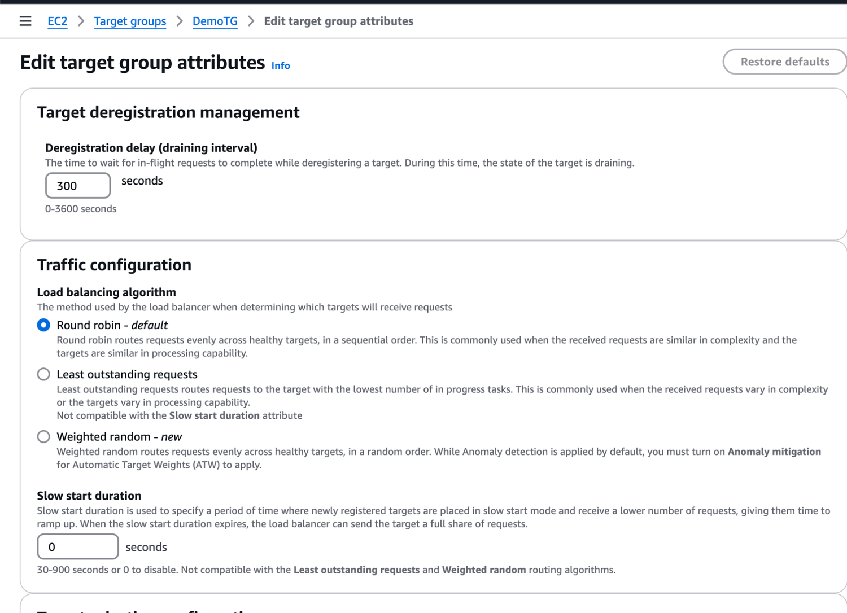
TOPIC 4
Activity: Sticky Session
AWS Certified SysOps Administrator - Associate (SOA-C02) · TGS-2024051413
© 2026 Tertiary Infotech Academy Pte Ltd
161

Slide 163
TOPIC 4
Cross-Zone Load Balancing
• Availability Zone 1
• Availability Zone 2
• 10
• 10
• 10
• 10
• 10
• 10
• 10
• 10
• 10
• 10
• Availability Zone 1
• Availability Zone 2
• 25
• 25
• 6.25
• 6.25
• With Cross Zone Load Balancing:
• each load balancer instance distributes evenly across all registered instances in all AZ
• Without Cross Zone Load Balancing:
• Requests are distributed in the instances of the node of the Elastic Load Balancer
• 50
• 50
• 50
• 50
AWS Certified SysOps Administrator - Associate (SOA-C02) · TGS-2024051413
© 2026 Tertiary Infotech Academy Pte Ltd
162

Slide 164
TOPIC 4
Cross-Zone Load Balancing
• Application Load Balancer
• Enabled by default (can be disabled at the Target Group level)
• No charges for inter AZ data
• Network Load Balancer $ Gateway Load Balancer
• Disabled by default
• You pay charges ($) for inter AZ data if enabled
• Classic Load Balancer
• Disabled by default
• No charges for inter AZ data if enabled
AWS Certified SysOps Administrator - Associate (SOA-C02) · TGS-2024051413
© 2026 Tertiary Infotech Academy Pte Ltd
163

Slide 165
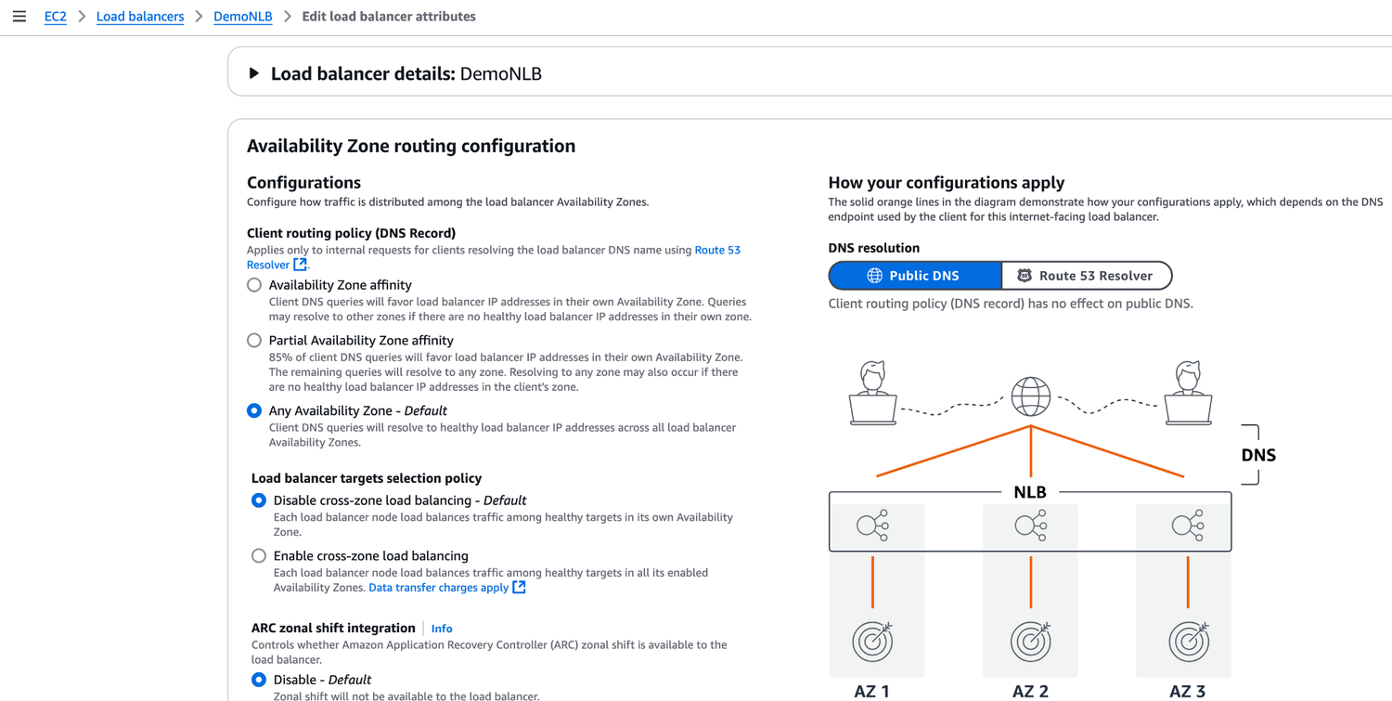
TOPIC 4
Activity: Cross Zone Load Balancing
AWS Certified SysOps Administrator - Associate (SOA-C02) · TGS-2024051413
© 2026 Tertiary Infotech Academy Pte Ltd
164

Slide 166
TOPIC 4
SSL/TLS - Basics
• An SSL Certificate allows traffic between your clients and your load balancer to be encrypted in transit (in-flight encryption)
• SSL refers to Secure Sockets Layer, used to encrypt connections
• TLS refers to Transport Layer Security, which is a newer version
• Nowadays, TLS certificates are mainly used, but people still refer as SSL
• Public SSL certificates are issued by Certificate Authorities (CA)
• Comodo, Symantec, GoDaddy, GlobalSign, Digicert, Letsencrypt, etc…
• SSL certificates have an expiration date (you set) and must be renewed
AWS Certified SysOps Administrator - Associate (SOA-C02) · TGS-2024051413
© 2026 Tertiary Infotech Academy Pte Ltd
165

Slide 167
TOPIC 4
The load balancer uses an X.509 certificate (SSL/TLS server certificate)
• You can manage certificates using ACM (AWS Certificate Manager)
• You can create upload your own certificates alternatively
• HTTPS listener:
• You must specify a default certificate
• You can add an optional list of certs to support multiple domains
• Cilents can use SNI (Server Name Indication) to specify the hostname they reach
• Ability to specify a security policy to support older versions of SSL / TLS (legacy clients)
• EC2
• Instance
• Users
• HTTPS (encrypted) Over www
• HTTP
• Over private VPC
• Load Balancer - SSL Certificates
• LOAD BALANCER
AWS Certified SysOps Administrator - Associate (SOA-C02) · TGS-2024051413
© 2026 Tertiary Infotech Academy Pte Ltd
166

Slide 168
TOPIC 4
SSL - Server Name Indication (SNI)
• SNI solves the problem of loading multiple SSL certificates onto multiple web servers (to serve multiple websites)
• It’s a “newer” protocol, and requires the client
• to indicate the hostname of the target server in the initial SSL handshake
• The server will then find the correct certificate, or return the default one
• Note:
• Only works for ALB & NLB (newer generation), CloudFront
• Does not work for CLB (older gen)
• Client
• ALB
• SSL Cert: Domain1.example.com
• SSL Cert: www.mycorp.com
• I would like www.mycorp.com
• Target group for www.mycorp.com
• Target group for Domain1.example.com
• ….
• Use the correct SSL cert
AWS Certified SysOps Administrator - Associate (SOA-C02) · TGS-2024051413
© 2026 Tertiary Infotech Academy Pte Ltd
167

Slide 169
TOPIC 4
Elastic Load Balancers - SSL Certificates
• Classic Load Balancer (v1)
• Support only one SSL certificate
• Must use multiple CLB for multiple hostname with multiple SSL certificates
• Application Load Balancer (v2)
• Supports multiple listeners with multiple SSL certificates
• Uses Server Name Indication (SNI) to make it work
• Network Load Balancer (v2)
• Supports multiple listeners with multiple SSL certificates
• Uses Server Name Indication (SNI) to make it work
AWS Certified SysOps Administrator - Associate (SOA-C02) · TGS-2024051413
© 2026 Tertiary Infotech Academy Pte Ltd
168

Slide 170
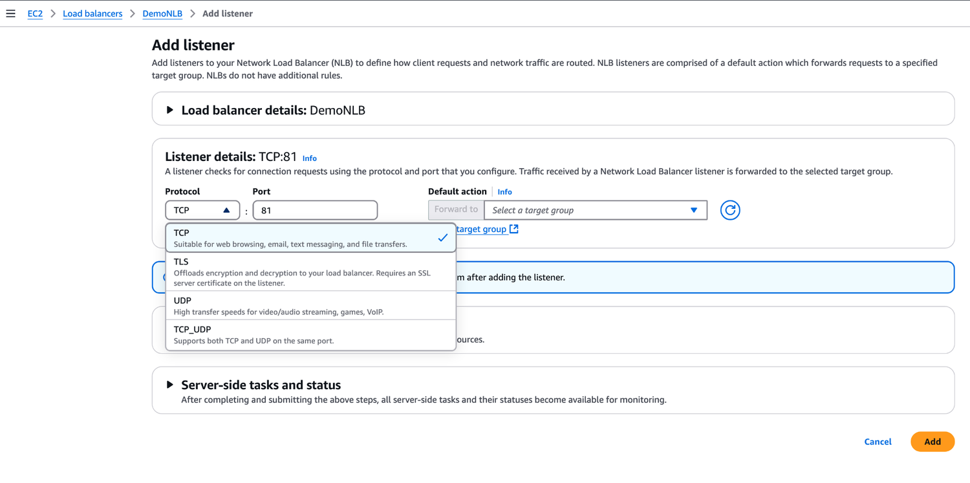
TOPIC 4
Activity: SSL/TLS
AWS Certified SysOps Administrator - Associate (SOA-C02) · TGS-2024051413
© 2026 Tertiary Infotech Academy Pte Ltd
169

Slide 171
TOPIC 4
Connection Draining
• Feature naming
• Connection Draining – for CLB
• Deregistration Delay – for ALB & NLB
• Time to complete “in-flight requests” while the instance is de-registering or unhealthy
• Stops sending new requests to the EC2 instance which is de-registering
• Between 1 to 3600 seconds (default: 300 seconds)
• Can be disabled (set value to 0)
• Set to a low value if your requests are short
• ELB
• waiting for existing
• connections to complete
• new connections
• established to all other instances
• Users
• EC2 Instance
• DRAINING
• EC2 Instance
• EC2 Instance
AWS Certified SysOps Administrator - Associate (SOA-C02) · TGS-2024051413
© 2026 Tertiary Infotech Academy Pte Ltd
170

Slide 172
TOPIC 4
ELB Health Checks
• Target Health Status
• Initial: registering the target
• Healthy
• Unhealthy
• Unused: target is not registered
• Draining: de-registering the target
• unavailable: health checks disabled
• If a group contains only unhealthy targets, ELB routes requests across its unhealthy targets
• Target Group
• Application Load Balancer
• Health Check
• Setting
• Value
• Description
• HealthCheckProtocol
• HTTP
• Protocol used to perform health checks
• HealthCheckPort
• 80
• Port used to perform health checks
• HealthCheckPath
• /
• Destination for health checks on targets
• HealthCheckTimeoutSeconds 5
• Consider the health check failed if no response after 5 seconds
• HealthCheckIntervalSeconds 30
• Send health check every 30 seconds
• HealthyThresholdCount
• 3
• Consider the target healthy after 3 successful health checks
• UnhealthyThresholdCount
• 5
• Consider the target unhealthy after 5 failed health checks
AWS Certified SysOps Administrator - Associate (SOA-C02) · TGS-2024051413
© 2026 Tertiary Infotech Academy Pte Ltd
171

Slide 173
TOPIC 4
Load Balancer Error codes
• Successful request : Code 200.
• Unsuccessful at client side : 4XX code.
• Error 400 : Bad Request
• Error 401 : Unauthorized
• Error 403 : Forbidden
• Error 460 : Client closed connection.
• Error 463 : X-Forwarded For header with >30 IP (Similar to malformed request).
• Unsuccessful at server side : 5xx code.
• An error 500 / Internal server error would mean some error on the ELB itself.
• Error 502 : Bad Gateway
• An error 503/ Service Unavailable
• Error 504 / Gateway timeout : probably an issue within the server.
• Error 561 : Unauthorized
AWS Certified SysOps Administrator - Associate (SOA-C02) · TGS-2024051413
© 2026 Tertiary Infotech Academy Pte Ltd
172

Slide 174
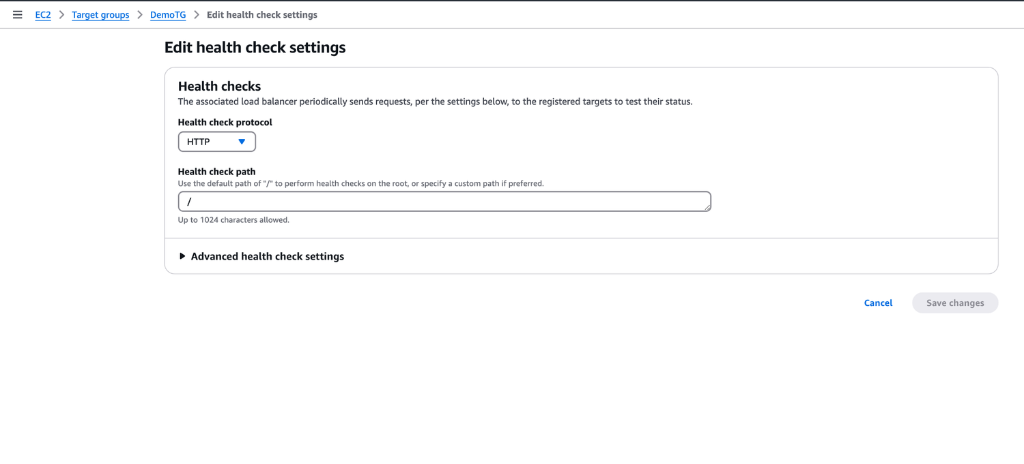
TOPIC 4
Activity: Health Check
AWS Certified SysOps Administrator - Associate (SOA-C02) · TGS-2024051413
© 2026 Tertiary Infotech Academy Pte Ltd
173

Slide 175
TOPIC 4
Load Balancers Monitoring
• All Load Balancer metrics are directly pushed to CloudWatch metrics
• BackendConnectionErrors
• HealthyHostCount / UnHealthyHostCount
• HTTPCode_Backend_2XX: Successful request.
• HTTPCode_Backend_3XX, redirected request
• HTTPCode_ELB_4XX: Client error codes
• HTTPCode_ELB_5XX:
• Server error codes generated by the load balancer.
• Latency
• RequestCount
• ReuqestCountPerTarget:
• SurgeQueueLength: the total
• number of requests (HTTP listener) or connections (TCP
• listener) that are pending routing to a healthy instance.
• Help to scale out ASG. Max value is 1024
• SpilloverCount: The total number of requests that were
• rejected because the surge queue is full.
• Target Group 2
• Application Load Balancer
• Target Group 1
• Health Checks
• HealthyHostCount: 4
• UnHealthyHostCount: 2
AWS Certified SysOps Administrator - Associate (SOA-C02) · TGS-2024051413
© 2026 Tertiary Infotech Academy Pte Ltd
174

Slide 176
TOPIC 4
Load Balancer troubleshooting using metrics
• HTTP 400: BAD_REQUEST=> The client sent a malformed request that does not meet HTTP specifications.
• HTTP 503: Service Unavailable => Ensure that you have healthy instances in
• every Availability Zone that your load balancer is configured to respond in. Look for HealthyHostCount in CloudWatch
• HTTP 504: Gateway Timeout => Check if keep-alive settings on your EC2
• instances are enabled and make sure that the keep-alive timeout is greater than the idle timeout settings of load balancer.
• Set alarms & look at the documentation for troubleshooting: https://docs.aws.amazon.com/elasticloadbalancing/latest/classic/ts-elb-error- message.html
AWS Certified SysOps Administrator - Associate (SOA-C02) · TGS-2024051413
© 2026 Tertiary Infotech Academy Pte Ltd
175

Slide 177
TOPIC 4
Load Balancers Access Logs
• Access logs from Load Balancers can be stored in S3 and contain:
• Time
• Client IP address
• Latencies
• Request paths
• Server response
• Trace Id
• Only pay for the S3 storage
• Helpful for compliance reason
• Helpful for keeping access data even after ELB or EC2 instances are terminated
• Access Logs are already encrypted
AWS Certified SysOps Administrator - Associate (SOA-C02) · TGS-2024051413
© 2026 Tertiary Infotech Academy Pte Ltd
176

Slide 178
TOPIC 4
Application Load Balancer Request Tracing
• Request tracing – Each HTTP request has an added custom header
• ‘X-Amzn-Trace-Id’
• Example:
• X-Amzn-Trace-Id: Root=1-67891233-abcdef012345678912345678
• This is useful in logs / distributed tracing platform to track a single request
• Application Load Balancer is not (yet) integrated with X-Ray
AWS Certified SysOps Administrator - Associate (SOA-C02) · TGS-2024051413
© 2026 Tertiary Infotech Academy Pte Ltd
177

Slide 179
TOPIC 4
Target Groups Settings
• Deregistration_delay.timeout_seconds time the load balancer waits before deregistering a target
• slow_start.duration_seconds: (see next slide)
• load_balancing.algorithm.type: ow the load balancer selects targets when routing requests (Round Robin, Least Outstanding Requests)
• Stickiness.enabled
• Stickiness.type: application-based or duration-based cookie
• Stickiness.app_cookie.cookie_name: name of the application cookie
• Stickiness.app_cookie.duration_seconds: application-based cookie expiration period
• Stickiness.lb_cookie.duration_seconds: duration-based cookie expiration period
AWS Certified SysOps Administrator - Associate (SOA-C02) · TGS-2024051413
© 2026 Tertiary Infotech Academy Pte Ltd
178

Slide 180
TOPIC 4
Slow Start Mode
• By default, a target receives its full share of requests once it’s registered with the target group
• slow start mode gives healthy targets time to warm-up before the load balancer sends them a full share of requests
• The load balancer linearly increases the number of requests that it sends to the target
• A target exits Slow Start Mode when:
• The duration period elapses
• The target becomes unhealthy
• To disable, set slow start duration value to 0
• Client
• ALB
• Slow Start duration
• without Slow Start mode
• with Slow Start mode
• EC2 Instance EC2 Instance
• Target Group
AWS Certified SysOps Administrator - Associate (SOA-C02) · TGS-2024051413
© 2026 Tertiary Infotech Academy Pte Ltd
179

Slide 181
TOPIC 4
Request Routing Algorithms - Least Outstanding Requests
• The next instance to receive the request is the instance that has the lowest number of pending/unfinished requests
• Works with Application Load Balancer and Classic Load Balancer (HTTP/HTTPS)
• EC2 Instance
• EC2 Instance
• EC2 Instance
• Registered Instances
• ALB
• CLB
• (HTTP/HTTPS Listener)
AWS Certified SysOps Administrator - Associate (SOA-C02) · TGS-2024051413
© 2026 Tertiary Infotech Academy Pte Ltd
180

Slide 182
TOPIC 4
Request Routing Algorithms - Round Robin
• Equally choose the targets from the target group
• Works with Application Load Balancer and Classic Load Balancer (TCP)
• ALB
• --- OR ---
• CLB (TCP Listener)
• EC2 Instance
• EC2 Instance
• EC2 Instance
• Target Group (ALB) / Registered Instances (CLB)
AWS Certified SysOps Administrator - Associate (SOA-C02) · TGS-2024051413
© 2026 Tertiary Infotech Academy Pte Ltd
181

Slide 183
TOPIC 4
Request Routing Algorithms - Flow Hash
• Selects a target based on the protocol, source/destination IP address, source/destination port, and TCP sequence number
• Each TCP/UDP connection is routed to a single target for the life of the connection
• Works with Network Load Balancer
• Network Load Balancer
• Flow Hash Algorithm
• Protocol
• Source & destination IP Source & destination Port TCP sequence no.
• Hash 8743b…
• EC2 Instance
• EC2 Instance
• EC2 Instance
• Target Group
AWS Certified SysOps Administrator - Associate (SOA-C02) · TGS-2024051413
© 2026 Tertiary Infotech Academy Pte Ltd
182

Slide 184
TOPIC 4
ALB - Listener Rules
• Processed in order (with Default Rule)
• Supported Actions (forward, redirect, fixed-response)
• Rule Conditions:
• host-header
• http-request-method
• path-pattern
• source-ip
• http-header
• query-string
• Rule #1
• Application Load Balancer
• Target
• Rule #2
• Rule (Default)
• Listener
• …
• …
• Target Group 2
• Target
• …
• Target Group 3
• Target
• …
• Target Group 1
AWS Certified SysOps Administrator - Associate (SOA-C02) · TGS-2024051413
© 2026 Tertiary Infotech Academy Pte Ltd
183

Slide 185
TOPIC 4
Target Group Weighting
• Specify weight for each Target Group on a single Rule
• Example: multiple versions of your app, blue/green deployment
• Allows you to control the distribution of the traffic to your applications
• Target Group 1 (Blue)
• Target Group 2 (Green)
• Application Load Balancer
• Target Group
• Weight
• Target Group 1
• 8
• Target Group 2
• 2
• Users
• 20%
• 80%
AWS Certified SysOps Administrator - Associate (SOA-C02) · TGS-2024051413
© 2026 Tertiary Infotech Academy Pte Ltd
184

Slide 186
TOPIC 4
What’s an Auto Scaling Group?
• In real-life, the load on your websites and application can change
• In the cloud, you can create and get rid of servers very quickly
• The goal of an Auto Scaling Group (ASG) is to:
• Scale out (add EC2 instances) to match an increased load
• Scale in (remove EC2 instances) to match a decreased load
• Ensure we have a minimum and a maximum number of EC2 instances running
• Automatically register new instances to a load balancer
• Re-create an EC2 instance in case a previous one is terminated (ex: if unhealthy)
• ASG are free (you only pay for the underlying EC2 instances)
AWS Certified SysOps Administrator - Associate (SOA-C02) · TGS-2024051413
© 2026 Tertiary Infotech Academy Pte Ltd
185

Slide 187
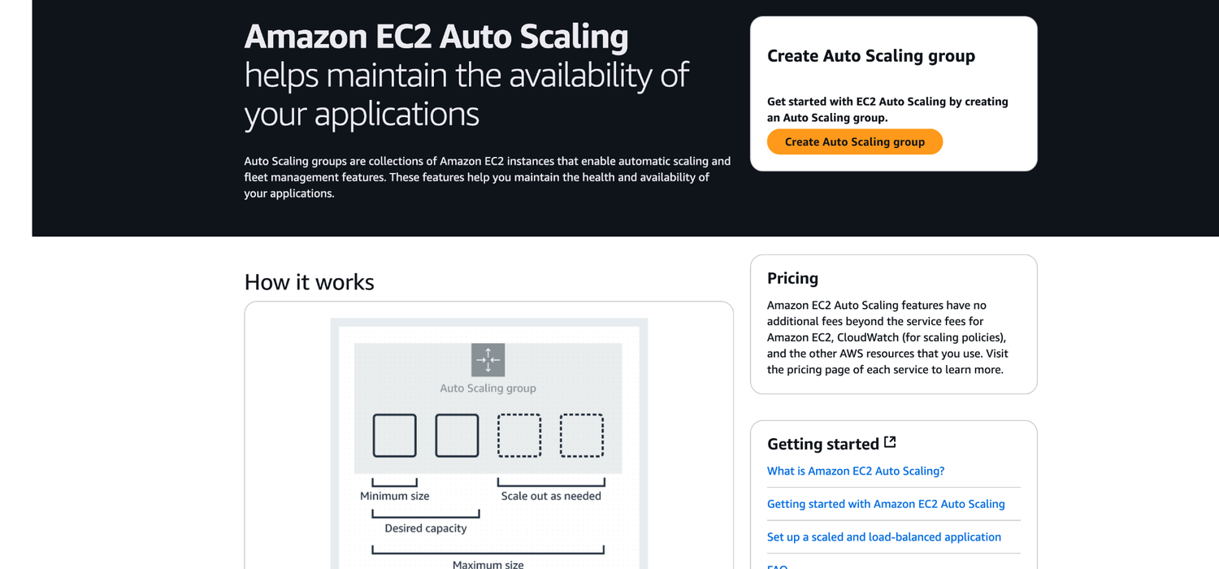
TOPIC 4
What’s an Auto Scaling Group?
AWS Certified SysOps Administrator - Associate (SOA-C02) · TGS-2024051413
© 2026 Tertiary Infotech Academy Pte Ltd
186

Slide 188
TOPIC 4
Auto Scaling Group in AWS
Auto Scaling Group
Minimum Capacity
Desired Capacity
1
2
3
Maximum Capacity
Scale Out as Needed
4
5
AWS Certified SysOps Administrator - Associate (SOA-C02) · TGS-2024051413
© 2026 Tertiary Infotech Academy Pte Ltd
187

Slide 189
TOPIC 4
Auto Scaling Group in AWS With Load Balancer
Users
Elastic Load Balancer
1
2
ELB can check the health of your EC2 instances!
Auto Scaling Group
3
4
AWS Certified SysOps Administrator - Associate (SOA-C02) · TGS-2024051413
© 2026 Tertiary Infotech Academy Pte Ltd
188

Slide 190
TOPIC 4
Auto Scaling Group Attributes
• A Launch Template (older “Launch Configurations” are deprecated)
• AMI + Instance Type
• EC2 User Data
• EBS Volumes
• Security Groups
• SSH Key Pair
• IAM Roles for your EC2 Instances
• Network + Subnets Information
• Load Balancer Information
• Min Size / Max Size / Initial Capacity
• Scaling Policies
• ASG Launch Template
• AMI
• Instance Type
• EBS Volumes
• Security Groups
• SSH Key Pair
• IAM Role
• …
• VPC + Subnets Load Balancer
AWS Certified SysOps Administrator - Associate (SOA-C02) · TGS-2024051413
© 2026 Tertiary Infotech Academy Pte Ltd
189

Slide 191
TOPIC 4
Auto Scaling - CloudWatch Alarms & Scaling
• It is possible to scale an ASG based on CloudWatch alarms
• An alarm monitors a metric (such as Average CPU or a custom metric)
• Metrics such as Average CPU are computed for the overall ASG instances
• Based on the alarm:
• We can create scale-out policies (increase the number of instances)
• We can create scale-in policies (decrease the number of instances)
• EC2
• Instance
• EC2
• Instance
• EC2
• Instance
• EC2
• Instance
• EC2
• Instance
• Auto Scaling Group
• CloudWatch Alarm
• trigger Scaling
AWS Certified SysOps Administrator - Associate (SOA-C02) · TGS-2024051413
© 2026 Tertiary Infotech Academy Pte Ltd
190

Slide 192
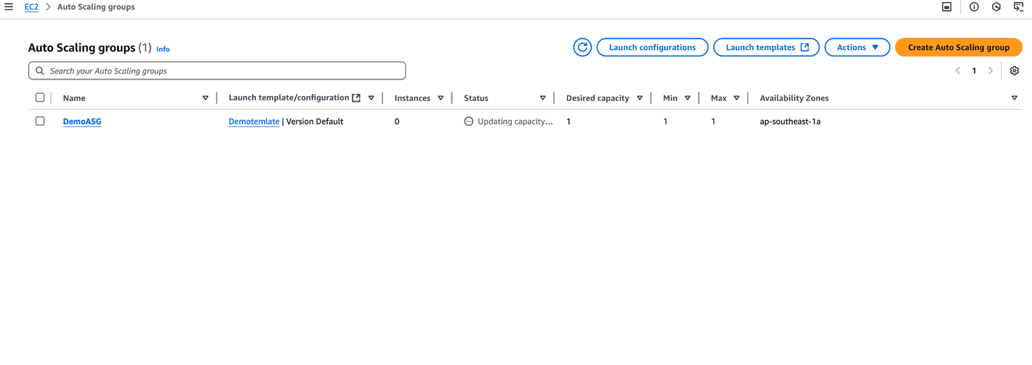
TOPIC 4
Activity: Auto Scaling Group
AWS Certified SysOps Administrator - Associate (SOA-C02) · TGS-2024051413
© 2026 Tertiary Infotech Academy Pte Ltd
191

Slide 193
TOPIC 4
Auto Scaling Groups - Scaling Policies
• Dynamic Scaling
• Target Tracking Scaling
• Simple to set-up
• Example: I want the average ASG CPU to stay at around 40%
• Simple / Step Scaling
• When a CloudWatch alarm is triggered (example CPU > 70%), then add 2 units
• When a CloudWatch alarm is triggered (example CPU < 30%), then remove 1
• Scheduled Scaling
• Anticipate a scaling based on known usage patterns
• Example: increase the min capacity to 10 at 5 pm on Fridays
AWS Certified SysOps Administrator - Associate (SOA-C02) · TGS-2024051413
© 2026 Tertiary Infotech Academy Pte Ltd
192

Slide 194
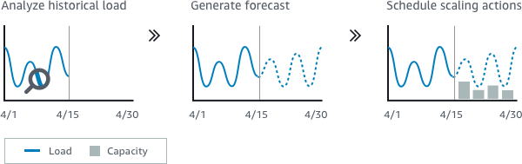
TOPIC 4
Auto Scaling Groups - Scaling Policies
Predictive scaling: continuously forecast load and schedule scaling ahead
AWS Certified SysOps Administrator - Associate (SOA-C02) · TGS-2024051413
© 2026 Tertiary Infotech Academy Pte Ltd
193

Slide 195
TOPIC 4
Good metrics to scale on
• CPUUtilization: Average CPU utilization across your instances
• RequestCountPerTarget: to make sure the number of requests per EC2 instances is stable
• Average Network In / Out: if you’re application is network bound)
• Any custom metric (that you push using CloudWatch)
• Auto Scaling group
• Users
• Application Load Balancer
• RequestCountPerTarget
• Target Value: 3
AWS Certified SysOps Administrator - Associate (SOA-C02) · TGS-2024051413
© 2026 Tertiary Infotech Academy Pte Ltd
194

Slide 196
TOPIC 4
Auto Scaling Groups - Scaling Cooldowns
• After a scaling activity happens, you are in the cooldown period (default 300 seconds)
• During the cooldown period, the ASG will not launch or terminate additional instances (to allow for metrics to stabilize)
• Advice: Use a ready-to-use AMI to reduce configuration time in order to be serving request fasters and reduce the cooldown period
• Scaling Action Occurs
• Default Cooldown in effect?
• Ignore Action
• Launch or Teminate Instance
• No
• Yes
AWS Certified SysOps Administrator - Associate (SOA-C02) · TGS-2024051413
© 2026 Tertiary Infotech Academy Pte Ltd
195

Slide 197
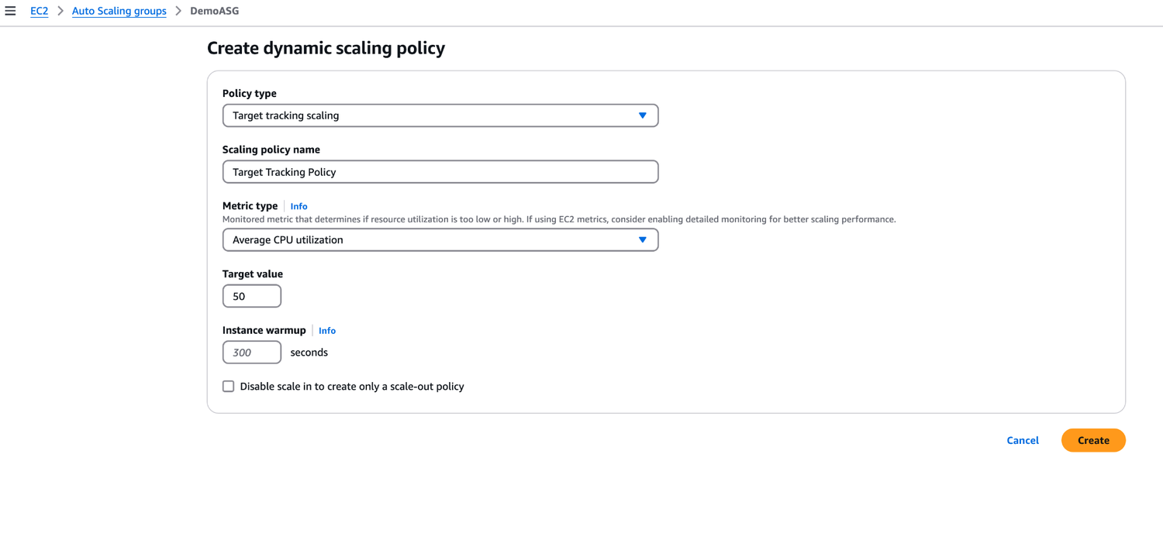
TOPIC 4
Activity: Scaling Policy
AWS Certified SysOps Administrator - Associate (SOA-C02) · TGS-2024051413
© 2026 Tertiary Infotech Academy Pte Ltd
196

Slide 198
TOPIC 4
ASG - Lifecycle Hooks
• By default, as soon as an instance is launched in an ASG it’s in service
• You can perform extra steps before
• the instance goes in service (Pending state)
• Define a script to run on the instances as they start
• You can perform some actions before
• the instance is terminated (Terminating state)
• Pause the instances before they’re terminated for troubleshooting
• Use cases: cleanup, log extraction, special health checks
• Integration with EventBridge, SNS, and SQS
• Pending
• Lifecycle Hook
• (EC2_Instance_Launching)
• Pending:Wait
• Pending:Proceed
• InService
• Terminating
• Terminated
• Lifecycle Hook
• (EC2_Instance_Terminating)
• Terminating:Wait
• Terminating:Proceed
• ASG
• scale out
• 1
• 2
• 3
• 4
• 5
• 6
• ASG
• lifecycle event trigger
• EventBridge
• SNS
• SQS
• Lambda
• invoke
AWS Certified SysOps Administrator - Associate (SOA-C02) · TGS-2024051413
© 2026 Tertiary Infotech Academy Pte Ltd
197

Slide 199
TOPIC 4
Launch Configuration vs. Launch Template
• Both:
• ID of the Amazon Machine Image (AMI), the instance type, a key pair, security groups, and the other parameters that you use to launch EC2 instances (tags, EC2 user-data...)
• You can’t edit both Launch Configurations and Launch Templates
• Launch configuration (legacy):
• must be re-created everytime
• Launch Template (newer):
• Can have multiple versions
• Create parameters subsets (partial configuration for re-use and inheritance)
• Provision using both On-Demand and Spot instances (or a mix)
• Supports Placement Groups, Capacity Reservations, Dedicated hosts, multiple instance types
• Can use T2 unlimited burst feature
• Recommended by AWS going forward
AWS Certified SysOps Administrator - Associate (SOA-C02) · TGS-2024051413
© 2026 Tertiary Infotech Academy Pte Ltd
198

Slide 200
TOPIC 4
SQS with Auto Scaling Group (ASG)
• SQS Queue
• CloudWatch Metric - Queue Length
• ApproximateNumberOfMessages
• EC2 Instances
• Poll for messages
• Auto Scaling Group
• scale
• CloudWatch Alarm
• Alarm for breach
AWS Certified SysOps Administrator - Associate (SOA-C02) · TGS-2024051413
© 2026 Tertiary Infotech Academy Pte Ltd
199

Slide 201
TOPIC 4
ASG Health Checks
• To make sure you have high availability, means you have least 2 instances running across 2 AZ in your ASG (must configure multi-AZ ASG)
• Health checks available:
• EC2 Status Checks
• ELB Health Checks
• Custom Health Checks: send instance’s health to ASG using AWS CLI or AWS SDK
• ASG will launch a new instance after terminating an unhealthy one
• ASG will not reboot unhealthy hosts for you
• Good to know CLI:
• set-instance-health (use with Custom Health Checks)
• terminate-instance-in-auto-scaling-group
AWS Certified SysOps Administrator - Associate (SOA-C02) · TGS-2024051413
© 2026 Tertiary Infotech Academy Pte Ltd
200

Slide 202
TOPIC 4
Troubleshooting ASG issues
• <number of instances> instance(s) are already running. Launching EC2 instance failed.
• The Auto Scaling group has reached the limit set by the MaximumCapacity parameter. Update your Auto Scaling group by providing a new value for the maximum capacity.
• Launching EC2 instances is failing:
• The security group does not exist. SG might have been deleted
• The key pair does not exist. The key pair might have been deleted
• If the ASG fails to launch an instance for over 24 hours, it will automatically suspend the processes (administration suspension)
AWS Certified SysOps Administrator - Associate (SOA-C02) · TGS-2024051413
© 2026 Tertiary Infotech Academy Pte Ltd
201

Slide 203
TOPIC 4
CloudWatch Metrics for ASG
• Metrics are collected every 1 minute
• ASG-level metrics: (opt-in)
• GroupMinSize, GroupMaxSize, GroupDesiredCapacity
• GroupInServiceInstances, GroupPendingInstances, GroupStandbyInstances
• GroupTerminatingInstances, GroupTotalInstances
• You should enable metric collection to see these metrics
• EC2-level metrics (enabled): CPU Utilization, etc…
• Basic monitoring: 5 minutes granularity
• Detailed monitoring: 1 minute granularity
AWS Certified SysOps Administrator - Associate (SOA-C02) · TGS-2024051413
© 2026 Tertiary Infotech Academy Pte Ltd
202

Slide 204
TOPIC 4
AWS Auto Scaling
• Backbone service of auto scaling for scalable resources in AWS:
• Amazon EC2 Auto Scaling groups: Launch or terminate EC2 instances
• Amazon EC2 Spot Fleet requests: Launch or terminate instances from a Spot Fleet request, or automatically replace instances that get interrupted for price or capacity reasons.
• Amazon ECS: Adjust the ECS service desired count up or down
• Amazon DynamoDB (table or global secondary index): WCU & RCU
• Amazon Aurora: Dynamic Read Replicas Auto Scaling
AWS Certified SysOps Administrator - Associate (SOA-C02) · TGS-2024051413
© 2026 Tertiary Infotech Academy Pte Ltd
203

Slide 205
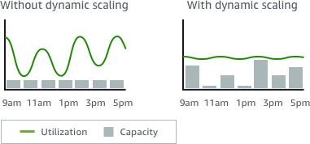
TOPIC 4
AWS Auto Scaling - Scaling Plans
Dynamic scaling: creates a target tracking scaling policy
AWS Certified SysOps Administrator - Associate (SOA-C02) · TGS-2024051413
© 2026 Tertiary Infotech Academy Pte Ltd
204

Slide 206
TOPIC 5
AWS Elastic Beanstalk
AWS Certified SysOps Administrator - Associate (SOA-C02) · TGS-2024051413
© 2026 Tertiary Infotech Academy Pte Ltd
205

Slide 207

TOPIC 5
Elastic Beanstalk - Overview
AWS Certified SysOps Administrator - Associate (SOA-C02) · TGS-2024051413
© 2026 Tertiary Infotech Academy Pte Ltd
206

Slide 208

TOPIC 5
Reference
AWS Certified SysOps Administrator - Associate (SOA-C02) · TGS-2024051413
© 2026 Tertiary Infotech Academy Pte Ltd
207

Slide 209

TOPIC 5
Reference
AWS Certified SysOps Administrator - Associate (SOA-C02) · TGS-2024051413
© 2026 Tertiary Infotech Academy Pte Ltd
208

Slide 210
TOPIC 5
Elastic Beanstalk - Overview
• Elastic Beanstalk is a developer centric view of deploying an application on AWS
• It uses all the component’s we’ve seen before: EC2, ASG, ELB, RDS, …
• Managed service
• Automatically handles capacity provisioning, load balancing, scaling, application health monitoring, instance configuration, …
• Just the application code is the responsibility of the developer
• We still have full control over the configuration
• Beanstalk is free but you pay for the underlying instances
AWS Certified SysOps Administrator - Associate (SOA-C02) · TGS-2024051413
© 2026 Tertiary Infotech Academy Pte Ltd
209

Slide 211
TOPIC 5
Multi AZ
• Availability zone 1
• Auto Scaling group
• Availability zone 2
• Availability zone 3
• ElastiCache
• Store / retrieve
• session data
• + Cached data
• PUBLIC SUBNET
• PRIVATE SUBNET
• Amazon RDS Read / write data
• DATA SUBNET
• ELB
• Typical architecture: Web App 3-tier
• Route 53
AWS Certified SysOps Administrator - Associate (SOA-C02) · TGS-2024051413
© 2026 Tertiary Infotech Academy Pte Ltd
210

Slide 212
TOPIC 5
Developer problems on AWS
• Managing infrastructure
• Deploying Code
• Configuring all the databases, load balancers, etc
• Scaling concerns
• Most web apps have the same architecture (ALB + ASG)
• All the developers want is for their code to run!
• Possibly, consistently across different applications and environments
AWS Certified SysOps Administrator - Associate (SOA-C02) · TGS-2024051413
© 2026 Tertiary Infotech Academy Pte Ltd
211

Slide 213
TOPIC 5
Elastic Beanstalk - Components
• Application: collection of Elastic Beanstalk components (environments, versions, configurations, …)
• Application Version: an iteration of your application code
• Environment
• Collection of AWS resources running an application version (only one application version at a time)
• Tiers: Web Server Environment Tier & Worker Environment Tier
• You can create multiple environments (dev, test, prod, …)
• update version
• Create Application
• Upload Version
• Launch Environment
• Manage Environment
• deploy new version
AWS Certified SysOps Administrator - Associate (SOA-C02) · TGS-2024051413
© 2026 Tertiary Infotech Academy Pte Ltd
212

Slide 214
TOPIC 5
Elastic Beanstalk - Supported Platforms
• Go
• Java SE
• Java with Tomcat
• .NET Core on Linux
• .NET on Windows Server
• Node.js
• PHP
• Python
• Ruby
• Packer Builder
• Single Container Docker
• Multi-container Docker
• Preconfigured Docker
AWS Certified SysOps Administrator - Associate (SOA-C02) · TGS-2024051413
© 2026 Tertiary Infotech Academy Pte Ltd
213

Slide 215
TOPIC 5
Web Server Tier vs Worker Tier
• Web Environment
• (myapp.us-east-1.elasticbeanstalk.com)
• Auto Scaling group
• Worker Environment
• Availability Zone 1
• Availability Zone 2
• SQS Queue
• SQS message
• pull SQS message
• messages
• EC2 Instance (Worker)
• EC2 Instance (Worker)
• Scale based on the number of SQS messages
• Can push messages to SQS queue from another Web Server Tier
AWS Certified SysOps Administrator - Associate (SOA-C02) · TGS-2024051413
© 2026 Tertiary Infotech Academy Pte Ltd
214

Slide 216
TOPIC 5
Elastic Beanstalk Deployment Modes
• Single Instance Great for dev
• High Availability with Load Balancer Great for prod
• Availability Zone 1
• Auto Scaling Group
• Availability Zone 2
• RDS Master
• RDS Standby
• EC2 Instance
• EC2 Instance
• ALB
• Availability Zone 1
• Elastic IP
• EC2 Instance
• RDS Master
AWS Certified SysOps Administrator - Associate (SOA-C02) · TGS-2024051413
© 2026 Tertiary Infotech Academy Pte Ltd
215

Slide 217

TOPIC 5
Activity: Elastic Beamstalk
AWS Certified SysOps Administrator - Associate (SOA-C02) · TGS-2024051413
© 2026 Tertiary Infotech Academy Pte Ltd
216

Slide 218
TOPIC 6
AWS CloudFormation for SysOps
AWS Certified SysOps Administrator - Associate (SOA-C02) · TGS-2024051413
© 2026 Tertiary Infotech Academy Pte Ltd
217

Slide 219
TOPIC 6
AWS CloudFormation
• CloudFormation is a declarative way of outlining your AWS Infrastructure, for any resources (most of them are supported)
• For example, within a CloudFormation template, you say:
• I want a security group
• I want two EC2 instances using this security group
• I want two Elastic IPs for these EC2 instances
• I want an S3 bucket
• I want a load balancer (ELB) in front of these EC2 instances
• Then CloudFormation creates those for you, in the right order, with the exact configuration that you specify
AWS Certified SysOps Administrator - Associate (SOA-C02) · TGS-2024051413
© 2026 Tertiary Infotech Academy Pte Ltd
218

Slide 220

TOPIC 6
Reference
AWS Certified SysOps Administrator - Associate (SOA-C02) · TGS-2024051413
© 2026 Tertiary Infotech Academy Pte Ltd
219

Slide 221

TOPIC 6
CloudFormation - Template Example
Application Composer
AWS Certified SysOps Administrator - Associate (SOA-C02) · TGS-2024051413
© 2026 Tertiary Infotech Academy Pte Ltd
220

Slide 222
TOPIC 6
Benefits of AWS CloudFormation (1/2)
• Infrastructure as code
• No resources are manually created, which is excellent for control
• The code can be version controlled for example using Git
• Changes to the infrastructure are reviewed through code
• Cost
• Each resources within the stack is tagged with an identifier so you can easily see how much a stack costs you
• You can estimate the costs of your resources using the CloudFormation template
• Savings strategy: In Dev, you could automation deletion of templates at 5 PM and recreated at 8 AM, safely
AWS Certified SysOps Administrator - Associate (SOA-C02) · TGS-2024051413
© 2026 Tertiary Infotech Academy Pte Ltd
221

Slide 223
TOPIC 6
Benefits of AWS CloudFormation (2/2)
• Productivity
• Ability to destroy and re-create an infrastructure on the cloud on the fly
• Automated generation of Diagram for your templates!
• Declarative programming (no need to figure out ordering and orchestration)
• Separation of concern: create many stacks for many apps and many layers. Eg.
• VPC stacks
• Network stacks
• App stacks
• Don't re-invent the wheel
• Leverage existing templates on the web!
• Leverage the documentation
AWS Certified SysOps Administrator - Associate (SOA-C02) · TGS-2024051413
© 2026 Tertiary Infotech Academy Pte Ltd
222

Slide 224
TOPIC 6
How CloudFormation Works
• Templates must be uploaded in S3 and then referenced in CloudFormation
• To update a template, we can’t edit previous ones. We have to re- upload a new version of the template to AWS
• Stacks are identified by a name
• Deleting a stack deletes every single artifact that was created by CloudFormation.
• Template
• S3 bucket
• AWS CloudFormation
• Stack
• upload
• reference
• create
• Create
• AWS Resources
AWS Certified SysOps Administrator - Associate (SOA-C02) · TGS-2024051413
© 2026 Tertiary Infotech Academy Pte Ltd
223

Slide 225
TOPIC 6
Deploying CloudFormation Templates
• Manual way
• Editing templates in Application Composer or code editor
• Using the console to input parameters, etc…
• We’ll mostly do this way in the course for learning purposes
• Automated way
• Editing templates in a YAML file
• Using the AWS CLI (Command Line Interface) to deploy the templates, or using a Continuous Delivery (CD) tool
• Recommended way when you fully want to automate your flow
• CloudFormation Console
• Template
• Application Composer / Code Editor
• Stack
• create
• Template
• AWS CLI
• create-stack
• CloudFormation
AWS Certified SysOps Administrator - Associate (SOA-C02) · TGS-2024051413
© 2026 Tertiary Infotech Academy Pte Ltd
224

Slide 226
TOPIC 6
CloudFormation - Building Blocks
• Template's Components
• AWSTemplateFormatVersion - identifies the capabilities of the template “2010-09-09”
• Description - comments about the template
• Resources (MANDATORY) - your AWS resources declared in the template
• Parameters - the dynamic inputs for your template
• Mappings - the static variables for your template
• Outputs - references to what has been created
• Conditionals - list of conditions to perform resource creation
• Template's Helpers
• Reference
• Functions
AWS Certified SysOps Administrator - Associate (SOA-C02) · TGS-2024051413
© 2026 Tertiary Infotech Academy Pte Ltd
225

Slide 227
TOPIC 6
Introductory Example
• We’re going to create a simple EC2 instance
• And we’re going to add security group to it
• For now, forget about the code syntax
• We’ll look at the structure of the files later
• We’ll see how in no-time, we are able to get started with CloudFormation!
• Web Server
• WebServerSecurityGroup
• Port: 22
• Port: 80
AWS Certified SysOps Administrator - Associate (SOA-C02) · TGS-2024051413
© 2026 Tertiary Infotech Academy Pte Ltd
226

Slide 228

TOPIC 6
Activity: CloudFormation
AWS Certified SysOps Administrator - Associate (SOA-C02) · TGS-2024051413
© 2026 Tertiary Infotech Academy Pte Ltd
227

Slide 229

TOPIC 6
YAML Crash Course
YAML and JSON are the languages you can use for CloudFormation
AWS Certified SysOps Administrator - Associate (SOA-C02) · TGS-2024051413
© 2026 Tertiary Infotech Academy Pte Ltd
228

Slide 230
TOPIC 6
CloudFormation - Resources
• Resources are the core of your CloudFormation template (MANDATORY)
• They represent the different AWS Components that will be created and configured
• Resources are declared and can reference each other
• AWS figures out creation, updates and deletes of resources for us
• There are over 700 types of resources (!)
• Resource types identifiers are of the form:
• service-provider::service-name::data-type-name
AWS Certified SysOps Administrator - Associate (SOA-C02) · TGS-2024051413
© 2026 Tertiary Infotech Academy Pte Ltd
229

Slide 231
TOPIC 6
How do I find Resources documentation?
• I can’t teach you all the 700+ resources, but I can teach you how to learn how to use them
• All the resources can be found here: https://docs.aws.amazon.com/AWSCloudFormation/latest/UserGuide/aws-template-resource-type-ref.html
• Then, we just read the docs ©
• Example here (for an EC2 instance): https://docs.aws.amazon.com/AWSCloudFormation/latest/UserGuide/aws-resource-ec2-instance.html
AWS Certified SysOps Administrator - Associate (SOA-C02) · TGS-2024051413
© 2026 Tertiary Infotech Academy Pte Ltd
230

Slide 232
TOPIC 6
Analysis of CloudFormation Template
• Going back to the example of the introductory lecture, let’s learn why it was written this way.
• Relevant documentation can be found here:
• https://docs.aws.amazon.com/AWSCloudFormation/latest/UserGuide/aws-resource-ec2-instance.html
• https://docs.aws.amazon.com/AWSCloudFormation/latest/UserGuide/aws-resource-ec2-securitygroup.html
• http://docs.aws.amazon.com/AWSCloudFormation/latest/UserGuide/aws-resource-ec2-eip.html
AWS Certified SysOps Administrator - Associate (SOA-C02) · TGS-2024051413
© 2026 Tertiary Infotech Academy Pte Ltd
231

Slide 233
TOPIC 6
CloudFormation - Resources FAQ
Can I create a dynamic number of resources?
Yes, you can by using CloudFormation Macros and Transform
It is not in the scope of this course
1
2
3
Is every AWS Service supported?
Almost. Only a select few niches are not there yet
You can work around that using CloudFormation Custom Resources
4
5
6
AWS Certified SysOps Administrator - Associate (SOA-C02) · TGS-2024051413
© 2026 Tertiary Infotech Academy Pte Ltd
232

Slide 234

TOPIC 6
Activity: Cloud Formation
AWS Certified SysOps Administrator - Associate (SOA-C02) · TGS-2024051413
© 2026 Tertiary Infotech Academy Pte Ltd
233

Slide 235
TOPIC 6
CloudFormation - Parameters
• Parameters are a way to provide inputs to your AWS CloudFormation template
• They’re important to know about if:
• You want to reuse your templates across the company
• Some inputs can not be determined ahead of time
• Parameters are extremely powerful, controlled, and can prevent errors from happening in your templates, thanks to types
• AWS CloudFormation
• User
• upload template
• +
• provide parameter values
• Parameter1: value1
• + Parameter2: valu
• CF template Parameters
• create stack
AWS Certified SysOps Administrator - Associate (SOA-C02) · TGS-2024051413
© 2026 Tertiary Infotech Academy Pte Ltd
234

Slide 236

TOPIC 6
When should you use a Parameter?
Ask yourself this:
AWS Certified SysOps Administrator - Associate (SOA-C02) · TGS-2024051413
© 2026 Tertiary Infotech Academy Pte Ltd
235

Slide 237
TOPIC 6
CloudFormation - Parameters Settings
• Type:
• String
• Number
• CommaDelimitedList
• List<Number>
• AWS-Specific Parameter
• (to help catch invalid values - match against existing values in the AWS account)
• List<AWS-Specific Parameter>
• SSM Parameter (get parameter value from SSM Parameter store)
• Description
• Constraint Description (String)
• Min/MaxLength
• Min/MaxValue
• Default
• Allowed Values (array)
• AllowedPattern (regex)
• NoEcho (Boolean)
• Parameters can be controlled by all these settings:
AWS Certified SysOps Administrator - Associate (SOA-C02) · TGS-2024051413
© 2026 Tertiary Infotech Academy Pte Ltd
236

Slide 238
TOPIC 6
CloudFormation - Parameters Example
• AllowedValues NoEcho
AWS Certified SysOps Administrator - Associate (SOA-C02) · TGS-2024051413
© 2026 Tertiary Infotech Academy Pte Ltd
237

Slide 239
TOPIC 6
How to Reference a Parameter?
The Fn::Ref function can be leveraged to reference parameters
Parameters can be used anywhere in a template
1
2
The shorthand for this in YAML is !Ref
The function can also reference other elements within the template
3
4
AWS Certified SysOps Administrator - Associate (SOA-C02) · TGS-2024051413
© 2026 Tertiary Infotech Academy Pte Ltd
238

Slide 240
TOPIC 6
CloudFormation - Pseudo Parameters
AWS offers us Pseudo Parameters in any CloudFormation template
These can be used at any time and are enabled by default
1
2
Important pseudo parameters:
3
AWS Certified SysOps Administrator - Associate (SOA-C02) · TGS-2024051413
© 2026 Tertiary Infotech Academy Pte Ltd
239

Slide 241
TOPIC 6
CloudFormation - Mappings
• Mappings are fixed variables within your CloudFormation template
• They’re very handy to differentiate between different environments (dev vs prod), regions (AWS regions), AMI types…
• All the values are hardcoded within the template
AWS Certified SysOps Administrator - Associate (SOA-C02) · TGS-2024051413
© 2026 Tertiary Infotech Academy Pte Ltd
240

Slide 242
TOPIC 6
Accessing Mapping Values (Fn::FindInMap)
We use Fn::FindInMap to return a named value from a specific key
!FindInMap [ MapName, TopLevelKey, SecondLevelKey ]
1
2
Mappings work great for AMIs Because AMIs are region-specific!
3
AWS Certified SysOps Administrator - Associate (SOA-C02) · TGS-2024051413
© 2026 Tertiary Infotech Academy Pte Ltd
241

Slide 243
TOPIC 6
When would you use Mappings vs Parameters?
• Mappings are great when you know in advance all the values that can be taken and that they can be deduced from variables such as
• Region
• Availability Zone
• AWS Account
• Environment (dev vs prod)
• etc…
• They allow safer control over the template
• Use parameters when the values are really user specific
AWS Certified SysOps Administrator - Associate (SOA-C02) · TGS-2024051413
© 2026 Tertiary Infotech Academy Pte Ltd
242

Slide 244
TOPIC 6
CloudFormation - Outputs
• The Outputs section declares optional outputs values that we can import into other stacks (if you export them first)!
• You can also view the outputs in the AWS Console or in using the AWS CLI
• They’re very useful for example if you define a network CloudFormation, and output the variables such as VPC ID and your Subnet IDs
• It’s the best way to perform some collaboration cross stack, as you let expert handle their own part of the stack
• Application Stack
• Network Stack
• VPC ID: vpc-2f09a348
• Exported Output
• reference
AWS Certified SysOps Administrator - Associate (SOA-C02) · TGS-2024051413
© 2026 Tertiary Infotech Academy Pte Ltd
243

Slide 245
TOPIC 6
CloudFormation - Outputs
Creating a SSH Security Group as part of one template
We create an output that references that security group
1
2
AWS Certified SysOps Administrator - Associate (SOA-C02) · TGS-2024051413
© 2026 Tertiary Infotech Academy Pte Ltd
244

Slide 246
TOPIC 6
CloudFormation - Outputs Cross-Stack Reference
• We then create a second template that leverages that security group
• For this, we use the Fn::ImportValue function
• You can’t delete the underlying stack until all the references are deleted
AWS Certified SysOps Administrator - Associate (SOA-C02) · TGS-2024051413
© 2026 Tertiary Infotech Academy Pte Ltd
245

Slide 247
TOPIC 6
CloudFormation - Conditions
• Conditions are used to control the creation of resources or outputs based on a condition
• Conditions can be whatever you want them to be, but common ones are:
• Environment (dev / test / prod)
• AWS Region
• Any parameter value
• Each condition can reference another condition, parameter value or mapping
• User
• EC2 Instance
• Dev Stack
• EC2 Instance
• EBS Volume
• Prod Stack
• Parameters
• Parameters
AWS Certified SysOps Administrator - Associate (SOA-C02) · TGS-2024051413
© 2026 Tertiary Infotech Academy Pte Ltd
246

Slide 248

TOPIC 6
How to define a Condition
The logical ID is for you to choose. It’s how you name condition
AWS Certified SysOps Administrator - Associate (SOA-C02) · TGS-2024051413
© 2026 Tertiary Infotech Academy Pte Ltd
247

Slide 249
TOPIC 6
How to use a Condition
• Conditions can be applied to resources / outputs / etc…
AWS Certified SysOps Administrator - Associate (SOA-C02) · TGS-2024051413
© 2026 Tertiary Infotech Academy Pte Ltd
248

Slide 250
TOPIC 6
CloudFormation - Intrinsic Functions
• Ref
• Fn::GetAtt
• Fn::FindInMap
• Fn::ImportValue
• Fn::Join
• Fn::Sub
• Fn::ForEach
• Fn::ToJsonString
• Condition Functions (Fn::If, Fn::Not, Fn::Equals, etc…)
• Fn::Base64
• Fn::Cidr
• Fn::GetAZs
• Fn::Select
• Fn::Split
• Fn::Transform
• Fn::Length
• Blue = must know
AWS Certified SysOps Administrator - Associate (SOA-C02) · TGS-2024051413
© 2026 Tertiary Infotech Academy Pte Ltd
249

Slide 251
TOPIC 6
Intrinsic Functions - Fn::Ref
• The Fn::Ref function can be leveraged to reference
• Parameters - returns the value of the parameter
• Resources - returns the physical ID of the underlying resource (e.g., EC2 ID)
• The shorthand for this in YAML is !Ref
AWS Certified SysOps Administrator - Associate (SOA-C02) · TGS-2024051413
© 2026 Tertiary Infotech Academy Pte Ltd
250

Slide 252
TOPIC 6
Intrinsic Functions - Fn::GetAtt
• Attributes are attached to any resources you create
• To know the attributes of your resources, the best place to look at is the documentation
• Example: the AZ of an EC2 instance!
AWS Certified SysOps Administrator - Associate (SOA-C02) · TGS-2024051413
© 2026 Tertiary Infotech Academy Pte Ltd
251

Slide 253
TOPIC 6
Intrinsic Functions - Fn::FindInMap
We use Fn::FindInMap to return a named value from a specific key
!FindInMap [ MapName, TopLevelKey, SecondLevelKey ]
1
2
AWS Certified SysOps Administrator - Associate (SOA-C02) · TGS-2024051413
© 2026 Tertiary Infotech Academy Pte Ltd
252

Slide 254
TOPIC 6
Intrinsic Functions - Fn::ImportValue
Import values that are exported in other stacks
For this, we use the Fn::ImportValue function
1
2
AWS Certified SysOps Administrator - Associate (SOA-C02) · TGS-2024051413
© 2026 Tertiary Infotech Academy Pte Ltd
253

Slide 255
TOPIC 6
Intrinsic Functions - Fn::Base64
Convert String to it’s Base64 representation
Example: pass encoded data to EC2 Instance’s UserData property
1
2
AWS Certified SysOps Administrator - Associate (SOA-C02) · TGS-2024051413
© 2026 Tertiary Infotech Academy Pte Ltd
254

Slide 256
TOPIC 6
Intrinsic Functions -Condition Functions
The logical ID is for you to choose. It’s how you name condition
AWS Certified SysOps Administrator - Associate (SOA-C02) · TGS-2024051413
© 2026 Tertiary Infotech Academy Pte Ltd
255

Slide 257
TOPIC 6
CloudFormation - Rollbacks
• Stack Creation Fails:
• Default: everything rolls back (gets deleted). We can look at the log
• Option to disable rollback and troubleshoot what happened
• Stack Update Fails:
• The stack automatically rolls back to the previous known working state
• Ability to see in the log what happened and error messages
• Rollback Failure? Fix resources manually then issue
• ContinueUpdateRollback API from Console
• Or from the CLI using continue-update-rollback API call20
AWS Certified SysOps Administrator - Associate (SOA-C02) · TGS-2024051413
© 2026 Tertiary Infotech Academy Pte Ltd
256

Slide 258
TOPIC 6
CloudFormation - Service Role
• IAM role that allows CloudFormation to create/update/delete stack resources on your behalf
• Give ability to users to create/update/delete the
• stack resources even if they don’t have permissions to work with the resources in the stack
• Use cases:
• You want to achieve the least privilege principle
• But you don’t want to give the user all the required permissions to create the stack resources
• User must have iam:PassRole permissions
• cloudformation:*
• iam:PassRole
• Permissions
• s3:*Bucket
• Service Role
• User
• Template
• CloudFormation
• S3 bucket Stack
AWS Certified SysOps Administrator - Associate (SOA-C02) · TGS-2024051413
© 2026 Tertiary Infotech Academy Pte Ltd
257

Slide 259
TOPIC 6
CloudFormation Capabilities
• CAPABILITY_NAMED_IAM and CAPABILITY_IAM Necessary to enable when you CloudFormation template is creating or updating IAM resources (IAM User, Role, Group, Policy, Access Keys, Instance Profile…)
• Specify CAPABILITY_NAMED_IAM if the resources are named
• CAPABILITY_AUTO_EXPAND
• Necessary when your CloudFormation template includes Macros or Nested Stacks (stacks within stacks) to perform dynamic transformations
• You’re acknowledging that your template may change before deploying
• InsufficientCapabilitiesException
• Exception that will be thrown by CloudFormation if the capabilities haven’t been acknowledged when deploying a template (security measure)
AWS Certified SysOps Administrator - Associate (SOA-C02) · TGS-2024051413
© 2026 Tertiary Infotech Academy Pte Ltd
258

Slide 260
TOPIC 6
CloudFormation - DeletionPolicy Delete
• DeletionPolicy:
• Control what happens when the CloudFormation template is deleted or when a resource is removed from a CloudFormation template
• Extra safety measure to preserve and backup resources
• Default DeletionPolicy=Delete
• Delete won’t work on an S3 bucket if the bucket is not empty
AWS Certified SysOps Administrator - Associate (SOA-C02) · TGS-2024051413
© 2026 Tertiary Infotech Academy Pte Ltd
259

Slide 261
TOPIC 6
CloudFormation - DeletionPolicy Retain
DeletionPolicy=Retain:
Specify on resources to preserve in case of CloudFormation deletes
1
2
Works with any resources
3
AWS Certified SysOps Administrator - Associate (SOA-C02) · TGS-2024051413
© 2026 Tertiary Infotech Academy Pte Ltd
260

Slide 262
TOPIC 6
CloudFormation - DeletionPolicy Snapshot
• DeletionPolicy=Snapshot
• Create one final snapshot before deleting the resource
• Examples of supported resources:
• EBS Volume, ElastiCache Cluster, ElastiCache ReplicationGroup
• RDS DBInstance, RDS DBCluster, Redshift Cluster, Neptune DBCluster, DocumentDB DBCluster0
AWS Certified SysOps Administrator - Associate (SOA-C02) · TGS-2024051413
© 2026 Tertiary Infotech Academy Pte Ltd
261

Slide 263

TOPIC 6
CloudFormation - Stack Policies
During a CloudFormation Stack update, all
AWS Certified SysOps Administrator - Associate (SOA-C02) · TGS-2024051413
© 2026 Tertiary Infotech Academy Pte Ltd
262

Slide 264
TOPIC 6
CloudFormation - Termination Protection
• To prevent accidental deletes of CloudFormation Stacks, use TerminationProtection
AWS Certified SysOps Administrator - Associate (SOA-C02) · TGS-2024051413
© 2026 Tertiary Infotech Academy Pte Ltd
263

Slide 265
TOPIC 6
CloudFormation – Custom Resources
• Used to
• define resources not yet supported by CloudFormation
• define custom provisioning logic for resources can that be outside of CloudFormation (on-premises resources, 3rd party resources…)
• have custom scripts run during create / update / delete through Lambda functions (running a Lambda function to empty an S3 bucket before being deleted)
• Defined in the template using
• AWS::CloudFormation::CustomResource or Custom::MyCustomResourceTypeName (recommended)
• Backed by a Lambda function (most common) or an SNS topic
AWS Certified SysOps Administrator - Associate (SOA-C02) · TGS-2024051413
© 2026 Tertiary Infotech Academy Pte Ltd
264

Slide 266
TOPIC 6
How to define a Custom Resource?
• Service token specifies where CloudFormation sends requests to, such as Lambda ARN or SNS ARN (required & must be in the same region)
• Input data parameters (optional)
AWS Certified SysOps Administrator - Associate (SOA-C02) · TGS-2024051413
© 2026 Tertiary Infotech Academy Pte Ltd
265

Slide 267
TOPIC 6
Use Case - Delete content from an S3 bucket
• You can't delete a non-empty S3 bucket
• To delete a non-empty S3 bucket, you must first delete all the objects inside it
• We can use a custom resource to empty an S3 bucket before it gets deleted by CloudFormation
• Custom resource Lambda function
• delete stack
• Stack
• empty bucket
• S3 bucket
• CloudFormation
• User
AWS Certified SysOps Administrator - Associate (SOA-C02) · TGS-2024051413
© 2026 Tertiary Infotech Academy Pte Ltd
266

Slide 268
TOPIC 6
CloudFormation - Dynamic References
• Reference external values stored in Systems Manager Parameter Store and Secrets Manager within CloudFormation templates
• CloudFormation retrieves the value of the specified reference during create/update/delete operations
• For example: retrieve RDS DB Instance master password from Secrets Manager
• Supports
• ssm - for plaintext values stored in SSM Parameter Store
• ssm-secure - for secure strings stored in SSM Parameter Store
• secretsmanager - for secret values stored in Secrets Manager
• ‘{{resolve:service-name:reference-key}}’
• CloudFormation
• create/update
• Template
• SSM Parameter Store
• Secrets Manager
• get value
• (reference-key)
• result
AWS Certified SysOps Administrator - Associate (SOA-C02) · TGS-2024051413
© 2026 Tertiary Infotech Academy Pte Ltd
267

Slide 269

TOPIC 6
CloudFormation - Dynamic References
SSM
AWS Certified SysOps Administrator - Associate (SOA-C02) · TGS-2024051413
© 2026 Tertiary Infotech Academy Pte Ltd
268

Slide 270
TOPIC 6
CloudFormation, Secrets Manager & RDS Option 1 - ManageMasterUserPassword
• ManageMasterUserPassword - creates admin secret implicitly
• RDS, Aurora will manage the secret in Secrets Manager and its rotation
• User
• create Stack
• CloudFormation
• Secrets Manager
• create Secret
• RDS
• create DB and
• configure Username/Password
AWS Certified SysOps Administrator - Associate (SOA-C02) · TGS-2024051413
© 2026 Tertiary Infotech Academy Pte Ltd
269

Slide 271
TOPIC 6
2. Reference secret in RDS DB instance
3. link the secret to RDS DB instance (for rotation)
1. secret is generated
1
2
CloudFormation, Secrets Manager & RDS Option 2 - Dynamic Reference
3
AWS Certified SysOps Administrator - Associate (SOA-C02) · TGS-2024051413
© 2026 Tertiary Infotech Academy Pte Ltd
270

Slide 272
TOPIC 6
User Data in EC2 for CloudFormation
• We can have user data at EC2 instance launch through the console
• Let’s learn how to write the same EC2 user-data script in our CloudFormation template
• The important thing to pass is the entire script through the function Fn::Base64
• Good to know, user data script log is in /var/log/cloud-init-output.log
• Let’s see how to do this in CloudFormation!
AWS Certified SysOps Administrator - Associate (SOA-C02) · TGS-2024051413
© 2026 Tertiary Infotech Academy Pte Ltd
271

Slide 273
TOPIC 6
The Problems with EC2 User Data
• What if we want to have a very large instance configuration?
• What if we want to evolve the state of the EC2 instance without terminating it and creating a new one?
• How do we make EC2 user-data more readable?
• How do we know or signal that our EC2 user-data script completed successfully?
• Enter CloudFormation Helper Scripts!
• Python scripts, that come directly on Amazon Linux AMIs, or can be installed using yum
• or dnf on non-Amazon Linux AMIs
• cfn-init, cfn-signal, cfn-get-metadata, cfn-hup
AWS Certified SysOps Administrator - Associate (SOA-C02) · TGS-2024051413
© 2026 Tertiary Infotech Academy Pte Ltd
272

Slide 274

TOPIC 6
AWS::CloudFormation::Init
A config contains the following and is executed in that order
AWS Certified SysOps Administrator - Associate (SOA-C02) · TGS-2024051413
© 2026 Tertiary Infotech Academy Pte Ltd
273

Slide 275
TOPIC 6
CloudFormation - cfn-init
• Used to retrieve and interpret the resource metadata, installing packages, creating files and starting services
• With the cfn-init script, it helps make complex EC2 configurations readable
• The EC2 instance will query the CloudFormation service to get init data
• AWS::CloudFormation::Init must be in the Metadata of a resource
• Logs go to /var/log/cfn-init.log
• launch
• retrieve init data
• run cfn-init
• CloudFormation
• EC2 Instance
AWS Certified SysOps Administrator - Associate (SOA-C02) · TGS-2024051413
© 2026 Tertiary Infotech Academy Pte Ltd
274

Slide 276
TOPIC 6
CloudFormation - cfn-signal & Wait Conditions
• We still don’t know how to tell CloudFormation that the EC2 instance got properly configured after a cfn-init
• For this, we can use the cfn-signal script!
• We run cfn-signal right after cfn-init
• Tell CloudFormation service that the resource creation success/fail to keep on going or fail
• We need to define WaitCondition:
• Block the template until it receives a signal from cfn-signal
• We attach a CreationPolicy (also works on EC2, ASG)
• We can define a Count > 1 (in case you need more than 1 signal)
• launch
• run cfn-init
• CloudFormation
• EC2 Instance
• retrieve init data
• signal from
• cfn-signal
• Wait Condition
AWS Certified SysOps Administrator - Associate (SOA-C02) · TGS-2024051413
© 2026 Tertiary Infotech Academy Pte Ltd
275

Slide 277
TOPIC 6
Wait Condition Didn't Receive the Required
• Number of Signals from an Amazon EC2 Instance
• Ensure that the AMI you're using has the AWS CloudFormation helper scripts
• installed. If the AMI doesn't include the helper scripts, you can also download them to your instance
• Verify that the cfn-init & cfn-signal command was successfully run on the instance.
• You can view logs, such as /var/log/cloud-init.log or /var/log/cfn-init.log, to help you debug the instance launch
• You can retrieve the logs by logging in to your instance, but you must disable
• rollback on failure or else AWS CloudFormation deletes the instance after your stack fails to create
• Verify that the instance has a connection to the Internet. If the instance is in a VPC,
• the instance should be able to connect to the Internet through a NAT device if it's is in a private subnet or through an Internet gateway if it's in a public subnet
• For example, run: curl -I https://aws.amazon.com
AWS Certified SysOps Administrator - Associate (SOA-C02) · TGS-2024051413
© 2026 Tertiary Infotech Academy Pte Ltd
276

Slide 278
TOPIC 6
CloudFormation - Nested Stacks
• Nested stacks are stacks as part of other stacks
• They allow you to isolate repeated patterns / common components in separate stacks and call them from other stacks
• Example:
• Load Balancer configuration that is re-used
• Security Group that is re-used
• Nested stacks are considered best practice
• To update a nested stack, always update the parent (root stack)
• Nested stacks can have nested stacks themselves!
• Stack B
• Stack A (root)
• Stack C
• Stack D
• Stack E
• Stack F
AWS Certified SysOps Administrator - Associate (SOA-C02) · TGS-2024051413
© 2026 Tertiary Infotech Academy Pte Ltd
277

Slide 279
TOPIC 6
Cross Stacks vs Nested Stacks
• Cross Stacks
• Helpful when stacks have different lifecycles
• Use Outputs Export and Fn::ImportValue
• When you need to pass export values to many stacks (VPC Id…)
• Nested Snacks
• Helpful when components must be re-used
• Example: re-use how to properly configure an Application Load Balancer
• The nested stack only is important to the higher-level stack (it’s not shared)
• VPC Stack
• App 1 Stack
• App 2 Stack
• App 3 Stack
• RDS Stack
• ASG Stack
• ELB Stack
• App 2 Stack
• RDS Stack
• ASG Stack
• ELB Stack
• App 1 Stack
AWS Certified SysOps Administrator - Associate (SOA-C02) · TGS-2024051413
© 2026 Tertiary Infotech Academy Pte Ltd
278

Slide 280
TOPIC 6
CloudFormation - DependsOn
• Specify that the creation of a specific resource follows another
• When added to a resource, that resource is created only after the creation of the resource specified in the DependsOn attribute
• Applied automatically when using !Ref and
• !GetAtt
• Use with any resource
AWS Certified SysOps Administrator - Associate (SOA-C02) · TGS-2024051413
© 2026 Tertiary Infotech Academy Pte Ltd
279

Slide 281
TOPIC 6
CloudFormation - StackSets
• Create, update, or delete stacks across
• multiple accounts and regions with a single operation/template
• Administrator account to create StackSets
• Target accounts to create, update, delete stack instances from StackSets
• When you update a stack
• set, all associated stack instances are updated throughout all accounts and regions
• Can be applied into all accounts of an AWS organizations
• Administrator account
• Template
• Create StackSet
• StackSet
• Region 1
• Target account A
• Target account B
• Stack Instance
• Stack Instance
• Region 2
• Target account A
• Target account C
• Stack Instance
• Stack Instance
AWS Certified SysOps Administrator - Associate (SOA-C02) · TGS-2024051413
© 2026 Tertiary Infotech Academy Pte Ltd
280

Slide 282
TOPIC 6
CloudFormation - StackSets Permission Models
• Self-managed Permissions
• Create the IAM roles (with established trusted relationship) in both administrator and target accounts
• Deploy to any target account in which you have permissions to create IAM role
• Service-managed Permissions
• Deploy to accounts managed by AWS Organizations
• StackSets create the IAM roles on your behalf (Enable trusted access with AWS Organizations)
• Must enable all features in AWS Organizations
• Ability to deploy to accounts added to your organization in the future (Automatic Deployments)
• Administrator account
• Target accounts
• AWSCloudFormagonStackSetAdministrationRole
• AWSCloudFormationStackSetExecutionRole
• Trust relationship
• AWS Organizations
• Management account
• Target accounts
AWS Certified SysOps Administrator - Associate (SOA-C02) · TGS-2024051413
© 2026 Tertiary Infotech Academy Pte Ltd
281

Slide 283
TOPIC 6
StackSets with AWS Organizations
• Ability to automatically deploy Stack instances to new Accounts in an Organization
• Can delegate StackSets administration to member accounts in AWS Organization
• Trusted access with AWS Organizations must be enabled before delegated administrators can deploy to accounts managed by Organizations
AWS Certified SysOps Administrator - Associate (SOA-C02) · TGS-2024051413
© 2026 Tertiary Infotech Academy Pte Ltd
282

Slide 284
TOPIC 6
StackSets with AWS Organizations
• OU (Prod)
• Member Account - A
• Member Account - B
• OU (Dev)
• Member Account - C
• New Account
• AWS Organization
• (Delegated) Administrator Account
• StackSet
• manage
• Stack Instance
• Stack Instance
• Stack Instance
• Stack Instance
AWS Certified SysOps Administrator - Associate (SOA-C02) · TGS-2024051413
© 2026 Tertiary Infotech Academy Pte Ltd
283

Slide 285
TOPIC 6
Hands-On: StackSets
• We’ll use StackSets to enable AWS Config across AWS regions with a single click
• Let’s see how this works!
• Region 1
• Administrator/Target account
• Template
• Create StackSet
• StackSet
• AWS Config
• Region 2
• AWS Config
• Region 3
• AWS Conﬁg
• enable
AWS Certified SysOps Administrator - Associate (SOA-C02) · TGS-2024051413
© 2026 Tertiary Infotech Academy Pte Ltd
284

Slide 286
TOPIC 6
CloudFormation - Troubleshooting
• DELETE_FAILED
• Some resources must be emptied before deleting, such as S3 buckets
• Use Custom Resources with Lambda functions to automate some actions
• Security Groups cannot be deleted until all EC2 instances in the group are gone
• Think about using DeletionPolicy=Retain to skip deletions
• UPDATE_ROLLBACK_FAILED
• Can be caused by resources changed outside of CloudFormation, insufficient permissions, Auto Scaling Group that doesn’t receive enough signals…
• Manually fix the error and then ContinueUpdateRollback
AWS Certified SysOps Administrator - Associate (SOA-C02) · TGS-2024051413
© 2026 Tertiary Infotech Academy Pte Ltd
285

Slide 287
TOPIC 6
CloudFormation - Stack Set Troubleshooting
• A stack operation failed, and the stack instance status is OUTDATED.
• Insufficient permissions in a target account for creating resources that are specified in your template.
• The template could be trying to create global resources that must be unique but aren't, such as S3 buckets
• The administrator account does not have a trust relationship with the target account
• Reached a limit or a quota in the target account (too many resources)
AWS Certified SysOps Administrator - Associate (SOA-C02) · TGS-2024051413
© 2026 Tertiary Infotech Academy Pte Ltd
286

Slide 288
AWS LAMBDA
It’s a Serverless world
AWS Certified SysOps Administrator - Associate (SOA-C02) · TGS-2024051413
© 2026 Tertiary Infotech Academy Pte Ltd
287

Slide 289

AWS Lambda
AWS Certified SysOps Administrator - Associate (SOA-C02) · TGS-2024051413
© 2026 Tertiary Infotech Academy Pte Ltd
288

Slide 290

Reference
AWS Certified SysOps Administrator - Associate (SOA-C02) · TGS-2024051413
© 2026 Tertiary Infotech Academy Pte Ltd
289

Slide 291

Reference
AWS Certified SysOps Administrator - Associate (SOA-C02) · TGS-2024051413
© 2026 Tertiary Infotech Academy Pte Ltd
290

Slide 292
Why AWS Lambda
• Virtual Servers in the Cloud
• Limited by RAM and CPU
• Continuously running
• Scaling means intervention to add / remove servers
• Amazon Lambda
• Amazon EC2
• Virtual functions – no servers to manage!
• Limited by time - short executions
• Run on-demand
• Scaling is automated!
AWS Certified SysOps Administrator - Associate (SOA-C02) · TGS-2024051413
© 2026 Tertiary Infotech Academy Pte Ltd
291

Slide 293
Benefits of AWS Lambda
• Easy Pricing:
• Pay per request and compute time
• Free tier of 1,000,000 AWS Lambda requests and 400,000 GBs of compute time
• Integrated with the whole AWS suite of services
• Integrated with many programming languages
• Easy monitoring through AWS CloudWatch
• Easy to get more resources per functions (up to 10GB of RAM!)
• Increasing RAM will also improve CPU and network!
AWS Certified SysOps Administrator - Associate (SOA-C02) · TGS-2024051413
© 2026 Tertiary Infotech Academy Pte Ltd
292

Slide 294
AWS Lambda language support
• Node.js (JavaScript)
• Python
• Java
• C# (.NET Core) / Powershell
• Ruby
• Custom Runtime API (community supported, example Rust or Golang)
• Lambda Container Image
• The container image must implement the Lambda Runtime API
• ECS / Fargate is preferred for running arbitrary Docker images
AWS Certified SysOps Administrator - Associate (SOA-C02) · TGS-2024051413
© 2026 Tertiary Infotech Academy Pte Ltd
293

Slide 295
AWS Lambda Integrations Main ones
• CloudWatch Logs
• SNS
• Cognito
• SQS
• S3
• Kinesis
• API Gateway
• DynamoDB
• CloudFront
• CloudWatch
• Events
• EventBridge
AWS Certified SysOps Administrator - Associate (SOA-C02) · TGS-2024051413
© 2026 Tertiary Infotech Academy Pte Ltd
294

Slide 296
Example: Serverless Thumbnail creation
• New image in S3
• AWS Lambda
• Function Creates a
• Thumbnail
• trigger
• push
• New thumbnail in S3
• Metadata in DynamoDB
• push
• Image name Image size Creation date etc…
AWS Certified SysOps Administrator - Associate (SOA-C02) · TGS-2024051413
© 2026 Tertiary Infotech Academy Pte Ltd
295

Slide 297
Example: Serverless CRON Job
• CloudWatch
• Events
• EventBridge
• AWS Lambda
• Function Perform
• a task
• Trigger Every 1 hour
AWS Certified SysOps Administrator - Associate (SOA-C02) · TGS-2024051413
© 2026 Tertiary Infotech Academy Pte Ltd
296

Slide 298
AWS Lambda Pricing: example
• You can find overall pricing information here: https://aws.amazon.com/lambda/pricing/
• Pay per calls:
• First 1,000,000 requests are free
• $0.20 per 1 million requests thereafter ($0.0000002 per request)
• Pay per duration: (in increment of 1 ms)
• 400,000 GB-seconds of compute time per month for FREE
• == 400,000 seconds if function is 1GB RAM
• == 3,200,000 seconds if function is 128 MB RAM
• After that $1.00 for 600,000 GB-seconds
• It is usually very cheap to run AWS Lambda so it’s very popular
AWS Certified SysOps Administrator - Associate (SOA-C02) · TGS-2024051413
© 2026 Tertiary Infotech Academy Pte Ltd
297

Slide 299

Activity: Create a Lambda
AWS Certified SysOps Administrator - Associate (SOA-C02) · TGS-2024051413
© 2026 Tertiary Infotech Academy Pte Ltd
298

Slide 300
CloudWatch Events / EventBridge
• CRON or Rate EventBridge Rule
• AWS Lambda
• Function Perform
• a task
• Trigger Every 1 hour
• CodePipeline EventBridge Rule
• AWS Lambda
• Function Perform
• a task
• Trigger on
• State Changes
AWS Certified SysOps Administrator - Associate (SOA-C02) · TGS-2024051413
© 2026 Tertiary Infotech Academy Pte Ltd
299

Slide 301

Activity: Lambda Triggered by Eventbridge
AWS Certified SysOps Administrator - Associate (SOA-C02) · TGS-2024051413
© 2026 Tertiary Infotech Academy Pte Ltd
300

Slide 302
S3 Events Notifications
• S3:ObjectCreated, S3:ObjectRemoved,
• S3:ObjectRestore, S3:Replication…
• Object name filtering possible (*.jpg)
• Use case: generate thumbnails of images uploaded to S3
• S3 event notifications typically deliver events in seconds but can sometimes take a minute or longer
• If two writes are made to a single non- versioned object at the same time, it is possible that only a single event notification will be sent
• If you want to ensure that an event notification is sent for every successful write, you can enable versioning on your bucket.
• Amazon S3
• events
• Lambda Function
• SQS
• Lambda Function
• SNS
• SQS
• SQS
• DLQ
• async
AWS Certified SysOps Administrator - Associate (SOA-C02) · TGS-2024051413
© 2026 Tertiary Infotech Academy Pte Ltd
301

Slide 303

Activity: S3 Event Notification
AWS Certified SysOps Administrator - Associate (SOA-C02) · TGS-2024051413
© 2026 Tertiary Infotech Academy Pte Ltd
302

Slide 304
.com
Simple S3 Event Pattern - Metadata Sync
S3 bucket
Table in RDS
1
2
3
New file event
Update metadata table
DynamoDB Table
4
5
6
AWS Certified SysOps Administrator - Associate (SOA-C02) · TGS-2024051413
© 2026 Tertiary Infotech Academy Pte Ltd
303

Slide 305

Activity: Lambda Triggered by S3
Upload coffee.jpg to S3
AWS Certified SysOps Administrator - Associate (SOA-C02) · TGS-2024051413
© 2026 Tertiary Infotech Academy Pte Ltd
304

Slide 306
Lambda Execution Role (IAM Role)
• Grants the Lambda function permissions to AWS services / resources
• Sample managed policies for Lambda:
• AWSLambdaBasicExecutionRole - Upload logs to CloudWatch.
• AWSLambdaKinesisExecutionRole - Read from Kinesis
• AWSLambdaDynamoDBExecutionRole - Read from DynamoDB Streams
• AWSLambdaSQSQueueExecutionRole - Read from SQS
• AWSLambdaVPCAccessExecutionRole - Deploy Lambda function in VPC
• AWSXRayDaemonWriteAccess - Upload trace data to X-Ray.
• When you use an event source mapping to invoke your function, Lambda uses the execution role to read event data.
• Best practice: create one Lambda Execution Role per function
AWS Certified SysOps Administrator - Associate (SOA-C02) · TGS-2024051413
© 2026 Tertiary Infotech Academy Pte Ltd
305

Slide 307
Lambda Resource Based Policies
• Use resource-based policies to give other accounts and AWS services permission to use your Lambda resources
• Similar to S3 bucket policies for S3 bucket
• An IAM principal can access Lambda:
• if the IAM policy attached to the principal authorizes it (e.g. user access)
• OR if the resource-based policy authorizes (e.g. service access)
• When an AWS service like Amazon S3 calls your Lambda function, the resource-based policy gives it access.
AWS Certified SysOps Administrator - Associate (SOA-C02) · TGS-2024051413
© 2026 Tertiary Infotech Academy Pte Ltd
306

Slide 308
Lambda Logging & Monitoring
• CloudWatch Logs:
• AWS Lambda execution logs are stored in AWS CloudWatch Logs
• Make sure your AWS Lambda function has an execution role with an IAM policy that authorizes writes to CloudWatch Logs
• CloudWatch Metrics:
• AWS Lambda metrics are displayed in AWS CloudWatch Metrics
• Invocations, Durations, Concurrent Executions
• Error count, Success Rates,Throttles
• Async Delivery Failures
• Iterator Age (Kinesis & DynamoDB Streams)
AWS Certified SysOps Administrator - Associate (SOA-C02) · TGS-2024051413
© 2026 Tertiary Infotech Academy Pte Ltd
307

Slide 309
Lambda Tracing with X-Ray
• Enable in Lambda configuration (Active Tracing)
• Runs the X-Ray daemon for you
• Use AWS X-Ray SDK in Code
• Ensure Lambda Function has a correct IAM Execution Role
• The managed policy is called AWSXRayDaemonWriteAccess
• Environment variables to communicate with X-Ray
• _X_AMZN_TRACE_ID: contains the tracing header
• AWS_XRAY_CONTEXT_MISSING: by default, LOG_ERROR
• AWS_XRAY_DAEMON_ADDRESS: the X-Ray Daemon IP_ADDRESS:PORT
AWS Certified SysOps Administrator - Associate (SOA-C02) · TGS-2024051413
© 2026 Tertiary Infotech Academy Pte Ltd
308

Slide 310
Lambda Function Configuration
• RAM:
• From 128MB to 10GB in 1MB increments
• The more RAM you add, the more vCPU credits you get
• At 1,792 MB, a function has the equivalent of one full vCPU
• After 1,792 MB, you get more than one CPU, and need to use multi-threading in your code to benefit from it (up to 6 vCPU)
• If your application is CPU-bound (computation heavy), increase RAM
• Timeout: default 3 seconds, maximum is 900 seconds (15 minutes)
AWS Certified SysOps Administrator - Associate (SOA-C02) · TGS-2024051413
© 2026 Tertiary Infotech Academy Pte Ltd
309

Slide 311
Lambda Execution Context
• The execution context is a temporary runtime environment that initializes any external dependencies of your lambda code
• Great for database connections, HTTP clients, SDK clients
• The execution context is maintained for some time in anticipation of another Lambda function invocation
• The next function invocation can “re-use” the context to execution time and save time in initializing connections objects
• The execution context includes the /tmp directory
AWS Certified SysOps Administrator - Associate (SOA-C02) · TGS-2024051413
© 2026 Tertiary Infotech Academy Pte Ltd
310

Slide 312
Initialize outside the handler
GOOD!
BAD!
1
2
The DB connection is established At every function invocation
The DB connection is established once And re-used across invocations
3
4
AWS Certified SysOps Administrator - Associate (SOA-C02) · TGS-2024051413
© 2026 Tertiary Infotech Academy Pte Ltd
311

Slide 313
Lambda Functions /tmp space
• If your Lambda function needs to download a big file to work…
• If your Lambda function needs disk space to perform operations…
• You can use the /tmp directory
• Max size is 10GB
• The directory content remains when the execution context is frozen, providing transient cache that can be used for multiple invocations (helpful to checkpoint your work)
• For permanent persistence of object (non temporary), use S3
• To encrypt content on /tmp, you must generate KMS Data Keys
AWS Certified SysOps Administrator - Associate (SOA-C02) · TGS-2024051413
© 2026 Tertiary Infotech Academy Pte Ltd
312

Slide 314
Lambda Concurrency and Throttling
• Concurrency limit: up to 1000 concurrent executions
• Can set a "reserved concurrency" at the function level (=limit)
• Each invocation over the concurrency limit will trigger a “Throttle”
• Throttle behavior:
• If synchronous invocation => return ThrottleError - 429
• If asynchronous invocation => retry automatically and then go to DLQ
• If you need a higher limit, open a support ticket
AWS Certified SysOps Administrator - Associate (SOA-C02) · TGS-2024051413
© 2026 Tertiary Infotech Academy Pte Ltd
313

Slide 315
Lambda Concurrency Issue
• If you don’t reserve (=limit) concurrency, the following can happen:
• Application Load Balancer
• SDK / CLI
• 1000 concurrent executions
• THROTTLE!
• API Gateway
• THROTTLE!
• Many users
• Few users
AWS Certified SysOps Administrator - Associate (SOA-C02) · TGS-2024051413
© 2026 Tertiary Infotech Academy Pte Ltd
314

Slide 316
Concurrency and Asynchronous Invocations
• S3 bucket
• New file event
• New file event
• New file event
• If the function doesn't have enough concurrency available to process all events, additional requests are throttled.
• For throttling errors (429) and system errors (500-series), Lambda returns the event to the queue and attempts to run the function again for up to 6 hours.
• The retry interval increases exponentially from 1 second after the first attempt to a maximum of 5 minutes.
AWS Certified SysOps Administrator - Associate (SOA-C02) · TGS-2024051413
© 2026 Tertiary Infotech Academy Pte Ltd
315

Slide 317
Cold Starts & Provisioned Concurrency
• Cold Start:
• New instance => code is loaded and code outside the handler run (init)
• If the init is large (code, dependencies, SDK…) this process can take some time.
• First request served by new instances has higher latency than the rest
• Provisioned Concurrency:
• Concurrency is allocated before the function is invoked (in advance)
• So the cold start never happens and all invocations have low latency
• Application Auto Scaling can manage concurrency (schedule or target utilization)
• Note:
• Note: cold starts in VPC have been dramatically reduced in Oct & Nov 2019
• https://aws.amazon.com/blogs/compute/announcing-improved-vpc-networking-for-aws-lambda-functions/
AWS Certified SysOps Administrator - Associate (SOA-C02) · TGS-2024051413
© 2026 Tertiary Infotech Academy Pte Ltd
316

Slide 318

Reserved and Provisioned Concurrency
https://docs.aws.amazon.com/lambda/latest/dg/configuration-concurrency.html
AWS Certified SysOps Administrator - Associate (SOA-C02) · TGS-2024051413
© 2026 Tertiary Infotech Academy Pte Ltd
317

Slide 319

Activity: Lambda Concurrency
AWS Certified SysOps Administrator - Associate (SOA-C02) · TGS-2024051413
© 2026 Tertiary Infotech Academy Pte Ltd
318

Slide 320
Lambda Monitoring - CloudWatch Metrics
• Invocations - number of times your function is invoked (success/failure)
• Duration - amount of time your function spends processing an event
• Errors - number of invocations that result in a function error
• Throttles - number of invocation requests that are throttled (no concurrency available)
• DeadLetterErrors - number of times Lambda failed to send an event to a DLQ (async invocations)
• LteratorAge - time between when a Stream receives a record and when the Event
• Source Mapping sends the event to the function (for Event Source Mapping that reads from Stream)
• ConcurrentExecutions - number of function instances that are processing events
AWS Certified SysOps Administrator - Associate (SOA-C02) · TGS-2024051413
© 2026 Tertiary Infotech Academy Pte Ltd
319

Slide 321

Example Lambda Metrics Dashboard
AWS Certified SysOps Administrator - Associate (SOA-C02) · TGS-2024051413
© 2026 Tertiary Infotech Academy Pte Ltd
320

Slide 322
Lambda Monitoring - CloudWatch Alarms
• Example 1 - No Lambda Invocations in the last hour using Invocations CloudWatch Metric
• Example 2 - When error > 0 using Errors CloudWatch Metric
• Example 3 - When throttles > 0 using Throttles CloudWatch Metric
AWS Certified SysOps Administrator - Associate (SOA-C02) · TGS-2024051413
© 2026 Tertiary Infotech Academy Pte Ltd
321

Slide 323

Lambda Monitoring - CloudWatch Logs
Lambda Function
AWS Certified SysOps Administrator - Associate (SOA-C02) · TGS-2024051413
© 2026 Tertiary Infotech Academy Pte Ltd
322

Slide 324

Lambda Monitoring - CloudWatch Logs Insights
Allows you to search through all your Lambda functions logs
AWS Certified SysOps Administrator - Associate (SOA-C02) · TGS-2024051413
© 2026 Tertiary Infotech Academy Pte Ltd
323

Slide 325
Lambda Monitoring - CloudWatch Logs Insights
• Example CloudWatch Logs Insights Queries
AWS Certified SysOps Administrator - Associate (SOA-C02) · TGS-2024051413
© 2026 Tertiary Infotech Academy Pte Ltd
324

Slide 326
Lambda Monitoring – Lambda Insights
• Collects, aggregates, and summarizes:
• System-level Metrics - CPU time, memory, disk, network
• Diagnostic Information - old starts, Lambda worker shutdowns
• Helps you isolate issues with your Lambda functions and resolve them quickly
• Uses a CloudWatch Lambda Extension (provided as a Lambda layer)
• CloudWatch Logs
• /aws/lambda-insights/..
• Lambda function
AWS Certified SysOps Administrator - Associate (SOA-C02) · TGS-2024051413
© 2026 Tertiary Infotech Academy Pte Ltd
325

Slide 327
TOPIC 7
Amazon EC2 Storage
AWS Certified SysOps Administrator - Associate (SOA-C02) · TGS-2024051413
© 2026 Tertiary Infotech Academy Pte Ltd
326

Slide 328
TOPIC 7
What’s an EBS Volume?
• An EBS (Elastic Block Store) Volume is a network drive you can attach to your instances while they run
• It allows your instances to persist data, even after their termination
• They can only be mounted to one instance at a time (at the CCP level)
• They are bound to a specific availability zone
• Analogy:Think of them as a “network USB stick”
• Free tier: 30 GB of free EBS storage of type General Purpose (SSD) or Magnetic per month
AWS Certified SysOps Administrator - Associate (SOA-C02) · TGS-2024051413
© 2026 Tertiary Infotech Academy Pte Ltd
327

Slide 329

TOPIC 7
Reference
AWS Certified SysOps Administrator - Associate (SOA-C02) · TGS-2024051413
© 2026 Tertiary Infotech Academy Pte Ltd
328

Slide 330
TOPIC 7
EBS Volume
• It’s a network drive (i.e. not a physical drive)
• It uses the network to communicate the instance, which means there might be a bit of latency
• It can be detached from an EC2 instance and attached to another one quickly
• It’s locked to an Availability Zone (AZ)
• An EBS Volume in us-east-1a cannot be attached to us-east-1b
• To move a volume across, you first need to snapshot it
• Have a provisioned capacity (size in GBs, and IOPS)
• You get billed for all the provisioned capacity
• You can increase the capacity of the drive over time
AWS Certified SysOps Administrator - Associate (SOA-C02) · TGS-2024051413
© 2026 Tertiary Infotech Academy Pte Ltd
329

Slide 331
TOPIC 7
US-EAST-1B
• US-EAST-1A
• EBS Volume - Example
• EBS (10 GB)
• EBS (100 GB)
• EBS (50 GB)
• EBS (50 GB)
• EBS (10 GB)
• unattached
AWS Certified SysOps Administrator - Associate (SOA-C02) · TGS-2024051413
© 2026 Tertiary Infotech Academy Pte Ltd
330

Slide 332
TOPIC 7
EC2 Instance Store
• EBS volumes are network drives with good but “limited” performance
• If you need a high-performance hardware disk, use EC2 Instance store
• Better I/O performance
• EC2 Instance Store lose their storage if they’re stopped (ephemeral)
• Good for buffer / cache / scratch data / temporary content
• Risk of data loss if hardware fails
• Backups and Replication are your responsibility
AWS Certified SysOps Administrator - Associate (SOA-C02) · TGS-2024051413
© 2026 Tertiary Infotech Academy Pte Ltd
331

Slide 333
TOPIC 7
.com
Local EC2 Instance Store
Very high IOPS
1
2
AWS Certified SysOps Administrator - Associate (SOA-C02) · TGS-2024051413
© 2026 Tertiary Infotech Academy Pte Ltd
332

Slide 334

TOPIC 7
.com
Activity: EBS
AWS Certified SysOps Administrator - Associate (SOA-C02) · TGS-2024051413
© 2026 Tertiary Infotech Academy Pte Ltd
333

Slide 335
TOPIC 7
EBS Volume Types
• EBS Volumes come in 6 types
• gp2 / gp3 (SSD): General purpose SSD volume that balances price and performance for a wide variety of workloads
• io1 / io2 Block Express (SSD): Highest-performance SSD volume for mission-critical low-latency or high-throughput workloads
• st1 (HDD): Low cost HDD volume designed for frequently accessed, throughput- intensive workloads
• sc1 (HDD): Lowest cost HDD volume designed for less frequently accessed workloads
• EBS Volumes are characterized in Size | Throughput | IOPS (I/O Ops Per Sec)
• When in doubt always consult the AWS documentation – it’s good!
• Only gp2/gp3 and io1/io2 Block Express can be used as boot volumes
AWS Certified SysOps Administrator - Associate (SOA-C02) · TGS-2024051413
© 2026 Tertiary Infotech Academy Pte Ltd
334

Slide 336
TOPIC 7
.com
• EBS Volume Types Use cases General Purpose SSD
• Cost effective storage, low-latency
• System boot volumes,Virtual desktops, Development and test environments
• 1 GiB - 16 TiB
• gp3:
• Baseline of 3,000 IOPS and throughput of 125 MiB/s
• Can increase IOPS up to 16,000 and throughput up to 1000 MiB/s independently
• gp2:
• Small gp2 volumes can burst IOPS to 3,000
• Size of the volume and IOPS are linked, max IOPS is 16,000
• 3 IOPS per GB, means at 5,334 GB we are at the max IOPS
AWS Certified SysOps Administrator - Associate (SOA-C02) · TGS-2024051413
© 2026 Tertiary Infotech Academy Pte Ltd
335

Slide 337
TOPIC 7
EBS Volume Types Use cases Provisioned IOPS (PIOPS) SSD
• Critical business applications with sustained IOPS performance
• Or applications that need more than 16,000 IOPS
• Great for databases workloads (sensitive to storage perf and consistency)
• io1 (4 GiB - 16 TiB):
• Max PIOPS: 64,000 for Nitro EC2 instances & 32,000 for other
• Can increase PIOPS independently from storage size
• io2 Block Express (4 GiB – 64 TiB):
• Sub-millisecond latency
• Max PIOPS: 256,000 with an IOPS:GiB ratio of 1,000:1
• Supports EBS Multi-attach
AWS Certified SysOps Administrator - Associate (SOA-C02) · TGS-2024051413
© 2026 Tertiary Infotech Academy Pte Ltd
336

Slide 338
TOPIC 7
EBS Volume Types Use cases
• Hard Disk Drives (HDD)
• Cannot be a boot volume
• 125 GiB to 16 TiB
• Throughput Optimized HDD (st1)
• Big Data, Data Warehouses, Log Processing
• Max through put500 MiB/s – max IOPS 500
• Cold HDD (sc1):
• For data that is infrequently accessed
• Scenarios where lowest cost is important
• Max throughput 250 MiB/s – max IOPS 250
AWS Certified SysOps Administrator - Associate (SOA-C02) · TGS-2024051413
© 2026 Tertiary Infotech Academy Pte Ltd
337

Slide 339

TOPIC 7
EBS - Volume Types Summary
https://docs.aws.amazon.com/AWSEC2/latest/UserGuide/ebs-volume-types.html#solid-state-drives
AWS Certified SysOps Administrator - Associate (SOA-C02) · TGS-2024051413
© 2026 Tertiary Infotech Academy Pte Ltd
338

Slide 340
TOPIC 7
EBS Multi-Attach - io1/io2 family
• Attach the same EBS volume to multiple EC2 instances in the same AZ
• Each instance has full read & write permissions to the high-performance volume
• Use case:
• Achieve higher application availability in clustered Linux applications (ex:Teradata)
• Applications must manage concurrent write operations
• Up to 16 EC2 Instances at a time
• Must use a file system that’s cluster-aware (not XFS, EXT4, etc…)
• Availability Zone 1
• io2 volume with Multi-Attach
AWS Certified SysOps Administrator - Associate (SOA-C02) · TGS-2024051413
© 2026 Tertiary Infotech Academy Pte Ltd
339

Slide 341
TOPIC 7
EBS Volume Resizing
• You can only increase the EBS volumes:
• Size (any volume type)
• IOPS (only in IO1)
• After resizing an EBS volume, you need to repartition your drive
• After increasing the size, it’s possible for the volume to be in a long time in the “optimisation” phase.The volume is still usable
• You can’t decrease the size of your EBS volume (create another smaller volume then migrate data)
• EBS Volume
• (250 GiB)
• EBS Volume
• (1 TiB)
• Modifying
• Optimizing
• Completed
• 250
• 750GB
• repartition
AWS Certified SysOps Administrator - Associate (SOA-C02) · TGS-2024051413
© 2026 Tertiary Infotech Academy Pte Ltd
340

Slide 342

TOPIC 7
.com
Activity: Modify EBS
AWS Certified SysOps Administrator - Associate (SOA-C02) · TGS-2024051413
© 2026 Tertiary Infotech Academy Pte Ltd
341

Slide 343
TOPIC 7
EBS Snapshots
• Make a backup (snapshot) of your EBS volume at a point in time
• Not necessary to detach volume to do snapshot, but recommended
• Can copy snapshots across AZ or Region
• US-EAST-1A
• EBS (50 GB)
• US-EAST-1B
• EBS (50 GB)
• EBS Snapshot
• snapshot
• restore
AWS Certified SysOps Administrator - Associate (SOA-C02) · TGS-2024051413
© 2026 Tertiary Infotech Academy Pte Ltd
342

Slide 344
TOPIC 7
Amazon Data Lifecycle Manager
• Automate the creation, retention, and deletion of EBS snapshots and EBS-backed AMIs
• Schedule backups, cross-account snapshot copies, delete outdated backups, …
• Uses resource tags to identify the resources (EC2 instances, EBS volumes)
• Can’t be used to manage snapshots/AMIs created outside DLM
• Can’t be used to manage instance-store backed AMIs
• Amazon Data Lifecycle Manager
• EBS Volume
• EBS Volumes
• EC2 Instance
• Tags
• Tags
• Snapshots
• AMI
AWS Certified SysOps Administrator - Associate (SOA-C02) · TGS-2024051413
© 2026 Tertiary Infotech Academy Pte Ltd
343

Slide 345

TOPIC 7
Amazon Data Lifecycle Manager
AWS Certified SysOps Administrator - Associate (SOA-C02) · TGS-2024051413
© 2026 Tertiary Infotech Academy Pte Ltd
344

Slide 346
TOPIC 7
EBS Snapshots - Fast Snapshot Restore (FSR)
• EBS Snapshots stored in S3
• By default, there’s a latency of I/O operations the first time each block is accessed (block must be pulled from S3)
• Solution: force the initialization of the entire
• volume (using the dd or fio command), or you can enable FSR
• FSR helps you to create a volume from a snapshot that is fully initialized at creation (no I/O latency)
• Enabled for a snapshot in a particular AZ (billed per minute – very expensive $$$)
• Can be enabled on snapshots created by Data Lifecycle Manager
• Amazon S3
• EBS Snapshot
• EBS Snapshot
• (FSR enabled)
• EBS Volume
• EBS Volume
• restore
• storage blocks
AWS Certified SysOps Administrator - Associate (SOA-C02) · TGS-2024051413
© 2026 Tertiary Infotech Academy Pte Ltd
345

Slide 347
TOPIC 7
EBS Snapshots Features
• EBS Snapshot Archive
• Move a Snapshot to an ”archive tier” that is 75% cheaper
• Takes within 24 to 72 hours for restoring the archive
• Recycle Bin for EBS Snapshots
• Setup rules to retain deleted snapshots so you can recover them after an accidental deletion
• Specify retention (from 1 day to 1 year)
• EBS Snapshot
• EBS Snapshot
• Archive
• archive
• EBS Snapshot
• Recycle Bin
• delete
AWS Certified SysOps Administrator - Associate (SOA-C02) · TGS-2024051413
© 2026 Tertiary Infotech Academy Pte Ltd
346

Slide 348

TOPIC 7
.com
Activity: EBS Snapshot
AWS Certified SysOps Administrator - Associate (SOA-C02) · TGS-2024051413
© 2026 Tertiary Infotech Academy Pte Ltd
347

Slide 349
TOPIC 7
EBS Migration
EBS Volumes are only locked to a specific AZ
To migrate it to a different AZ (or region):
Snapshot the volume
1
2
3
(optional) Copy the volume to a different region
Create a volume from the snapshot in the AZ of your choice
Let’s practice!
4
5
6
AWS Certified SysOps Administrator - Associate (SOA-C02) · TGS-2024051413
© 2026 Tertiary Infotech Academy Pte Ltd
348

Slide 350
TOPIC 7
EBS Encryption
• When you create an encrypted EBS volume, you get the following:
• Data at rest is encrypted inside the volume
• All the data in flight moving between the instance and the volume is encrypted
• All snapshots are encrypted
• All volumes created from the snapshot
• Encryption and decryption are handled transparently (you have nothing to do)
• Encryption has a minimal impact on latency
• EBS Encryption leverages keys from KMS (AES-256)
• Copying an unencrypted snapshot allows encryption
• Snapshots of encrypted volumes are encrypted
AWS Certified SysOps Administrator - Associate (SOA-C02) · TGS-2024051413
© 2026 Tertiary Infotech Academy Pte Ltd
349

Slide 351
TOPIC 7
Encryption: encrypt an unencrypted EBS volume
• Create an EBS snapshot of the volume
• Encrypt the EBS snapshot (using copy)
• Create new ebs volume from the snapshot (the volume will also be encrypted)
• Now you can attach the encrypted volume to the original instance
AWS Certified SysOps Administrator - Associate (SOA-C02) · TGS-2024051413
© 2026 Tertiary Infotech Academy Pte Ltd
350

Slide 352

TOPIC 7
.com
Activity: Encrypt EBS
AWS Certified SysOps Administrator - Associate (SOA-C02) · TGS-2024051413
© 2026 Tertiary Infotech Academy Pte Ltd
351

Slide 353
TOPIC 7
Amazon EFS - Elastic File System
• Managed NFS (network file system) that can be mounted on many EC2
• EFS works with EC2 instances in multi-AZ
• Highly available, scalable, expensive (3x gp2), pay per use
• us-east-1a
• EC2 Instances
• us-east-1b
• EC2 Instances
• us-east-1c
• EC2 Instances
• Security Group
• EFS FileSystem
AWS Certified SysOps Administrator - Associate (SOA-C02) · TGS-2024051413
© 2026 Tertiary Infotech Academy Pte Ltd
352

Slide 354

TOPIC 7
Amazon EFS - Elastic File System
AWS Certified SysOps Administrator - Associate (SOA-C02) · TGS-2024051413
© 2026 Tertiary Infotech Academy Pte Ltd
353

Slide 355
TOPIC 7
Amazon EFS - Elastic File System
• Use cases: content management, web serving, data sharing, Wordpress
• Uses NFSv4.1 protocol
• Uses security group to control access to EFS
• Compatible with Linux based AMI (not windows)
• Encryption at rest using KMS
• POSIX file system (~Linux) that has a standard file API
• File system scales automatically, pay-per-use, no capacity planning!
AWS Certified SysOps Administrator - Associate (SOA-C02) · TGS-2024051413
© 2026 Tertiary Infotech Academy Pte Ltd
354

Slide 356

TOPIC 7
Reference
AWS Certified SysOps Administrator - Associate (SOA-C02) · TGS-2024051413
© 2026 Tertiary Infotech Academy Pte Ltd
355

Slide 357
TOPIC 7
EFS - Performance & Storage Classes
• EFS Scale
• 1000s of concurrent NFS clients, 10 GB+ /s throughput
• Grow to Petabyte-scale network file system, automatically
• Performance Mode (set at EFS creation time)
• General Purpose (default) - latency-sensitive use cases (web server, CMS, etc…)
• Max I/O - higher latecy, throughput, highly parallel (big data, media processing)
• Throughput Mode
• Bursting - 1TB = 50MiB/s + burst of up to 100MiB/s
• Provisioned - set your throughput regardless of storage size, ex: 1 GiB/s for 1 TB storage
• Elastic - automatically scales throughput up or down based on your workloads
• Up to 3GiB/s for reads and 1GiB/s for writes
• Used for unpredictable workloads
AWS Certified SysOps Administrator - Associate (SOA-C02) · TGS-2024051413
© 2026 Tertiary Infotech Academy Pte Ltd
356

Slide 358
TOPIC 7
EFS - Storage Classes
• Storage Tiers (lifecycle management feature move file after N days)
• Standard: for frequently accessed files
• Infrequent access (EFS-IA): cost to retrieve files, lower price to store.
• Archive: rarely accessed data (few times each year), 50% cheaper
• Implement Lifecycle policies to move files between storage tiers
• Availability and durability
• Standard: Multi-AZ, great for prod
• One Zone: One AZ, great for dev, backup enabled by default, compatible with IA (EFS One Zone-IA)
• Over 90% in cost savings
• Amazon EFS File System
• EFS IA
• Lifecycle Policy
• no access for 60 days
• EFS Standard
• move
AWS Certified SysOps Administrator - Associate (SOA-C02) · TGS-2024051413
© 2026 Tertiary Infotech Academy Pte Ltd
357

Slide 359

TOPIC 7
Reference
AWS Certified SysOps Administrator - Associate (SOA-C02) · TGS-2024051413
© 2026 Tertiary Infotech Academy Pte Ltd
358

Slide 360

TOPIC 7
.com
Activity: EFS
AWS Certified SysOps Administrator - Associate (SOA-C02) · TGS-2024051413
© 2026 Tertiary Infotech Academy Pte Ltd
359

Slide 361
TOPIC 7
EBS vs EFS - Elastic Block Storage
• EBS volumes…
• one instance (except multi-attach io1/io2)
• are locked at the Availability Zone (AZ) level
• gp2: IO increases if the disk size increases
• gp3 & io1: can increase IO independently
• To migrate an EBS volume across AZ
• Take a snapshot
• Restore the snapshot to another AZ
• EBS backups use IO and you shouldn’t run
• them while your application is handling a lot of traffic
• Root EBS Volumes of instances get terminated by default if the EC2 instance gets terminated. (you can disable that)
• snapshot
• restore
• Availability Zone 1
• EBS
• EBS Snapshot
• Availability Zone 2
• EBS
AWS Certified SysOps Administrator - Associate (SOA-C02) · TGS-2024051413
© 2026 Tertiary Infotech Academy Pte Ltd
360

Slide 362
TOPIC 7
EBS vs EFS - Elastic File System
• Mounting 100s of instances across AZ
• EFS share website files (WordPress)
• Only for Linux Instances (POSIX)
• EFS has a higher price point than EBS
• Can leverage Storage Tiers for cost savings
• Remember: EFS vs EBS vs Instance Store
• Availability Zone 1
• EFS
• Availability Zone 2
• EFS
• Mount
• Target
• Linux
• Linux
• EFS
• Mount
• Target
AWS Certified SysOps Administrator - Associate (SOA-C02) · TGS-2024051413
© 2026 Tertiary Infotech Academy Pte Ltd
361

Slide 363
TOPIC 7
EFS - Access Points
• Easily manage applications access to NFS environments
• Enforce a POSIX user and group to use when accessing the file system
• Restrict access to a directory within the file system and optionally specify a different root directory
• Can restrict access from NFS clients using IAM policies
• EFS File System
• /
• /data
• /secret
• /config
• Access Point 1
• UID: 1001
• GID: 1001
• Path: /config
• Access Point 2
• UID: 1002
• GID: 1002
• Path: /data
• Analytics Users/Groups
• Developers Users/Groups
• / = /data
• / = /config
• Permissions
AWS Certified SysOps Administrator - Associate (SOA-C02) · TGS-2024051413
© 2026 Tertiary Infotech Academy Pte Ltd
362

Slide 364

TOPIC 7
.com
Activity: EFS Access Point
AWS Certified SysOps Administrator - Associate (SOA-C02) · TGS-2024051413
© 2026 Tertiary Infotech Academy Pte Ltd
363

Slide 365
TOPIC 7
EFS - Operations
• Operations that can be done in place:
• Lifecycle Policy (enable IA or change IA settings)
• Throughput Mode and Provisioned Throughput Numbers
• EFS Access Points
• Operations that require a migration using DataSync (replicates all file attributes and metadata)
• Migration to encrypted EFS
• Performance Mode (e.g. Max IO)
• AWS DataSync
• EFS File System
• (source)
• EFS File System
• (destination - encrypted)
AWS Certified SysOps Administrator - Associate (SOA-C02) · TGS-2024051413
© 2026 Tertiary Infotech Academy Pte Ltd
364

Slide 366

TOPIC 7
AWS DataSync
AWS Certified SysOps Administrator - Associate (SOA-C02) · TGS-2024051413
© 2026 Tertiary Infotech Academy Pte Ltd
365

Slide 367

TOPIC 7
.com
Activity: AWS DataSync
AWS Certified SysOps Administrator - Associate (SOA-C02) · TGS-2024051413
© 2026 Tertiary Infotech Academy Pte Ltd
366

Slide 368

TOPIC 7
EFS - CloudWatch Metrics
PercentIOLimit
AWS Certified SysOps Administrator - Associate (SOA-C02) · TGS-2024051413
© 2026 Tertiary Infotech Academy Pte Ltd
367

Slide 369
TOPIC 8
Amazon S3
AWS Certified SysOps Administrator - Associate (SOA-C02) · TGS-2024051413
© 2026 Tertiary Infotech Academy Pte Ltd
368

Slide 370
TOPIC 8
Amazon S3
Amazon S3 is one of the main building blocks of AWS
It’s advertised as ”infinitely scaling” storage
Many websites use Amazon S3 as a backbone
1
2
3
Many AWS services use Amazon S3 as an integration as well
We’ll have a step-by-step approach to S3
4
5
AWS Certified SysOps Administrator - Associate (SOA-C02) · TGS-2024051413
© 2026 Tertiary Infotech Academy Pte Ltd
369

Slide 371

TOPIC 8
Reference
AWS Certified SysOps Administrator - Associate (SOA-C02) · TGS-2024051413
© 2026 Tertiary Infotech Academy Pte Ltd
370

Slide 372

TOPIC 8
Amazon S3 Use cases
Backup and storage
AWS Certified SysOps Administrator - Associate (SOA-C02) · TGS-2024051413
© 2026 Tertiary Infotech Academy Pte Ltd
371

Slide 373
TOPIC 8
.com
• Amazon S3 - Buckets
• Amazon S3 allows people to store objects (files) in “buckets” (directories)
• Buckets must have a globally unique name (across all regions all accounts)
• Buckets are defined at the region level
• S3 looks like a global service but buckets are created in a region
• Naming convention
• No uppercase, No underscore
• 3-63 characters long
• Not an IP
• Must start with lowercase letter or number
• Must NOT start with the prefix xn--
• Must NOT end with the suffix -s3alias
• S3 Bucket
AWS Certified SysOps Administrator - Associate (SOA-C02) · TGS-2024051413
© 2026 Tertiary Infotech Academy Pte Ltd
372

Slide 374
TOPIC 8
Amazon S3 - Objects
• Object (files) have a Key
• The key is the FULL path:
• s3://my-bucket/my_file.txt
• s3://my-bucket/my_folder1/another_folder/my_file.txt
• They key is composed of prefix + object name
• s3://my-bucket/my_folder1/another_folder/my_file.txt
• There’s no concept of “directories” within buckets (although the UI will trick you to think otherwise)
• Just keys with very long names that contain slashes (“/”)
• S3 Bucket with Objects
• Object
AWS Certified SysOps Administrator - Associate (SOA-C02) · TGS-2024051413
© 2026 Tertiary Infotech Academy Pte Ltd
373

Slide 375
TOPIC 8
Amazon S3 - Objects (cont.)
• Object values are the content of the body:
• Max. Object Size is 5TB (5000GB)
• If uploading more than 5GB, must use “multi-part upload”
• Metadata (list of text key / value pairs – system or user metadata)
• Tags (Unicode key / value pair – up to 10) – useful for security / lifecycle
• Version ID (if versioning is enabled)
AWS Certified SysOps Administrator - Associate (SOA-C02) · TGS-2024051413
© 2026 Tertiary Infotech Academy Pte Ltd
374

Slide 376
TOPIC 8
Amazon S3 - Security
• User-Based
• IAM Policies - which API calls should be allowed for a specific user from IAM
• Resource-Based
• Bucket policies - bucket wide rules from the S3 console - allows cross account
• Object Access Control List (ACL) - finer grain (can be disabled)
• Bucket Access Control List (ACL) - less common (can be disabled)
• Note: an IAM principal can access an S3 object if
• The user IAM permissions ALLOW it OR the resource policy ALLOWS it
• AND there’s no explicit DENY
• Encryption: encrypt objects in Amazon S3 using encryption keys
AWS Certified SysOps Administrator - Associate (SOA-C02) · TGS-2024051413
© 2026 Tertiary Infotech Academy Pte Ltd
375

Slide 377

TOPIC 8
Activity - Amazon S3
Create bucket and upload images to S3
AWS Certified SysOps Administrator - Associate (SOA-C02) · TGS-2024051413
© 2026 Tertiary Infotech Academy Pte Ltd
376

Slide 378
TOPIC 8
S3 Bucket Policies
• JSON based policies
• Resources: buckets and objects
• Effect: Allow / Deny
• Actions: Set of API to Allow or Deny
• Principal: The account or user to apply the policy to
• Use S3 bucket for policy to:
• Grant public access to the bucket
• Force objects to be encrypted at upload
• Grant access to another account (Cross Account)
AWS Certified SysOps Administrator - Associate (SOA-C02) · TGS-2024051413
© 2026 Tertiary Infotech Academy Pte Ltd
377

Slide 379
TOPIC 8
Example: Public Access - Use Bucket Policy
S3 Bucket
Anonymous www website visitor
1
2
S3 Bucket Policy Allows Public Access
3
AWS Certified SysOps Administrator - Associate (SOA-C02) · TGS-2024051413
© 2026 Tertiary Infotech Academy Pte Ltd
378

Slide 380
TOPIC 8
Example: User Access to S3 - IAM permissions
S3 Bucket
IAM Policy
1
2
IAM User
3
AWS Certified SysOps Administrator - Associate (SOA-C02) · TGS-2024051413
© 2026 Tertiary Infotech Academy Pte Ltd
379

Slide 381
TOPIC 8
.com
Example: EC2 instance access - Use IAM Roles
S3 Bucket
EC2 Instance Role
1
2
3
IAM permissions
EC2 Instance
4
5
AWS Certified SysOps Administrator - Associate (SOA-C02) · TGS-2024051413
© 2026 Tertiary Infotech Academy Pte Ltd
380

Slide 382
TOPIC 8
Advanced: Cross-Account Access - Use Bucket Policy
S3 Bucket
IAM User
1
2
Other AWS account
S3 Bucket Policy Allows Cross-Account
3
4
AWS Certified SysOps Administrator - Associate (SOA-C02) · TGS-2024051413
© 2026 Tertiary Infotech Academy Pte Ltd
381

Slide 383

TOPIC 8
Bucket settings for Block Public Access
These settings were created to prevent company data leaks
AWS Certified SysOps Administrator - Associate (SOA-C02) · TGS-2024051413
© 2026 Tertiary Infotech Academy Pte Ltd
382

Slide 384
TOPIC 8
S3 Bucket Policies
• Use S3 bucket for policy to:
• Grant public access to the bucket
• Force objects to be encrypted at upload
• Grant access to another account (Cross account)
• Optional Conditions on:
• Public IP or Elastic IP (not on Private IP)
• Source VPC or Source VPC Endpoint – only works with VPC Endpoints
• CloudFront Origin Identity
• MFA
• Examples here: https://docs.aws.amazon.com/AmazonS3/latest/dev/example- bucket-policies.html
AWS Certified SysOps Administrator - Associate (SOA-C02) · TGS-2024051413
© 2026 Tertiary Infotech Academy Pte Ltd
383

Slide 385
TOPIC 8
Bucket Policies Examples
• {
• "Version": "2012-10-17",
• "Id": "Policy1734311494060",
• "Statement": [
• {
• "Sid": "Stmt1734311424063",
• "Effect": "Allow",
• "Principal": "*",
• "Action": "s3:GetObject",
• "Resource": "arn:aws:s3:::alfred-ang-s3-buckets/*"
• }
• ]
• }
AWS Certified SysOps Administrator - Associate (SOA-C02) · TGS-2024051413
© 2026 Tertiary Infotech Academy Pte Ltd
384

Slide 386

TOPIC 8
Activity - Amazon S3 Bucket Policies
Allow public to access the images on S3
AWS Certified SysOps Administrator - Associate (SOA-C02) · TGS-2024051413
© 2026 Tertiary Infotech Academy Pte Ltd
385

Slide 387
TOPIC 8
Amazon S3 - Static Website Hosting
• S3 can host static websites and have them accessible on the Internet
• http://bucket-name.s3-website-aws-region.amazonaws.com/
• OR
• http://bucket-name.s3-website/
• If you get a 403 Forbidden error, make sure the bucket policy allows public reads!
• S3 Bucket
• (demo-bucket)
• us-west-2
• User
• http://demo-bucket.s3-website-us-west-2.amazonaws.com http://demo-bucket.s3-website.us-west-2.amazonaws.com
• The website URL will be (depending on the region)
AWS Certified SysOps Administrator - Associate (SOA-C02) · TGS-2024051413
© 2026 Tertiary Infotech Academy Pte Ltd
386

Slide 388

TOPIC 8
Activity - Website Hosting
Enable Website hosting on S3
AWS Certified SysOps Administrator - Associate (SOA-C02) · TGS-2024051413
© 2026 Tertiary Infotech Academy Pte Ltd
387

Slide 389
TOPIC 8
Amazon S3 - Versioning
• You can version your files in Amazon S3
• It is enabled at the bucket level
• Same key overwrite will change the “version”: 1, 2, 3….
• It is best practice to version your buckets
• Protect against unintended deletes (ability to restore a version)
• Easy roll back to previous version
• Notes:
• Any file that is not versioned prior to enabling versioning will have version “null”
• Suspending versioning does not delete the previous versions
• S3 Bucket
• (my-bucket)
• s3://my-bucket/my-file.docx
• User
• upload
• Version 1
• Version 2
• Version 3
AWS Certified SysOps Administrator - Associate (SOA-C02) · TGS-2024051413
© 2026 Tertiary Infotech Academy Pte Ltd
388

Slide 390

TOPIC 8
Activity - S3 Versioning
Allow public to access the images on S3
AWS Certified SysOps Administrator - Associate (SOA-C02) · TGS-2024051413
© 2026 Tertiary Infotech Academy Pte Ltd
389

Slide 391
TOPIC 8
Amazon S3 - Replication (CRR & SRR)
• Must enable Versioning in source and destination buckets
• Cross-Region Replication (CRR)
• Same-Region Replication (SRR)
• Buckets can be in different AWS accounts
• Copying is asynchronous
• Must give proper IAM permissions to S3
• Use cases:
• CRR - compliance, lower latency access, replication across accounts
• SRR - log aggregation, live replication between production and test accounts
• S3 Bucket
• (eu-west-1)
• S3 Bucket
• (us-east-2)
• asynchronous replication
AWS Certified SysOps Administrator - Associate (SOA-C02) · TGS-2024051413
© 2026 Tertiary Infotech Academy Pte Ltd
390

Slide 392
TOPIC 8
Amazon S3 - Replication (Notes)
• After you enable Replication, only new objects are replicated
• Optionally, you can replicate existing objects using S3 Batch Replication
• Replicates existing objects and objects that failed replication
• For DELETE operations
• Can replicate delete markers from source to target (optional setting)
• Deletions with a version ID are not replicated (to avoid malicious deletes)
• There is no "chaining" of replication
• If bucket 1 has replication into bucket 2, which has replication into bucket 3
• Then objects created in bucket 1 are not replicated to bucket 3
AWS Certified SysOps Administrator - Associate (SOA-C02) · TGS-2024051413
© 2026 Tertiary Infotech Academy Pte Ltd
391

Slide 393

TOPIC 8
Activity - S3 Replication
Create a Replication Rule between two buckets
AWS Certified SysOps Administrator - Associate (SOA-C02) · TGS-2024051413
© 2026 Tertiary Infotech Academy Pte Ltd
392

Slide 394
TOPIC 8
S3 Storage Classes
• Amazon S3 Standard - General Purpose
• Amazon S3 Standard-Infrequent Access (IA)
• Amazon S3 One Zone-Infrequent Access
• Amazon S3 Glacier Instant Retrieval
• Amazon S3 Glacier Flexible Retrieval
• Amazon S3 Glacier Deep Archive
• Amazon S3 Intelligent Tiering
• Can move between classes manually or using S3 Lifecycle configurations
AWS Certified SysOps Administrator - Associate (SOA-C02) · TGS-2024051413
© 2026 Tertiary Infotech Academy Pte Ltd
393

Slide 395
TOPIC 8
S3 Durability and Availability
• Durability:
• High durability (99.999999999%, 11 9’s) of objects across multiple AZ
• If you store 10,000,000 objects with Amazon S3, you can on average expect to incur a loss of a single object once every 10,000 years
• Same for all storage classes
• Availability:
• Measures how readily available a service is
• Varies depending on storage class
• Example: S3 standard has 99.99% availability = not available 53 minutes a year
AWS Certified SysOps Administrator - Associate (SOA-C02) · TGS-2024051413
© 2026 Tertiary Infotech Academy Pte Ltd
394

Slide 396
TOPIC 8
S3 Standard - General Purpose
• 99.99% Availability
• Used for frequently accessed data
• Low latency and high throughput
• Sustain 2 concurrent facility failures
• Use Cases: Big Data analytics, mobile & gaming applications, content distribution…
AWS Certified SysOps Administrator - Associate (SOA-C02) · TGS-2024051413
© 2026 Tertiary Infotech Academy Pte Ltd
395

Slide 397
TOPIC 8
S3 Storage Classes - Infrequent Access
• For data that is less frequently accessed, but requires rapid access when needed
• Lower cost than S3 Standard
• Amazon S3 Standard-Infrequent Access (S3 Standard-IA)
• 99.9% Availability
• Use cases: Disaster Recovery, backups
• Amazon S3 One Zone-Infrequent Access (S3 Standard-IA)
• High durability (99.999999999%) in a single AZ; data lost when AZ is destroyed
• 99.5% Availability
• Use Cases: Storing secondary backup copies of on-premises data, or data you can recreate
AWS Certified SysOps Administrator - Associate (SOA-C02) · TGS-2024051413
© 2026 Tertiary Infotech Academy Pte Ltd
396

Slide 398
TOPIC 8
Amazon S3 Glacier Storage Classes
• Low-cost object storage meant for archiving / backup
• Pricing: price for storage + object retrieval cost
• Amazon S3 Glacier Instant Retrieval
• Millisecond retrieval, great for data accessed once a quarter
• Minimum storage duration of 90 days
• Amazon S3 Glacier Flexible Retrieval (formerly Amazon S3 Glacier):
• Expedited (1 to 5 minutes), Standard (3 to 5 hours), Bulk (5 to 12 hours) – free
• Minimum storage duration of 90 days
• Amazon S3 Glacier Deep Archive - for long term storage:
• Standard (12 hours), Bulk (48 hours)
• Minimum storage duration of 180 days
AWS Certified SysOps Administrator - Associate (SOA-C02) · TGS-2024051413
© 2026 Tertiary Infotech Academy Pte Ltd
397

Slide 399
TOPIC 8
S3 Intelligent-Tiering
• Small monthly monitoring and auto-tiering fee
• Moves objects automatically between Access Tiers based on usage
• There are no retrieval charges in S3 Intelligent-Tiering
• Frequent Access tier (automatic): default tier
• Infrequent Access tier (automatic): objects not accessed for 30 days
• Archive Instant Access tier (automatic): objects not accessed for 90 days
• Archive Access tier (optional): configurable from 90 days to 700+ days
• Deep Archive Access tier (optional): config. from 180 days to 700+ days
AWS Certified SysOps Administrator - Associate (SOA-C02) · TGS-2024051413
© 2026 Tertiary Infotech Academy Pte Ltd
398

Slide 400
TOPIC 8
S3 Storage Classes Comparison
• https://aws.amazon.com/s3/storage-classes/
AWS Certified SysOps Administrator - Associate (SOA-C02) · TGS-2024051413
© 2026 Tertiary Infotech Academy Pte Ltd
399

Slide 401
TOPIC 8
S3 Storage Classes - Price Comparison Example: us-east-1
• https://aws.amazon.com/s3/pricing/
AWS Certified SysOps Administrator - Associate (SOA-C02) · TGS-2024051413
© 2026 Tertiary Infotech Academy Pte Ltd
400

Slide 402

TOPIC 8
Activity - S3 Life Cycle Rule
Create a S3 life cycle rule as shown below:
AWS Certified SysOps Administrator - Associate (SOA-C02) · TGS-2024051413
© 2026 Tertiary Infotech Academy Pte Ltd
401

Slide 403
TOPIC 9
Advanced Amazon S3 and Athena
AWS Certified SysOps Administrator - Associate (SOA-C02) · TGS-2024051413
© 2026 Tertiary Infotech Academy Pte Ltd
402

Slide 404
TOPIC 9
Amazon S3 - Moving between Storage Classes
• You can transition objects between storage classes
• For infrequently accessed object, move them to Stanard IA
• For archive objects that you don’t need fast access to, move them to Glacier or Glacier Deep Archive
• Moving objects can be automated using a Lifecycle Rules
• Standard
• Standard IA
• Intelligent Tiering
• One-Zone IA
• Glacier Instant Retrieval
• Glacier Flexible Retrieval
• Glacier Deep Archive
AWS Certified SysOps Administrator - Associate (SOA-C02) · TGS-2024051413
© 2026 Tertiary Infotech Academy Pte Ltd
403

Slide 405
TOPIC 9
Amazon S3 - Lifecycle Rules
• Transition Actions - configure objects to transition to another storage class
• Move objects to Standard IA class 60 days after creation
• Move to Glacier for archiving after 6 months
• Expiration Actions - configure objects to expire (delete) after some time
• Access log files can be set to delete after a 365 days
• Can be used to delete old versions of files (if versioning is enabled)
• Can be used to delete incomplete Multi-Part uploads
• Rules can be created for a certain prefix (example: s3://mybucket/mp3/*)
• Rules can be created for certain objects Tags (example: Department: Finance)
AWS Certified SysOps Administrator - Associate (SOA-C02) · TGS-2024051413
© 2026 Tertiary Infotech Academy Pte Ltd
404

Slide 406
TOPIC 9
Amazon S3 - Lifecycle Rules (Scenario 1)
• Your application on EC2 creates images thumbnails after profile
• photos are uploaded to Amazon S3. These thumbnails can be easily recreated, and only need to be kept for 60 days. The source images should be able to be immediately retrieved for these 60 days, and afterwards, the user can wait up to 6 hours. How would you design this?
• S3 source images can be on Standard with a lifecycle configuration to trainsition them to Glacier after 60 days
• S3 thumbnails can be on One-Zone IA with a lifecycle configuration to expire them (delete them) after 60 days
AWS Certified SysOps Administrator - Associate (SOA-C02) · TGS-2024051413
© 2026 Tertiary Infotech Academy Pte Ltd
405

Slide 407
TOPIC 9
Amazon S3 - Lifecycle Rules (Scenario 2)
• A rule in your company states that you should be able to recover your deleted S3 objects immediately for 30 days, although this may happen rarely. After this time, and for up to 365 days, deleted objects should
• be recoverable within 48 hours.
• Enable S3 Versioning in order to have object versions, so that “deleted objects” are in fact hidden by a “delete marker” and can be recovered
• Transition the “noncurrent versions” of the object to Standard IA
• Transition afterwards the “noncurrent versions” to Glacier Deep Archive
AWS Certified SysOps Administrator - Associate (SOA-C02) · TGS-2024051413
© 2026 Tertiary Infotech Academy Pte Ltd
406

Slide 408
TOPIC 9
Amazon S3 Analytics - Storage Class Analysis
• Help you decide when to transition objects to the right storage class
• Recommendations for Standard and Stanard IA
• Does NOT work for One-Zone IA or Glacier
• Report is updated daily
• 24 to 48 hours to start seeing data analysis
• Good first step to put together Lifecycle Rules (or improve them)!
• S3 Bucket
• S3 Analytics
• .csv report
AWS Certified SysOps Administrator - Associate (SOA-C02) · TGS-2024051413
© 2026 Tertiary Infotech Academy Pte Ltd
407

Slide 409
TOPIC 9
S3 Event Notifications
• Amazon S3
• events
• Lambda Function
• SQS
• SNS
• S3:ObjectCreated, S3:ObjectRemoved, S3:ObjectRestore, S3:Replication…
• Object name filtering possible (*.jpg)
• Use case: generate thumbnails of images uploaded to S3
• Can create as many "S3 events" as desired
• S3 event notifications typically deliver events in seconds but can sometimes take a minute or longer
AWS Certified SysOps Administrator - Associate (SOA-C02) · TGS-2024051413
© 2026 Tertiary Infotech Academy Pte Ltd
408

Slide 410

TOPIC 9
S3 Event Notifications - IAM Permissions
Lambda Resource Policy
AWS Certified SysOps Administrator - Associate (SOA-C02) · TGS-2024051413
© 2026 Tertiary Infotech Academy Pte Ltd
409

Slide 411
TOPIC 9
S3 Event Notifications with Amazon EventBridge
• Amazon S3 bucket
• events
• All events
• Amazon EventBridge
• rules
• Over 18
• AWS services
• as destinations
• Advanced filtering options with JSON rules (metadata, object size, name...)
• Multiple Destinations - ex Step Functions, Kinesis Streams / Firehose…
• EventBridge Capabilties - Archive, Replay Events, Reliable delivery
AWS Certified SysOps Administrator - Associate (SOA-C02) · TGS-2024051413
© 2026 Tertiary Infotech Academy Pte Ltd
410

Slide 412

TOPIC 9
Activity: Event Notification
AWS Certified SysOps Administrator - Associate (SOA-C02) · TGS-2024051413
© 2026 Tertiary Infotech Academy Pte Ltd
411

Slide 413
TOPIC 9
S3 - Baseline Performance
• Amazon S3 automatically scales to high request rates, latency 100-200 ms
• Your application can achieve at least 3,500 PUT/COPY/POST/DELETE or 5,500 GET/HEAD requests per second per prefix in a bucket.
• There are no limits to the number of prefixes in a bucket.
• Example (object path => prefix):
• bucket/folder1/sub1/file => /folder1/sub1/
• bucket/folder1/sub2/file => /folder1/sub2/
• bucket/1/file => /1/
• bucket/2/file => /2/
• If you spread reads across all four prefixes evenly, you can achieve 22,000 requests per second for GET and HEAD
AWS Certified SysOps Administrator - Associate (SOA-C02) · TGS-2024051413
© 2026 Tertiary Infotech Academy Pte Ltd
412

Slide 414
TOPIC 9
S3 Performance
• Multi-Part upload:
• recommended for files > 100MB, must use for files > 5GB
• Can help parallelize uploads (speed up transfers)
• S3 Transfer Acceleration
• Increase transfer speed by transferring file to an AWS edge location which will forward the data to the S3 bucket in the target region
• Compatible with multi-part upload
• Amazon S3
• Parallel uploads
• Divide In parts
• BIG file
• S3 Bucket
• Australia
• Edge Location
• USA
• Fast
• (public www)
• Fast
• (private AWS)
• File in USA
AWS Certified SysOps Administrator - Associate (SOA-C02) · TGS-2024051413
© 2026 Tertiary Infotech Academy Pte Ltd
413

Slide 415
TOPIC 9
S3 Performance - S3 Byte-Range Fetches
• Can be used to speed up downloads
• Parallelize GETs by requesting specific byte ranges
• Better resilience in case of failures
• Can be used to retrieve only partial
• File in S3
• Byte-range request for header (first XX bytes)
• header
• File in S3
• Part 1
• Part 2
• Part N
• …
• data (for example the head of a file)
• Requests in parallel
AWS Certified SysOps Administrator - Associate (SOA-C02) · TGS-2024051413
© 2026 Tertiary Infotech Academy Pte Ltd
414

Slide 416
TOPIC 9
S3 Batch Operations
• Perform bulk operations on existing S3 objects with a single request, example:
• Modify object metadata & properties
• Copy objects between S3 buckets
• Encrypt un-encrypted objects
• Modify ACLs, tags
• Restore objects from S3 Glacier
• Invoke Lambda function to perform custom action on each object
• A job consists of a list of objects, the action to perform, and optional parameters
• S3 Batch Operations manages retries, tracks progress, sends completion notifications, generate reports …
• You can use S3 Inventory to get object list to use
• S3 Select to filter your objects
• S3 Inventory
• S3 Select
• Objects List Report
• filtered list
• filter
• S3 Batch Operations
• operation
• +
• parameters
• User
• Processed Objects
• …
AWS Certified SysOps Administrator - Associate (SOA-C02) · TGS-2024051413
© 2026 Tertiary Infotech Academy Pte Ltd
415

Slide 417
TOPIC 9
S3 Inventory
• List objects and their corresponding metadata (alternative to S3 List API operation)
• Usage examples:
• Audit and report on the replication and encryption status of your objects
• Get the number of objects in an S3 bucket
• Identify the total storage of previous object versions
• Generate daily or weekly reports
• Output files: CSV, ORC, or Apache Parquet
• You can query all the data using Amazon Athena, Redshift, Presto, Hive, Spark…
• You can filter generated report using S3 Select
• Use cases: Business, Compliance, Regulatory needs, …
AWS Certified SysOps Administrator - Associate (SOA-C02) · TGS-2024051413
© 2026 Tertiary Infotech Academy Pte Ltd
416

Slide 418
TOPIC 9
Amazon S3 Glacier
• Low-cost object storage meant for archiving / backup
• Data is retained for the longer term (10s of years)
• Alternative to on-premises magnetic tape storage
• Average annual durability is 99.999999999%
• Cost per storage per month ($0.004 / GB – Standard | $0.00099 / GB Deep Archive)
• Each item in Glacier is called "Archive" (up to 40TB)
• Archives are stored in "Vaults"
• By default, data encrypted at rest using AES-256 – keys managed by AWS
• Exam tip: archival from S3 after XXX days => use Glacier
AWS Certified SysOps Administrator - Associate (SOA-C02) · TGS-2024051413
© 2026 Tertiary Infotech Academy Pte Ltd
417

Slide 419
TOPIC 9
Amazon S3 Glacier Operations
• Vault Operations:
• Create & Delete - delete only when there’s no archives in it
• Retrieving Metadata - creation date, number of archives, total size of all archives, …
• Download Inventory - list of archives in the vault (archive ID, creation date, size, …)
• Glacier Operations:
• Upload- single operation or by parts (MultiPart upload) for larger archives
• Download - first initiate a retrieval job for the archive, Glacier then prepares it for download.
• User then has a limited time to download the data from staging server. (optionally, specify a range or portion of bytes to retrieve)
• Delete - use Glacier Rest API or AWS SDKs by specifying archive ID
• Restore links have an expiry date
• Retrieval Options:
• Expedited (1 to 5 minutes retrieval) - $0.03 per GB and $10 per 1000 requests
• Standard (3 to 5 hours) - $0.01 per GB and 0.03 per 1000 requests
• Bulk (5 to 12 hours) - $0.0025 per GB and $0.025 per 1000 requests
AWS Certified SysOps Administrator - Associate (SOA-C02) · TGS-2024051413
© 2026 Tertiary Infotech Academy Pte Ltd
418

Slide 420
TOPIC 9
Amazon S3 Glacier - Vault Policies & Vault Lock
• Each Vault has:
• ONE vault access policy
• ONE vault lock policy
• Vault Policies are written in JSON
• Vault Access Policy is like a bucket policy (restrict user / account permissions)
• Vault Lock Policy is a policy you lock, for regulatory and compliance requirements.
• The policy is immutable, it can never be changed (that's why it’s called a LOCK)
• Example 1: forbid deleting an archive if less than 1 year old
• Example 2: implement WORM policy (write once read many)
• Users
• Permissions
• Vault Access Policy
• Vault
• Vault Lock Policy
• …
• Archives
AWS Certified SysOps Administrator - Associate (SOA-C02) · TGS-2024051413
© 2026 Tertiary Infotech Academy Pte Ltd
419

Slide 421
TOPIC 9
Glacier - Notifications for Restore Operations
• Vault Notification Configuration
• Configure a vault so that when a job completes a message is sent to SNS
• Optionally, specify an SNS topic when you initiate a job
• S3 Event Notifications
• S3 supports the restoration of objects archived to S3 Glacier storage classes
• s3:ObjectRestore:Post => notify when object restoration initiated
• s3:ObjectRestore:Completed => notify when object restoration completed
• Vault
• Archives
• initiate restore archive job
• SNS
• Amazon Glacier
• archive ready restore
• send notification
• notify
• User
• download
AWS Certified SysOps Administrator - Associate (SOA-C02) · TGS-2024051413
© 2026 Tertiary Infotech Academy Pte Ltd
420

Slide 422

TOPIC 9
Activity: S3 Glacier
AWS Certified SysOps Administrator - Associate (SOA-C02) · TGS-2024051413
© 2026 Tertiary Infotech Academy Pte Ltd
421

Slide 423
TOPIC 9
S3 Multi Part Upload - Deep Dive
• Upload large objects in parts (any order)
• Recommended for files > 100MB, must use for files > 5GB
• Can help parallelize uploads (speed up transfers)
• Max. parts: 10,000
• Failures: restart uploading ONLY failed parts (improves performance)
• Use Lifecycle policy to automate old parts
• Deletion of unfinished upload after x days (e.g., network outage)
• Upload using AWS CLI or AWS SDK
• BIG file
• …
• parts
• (max. 10,000)
• parallel uploads
• Amazon S3
• …
• Concatenating parts (COMPLETE request)
AWS Certified SysOps Administrator - Associate (SOA-C02) · TGS-2024051413
© 2026 Tertiary Infotech Academy Pte Ltd
422

Slide 424
TOPIC 9
Amazon Athena
• Serverless query service to analyze data stored in Amazon S3
• Uses standard SQL language to query the files (built on Presto)
• Supports CSV, JSON, ORC, Avro, and Parquet
• Pricing: $5.00 per TB of data scanned
• Commonly used with Amazon Quicksight for reporting/dashboards
• Use cases: Business intelligence / analytics / reporting, analyze & query VPC Flow Logs, ELB Logs, CloudTrail trails, etc...
• Exam Tip: analyze data in S3 using serverless SQL, use Athena
• S3 Bucket
• load data
• Amazon Athena
• Query & Analyze
• Amazon QuickSight
• Reporting & Dashboards
AWS Certified SysOps Administrator - Associate (SOA-C02) · TGS-2024051413
© 2026 Tertiary Infotech Academy Pte Ltd
423

Slide 425

TOPIC 9
Amazon Anthena
AWS Certified SysOps Administrator - Associate (SOA-C02) · TGS-2024051413
© 2026 Tertiary Infotech Academy Pte Ltd
424

Slide 426
TOPIC 9
Amazon Athena - Performance Improvement
• Use Columnar data for cost-savings (less scan)
• Apache Parquet or ORC is recommended
• Huge performance improvement
• Use Glue to convert your data to Parquet or ORC
• Compress data for smaller retrievals (bzip2, gzip, lz4, snappy, zlip, zstd…)
• Partition datasets in S3 for easy querying on virtual columns
• s3://yourBucket/pathToTable
• /<PARTITION_COLUMN_NAME>=<VALUE>
• /<PARTITION_COLUMN_NAME>=<VALUE>
• /<PARTITION_COLUMN_NAME>=<VALUE>
• /etc…
• Example: s3://athena-examples/flight/parquet/year=1991/month=1/day=1/
• Use larger files (> 128 MB) to minimize overhead
AWS Certified SysOps Administrator - Associate (SOA-C02) · TGS-2024051413
© 2026 Tertiary Infotech Academy Pte Ltd
425

Slide 427
TOPIC 9
Amazon Athena - Federated Query
• Allows you to run SQL queries across data stored in relational, non-relational, object, and custom data sources (AWS or on-premises)
• Uses Data Source Connectors that run on AWS Lambda to run Federated Queries (e.g., CloudWatch Logs, DynamoDB, RDS, …)
• Store the results back in Amazon S3
• Amazon Athena
• Database (On-Premises)
• S3 Bucket
• Lambda
• (Data Source
• Connector)
• ElastiCache
• DocumentDB
• DynamoDB
• Redshift
• HBase in EMR
• MySQL
• Aurora
• SQL Server
AWS Certified SysOps Administrator - Associate (SOA-C02) · TGS-2024051413
© 2026 Tertiary Infotech Academy Pte Ltd
426

Slide 428

TOPIC 9
Activity: Athena
AWS Certified SysOps Administrator - Associate (SOA-C02) · TGS-2024051413
© 2026 Tertiary Infotech Academy Pte Ltd
427

Slide 429
AMAZON S3 - SECURITY
Amazon S3 - Security
AWS Certified SysOps Administrator - Associate (SOA-C02) · TGS-2024051413
© 2026 Tertiary Infotech Academy Pte Ltd
428

Slide 430
Amazon S3 - Object Encryption
• You can encrypt objects in S3 buckets using one of 4 methods
• Server-Side Encryption (SSE)
• Server-Side Encryption with Amazon S3-Managed Keys (SSE-S3) Enabled by Default
• Encrypts S3 objects using keys handled, managed, and owned by AWS
• Server-Side Encryption with KMS Keys stored in AWS KMS (SSE-KMS)
• Leverage AWS Key Management Service (AWS KMS) to manage encryption keys
• Server-Side Encryption with Customer-Provided Keys (SSE-C)
• When you want to manage your own encryption keys
• Cilent-Side Encryption
• It’s important to understand which ones are for which situation for the exam
AWS Certified SysOps Administrator - Associate (SOA-C02) · TGS-2024051413
© 2026 Tertiary Infotech Academy Pte Ltd
429

Slide 431
Amazon S3 Encryption - SSE-S3
• User
• upload
• HTTP(S) + Header
• S3 Bucket
• +
• Encryption using keys handled, managed, and owned by AWS
• Object is encrypted server-side
• Encryption type is AES-256
• Must set header "x-amz-server-side-encryption":"AES256"
• Enabled by default for new buckets & new objects
• S3 Owned Key
• Encryption
• Amazon S3
• Object
AWS Certified SysOps Administrator - Associate (SOA-C02) · TGS-2024051413
© 2026 Tertiary Infotech Academy Pte Ltd
430

Slide 432
Amazon S3 Encryption - SSE-KMS
• User
• upload
• HTTP(S) + Header
• S3 Bucket
• +
• Encryption using keys handled and managed by AWS KMS (Key Management Service)
• KMS advantages: user control + audit key usage using CloudTrail
• Object is encrypted server side
• Must set header "x-amz-server-side-encryption":"AWS:KMS"
• KMS Key
• AWS KMS
• Encryption
• Amazon S3
• Object
AWS Certified SysOps Administrator - Associate (SOA-C02) · TGS-2024051413
© 2026 Tertiary Infotech Academy Pte Ltd
431

Slide 433
SSE-KMS Limitation
• If you use SSE-KMS, you may be impacted by the KMS limits
• When you upload, it calls the
• GenerateDataKey KMS API
• When you download, it calls the Decrypt KMS API
• Count towards the KMS quota per second (5500, 10000, 30000 req/s based on region)
• You can request a quota increase using the Service Quotas Console
• KMS Key
• S3 Bucket
• Users
• Upload / download SSE-KMS
• API call
AWS Certified SysOps Administrator - Associate (SOA-C02) · TGS-2024051413
© 2026 Tertiary Infotech Academy Pte Ltd
432

Slide 434
Amazon S3 Encryption - SSE-C
• Server-Side Encryption using keys fully managed by the customer outside of AWS
• Amazon S3 does NOT store the encryption key you provide
• HTTPS must be used
• Encryption key must provided in HTTP headers, for every HTTP request made
• User
• HTTPS ONLY
• + Key in Header
• S3 Bucket
• +
• Client-Provided Key
• +
• upload
• Encryption
• Amazon S3
• Object
AWS Certified SysOps Administrator - Associate (SOA-C02) · TGS-2024051413
© 2026 Tertiary Infotech Academy Pte Ltd
433

Slide 435
Amazon S3 Encryption - Client-Side Encryption
• Amazon S3
• S3 Bucket
• Use client libraries such as Amazon S3 Cilent-Side Encryption Library
• Clients must encrypt data themselves before sending to Amazon S3
• Clients must decrypt data themselves when retrieving from Amazon S3
• Customer fully manages the keys and encryption cycle
• +
• File
• Client Key
• File
• (encrypted)
• upload
• HTTP(S)
• Encryption
AWS Certified SysOps Administrator - Associate (SOA-C02) · TGS-2024051413
© 2026 Tertiary Infotech Academy Pte Ltd
434

Slide 436
Amazon S3 - Encryption in transit (SSL/TLS)
• Encryption in flight is also called SSL/TLS
• Amazon S3 exposes two endpoints:
• HTTP Endpoint - non encrypted
• HTTPS Endpoint - encryption in flight
• HTTPS is recommended
• HTTPS is mandatory for SSE-C
• Most clients would use the HTTPS endpoint by default
AWS Certified SysOps Administrator - Associate (SOA-C02) · TGS-2024051413
© 2026 Tertiary Infotech Academy Pte Ltd
435

Slide 437
Amazon S3 – Force Encryption in Transit aws:SecureTransport
• Account B
• S3 Bucket
• (my-bucket)
• Bucket Policy
• User
• User
• http
• https
AWS Certified SysOps Administrator - Associate (SOA-C02) · TGS-2024051413
© 2026 Tertiary Infotech Academy Pte Ltd
436

Slide 438

Amazon S3 - Default Encryption vs. Bucket Policies
SSE-S3 encryption is automatically applied to new objects stored in S3 bucket
AWS Certified SysOps Administrator - Associate (SOA-C02) · TGS-2024051413
© 2026 Tertiary Infotech Academy Pte Ltd
437

Slide 439

Activity: S3 Encryption
AWS Certified SysOps Administrator - Associate (SOA-C02) · TGS-2024051413
© 2026 Tertiary Infotech Academy Pte Ltd
438

Slide 440
What is CORS?
• Cross-Origin Resource Sharing (CORS)
• Origin = scheme (protocol) + host (domain) + port
• example: https://www.example.com (implied port is 443 for HTTPS, 80 for HTTP)
• Web Browser based mechanism to allow requests to other origins while visiting the main origin
• Same origin: http://example/app1 & http://example/app2
• Different origins: http://example.com & http://other.example/
• The requests won’t be fulfilled unless the other origin allows for the requests, using CORS Headers (example: Access-Control-Allow-Origin)
AWS Certified SysOps Administrator - Associate (SOA-C02) · TGS-2024051413
© 2026 Tertiary Infotech Academy Pte Ltd
439

Slide 441
What is CORS?
• Web Server
• (Origin) https://www.example.com
• Web Server
• (Cross-Origin) https://www.other.com
• Web Browser
• HTTPS Request
• OPTIONS /
• Host: www.other.com
• Origin: https://www.example.com
• Preflight Request
• Access-Control-Allow-Origin: https://www.example.com Access-Control-Allow-Methods: GET, PUT, DELETE
• Preflight Response
• GET /
• Host: www.other.com
• Origin: https://www.example.com
• CORS Headers received already by the Origin
• The Web Browser can make requests
AWS Certified SysOps Administrator - Associate (SOA-C02) · TGS-2024051413
© 2026 Tertiary Infotech Academy Pte Ltd
440

Slide 442
Amazon S3 - CORS
• If a client makes a cross-origin request on our S3 bucket, we need to enable the correct CORS headers
• It’s a popular exam question
• You can allow for a specific origin or for * (all origins)
• Web Browser
• S3 Bucket
• (my-bucket-html)
• (Static Website Enabled)
• S3 Bucket
• (my-bucket-assets)
• (Static Website Enabled)
• GET /index.html
• Host: http://my-bucket-html.s3-website.us-west-2.amazonaws.com
• index.html
• GET /images/coffee.jpg
• Host: http://my-bucket-assets.s3-website.us-west-2.amazonaws.com Origin: http://my-bucket-html.s3-website.us-west-2.amazonaws.com
• Access-Control-Allow-Origin: http://my-bucket-html.s3-website.us-west-2.amazonaws.com
AWS Certified SysOps Administrator - Associate (SOA-C02) · TGS-2024051413
© 2026 Tertiary Infotech Academy Pte Ltd
441

Slide 443

Activity: CORS
AWS Certified SysOps Administrator - Associate (SOA-C02) · TGS-2024051413
© 2026 Tertiary Infotech Academy Pte Ltd
442

Slide 444
Amazon S3 - MFA Delete
• MFA (Multi-Factor Authentication) - force users to generate a code on a device (usually a mobile phone or hardware) before doing important operations on S3
• MFA will be required to:
• Permanently delete an object version
• Suspend Versioning on the bucket
• MFA won’t be required to:
• Enable Versioning
• List deleted versions
• To use MFA Delete, Versioning must be enabled on the bucket
• Only the bucket owner (root account) can enable/disable MFA Delete
• Google Authenticator
• MFA Hardware Device
AWS Certified SysOps Administrator - Associate (SOA-C02) · TGS-2024051413
© 2026 Tertiary Infotech Academy Pte Ltd
443

Slide 445
S3 Access Logs
• For audit purpose, you may want to log all access to S3 buckets
• Any request made to S3, from any account, authorized or denied will be logged into another S3 bucket
• That data can be analyzed using data analysis tools…
• The target logging bucket must be in the same AWS region
• The log format is at: https://docs.aws.amazon.com/AmazonS3/latest/dev/LogFormat.html
• My-bucket
• requests
• Log all requests
• Logging Bucket
AWS Certified SysOps Administrator - Associate (SOA-C02) · TGS-2024051413
© 2026 Tertiary Infotech Academy Pte Ltd
444

Slide 446
S3 Access Logs: Warning
Do not set your logging bucket to be the monitored bucket
It will create a logging loop, and your bucket will grow exponentially
App Bucket & Logging Bucket
1
2
3
Logging loop
PutObject
Do not try this at home ©
4
5
6
AWS Certified SysOps Administrator - Associate (SOA-C02) · TGS-2024051413
© 2026 Tertiary Infotech Academy Pte Ltd
445

Slide 447
Amazon S3 - Pre-Signed URLs
• Generate pre-signed URLs using the S3 Console, AWS CLI or SDK
• URL Expiration
• S3 Console - 1 min up to 720 mins (12 hours)
• AWS CLI - configure expiration with --expires-in parameter in seconds (default 3600 secs, max. 604800 secs ~ 168 hours)
• Users given a pre-signed URL inherit the permissions of the user that generated the URL for GET / PUT
• Examples:
• Allow only logged-in users to download a premium video from your S3 bucket
• Allow an ever-changing list of users to download files by generating URLs dynamically
• Allow temporarily a user to upload a file to a precise location in your S3 bucket
• S3 Bucket
• (Private)
• Owner
• User
• generate pre-signed URL
• URL
• URL
• URL
AWS Certified SysOps Administrator - Associate (SOA-C02) · TGS-2024051413
© 2026 Tertiary Infotech Academy Pte Ltd
446

Slide 448

Activity: Access Log
AWS Certified SysOps Administrator - Associate (SOA-C02) · TGS-2024051413
© 2026 Tertiary Infotech Academy Pte Ltd
447

Slide 449
S3 Glacier Vault Lock
• Adopt a WORM (Write Once Read Many) model
• Create a Vault Lock Policy
• Lock the policy for future edits
• (can no longer be changed or deleted)
• Helpful for compliance and data retention
• Object
• Vault Lock Policy
• Object can’t be deleted
AWS Certified SysOps Administrator - Associate (SOA-C02) · TGS-2024051413
© 2026 Tertiary Infotech Academy Pte Ltd
448

Slide 450
S3 Object Lock (versioning must be enabled)
• Adopt a WORM (Write Once Read Many) model
• Block an object version deletion for a specified amount of time
• Retention mode - Compliance:
• Object versions can't be overwritten or deleted by any user, including the root user
• Objects retention modes can't be changed, and retention periods can't be shortened
• Retention mode - Governance:
• Most users can't overwrite or delete an object version or alter its lock settings
• Some users have special permissions to change the retention or delete the object
• Retention Period: protect the object for a fixed period, it can be extended
• Legal Hold:
• protect the object indefinitely, independent from retention period
• can be freely placed and removed using the s3:PutObjectLegalHold IAM permission
AWS Certified SysOps Administrator - Associate (SOA-C02) · TGS-2024051413
© 2026 Tertiary Infotech Academy Pte Ltd
449

Slide 451
S3 - Access Points
• S3 Bucket
• /finance/…
• /sales/…
• Simple Bucket Policy
• Finance Access Point
• Sales Access Point
• Analytics Access Point
• Policy
• Grant R/W to
• /finance prefix
• Policy
• Grant R/W to
• /sales prefix
• Policy
• Grant R to
• entire bucket
• Users
• (Finance)
• Users
• (Sales)
• Users
• (Analytics)
• Access Points simplify security management for S3 Buckets
• Each Access Point has:
• its own DNS name (Internet Origin or VPC Origin)
• an access point policy (similar to bucket policy) - manage security at scale
AWS Certified SysOps Administrator - Associate (SOA-C02) · TGS-2024051413
© 2026 Tertiary Infotech Academy Pte Ltd
450

Slide 452

S3 - Access Points - VPC Origin
We can define the access point to be accessible only from within the VPC
AWS Certified SysOps Administrator - Associate (SOA-C02) · TGS-2024051413
© 2026 Tertiary Infotech Academy Pte Ltd
451

Slide 453
S3 - Multi-Region Access Points
• Provide a global endpoint that span S3 buckets in multiple AWS regions
• Dynamically route requests to the nearest S3 bucket (lowest latency)
• Bi-directional S3 bucket replication rules are created to keep data in sync across regions
• Failover Controls - allows you to shift requests across S3 buckets in different AWS regions within minutes (Active-Active or Active-Passive)
• S3 Multi-Region Access Point
• Bi-directional replication
AWS Certified SysOps Administrator - Associate (SOA-C02) · TGS-2024051413
© 2026 Tertiary Infotech Academy Pte Ltd
452

Slide 454
S3 - Multi-Region Access Points
• S3 Multi-Region Access Point
• us-east-1
• S3 Bucket
• eu-west-1
• S3 Bucket
• ap-southeast-1
• S3 Bucket
• Bi-directional Cross-Region Replication
• Application
• request S3 object
• request routed to AWS region with the lowest latency
• Bi-directional Cross-Region Replication
• Bi-directional Cross-Region Replication
AWS Certified SysOps Administrator - Associate (SOA-C02) · TGS-2024051413
© 2026 Tertiary Infotech Academy Pte Ltd
453

Slide 455
Multi-Region Access Points - Failover Controls
• S3 Multi-Region Access Point
• us-east-1
• Selected Active S3 Bucket
• eu-west-1
• Selected Passive S3 Bucket
• Application
• request S3 object
• Failover initiated
• Active/Passive Failover Controls
• Regional traffic disruption
• Works with active/active or active/passive setups
• Bi-directional Cross-Region Replication
AWS Certified SysOps Administrator - Associate (SOA-C02) · TGS-2024051413
© 2026 Tertiary Infotech Academy Pte Ltd
454

Slide 456
VPC Endpoint Gateway for S3
• VPC Endpoint Gateway
• Private Instance
• Public Instance
• S3 Bucket
• Bucket policy by AWS:SourceIP (public IP)
• Public www
• VPC
• S3 Bucket Bucket policy by
• AWS:SourceVpce
• (one or few endpoints)
• OR
• AWS:SourceVpc
• (encompass all possible VPC endpoints)
• Internet Gateway
• private
AWS Certified SysOps Administrator - Associate (SOA-C02) · TGS-2024051413
© 2026 Tertiary Infotech Academy Pte Ltd
455

Slide 457

Activity: Access Point
AWS Certified SysOps Administrator - Associate (SOA-C02) · TGS-2024051413
© 2026 Tertiary Infotech Academy Pte Ltd
456

Slide 458
TOPIC 10
Advanced Storage Solutions
AWS Certified SysOps Administrator - Associate (SOA-C02) · TGS-2024051413
© 2026 Tertiary Infotech Academy Pte Ltd
457

Slide 459
TOPIC 10
AWS Snow Family
• Highly-secure, portable devices to collect and process data at the edge and migrate data into and out of AWS
• Snowball Edge
• Snowcone
AWS Certified SysOps Administrator - Associate (SOA-C02) · TGS-2024051413
© 2026 Tertiary Infotech Academy Pte Ltd
458

Slide 460

TOPIC 10
AWS Snow Family
AWS Certified SysOps Administrator - Associate (SOA-C02) · TGS-2024051413
© 2026 Tertiary Infotech Academy Pte Ltd
459

Slide 461
TOPIC 10
Data Migrations with AWS Snow Family
• Challenges:
• Limited connectivity
• Limited bandwidth
• High network cost
• Shared bandwidth (can’t maximize the line)
• Connection stability
• AWS Snow Family: offline devices to perform data migrations
• If it takes more than a week to transfer over the network, use Snowball devices!
AWS Certified SysOps Administrator - Associate (SOA-C02) · TGS-2024051413
© 2026 Tertiary Infotech Academy Pte Ltd
460

Slide 462
TOPIC 10
Diagrams
• Direct upload to S3:
• With Snow Family:
• client
• Amazon S3 bucket
• import/ Amazon S3
• export bucket
• AWS
• Snowball
• client
• AWS
• Snowball
• www: 10Gbit/s
• ship
AWS Certified SysOps Administrator - Associate (SOA-C02) · TGS-2024051413
© 2026 Tertiary Infotech Academy Pte Ltd
461

Slide 463
TOPIC 10
Snow Family - Usage Process
Request Snowball devices from the AWS console for delivery
Install the snowball client / AWS OpsHub on your servers
Connect the snowball to your servers and copy files using the client
1
2
3
Ship back the device when you’re done (goes to the right AWS facility)
Data will be loaded into an S3 bucket
Snowball is completely wiped
4
5
6
AWS Certified SysOps Administrator - Associate (SOA-C02) · TGS-2024051413
© 2026 Tertiary Infotech Academy Pte Ltd
462

Slide 464
TOPIC 10
What is Edge Computing?
• Process data while it’s being created on an edge location
• A truck on the road, a ship on the sea, a mining station underground...
• These locations may have limited internet and no access to computing power
• We setup a Snowball Edge / Snowcone device to do edge computing
• Snowcone: 2 CPUs, 4 GB of memory, wired or wireless access
• Snowball Edge Compute Optimized (dedicated for that use case) & Storage Optimized
• Run EC2 Instances or Lambda functions at the edge
• Use cases: preprocess data, machine learning, transcoding media
AWS Certified SysOps Administrator - Associate (SOA-C02) · TGS-2024051413
© 2026 Tertiary Infotech Academy Pte Ltd
463

Slide 465
TOPIC 10
Amazon FSx - Overview
• Launch 3rd party high-performance file systems on AWS
• Fully managed service
• FSx for Lustre
• FSx for Windows File Server
• FSx for
• NetApp ONTAP
• FSx for OpenZFS
AWS Certified SysOps Administrator - Associate (SOA-C02) · TGS-2024051413
© 2026 Tertiary Infotech Academy Pte Ltd
464

Slide 466

TOPIC 10
AWS FSx
AWS Certified SysOps Administrator - Associate (SOA-C02) · TGS-2024051413
© 2026 Tertiary Infotech Academy Pte Ltd
465

Slide 467
TOPIC 10
Amazon FSx for Windows (File Server)
• FSx for Windows is a fully managed Windows file system share drive
• Supports SMB protocol & Windows NTFS
• Microsoft Active Directory integration, ACLs, user quotas
• Can be mounted on Linux EC2 instances
• Supports Microsoft's Distrubuted File System (DFS) Namespaces (group files across multiple FS)
• Scale up to 10s of GB/s, millions of IOPS, 100s PB of data
• Storage Options:
• SSD - latency sensitive workloads (databases, media processing, data analytics, …)
• HDD - broad spectrum of workloads (home directory, CMS, …)
• Can be accessed from your on-premises infrastructure (VPN or Direct Connect)
• Can be configured to be Multi-AZ (high availability)
• Data is backed-up daily to S3
AWS Certified SysOps Administrator - Associate (SOA-C02) · TGS-2024051413
© 2026 Tertiary Infotech Academy Pte Ltd
466

Slide 468
TOPIC 10
Amazon FSx for Lustre
• Lustre is a type of parallel distributed file system, for large-scale computing
• The name Lustre is derived from “Linux” and “cluster
• Machine Learning, High Performance Computing (HPC)
• Video Processing, Financial Modeling, Electronic Design Automation
• Scales up to 100s GB/s, millions of IOPS, sub-ms latencies
• Storage Options:
• SSD - low-latency, IOPS intensive workloads, small & random file operations
• HDD - throughput-intensive workloads, large & sequential file operations
• Seamless integration with S3
• Can “read S3” as a file system (through FSx)
• Can write the output of the computations back to S3 (through FSx)
• Can be used from on-premises servers (VPN or Direct Connect)
AWS Certified SysOps Administrator - Associate (SOA-C02) · TGS-2024051413
© 2026 Tertiary Infotech Academy Pte Ltd
467

Slide 469
TOPIC 10
FSx Lustre - File System Deployment Options
• Scratch File System
• Temporary storage
• Data is not replicated (doesn’t persist if file server fails)
• High burst (6x faster, 200MBps per TiB)
• Usage: short-term processing, optimize costs
• Persistent File System
• Long-term storage
• Data is replicated within same AZ
• Replace failed files within minutes
• Usage: long-term processing, sensitive data
• Region
• Availability Zone 1
• Compute
• instances
• Availability Zone 2
• Compute instances
• S3 bucket
• (optional data repository)
• FSx For Lustre
• (Scratch file system)
• Region
• Availability Zone 1
• Compute
• instances
• Availability Zone 2
• Compute instances
• S3 bucket
• (optional data repository)
• FSx For Lustre
• (Persistent file system)
• ENI
• ENI
AWS Certified SysOps Administrator - Associate (SOA-C02) · TGS-2024051413
© 2026 Tertiary Infotech Academy Pte Ltd
468

Slide 470
TOPIC 10
.com
• Amazon FSx for NetApp ONTAP
• Managed NetApp ONTAP on AWS
• File System compatible with NFS, SMB, iSCSI protocol
• Move workloads running on ONTAP or NAS to AWS
• Works with:
• Linux
• Windows
• MacOS
• VMware Cloud on AWS
• Amazon Workspaces & AppStream 2.0
• Amazon EC2, ECS and EKS
• Storage shrinks or grows automatically
• Snapshots, replication, low-cost, compression and data de-duplication
• Point-in-time instantaneous cloning (helpful for testing new workloads)
• Amazon FSx for NetApp ONTAP FS
• VMware Cloud Amazon
• on AWS AppStream 2.0
• EC2
• ECS
• EKS
• Amazon On-premises WorkSpaces Server
• NFS, SMB, iSCSI
AWS Certified SysOps Administrator - Associate (SOA-C02) · TGS-2024051413
© 2026 Tertiary Infotech Academy Pte Ltd
469

Slide 471
TOPIC 10
Amazon FSx for OpenZFS
• Managed OpenZFS file system on AWS
• File System compatible with NFS (v3, v4, v4.1, v4.2)
• Move workloads running on ZFS to AWS
• Works with:
• Linux
• Windows
• MacOS
• VMware Cloud on AWS
• Amazon Workspaces & AppStream 2.0
• Amazon EC2, ECS and EKS
• Up to 1,000,000 IOPS with < 0.5ms latency
• Snapshots, compression and low-cost
• Point-in-time instantaneous cloning (helpful for testing new workloads)
• Amazon FSx for OpenZFS
• VMware Cloud Amazon
• on AWS AppStream 2.0
• EC2
• ECS
• EKS
• Amazon
• On- Premises Workplaces
• NFS (v3, v4, v4.1, v4.2)
AWS Certified SysOps Administrator - Associate (SOA-C02) · TGS-2024051413
© 2026 Tertiary Infotech Academy Pte Ltd
470

Slide 472
TOPIC 10
FSx for SysOps
• FSx for Windows - Single-AZ
• Automatically replicates data within an AZ
• Two generations: Single-AZ 1 (SSD), Single-AZ 2 (SSD & HDD)
• us-east-1
• us-east-1
• us-east-1a
• File System
• FSx for Windows - Multi-AZ
• Automatically replicates data across AZs (synchronous)
• Standby file server in a different AZ (automatic failover)
• us-east-1a
• File System
• File System
• (standby)
• us-east-1b
• synchronous replication
• failover
AWS Certified SysOps Administrator - Associate (SOA-C02) · TGS-2024051413
© 2026 Tertiary Infotech Academy Pte Ltd
471

Slide 473

TOPIC 10
Activity: FSx
AWS Certified SysOps Administrator - Associate (SOA-C02) · TGS-2024051413
© 2026 Tertiary Infotech Academy Pte Ltd
472

Slide 474
TOPIC 10
Hybrid Cloud for Storage
• AWS is pushing for ”hybrid cloud”
• Part of your infrastructure is on the cloud
• Part of your infrastructure is on-premises
• This can be due to
• Long cloud migrations
• Security requirements
• Compliance requirements
• IT strategy
• S3 is a proprietary storage technology (unlike EFS / NFS), so how do you expose the S3 data on-premises?
• AWS Storage Gateway!
AWS Certified SysOps Administrator - Associate (SOA-C02) · TGS-2024051413
© 2026 Tertiary Infotech Academy Pte Ltd
473

Slide 475
TOPIC 10
AWS Storage Cloud Native Options
• Block
• File
• Object
• Amazon EBS
• EC2 Instance
• Store
• Amazon EFS
• Amazon FSx
• Amazon S3
• Amazon Glacier
AWS Certified SysOps Administrator - Associate (SOA-C02) · TGS-2024051413
© 2026 Tertiary Infotech Academy Pte Ltd
474

Slide 476
TOPIC 10
AWS Storage Gateway
• Bridge between on-premises data and cloud data
• Use cases:
• disaster recovery
• backup & restore
• tiered storage
• on-premises cache & low-latency files access
• Types of Storage Gateway:
• S3 File Gateway
• FSx File Gateway
• Volume Gateway
• Tape gateway
• Storage Gateway
AWS Certified SysOps Administrator - Associate (SOA-C02) · TGS-2024051413
© 2026 Tertiary Infotech Academy Pte Ltd
475

Slide 477

TOPIC 10
AWS Storage Gateway
AWS Certified SysOps Administrator - Associate (SOA-C02) · TGS-2024051413
© 2026 Tertiary Infotech Academy Pte Ltd
476

Slide 478

TOPIC 10
Reference
AWS Certified SysOps Administrator - Associate (SOA-C02) · TGS-2024051413
© 2026 Tertiary Infotech Academy Pte Ltd
477

Slide 479

TOPIC 10
Activity: Storage Gateway
AWS Certified SysOps Administrator - Associate (SOA-C02) · TGS-2024051413
© 2026 Tertiary Infotech Academy Pte Ltd
478

Slide 480
TOPIC 10
Amazon S3 File Gateway
• Configured S3 buckets are accessible using the NFS and SMB protocol
• Most recently used data is cached in the file gateway
• Supports S3 Standard, S3 Standard IA, S3 One Zone A, S3 Intelligent Tiering
• Transition to S3 Glacier using a lifecycle Policy
• Bucket access using IAM roles for each File Gateway
• SMB Protocol has integration with Active Directory (AD) for user authentication
• Corporate Data Center
• .
• HTTPS
• Application Server
• S3 File Gateway
• S3 Standard S3 Standard-IA
• S3 One Zone-IA
• S3 Intelligent-Tiering
• S3 Glacier
• NFS or SMB
• AWS Cloud
• Lifecycle policy
AWS Certified SysOps Administrator - Associate (SOA-C02) · TGS-2024051413
© 2026 Tertiary Infotech Academy Pte Ltd
479

Slide 481
TOPIC 10
Amazon FSx File Gateway
• Native access to Amazon FSx for Windows File Server
• Local cache for frequently accessed data
• Windows native compatibility (SMB, NTFS, Active Directory...)
• Useful for group file shares and home directories
• Corporate Data Center
• AWS Cloud
• SMB Clients
• Amazon FSx File Gateway
• File systems
• Amazon FSx
• for Windows File Server
AWS Certified SysOps Administrator - Associate (SOA-C02) · TGS-2024051413
© 2026 Tertiary Infotech Academy Pte Ltd
480

Slide 482
TOPIC 10
Volume Gateway
• Block storage using iSCSI protocol backed by S3
• Backed by EBS snapshots which can help restore on-premises volumes!
• Cached volumes: low latency access to most recent data
• Stored volumes: entire dataset is on premise, scheduled backups to S3
• Corporate Data Center
• AWS Cloud
• Region
• S3 Bucket
• Amazon EBS Snapshots
• Application Server
• iSCSI
• Volume Gateway
• HTTPS
AWS Certified SysOps Administrator - Associate (SOA-C02) · TGS-2024051413
© 2026 Tertiary Infotech Academy Pte Ltd
481

Slide 483
TOPIC 10
Tape Gateway
• Some companies have backup processes using physical tapes (!)
• With Tape Gateway, companies use the same processes but, in the cloud
• Virtual Tape Library (VTL) backed by Amazon S3 and Glacier
• Back up data using existing tape-based processes (and iSCSI interface)
• Works with leading backup software vendors
• Corporate Data Center
• AWS Cloud
• Region
• Virtual Tapes stored in Amazon S3
• Archived Tapes stored in Amazon Glacier
• iSCSI
• Backup Server
• HTTPS
• Tape Gateway
• Media Changer
• Tape Drive
AWS Certified SysOps Administrator - Associate (SOA-C02) · TGS-2024051413
© 2026 Tertiary Infotech Academy Pte Ltd
482

Slide 484

TOPIC 10
Storage Gateway - Hardware appliance
Using Storage Gateway means you need on-premises virtualization
AWS Certified SysOps Administrator - Associate (SOA-C02) · TGS-2024051413
© 2026 Tertiary Infotech Academy Pte Ltd
483

Slide 485
TOPIC 10
AWS Storage Gateway
• On-Premises
• File Gateway
• local cache
• Volume Gateway
• local cache
• Tape Gateway
• local cache
• Application Server
• Backup Application
• User/group file shares
• AWS Cloud
• NFS/SMB
• iSCSI
• iSCSI VTL
• Gateway Deployment Options VM(VMware, Hyper-V, KVM) or Hardware Appliance
• Amazon S3 excluding Glacier &
• Glacier Deep Archive
• Amazon S3
• Amazon S3
• Tape Library
• Amazon FSx
• For Windows File Server
• Any S3 Storage Class
• Including Glacier
• AWS EBS
• Tape Archive
• Glacier & Glacier Deep Archive
• Amazon S3
• Eject from backup application
• Automated Backups
• Storage Gateway
• Encryption in Transit
• Internet or Direct Connect
AWS Certified SysOps Administrator - Associate (SOA-C02) · TGS-2024051413
© 2026 Tertiary Infotech Academy Pte Ltd
484

Slide 486
TOPIC 10
Amazon FSx File Gateway
• Native access to Amazon FSx for Windows File Server
• Local cache for frequently accessed data
• Windows native compatibility (SMB, NFTS, Active Directory...)
• Useful for group file shares and home directories
• Corporate Data Center
• AWS Cloud
• SMB Clients
• Amazon FSx File Gateway
• File systems
• Amazon FSx
• for Windows File Server
AWS Certified SysOps Administrator - Associate (SOA-C02) · TGS-2024051413
© 2026 Tertiary Infotech Academy Pte Ltd
485

Slide 487
TOPIC 10
Storage Gateway - SysOps
• File Gateway is POSIX compliant (Linux file system)
• POSIX metadata ownership, permissions, and timestamps stored in the object’s metadata in S3
• Reboot Storage Gateway VM: (e.g., maintenance)
• File Gateway: simply restart the Storage Gateway VM
• Volume and Tape Gateway:
• Stop Storage Gateway Service (AWS Console,VM local Console, Storage Gateway API)
• Reboot the Storage Gateway VM
• Start Storage Gateway Service (AWS Console,VM local Console, Storage Gateway API)
AWS Certified SysOps Administrator - Associate (SOA-C02) · TGS-2024051413
© 2026 Tertiary Infotech Academy Pte Ltd
486

Slide 488
TOPIC 10
Storage Gateway - Activations
• Two ways to get Activation Key:
• Using the Gateway VM CLI
• Make a web request to the Gateway VM (Port 80)
• Troubleshooting Activation Failures:
• Make sure the Gateway VM has port 80 opened
• Check that the Gateway VM has the correct time and synchronizing its time automatically to a Network Time Protocol (NTP) server
• File Gateway
• curl ‘vm_ip_address/?activationRegion= activation_region&no_redirect’
• F9KRH-….
• AWS Console
• F9KRH-….
• Corporate Data Center
• Port 80
• NTP Server
• sync
• User
AWS Certified SysOps Administrator - Associate (SOA-C02) · TGS-2024051413
© 2026 Tertiary Infotech Academy Pte Ltd
487

Slide 489
TOPIC 10
Storage Gateway - Volume Gateway Cache
• Cached mode: only the most recent data is stored
• Looking at cache efficiency
• Look at the CacheHitPercent metric (you want it to be high)
• Look at the CachePercentUsed (you don’t want it to be too high)
• Create a larger cache disk
• Use the cached volume to clone a new volume of a larger size
• Select the new disk as the cached volume
• AWS Cloud
• S3 Bucket
• Cached
• Volume
• Gateway
• Client
• Server
• iSCSI
• Cache Miss
• Corporate Data Center Cache
• Hit
• CacheHitPercent: 30%
AWS Certified SysOps Administrator - Associate (SOA-C02) · TGS-2024051413
© 2026 Tertiary Infotech Academy Pte Ltd
488

Slide 490
TOPIC 11
Amazon CloudFront
AWS Certified SysOps Administrator - Associate (SOA-C02) · TGS-2024051413
© 2026 Tertiary Infotech Academy Pte Ltd
489

Slide 491
TOPIC 11
Amazon CloudFront
• Content Delivery Network (CDN)
• Improves read performance, content is cached at the edge
• Improves users experience
• 216 Point of Presence globally (edge locations)
• DDoS protection (because worldwide), integration with Shield, AWS Web Application Firewall
• Source: https://aws.amazon.com/cloudfront/features/?nc=sn&loc=2
AWS Certified SysOps Administrator - Associate (SOA-C02) · TGS-2024051413
© 2026 Tertiary Infotech Academy Pte Ltd
490

Slide 492

TOPIC 11
Amazon CloudFront
AWS Certified SysOps Administrator - Associate (SOA-C02) · TGS-2024051413
© 2026 Tertiary Infotech Academy Pte Ltd
491

Slide 493
TOPIC 11
CloudFront - Origins
• S3 Bucket
• For distributing files and caching them at the edge
• Enhanced security with CloudFront Origin Access Control (OAC)
• OAC is replacing Origin Access Identity (OAI)
• CloudFront can be used as an ingress (to upload files to S3)
• Custom Origin (HTTP)
• Application Load Balancer
• EC2 instance
• S3 website (must first enable the bucket as a static S3 website)
• Any HTTP backend you want
AWS Certified SysOps Administrator - Associate (SOA-C02) · TGS-2024051413
© 2026 Tertiary Infotech Academy Pte Ltd
492

Slide 494
TOPIC 11
CloudFront at a high level
• CloudFront Edge Location
• Forward Request to your Origin
• Local Cache
• Origin
• S3
• or
• HTTP
• Client
• GET /beach.jpg?size=300x300 HTTP/1.1
• User-Agent: Mozilla/4.0 (compatible; MSIE5.01; Windows NT) Host: www.example.com
• Accept-Encoding: gzip, deflate
AWS Certified SysOps Administrator - Associate (SOA-C02) · TGS-2024051413
© 2026 Tertiary Infotech Academy Pte Ltd
493

Slide 495
TOPIC 11
CloudFront - S3 as an Origin
• Edge
• Los Angeles
• Edge Mumbai
• Edge
• Melbourne
• Public www
• Public www
• Edge
• São Paulo
• Origin Access Control
• + S3 bucket policy
• Origin (S3 bucket)
• OAC
• Private AWS
• Private AWS
• Private AWS
• Private AWS
• AWS Cloud
AWS Certified SysOps Administrator - Associate (SOA-C02) · TGS-2024051413
© 2026 Tertiary Infotech Academy Pte Ltd
494

Slide 496
TOPIC 11
CloudFront vs S3 Cross Region Replication
• CloudFront:
• Global Edge network
• Files are cached for a TTL (maybe a day)
• Great for static content that must be available everything
• S3 Cross Region Replication:
• Must be setup for each region you want replication to happen
• Files are updated in near real-time
• Read only
• Great for dynamic content that needs to be available at low-latency in few regions
AWS Certified SysOps Administrator - Associate (SOA-C02) · TGS-2024051413
© 2026 Tertiary Infotech Academy Pte Ltd
495

Slide 497

TOPIC 11
Activity: CloudFront
Upload some images and index.html to a new S3 bucket
AWS Certified SysOps Administrator - Associate (SOA-C02) · TGS-2024051413
© 2026 Tertiary Infotech Academy Pte Ltd
496

Slide 498
TOPIC 11
CloudFront - ALB or EC2 as an origin
• http://d7uri8nf7uskq.cloudfront.net/tools/list-cloudfront-ips
• Edge Location
• Public IPs
• Allow Security Group of Load Balancer
• Allow Public IP of Edge Locations
• Security group
• EC2 Instances
• Can be Private
• Security group
• Application Load Balancer
• Must be Public
• Edge Location
• Allow Public IP of Edge Locations
• Security group
• EC2 Instances
• Must be Public
AWS Certified SysOps Administrator - Associate (SOA-C02) · TGS-2024051413
© 2026 Tertiary Infotech Academy Pte Ltd
497

Slide 499
TOPIC 11
CloudFront Geo Restriction
• You can restrict who can access your distribution
• Allowlist: Allow your users to access your content only if they're in one of the countries on a list of approved countries.
• Blocklist: Prevent your users from accessing your content if they're in one of the countries on a list of banned countries.
• The “country” is determined using a 3rd party Geo-IP database
• Use case: Copyright Laws to control access to content
AWS Certified SysOps Administrator - Associate (SOA-C02) · TGS-2024051413
© 2026 Tertiary Infotech Academy Pte Ltd
498

Slide 500
TOPIC 11
CloudFront Access Logs
• Logs every request made to CloudFront into a logging S3 bucket
• Edge Location
• Edge Location
• Edge Location
• Edge Location
• Website A
• http://d111111abcdef8.cloudfront.net
• Website B
• http://d222222abcdef8.cloudfront.net
• Amazon S3
• Origin Bucket
• Logs Bucket
• Users
• Log File (Distribution A)
• Log File (Distribution B)
• data about requests
AWS Certified SysOps Administrator - Associate (SOA-C02) · TGS-2024051413
© 2026 Tertiary Infotech Academy Pte Ltd
499

Slide 501
TOPIC 11
CloudFront Reports
• It’s possible to generate reports on:
• Cache Statistics Report
• Popular Objects Report
• Top Referrers Report
• Usage Reports
• Viewers Report
• These reports are based on the data from the Access Logs.
AWS Certified SysOps Administrator - Associate (SOA-C02) · TGS-2024051413
© 2026 Tertiary Infotech Academy Pte Ltd
500

Slide 502
TOPIC 11
CloudFront troubleshooting
• CloudFront caches HTTP 4xx and 5xx status codes returned by S3 ( or the origin server)
• 4xx error code indicates that user doesn’t have access to the underlying bucket (403) or the object user is requesting is not found (404)
• 5xx error codes indicates Gateway issues
AWS Certified SysOps Administrator - Associate (SOA-C02) · TGS-2024051413
© 2026 Tertiary Infotech Academy Pte Ltd
501

Slide 503
TOPIC 11
CloudFront Caching
• Cache based on
• Headers
• Session Cookies
• Query String Parameters
• The cache lives at each CloudFront Edge Location
• You want to maximize the cache hit rate to minimize requests on the origin
• Control the TTL (0 seconds to 1 year), can
• be set by the origin using the Cache- Control header, Expires header…
• You can invalidate part of the cache using the CreateInvalidation API
• Request
• Origin
• forwards
• Expire based on TTL
• Edge Location
• Check / Update cache Based on Headers / Cookies
• Client
AWS Certified SysOps Administrator - Associate (SOA-C02) · TGS-2024051413
© 2026 Tertiary Infotech Academy Pte Ltd
502

Slide 504
TOPIC 11
CloudFront Cache Behaviour for Headers
• Forward all headers to your origin
• => no caching, every request to origin
• => TTL must be set to 0
• Forward a whitelist of headers
• caching based on values in all the specified headers
• (None) == Forward only the default headers
• no caching based on request headers
• Best caching performance
• Request
• Client
• GET /image/cat.jpg HTTP/1.1
• Host: pics.mywebsite.com
• User-Agent: Mozilla/5.0 (Mac OS X 10_15_2….) Date: Tue, 28 Jan 2020 17:01:57 GMT
• Authorization: SAPISIDHASH fdd00ecee39fe….
• Keep-Alive: 300 Accept-Ranges: bytes;
AWS Certified SysOps Administrator - Associate (SOA-C02) · TGS-2024051413
© 2026 Tertiary Infotech Academy Pte Ltd
503

Slide 505
TOPIC 11
CloudFront Caching – Whitelist Headers
• Request
• Origin
• forward
• Edge Location
• Client
• GET /image/cat.jpg HTTP/1.1
• Host: pics.mywebsite.com
• User-Agent: Mozilla/5.0 (Mac OS X 10_15_2….) Date: Tue, 28 Jan 2020 17:01:57 GMT
• Authorization: SAPISIDHASH fdd00ecee39fe….
• Keep-Alive: 300 Accept-Ranges: bytes
• GET /image/cat.jpg HTTP/1.1
• Host: pics.mywebsite.com
• Authorization: SAPISIDHASH fdd00ecee39fe….
• whitelisting
• Cache based on Host & Authorization
• Better caching because less headers values
AWS Certified SysOps Administrator - Associate (SOA-C02) · TGS-2024051413
© 2026 Tertiary Infotech Academy Pte Ltd
504

Slide 506
TOPIC 11
CloudFront Origin Headers vs Cache Behavior
Origin Custom Headers:
Origin-level setting
Set a constant header / header value for all requests to origin
1
2
3
Behavior setting:
Cache-related settings
Contains the whitelist of headers to forward
4
5
6
AWS Certified SysOps Administrator - Associate (SOA-C02) · TGS-2024051413
© 2026 Tertiary Infotech Academy Pte Ltd
505

Slide 507
TOPIC 11
CloudFront Caching TTL
• “Cache-Control: max-age” is preferred to “Expires” header
• If the origin always sends back the header Cache-Control then you can set the TTL to be controlled only by that header
• In case you want to set min/max boundaries, you choose “customize” for the Object Caching setting
• In case the Cache-Control header is missing, it will default to “default value”
• Min. TTL
• Max. TTL
• Default TTL
• Cache-Control (optional)
AWS Certified SysOps Administrator - Associate (SOA-C02) · TGS-2024051413
© 2026 Tertiary Infotech Academy Pte Ltd
506

Slide 508
TOPIC 11
CloudFront Cache Behaviour for Cookies
• Cookies is a specific request header
• Default: do not process the cookies
• Caching is not based on cookies
• Cookies are not forwarded
• Forward a whitelist of cookies
• caching based on values in all the specified cookies
• Forward all cookies
• Worst caching performance
• Client
• GET /image/cat.jpg HTTP/1.1
• …
• Cookie: username=John Doe; location=uk; lang = eng; user_id = 12342
• …
• Request
AWS Certified SysOps Administrator - Associate (SOA-C02) · TGS-2024051413
© 2026 Tertiary Infotech Academy Pte Ltd
507

Slide 509
TOPIC 11
CloudFront Caching - Cookies
• Request
• Origin
• forward
• Edge Location
• Client
• GET /image/cat.jpg HTTP/1.1
• …
• Cookie: username=John Doe; location=uk; lang = eng; user_id = 12342
• …
• GET /image/cat.jpg HTTP/1.1
• …
• Cookie: user_id = 12342
• …
• Whitelisting on user_id
• Cache based on yser_id
• Better caching because less cookies values
AWS Certified SysOps Administrator - Associate (SOA-C02) · TGS-2024051413
© 2026 Tertiary Infotech Academy Pte Ltd
508

Slide 510
TOPIC 11
CloudFront Cache Behaviour for Query Strings
• Query Strings Parameters are in the URL
• Default: do not process the query strings
• Caching is not based on query strings
• Parameters are not forwarded
• Forward a whitelist of query strings
• Caching based on the parameter whitelist
• Forward all query strings
• Caching based on all parameters
• Client
• GET /image/cat.jpg?border=red&size=large HTTP/1.1
• …
• Request
AWS Certified SysOps Administrator - Associate (SOA-C02) · TGS-2024051413
© 2026 Tertiary Infotech Academy Pte Ltd
509

Slide 511
TOPIC 11
CloudFront Caching - Query String Parameters
• Request
• Origin
• forward
• Edge Location
• Client
• GET /image/cat.jpg?border=red&size=large HTTP/1.1
• …
• GET /image/cat.jpg?size=large HTTP/1.1
• …
• Whitelisting on size
• Cache based on size
• Better caching because less query string values
AWS Certified SysOps Administrator - Associate (SOA-C02) · TGS-2024051413
© 2026 Tertiary Infotech Academy Pte Ltd
510

Slide 512
TOPIC 11
CloudFront - Maximize cache hits by separating static and dynamic distributions
• Dynamic Content (REST, HTTP server):
• ALB + EC2
• API Gateway + Lambda
• CDN Layer
• CloudFront
• Dynamic
• Static requests
• Static content
• Cache based on correct headers and cookie
• No headers / session caching rules Required for maximizing cache hits
AWS Certified SysOps Administrator - Associate (SOA-C02) · TGS-2024051413
© 2026 Tertiary Infotech Academy Pte Ltd
511

Slide 513
TOPIC 11
CloudFront - Increasing Cache Ratio
Monitor the CloudWatch metric CacheHitRate
Specify how long to cache your objects: Cache-Control max-age header
Specify none or the minimally required headers
1
2
3
Specify none or the minimally required cookies
Specify none or the minimally required query string parameters
Separate static and dynamic distributions (two origins)
4
5
6
AWS Certified SysOps Administrator - Associate (SOA-C02) · TGS-2024051413
© 2026 Tertiary Infotech Academy Pte Ltd
512

Slide 514
TOPIC 11
CloudFront with ALB sticky sessions
• Must forward / whitelist the cookie that controls the session affinity to the origin to allow the session affinity to work
• Set a TTL to a value lesser than when the authentication cookie expires
• requests
• forward cookies
• Edge Location
• GET /orders/all HTTP/1.1
• …
• Cookie: AWSALB=…
• Whitelisting on
• AWSALB cookie
• CloudFront
• Target Group
• GET /orders/all HTTP/1.1
• …
• Cookie: AWSALB=…
• Application Load Balancer
• AWSALB
• AWSALB
AWS Certified SysOps Administrator - Associate (SOA-C02) · TGS-2024051413
© 2026 Tertiary Infotech Academy Pte Ltd
513

Slide 515
TOPIC 12
Database For SysOps
AWS Certified SysOps Administrator - Associate (SOA-C02) · TGS-2024051413
© 2026 Tertiary Infotech Academy Pte Ltd
514

Slide 516
TOPIC 12
Amazon RDS Overview
• RDS stands for Relational Database Service
• It’s a managed DB service for DB use SQL as a query language.
• It allows you to create databases in the cloud that are managed by AWS
• Postgres
• MySQL
• MariaDB
• Oracle
• Microsoft SQL Server
• IBM DB2
• Aurora (AWS Proprietary database)
AWS Certified SysOps Administrator - Associate (SOA-C02) · TGS-2024051413
© 2026 Tertiary Infotech Academy Pte Ltd
515

Slide 517

TOPIC 12
Amazon RDS Overview
AWS Certified SysOps Administrator - Associate (SOA-C02) · TGS-2024051413
© 2026 Tertiary Infotech Academy Pte Ltd
516

Slide 518

TOPIC 12
Activity: Create RDS
AWS Certified SysOps Administrator - Associate (SOA-C02) · TGS-2024051413
© 2026 Tertiary Infotech Academy Pte Ltd
517

Slide 519
TOPIC 12
Advantage over using RDS versus deploying DB on EC2
• RDS is a managed service:
• Automated provisioning, OS patching
• Continuous backups and restore to specific timestamp (Point in Time Restore)!
• Monitoring dashboards
• Read replicas for improved read performance
• Multi AZ setup for DR (Disaster Recovery)
• Maintenance windows for upgrades
• Scaling capability (vertical and horizontal)
• Storage backed by EBS
• BUT you can’t SSH into your instances
AWS Certified SysOps Administrator - Associate (SOA-C02) · TGS-2024051413
© 2026 Tertiary Infotech Academy Pte Ltd
518

Slide 520
TOPIC 12
RDS - Storage Auto Scaling
• Helps you increase storage on your RDS DB instance dynamically
• When RDS detects you are running out of free database storage, it scales automatically
• Avoid manually scaling your database storage
• You have to set Maximum Storage Threshold (maximum limit for DB storage)
• Automatically modify storage if:
• Free storage is less than 10% of allocated storage
• Low-storage lasts at least 5 minutes
• 6 hours have passed since last modification
• Useful for applications with unpredictable workloads
• Supports all RDS database engines
• Read/Write
• Application
• Storage
AWS Certified SysOps Administrator - Associate (SOA-C02) · TGS-2024051413
© 2026 Tertiary Infotech Academy Pte Ltd
519

Slide 521
TOPIC 12
RDS Read Replicas for read scalability
• RDS DB
• instance
• RDS DB
• instance read replica
• RDS DB
• instance read replica
• Application
• writes
• reads
• reads
• reads
• ASYNC
• replication
• ASYNC
• replication
• Up to 15 Read Replicas
• Within AZ, Cross AZ or Cross Region
• Replication is ASYNC so reads are eventually consistent
• Replicas can be promoted to their own DB
• Applications must update the connection
• string to leverage read replicas
AWS Certified SysOps Administrator - Associate (SOA-C02) · TGS-2024051413
© 2026 Tertiary Infotech Academy Pte Ltd
520

Slide 522
TOPIC 12
RDS Read Replicas - Use Cases
• You have a production database that is taking on normal load
• You want to run a reporting application to run some analytics
• You create a Read Replica to run the new workload there
• The production application is unaffected
• Read replicas are used for SELECT (=read) only kind of statements (not INSERT, UPDATE, DELETE)
• RDS DB
• instance
• Production
• Application
• RDS DB
• instance read replica
• reads
• reads
• ASYNC
• replication
• Reporting Application
AWS Certified SysOps Administrator - Associate (SOA-C02) · TGS-2024051413
© 2026 Tertiary Infotech Academy Pte Ltd
521

Slide 523
TOPIC 12
RDS Read Replicas - Network Cost
• ASYNC
• Replication
• Cross-Region
• $$$
• Region/AZ
• us-east-1a
• RDS DB
• instance
• Region/AZ
• eu-west-1b
• RDS DB
• instance read replica
• In AWS there’s a network cost when data goes from one AZ to another
• For RDS Read Replicas within the same region, you don’t pay that fee
• VS
• RDS DB
• instance
• RDS DB
• instance read replica
• ASYNC
• Replication
• Same Region
• Free
• Same Region / Different AZ
• us-east-1a us-east-1b
AWS Certified SysOps Administrator - Associate (SOA-C02) · TGS-2024051413
© 2026 Tertiary Infotech Academy Pte Ltd
522

Slide 524
TOPIC 12
RDS Multi AZ (Disaster Recovery)
• RDS Master DB instance (AZ A)
• Application
• writes
• reads
• SYNC
• replication
• SYNC replication
• One DNS name - automatic app failover to standby
• Increase availability
• Failover in case of loss of AZ, loss of network, instance or storage failure
• No manual intervention in apps
• Not used for scaling
• Note:The Read Replicas be setup as Multi AZ for Disaster Recovery (DR)
• RDS DB
• instance standby (AZ B)
• One DNS name – automatic failover
AWS Certified SysOps Administrator - Associate (SOA-C02) · TGS-2024051413
© 2026 Tertiary Infotech Academy Pte Ltd
523

Slide 525
TOPIC 12
RDS - From Single-AZ to Multi-AZ
• Zero downtime operation (no need to stop the DB)
• Just click on “modify” for the database
• The following happens internally:
• A snapshot is taken
• A new DB is restored from the snapshot in a new AZ
• Synchronization is established between the two databases
• RDS DB
• instance
• SYNC
• Replication
• Standby DB
• snapshot
• restore
• DB snapshot
AWS Certified SysOps Administrator - Associate (SOA-C02) · TGS-2024051413
© 2026 Tertiary Infotech Academy Pte Ltd
524

Slide 526
TOPIC 12
RDS Multi AZ - Failover Conditions
• The primary DB instance
• Failed
• OS is undergoing software patches
• Unreachable due to loss of network connectivity
• Modified (e.g., DB instance type changed)
• Busy and unresponsive
• Underlying storage failure
• An Availability Zone outage
• A manual failover of the DB instance was initiated using Reboot with failover
AWS Certified SysOps Administrator - Associate (SOA-C02) · TGS-2024051413
© 2026 Tertiary Infotech Academy Pte Ltd
525

Slide 527
TOPIC 12
Lambda by default
• AWS Cloud
• Private RDS
• DynamoDB
• VPC & Private Subnet
• Not working
• Default Lambda Deployment
• Public www works
• By default, your Lambda function is launched outside your own VPC (in an AWS-owned VPC)
• Therefore, it cannot access resources in your VPC (RDS, ElastiCache, internal ELB…)
AWS Certified SysOps Administrator - Associate (SOA-C02) · TGS-2024051413
© 2026 Tertiary Infotech Academy Pte Ltd
526

Slide 528
TOPIC 12
Private subnet
• Lambda in VPC
• You must define the VPC ID, the Subnets and the Security Groups
• Lambda will create an ENI (Elastic Network Interface) in your subnets
• AWSLambdaVPCAccessExecutionRole
• Lambda Function
• Lambda Security group
• RDS Security group
• Amazon RDS In VPC
• Elastic Network Interface (ENI)
AWS Certified SysOps Administrator - Associate (SOA-C02) · TGS-2024051413
© 2026 Tertiary Infotech Academy Pte Ltd
527

Slide 529
TOPIC 12
Public subnet
• VPC
• Private subnet
• RDS Proxy for AWS Lambda
• When using Lambda functions with RDS, it opens and maintains a database connection
• This can result in a "TooManyConnections" exception
• With RDS Proxy, you no longer need code
• that handles cleaning up idle connections and managing connection pools
• Supports IAM authentication or DB authentication, auto-scaling
• The Lambda function must have connectivity to the Proxy (public proxy => public Lambda, private proxy => Lambda in VPC)
• …
• Lambda functions
• RDS Proxy
• RDS DB
• Instance
• IAM
• Authentication
AWS Certified SysOps Administrator - Associate (SOA-C02) · TGS-2024051413
© 2026 Tertiary Infotech Academy Pte Ltd
528

Slide 530
TOPIC 12
DB Parameter Groups
• You can configure the DB engine using Parameter Groups
• Dynamic parameters are applied immediately
• Static parameters are applied after instance reboot
• You can modify parameter group associated with a DB (must reboot)
• See documentation for list of parameters for a DB technology
• Must-know parameter
• PostgreSQL / SQL Server: rds.force_ssl=1 => force SSL connections
• MySQL / MariaDB: require_secure_transport=1 => force SSL connections
AWS Certified SysOps Administrator - Associate (SOA-C02) · TGS-2024051413
© 2026 Tertiary Infotech Academy Pte Ltd
529

Slide 531
TOPIC 12
RDS Backup vs Snapshots
• Backups are “continuous” and allow point in time recovery
• Backups happen during maintenance windows
• When you delete a DB instance, you can retain automated backups
• Backups have a retention period you set between 0 and 35 days
• To disable backups, set retention period to 0
• Snapshots takes IO operations and can stop the database from seconds to minutes
• Snapshots taken on Multi AZ DB don’t impact the master – just the standby
• Snapshots are incremental after the first snapshot (which is full)
• You can copy & share DB Snapshots
• Manual Snapshots don’t expire
• You can take a “final snapshot” when you delete your DB
• Backups
• Snapshots
• Restoring from Automated Backups or DB Snapshots creates a new DB Instance
AWS Certified SysOps Administrator - Associate (SOA-C02) · TGS-2024051413
© 2026 Tertiary Infotech Academy Pte Ltd
530

Slide 532
TOPIC 12
RDS Snapshots Sharing
• Manual snapshots: can be shared with AWS accounts
• Automated snapshots: can’t be shared, copy first
• You can only share unencrypted snapshots and snapshots encrypted with a customer managed key
• If you share an encrypted snapshots, you must also share any customer managed keys used to encrypt them
• Account B
• Share with Account B
• DB Instance
• (Snapshot: mydbsnapshot)
• RDS DB
• Snapshot
• Account A
• Snapshot: mydbsnapshot
AWS Certified SysOps Administrator - Associate (SOA-C02) · TGS-2024051413
© 2026 Tertiary Infotech Academy Pte Ltd
531

Slide 533
TOPIC 12
RDS Snapshots Sharing with KMS Encryption
• Account A
• us-east-1
• CMK - A
• Source
• Account B
• Target
• IAM Permissions
• kms:DescribeKey kms:CreateGrant kms:Encrypt kms:Decrypt kms:GenerateDataKey kms:ReEncrypt
• share
• us-east-1
• DB Instance
• (Snapshot: mydbsnapshot)
• RDS DB
• Snapshot (encrypted)
• Snapshot: mydbsnapshot
AWS Certified SysOps Administrator - Associate (SOA-C02) · TGS-2024051413
© 2026 Tertiary Infotech Academy Pte Ltd
532

Slide 534
TOPIC 12
RDS Events & Event Subscriptions
• RDS keeps record of events related to:
• DB instances
• Snapshots
• Parameter groups, security groups …
• Example: DB state changed from pending to running
• RDS Event Subscription
• Subscribe to events to be notified when an event occurs using SNS
• Specify the Event Source (instances, SGs, …) and the Event Category (creation, failover, …)
• RDS delivers events to EventBridge
• DB Instance
• (backup event)
• SNS
• event
• notification
• EventBridge
• RDS Events
• trigger
AWS Certified SysOps Administrator - Associate (SOA-C02) · TGS-2024051413
© 2026 Tertiary Infotech Academy Pte Ltd
533

Slide 535
TOPIC 12
RDS Database Log Files
• DB Instance
• CW Logs
• Store Logs:
• General
• Audit
• Error
• Slow Query
• CW Alarm
• Alert
• Amazon SNS
• DB Admin
• notification
• CloudWatch
• Metric Filter: Error
AWS Certified SysOps Administrator - Associate (SOA-C02) · TGS-2024051413
© 2026 Tertiary Infotech Academy Pte Ltd
534

Slide 536
TOPIC 12
RDS with CloudWatch
• CloudWatch metrics associated with RDS (gathered from the hypervisor):
• DatabaseConnections
• SwapUsage
• ReadIOPS / WriteIOPS
• ReadLatency / WriteLatency
• ReadThroughPut / WriteThroughPut
• DiskQueueDepth
• FreeStorageSpace
• Enhanced Monitoring (gathered from an agent on the DB instance)
• Useful when you need to see how different processes or threads use the CPU
• Access to over 50 new CPU, memory, file system, and disk I/O metrics
AWS Certified SysOps Administrator - Associate (SOA-C02) · TGS-2024051413
© 2026 Tertiary Infotech Academy Pte Ltd
535

Slide 537
TOPIC 12
RDS Performance Insights
• Visualize your database performance and analyze any issues that affect it
• With the Performance Insights dashboard, you can visualize the database load and filter the load:
• By Waits => find the resource that is the bottleneck (CPU, IO, lock, etc…)
• By SQL statements => find the SQL statement that is the problem
• By Hosts => find the server that is using the most our DB
• By Users => find the user that is using the most our DB
• DBLoad = the number of active sessions for the DB engine
• You can view the SQL queries that are putting load on your database
AWS Certified SysOps Administrator - Associate (SOA-C02) · TGS-2024051413
© 2026 Tertiary Infotech Academy Pte Ltd
536

Slide 538

TOPIC 12
Performance Insights Screenshots DB Waits
From: https://aws.amazon.com/blogs/database/tuning-amazon-rds-for-mysql-with-performance-insights/
AWS Certified SysOps Administrator - Associate (SOA-C02) · TGS-2024051413
© 2026 Tertiary Infotech Academy Pte Ltd
537

Slide 539

TOPIC 12
Performance Insights Screenshots SQL
From: https://aws.amazon.com/blogs/database/tuning-amazon-rds-for-mysql-with-performance-insights/
AWS Certified SysOps Administrator - Associate (SOA-C02) · TGS-2024051413
© 2026 Tertiary Infotech Academy Pte Ltd
538

Slide 540

TOPIC 12
Performance Insights Screenshots Users
From: https://aws.amazon.com/blogs/database/tuning-amazon-rds-for-mysql-with-performance-insights/
AWS Certified SysOps Administrator - Associate (SOA-C02) · TGS-2024051413
© 2026 Tertiary Infotech Academy Pte Ltd
539

Slide 541
TOPIC 13
Aurora
AWS Certified SysOps Administrator - Associate (SOA-C02) · TGS-2024051413
© 2026 Tertiary Infotech Academy Pte Ltd
540

Slide 542
TOPIC 13
Amazon Aurora
• Aurora is a proprietary technology from AWS (not open sourced)
• Postgres and MySQL are both supported as Aurora DB (that means your drivers will work as if Aurora was a Postgres or MySQL database)
• Aurora is “AWS cloud optimized” and claims 5x performance improvement over MySQL on RDS, over 3x the performance of Postgres on RDS
• Aurora storage automatically grows in increments of 10GB, up to 128TB.
• Aurora can have up to 15 replicas and the replication process is faster than MySQL (sub 10 ms replica lag)
• Failover in Aurora is instantaneous. It’s HA (High Availability) native.
• Aurora costs more than RDS (20% more) – but is more efficient
AWS Certified SysOps Administrator - Associate (SOA-C02) · TGS-2024051413
© 2026 Tertiary Infotech Academy Pte Ltd
541

Slide 543

TOPIC 13
Amazon Aurora
AWS Certified SysOps Administrator - Associate (SOA-C02) · TGS-2024051413
© 2026 Tertiary Infotech Academy Pte Ltd
542

Slide 544
TOPIC 13
Aurora High Availability and Read Scaling
• 6 copies of your data across 3 AZ:
• 4 copies out of 6 needed for writes
• 3 copies out of 6 need for reads
• Self healing with peer-to-peer replication
• Storage is striped across 100s of volumes
• One Aurora Instance takes writes (master)
• Automated failover for master in less than 30 seconds
• Master + up to 15 Aurora Read Replicas serve reads
• Support for Cross Region Replication
AWS Certified SysOps Administrator - Associate (SOA-C02) · TGS-2024051413
© 2026 Tertiary Infotech Academy Pte Ltd
543

Slide 545
TOPIC 13
Auto Scaling
• Aurora DB Cluster
• W
• R
• R R R
• R
• Reader Endpoint
• Connection Load Balancing
• Writer Endpoint
• Pointing to the master
• client
• Shared storage Volume
• Auto Expanding from 10G to 128 TB
AWS Certified SysOps Administrator - Associate (SOA-C02) · TGS-2024051413
© 2026 Tertiary Infotech Academy Pte Ltd
544

Slide 546
TOPIC 13
Features of Aurora
• Automatic fail-over
• Backup and Recovery
• Isolation and security
• Industry compliance
• Push-button scaling
• Automated Patching with Zero Downtime
• Advanced Monitoring
• Routine Maintenance
• Backtrack: restore data at any point of time without using backups
AWS Certified SysOps Administrator - Associate (SOA-C02) · TGS-2024051413
© 2026 Tertiary Infotech Academy Pte Ltd
545

Slide 547

TOPIC 13
Activity: Create Aurora
AWS Certified SysOps Administrator - Associate (SOA-C02) · TGS-2024051413
© 2026 Tertiary Infotech Academy Pte Ltd
546

Slide 548
TOPIC 13
Backups, Backtracking & Restores in Aurora
• Automatic Backups
• Retention period 1-35 days (can’t be disabled)
• PITR, restore your DB cluster within 5 minutes of the current time
• Restore to a new DB cluster
• Aurora Backtracking
• Rewind the DB cluster back and forth in time (up to 72 hours)
• Doesn’t create a new DB cluster (in-place restore)
• Supports Aurora MySQL only
• Aurora Database Cloning
• Creates a new DB cluster that uses the same DB cluster volume as the original cluster
• Uses copy-on-write protocol (use the original/single copy of the data and allocate storage only when changes made to the data)
• Example: create a test environment using your production data
AWS Certified SysOps Administrator - Associate (SOA-C02) · TGS-2024051413
© 2026 Tertiary Infotech Academy Pte Ltd
547

Slide 549
TOPIC 13
Aurora for SysOps
• You can associate a priority tier (0-15) on each Read Replica
• Controls the failover priority
• RDS will promote the Read Replica with the highest priority (lowest tier)
• If replicas have the same priority, RDS promotes the largest in size
• If replicas have the same priority and size, RDS promotes arbitrary replica
• You can migrate an RDS MySQL snapshot to Aurora MySQL Cluster
AWS Certified SysOps Administrator - Associate (SOA-C02) · TGS-2024051413
© 2026 Tertiary Infotech Academy Pte Ltd
548

Slide 550
TOPIC 13
Aurora: CloudWatch metrics
• AuroraReplicaLag: amount of lag when replicating updates from the primary instance
• AuroraReplicaLagMaximum: max. amount of lag across all DB instances in the cluster
• AuroraReplicaLagMinimum: min. amount of lag across all DB instances in the cluster
• If replica lag is high, that means the users will
• have a different experience based on which replica they get the data from (eventual consistency)
• DatabaseConnections: current number of connections to a DB instance
• InsertLatency: average duration of insert operations
• AZ 1
• AZ 2
• AZ 3
• W
• R
• R R
• Shared storage Volume
• R
• R
• write
• Replication
• read
• read
• High Replica Lag
AWS Certified SysOps Administrator - Associate (SOA-C02) · TGS-2024051413
© 2026 Tertiary Infotech Academy Pte Ltd
549

Slide 551
TOPIC 13
RDS & Aurora Security
• At-rest encryption:
• Database master & replicas encryption using AWS KMS – must be defined as launch time
• If the master is not encrypted, the read replicas cannot be encrypted
• To encrypt an un-encrypted database, go through a DB snapshot & restore as encrypted
• In-flight encryption: TLS-ready by default, use the AWS TLS root certificates client-side
• IAM Authenication: IAM roles to connect to your database (instead of username/pw)
• Security Groups: control Network access to your RDS / Aurora DB
• No SSH available except on RDS Custom
• Audit Logs can be enabled and sent to CloudWatch Logs for longer retention
AWS Certified SysOps Administrator - Associate (SOA-C02) · TGS-2024051413
© 2026 Tertiary Infotech Academy Pte Ltd
550

Slide 552
TOPIC 13
Amazon ElastiCache Overview
• The same way RDS is to get managed Relational Databases…
• ElastiCache is to get managed Redis or Memcached
• Caches are in-memory databases with really high performance, low latency
• Helps reduce load off of databases for read intensive workloads
• Helps make your application stateless
• AWS takes care of OS maintenance / patching, optimizations, setup, configuration, monitoring, failure recovery and backups
• Using ElastiCache involves heavy application code changes
AWS Certified SysOps Administrator - Associate (SOA-C02) · TGS-2024051413
© 2026 Tertiary Infotech Academy Pte Ltd
551

Slide 553
TOPIC 13
ElastiCache Solution Architecture - DB Cache
• Applications queries ElastiCache, if not available, get from RDS and store in ElastiCache.
• Helps relieve load in RDS
• Cache must have an invalidation strategy to make sure only the most current data is used in there.
• application
• Cache hit
• Amazon RDS
• Amazon ElastiCache
• Cache miss
• Read from DB
• Write to cache
AWS Certified SysOps Administrator - Associate (SOA-C02) · TGS-2024051413
© 2026 Tertiary Infotech Academy Pte Ltd
552

Slide 554
TOPIC 13
ElastiCache Solution Architecture - User Session Store
• User logs into any of the application
• The application writes the session data into ElastiCache
• The user hits another instance of our application
• The instance retrieves the data and the user is already logged in
• application
• Retrieve session
• Amazon ElastiCache
• application
• application
• Write session
• User
AWS Certified SysOps Administrator - Associate (SOA-C02) · TGS-2024051413
© 2026 Tertiary Infotech Academy Pte Ltd
553

Slide 555
TOPIC 13
ElastiCache - Redis vs Memcached
• REDIS
• Multi AZ with Auto-Failover
• Read Replicas to scale reads and have high availability
• Data Durability using AOF persistence
• Backup and restore features
• Supports Sets and Sorted Sets
• MEMCACHED
• Multi-node for partitioning of data (sharding)
• No high availability (replication)
• Non persistent
• Backup and restore (Serverless)
• Multi-threaded architecture
• +
• Replication
• sharding
AWS Certified SysOps Administrator - Associate (SOA-C02) · TGS-2024051413
© 2026 Tertiary Infotech Academy Pte Ltd
554

Slide 556
TOPIC 13
One primary node, up to 5 replicas
• Asynchronous Replication
• The primary node is used for read/write
• The other nodes are read-only
• One shard, all nodes have all the data
• Guard against data loss if node failure
• Multi-AZ enabled by default for failover
• Helpful to scale read performance
• ElastiCache Replication: Cluster Mode Disabled
• Shard
• Primary Node
• …
• 0-5 Replica Nodes
• Redis (cluster mode disabled) Cluster with Replication
AWS Certified SysOps Administrator - Associate (SOA-C02) · TGS-2024051413
© 2026 Tertiary Infotech Academy Pte Ltd
555

Slide 557
TOPIC 13
Redis Scaling - Cluster Mode Disabled
• Primary Node
• …
• 0-5 Replica Nodes
• Horizontal:
• Scale out/in by adding/removing read replicas (max. 5 replicas)
• Vertical:
• Scale up/down to larger/smaller node type
• ElastiCache will internally create a new node group, then data replication and DNS update
• Old Node Group New Node Group
• Primary Node
• …
• 0-5 Replica Nodes
• Replication
• DNS update
AWS Certified SysOps Administrator - Associate (SOA-C02) · TGS-2024051413
© 2026 Tertiary Infotech Academy Pte Ltd
556

Slide 558
TOPIC 13
ElastiCache Replication: Cluster Mode Enabled
• Data is partitioned across shards (helpful to scale writes)
• Each shard has a primary and up to 5 replica nodes (same concept as before)
• Multi-AZ capability
• Up to 500 nodes per cluster:
• 500 shards with single master
• 250 shards with 1 master and 1 replica
• …
• 83 shards with one master and 5 replicas
• Availability Zone
• Redis (cluster mode enabled)
• Cluster with Replication
• Shard 1
• Primary Node
• 0-5 Replica Nodes
• …
• Shard N
• Primary Node
• 0-5 Replica Nodes
• …
• Availability Zone
AWS Certified SysOps Administrator - Associate (SOA-C02) · TGS-2024051413
© 2026 Tertiary Infotech Academy Pte Ltd
557

Slide 559
TOPIC 13
ElastiCache Redis (Cluster Mode Enabled)
• ElastiCache for Redis - Auto Scaling
• Shard 1
• Primary
• Replicas
• Shard 2
• Primary
• Replicas
• CloudWatch Metrics
• CloudWatch Alarm
• ElastiCachePrimaryEngineCPUUtilization
• CloudWatch Metric
• Target Tracking Policy ElastiCachePrimaryEngineCPUUtilization = 60%
• trigger
• increase desired count
• (Shards)
• Automatically increase/decrease the desired shards or replicas
• Supports both Target Tracking and Scheduled Scaling Policies
• Works only for Redis with Cluster Mode Enabled
• Recommended: update apps to use the
• Cluster’s Configuration Endpoint
AWS Certified SysOps Administrator - Associate (SOA-C02) · TGS-2024051413
© 2026 Tertiary Infotech Academy Pte Ltd
558

Slide 560
TOPIC 13
ElastiCache - Redis Connection Endpoints
• Standalone Node
• One endpoint for read and write operations
• Cluster Mode Disabled Cluster
• Primary Endpoint - for all write operations
• Reader Endpoint - evenly split read operations across all read replicas
• Node Endpoint - for read operations
• Cluster Mode EnabledCluster
• Configuration Endpoint - for all read/write operations that support Cluster Mode Enabled commands
• Node Endpoint - for read operations
• Primary
• Read Replicas
• Primary Endpoint
• Client
• Reader Endpoint
• writes
• reads
AWS Certified SysOps Administrator - Associate (SOA-C02) · TGS-2024051413
© 2026 Tertiary Infotech Academy Pte Ltd
559

Slide 561

TOPIC 13
Activity: Create Elastic Cache
AWS Certified SysOps Administrator - Associate (SOA-C02) · TGS-2024051413
© 2026 Tertiary Infotech Academy Pte Ltd
560

Slide 562
TOPIC 13
Redis Scaling - Cluster Mode Disabled
• Horizontal:
• Scale out/in by adding/removing read replicas (max. 5 replicas)
• Vertical:
• Scale up/down to larger/smaller node type
• ElastiCache will internally create a new node group, then data replication and DNS update
• Primary Node
• …
• 0-5 Replica Nodes
• Primary Node
• …
• 0-5 Replica Nodes
• Replication
• DNS update
• Old Node Group New Node Group
AWS Certified SysOps Administrator - Associate (SOA-C02) · TGS-2024051413
© 2026 Tertiary Infotech Academy Pte Ltd
561

Slide 563
TOPIC 13
Redis Scaling - Cluster Mode Enabled
• Two Modes:
• Online Scaling: continue serving requests during the scaling process (no downtime, some degradation in performance)
• Offline Scaling: unable to serve requests during the scaling process (backup and
• restore). Additional configurations supported (change node type, upgrade engine version, …)
• Horizontal: (Resharding and Shard Rebalancing)
• Resharding: scale out/in by adding/removing shards
• Shard Rebalancing: equally distribute the keyspaces among the shards as possible
• Supports Online and Offline Scaling
• Vertical: (change read/write capacity)
• Scale up/down to larger/smaller node type
• Supports Online Scaling
AWS Certified SysOps Administrator - Associate (SOA-C02) · TGS-2024051413
© 2026 Tertiary Infotech Academy Pte Ltd
562

Slide 564
TOPIC 13
Redis Metrics to Monitor
• Evictions: the number of non-expired items the cache evicted to allow space for new writes (memory is overfilled). Solution:
• Choose an eviction policy to evict expired items (e.g., evict least recently used (LRU) items)
• Scale up to larger node type (more memory) or scale out by adding more nodes
• CPUUtilization: monitor CPU utilization for the entire host
• Solution: scale up to larger node type (more memory) or scale out by adding more nodes
• SwapUsage: should not exceed 50 MB
• Solution: verify that you have configured enough reserved memory
AWS Certified SysOps Administrator - Associate (SOA-C02) · TGS-2024051413
© 2026 Tertiary Infotech Academy Pte Ltd
563

Slide 565
TOPIC 13
Redis Metrics to Monitor
CurrConnections: the number of concurrent and active connections
Solution: investigate application behavior to address the issue
DatabaseMemoryUsagePercentage: the percentage of memory utilization
1
2
3
NetworkBytesIn/Out & NetworkPacketsIn/Out
ReplicationBytes: the volume of data being replicated
ReplicationLag: how far behind the replica is from the primary node
4
5
6
AWS Certified SysOps Administrator - Associate (SOA-C02) · TGS-2024051413
© 2026 Tertiary Infotech Academy Pte Ltd
564

Slide 566
TOPIC 13
Memcached Scaling
• Memcached Clusters can have 1-40 nodes (soft limit)
• Horizontal:
• Add/remove nodes from the cluster
• Auto-discovery allow your app to find nodes
• Vertical:
• Scale up/down to larger/smaller node type
• Scale up process:
• Create a new cluster with the new node type
• Update your application to use the new cluster’s endpoints
• Delete the old cluster
• Memcached clusters/nodes start out empty
• Horizontal Scaling
• Memcached Cluster
• …
• Cache
• Vertical Scaling
• Memcached Cluster (Old)
• …
• Memcached Cluster (New)
• …
• update endpoints
• Application
• populate data
• auto-discovery
AWS Certified SysOps Administrator - Associate (SOA-C02) · TGS-2024051413
© 2026 Tertiary Infotech Academy Pte Ltd
565

Slide 567
TOPIC 13
Memcached Auto Discovery
• Typically you need to manually connect to individual cache nodes in the cluster using its DNS endpoints
• Auto Discovery automatically identifies all of the nodes
• All the cache nodes in the cluster maintain a list of metadata about all other nodes
• This is seamless from a client perspective
• Memcached Cluster
• Cache Node 1
• Cache Node 2
• Cache Node 3
• Cache Node 4
• Client
• connect to configuration endpoint
• Cache Node 1 (IP address)
• connect
• Nodes’ metadata:
• Node 1: 12.28.33.24
• Node 2: 43.52.61.27
• …
AWS Certified SysOps Administrator - Associate (SOA-C02) · TGS-2024051413
© 2026 Tertiary Infotech Academy Pte Ltd
566

Slide 568
TOPIC 13
Memcached Metrics to Monitor
• Evictions: the number of non-expired items the cache evicted to allow space for new writes (memory is overfilled). Solution:
• Choose an eviction policy to evict expired items (e.g., LRU items)
• Scale up to larger node type (more memory) or scale out by adding more nodes
• CPUUtilization
• Solution: scale up to larger node type or scale out by adding more nodes
• SwapUsage: should not exceed 50 MB
• CurrConnections: the number of concurrent and active connections
• Solution: investigate application behavior to address the issue
• Freeable Memory: amount of free memory on the host
AWS Certified SysOps Administrator - Associate (SOA-C02) · TGS-2024051413
© 2026 Tertiary Infotech Academy Pte Ltd
567

Slide 569
TOPIC 13
Example for RDS
• AWS responsibility:
• Manage the underlying EC2 instance, disable SSH access
• Automated DB patching
• Automated OS patching
• Audit the underlying instance and disks & guarantee it functions
• Your responsibility:
• Check the ports / IP / security group inbound rules in DB’s SG
• In-database user creation and permissions
• Creating a database with or without public access
• Ensure parameter groups or DB is configured to only allow SSL connections
• Database encryption setting
AWS Certified SysOps Administrator - Associate (SOA-C02) · TGS-2024051413
© 2026 Tertiary Infotech Academy Pte Ltd
568

Slide 570
TOPIC 13
Example for S3
• AWS responsibility:
• Guarantee you get unlimited storage
• Guarantee you get encryption
• Ensure separation of the data between different customers
• Ensure AWS employees can’t access your data
• Your responsibility:
• Bucket configuration
• Bucket policy / public setting
• IAM user and roles
• Enabling encryption
AWS Certified SysOps Administrator - Associate (SOA-C02) · TGS-2024051413
© 2026 Tertiary Infotech Academy Pte Ltd
569

Slide 571
TOPIC 14
AWS Monitoring, Audit & Performance
AWS Certified SysOps Administrator - Associate (SOA-C02) · TGS-2024051413
© 2026 Tertiary Infotech Academy Pte Ltd
570

Slide 572

TOPIC 14
AWS CloudWatch
AWS Certified SysOps Administrator - Associate (SOA-C02) · TGS-2024051413
© 2026 Tertiary Infotech Academy Pte Ltd
571

Slide 573

TOPIC 14
Reference
AWS Certified SysOps Administrator - Associate (SOA-C02) · TGS-2024051413
© 2026 Tertiary Infotech Academy Pte Ltd
572

Slide 574
TOPIC 14
AWS CloudWatch Metrics
• CloudWatch provides metrics for every services in AWS
• Metric is a variable to monitor (CPUUtilization, NetworkIn…)
• Metrics belong to namespaces
• Dimension is an attribute of a metric (instance id, environment, etc…).
• Up to 30 dimensions per metric
• Metrics have timestamps
• Can create CloudWatch dashboards of metrics
AWS Certified SysOps Administrator - Associate (SOA-C02) · TGS-2024051413
© 2026 Tertiary Infotech Academy Pte Ltd
573

Slide 575
TOPIC 14
EC2 Detailed monitoring
• EC2 instance metrics have metrics “every 5 minutes”
• With detailed monitoring (for a cost), you get data “every 1 minute”
• Use detailed monitoring if you want to scale faster for your ASG!
• The AWS Free Tier allows us to have 10 detailed monitoring metrics
• Note: EC2 Memory usage is by default not pushed (must be pushed from inside the instance as a custom metric)
AWS Certified SysOps Administrator - Associate (SOA-C02) · TGS-2024051413
© 2026 Tertiary Infotech Academy Pte Ltd
574

Slide 576
TOPIC 14
CloudWatch Custom Metrics
• Possibility to define and send your own custom metrics to CloudWatch
• Example: memory (RAM) usage, disk space, number of logged in users …
• Use API call PutMetricData
• Ability to use dimensions (attributes) to segment metrics
• Instance.id
• Environment.name
• Metric resolution (StorageResolution API parameter - two possible value):
• Standard: 1 minute (60 seconds)
• High Resolution: 1/5/10/30 second(s) - Higher cost
• Important: Accepts metric data points two weeks in the past and two hours in the future (make sure to configure your EC2 instance time correctly)
AWS Certified SysOps Administrator - Associate (SOA-C02) · TGS-2024051413
© 2026 Tertiary Infotech Academy Pte Ltd
575

Slide 577
TOPIC 14
CloudWatch Dashboards
• Great way to setup custom dashboards for quick access to key metrics and alarms
• Dashboards are global
• Dashboards can include graphs from different AWS accounts and regions
• You can change the time zone & time range of the dashboards
• You can setup automatic refresh (10s, 1m, 2m, 5m, 15m)
• Dashboards can be shared with people who don’t have an AWS account (public, email address, 3rd party SSO provider through Amazon Cognito)
• Pricing:
• 3 dashboards (up to 50 metrics) for free
• $3/dashboard/month afterwards
AWS Certified SysOps Administrator - Associate (SOA-C02) · TGS-2024051413
© 2026 Tertiary Infotech Academy Pte Ltd
576

Slide 578

TOPIC 14
Activity: CloudWatch Dashboards
AWS Certified SysOps Administrator - Associate (SOA-C02) · TGS-2024051413
© 2026 Tertiary Infotech Academy Pte Ltd
577

Slide 579
TOPIC 14
CloudWatch Logs
• Logs group: arbitrary name, usually representing an application
• Log stream: instances within application / log files / containers
• Can define log expiration policies (never expire, 1 day to 10 years…)
• CloudWatch Logs can send logs to:
• Amazon S3 (exports)
• Kinesis Data Streams
• Kinesis Data Firehose
• AWS Lambda
• OpenSearch
• Logs are encrypted by default
• Can setup KMS-based encryption with your own keys
AWS Certified SysOps Administrator - Associate (SOA-C02) · TGS-2024051413
© 2026 Tertiary Infotech Academy Pte Ltd
578

Slide 580
TOPIC 14
CloudWatch Logs - Sources
• SDK, CloudWatch Logs Agent, CloudWatch Unified Agent
• Elastic Beanstalk: collection of logs from application
• ECS: collection from containers
• AWS Lambda: collection from function logs
• VPC Flow Logs:VPC specific logs
• API Gateway
• CloudTrail based on filter
• Route53: Log DNS queries
AWS Certified SysOps Administrator - Associate (SOA-C02) · TGS-2024051413
© 2026 Tertiary Infotech Academy Pte Ltd
579

Slide 581

TOPIC 14
CloudWatch Logs Insights
https://mng.workshop.aws/operations-2022/detect/cwlogs.html
AWS Certified SysOps Administrator - Associate (SOA-C02) · TGS-2024051413
© 2026 Tertiary Infotech Academy Pte Ltd
580

Slide 582
TOPIC 14
CloudWatch Logs Insights
• Search and analyze log data stored in CloudWatch Logs
• Example: find a specific IP inside a log, count occurrences of “ERROR” in your logs…
• Provides a purpose-built query language
• Automatically discovers fields from AWS services and JSON log events
• Fetch desired event fields, filter based on conditions, calculate aggregate statistics, sort events, limit number of events…
• Can save queries and add them to CloudWatch Dashboards
• Can query multiple Log Groups in different AWS accounts
• It’s a query engine, not a real-time engine
AWS Certified SysOps Administrator - Associate (SOA-C02) · TGS-2024051413
© 2026 Tertiary Infotech Academy Pte Ltd
581

Slide 583
TOPIC 14
CloudWatch Logs - S3 Export
• Log data can take up to 12 hours to become available for export
• The API call is CreateExportTaskNot near-real time or real-time… use Logs Subscriptions instead
• CloudWatch Logs
• Amazon S3
AWS Certified SysOps Administrator - Associate (SOA-C02) · TGS-2024051413
© 2026 Tertiary Infotech Academy Pte Ltd
582

Slide 584

TOPIC 14
Activity: CloudWatch Logs
AWS Certified SysOps Administrator - Associate (SOA-C02) · TGS-2024051413
© 2026 Tertiary Infotech Academy Pte Ltd
583

Slide 585
TOPIC 14
CloudWatch Logs Subscriptions
• Get a real-time log events from CloudWatch Logs for processing and analysis
• Send to Kinesis Data Streams, Kinesis Data Firehose, or Lambda
• Subscription filter - filter which logs are events delivered to your destination
• CloudWatch Logs
• Subscription Filter
• Lambda
• Kinesis Data Firehose
• Kinesis Data Streams
• OpenSearch Service
• S3
• logs
• real-time
• near real-time
• KDF KDA
• EC2 Lambda
• …
AWS Certified SysOps Administrator - Associate (SOA-C02) · TGS-2024051413
© 2026 Tertiary Infotech Academy Pte Ltd
584

Slide 586
TOPIC 14
CloudWatch Logs Aggregation Multi-Account & Multi Region
• Kinesis Data Streams
• Kinesis Data Firehose
• Near Real Time
• Amazon S3
• ACCOUNT A REGION 1
• CloudWatch Logs Subscription Filter
• ACCOUNT B REGION 2
• CloudWatch Logs Subscription Filter
• ACCOUNT B REGION 3
• CloudWatch Logs Subscription Filter
AWS Certified SysOps Administrator - Associate (SOA-C02) · TGS-2024051413
© 2026 Tertiary Infotech Academy Pte Ltd
585

Slide 587
TOPIC 14
CloudWatch Logs Subscriptions
• Cross-Account Subscription - send log events to resources in a different AWS account (KDS, KDF)
• Account - Sender
• (111111111111)
• CloudWatch Logs
• Subscription
• Filter
• logs
• Account - Recipient
• (999999999999)
• Kinesis Data Streams
• (RecipientStream)
• Subscription Destination
• Destination Access Policy
• IAM Role
• IAM Role (Cross-Account)
• Destination Access Policy
• logs
• Can be assumed
• allow PutRecord
AWS Certified SysOps Administrator - Associate (SOA-C02) · TGS-2024051413
© 2026 Tertiary Infotech Academy Pte Ltd
586

Slide 588
TOPIC 14
CloudWatch Alarms
• Alarms are used to trigger notifications for any metric
• Various options (sampling, %, max, min, etc…)
• Alarm States:
• OK
• INSUFFICIENT_DATA
• ALARM
• Period:
• Length of time in seconds to evaluate the metric
• High resolution custom metrics: 10 sec, 30 sec or multiples of 60 sec
AWS Certified SysOps Administrator - Associate (SOA-C02) · TGS-2024051413
© 2026 Tertiary Infotech Academy Pte Ltd
587

Slide 589
TOPIC 14
CloudWatch Alarm Targets
Stop,Terminate, Reboot, or Recover an EC2 Instance
Trigger Auto Scaling Action
Send notification to SNS (from which you can do pretty much anything)
1
2
3
Amazon EC2
EC2 Auto Scaling
Amazon SNS
4
5
6
AWS Certified SysOps Administrator - Associate (SOA-C02) · TGS-2024051413
© 2026 Tertiary Infotech Academy Pte Ltd
588

Slide 590
TOPIC 14
CloudWatch Alarms - Composite Alarms
• CloudWatch Alarms are on a single metric
• Composite Alarms are monitoring the states of multiple other alarms
• AND and OR conditions
• Helpful to reduce “alarm noise” by creating complex composite alarms
• EC2 Instance
• monitor CPU
• monitor IOPS
• Amazon SNS
• Composite Alarm
• ALARM
• CW Alarm - A
• ALARM
• CW Alarm - B
• trigger
AWS Certified SysOps Administrator - Associate (SOA-C02) · TGS-2024051413
© 2026 Tertiary Infotech Academy Pte Ltd
589

Slide 591

TOPIC 14
Activity: CloudWatch Alarms
AWS Certified SysOps Administrator - Associate (SOA-C02) · TGS-2024051413
© 2026 Tertiary Infotech Academy Pte Ltd
590

Slide 592
TOPIC 14
EC2 Instance Recovery
• CloudWatch Alarm
• StatusCheckFailed_System
• Status Check:
• Instance status = check the EC2 VM
• System status = check the underlying hardware
• Attached EBS status = check attached EBS volumes
• EC2 Instance
• monitor
• EC2 Instance Recovery
• Recovery: same Private, Public, Elastic IP, metadata, placement group
• SNS Topic
• alert
AWS Certified SysOps Administrator - Associate (SOA-C02) · TGS-2024051413
© 2026 Tertiary Infotech Academy Pte Ltd
591

Slide 593
TOPIC 14
CloudWatch Alarm: good to know
• Alarms can be created based on CloudWatch Logs Metrics Filters
• CW Logs
• CW Alarm
• Alert
• Amazon SNS
• To test alarms and notifications, set the alarm state to Alarm using CLI
• aws cloudwatch set-alarm-state --alarm-name "myalarm" --state-value ALARM --state-reason "testing purposes"
• CloudWatch
• Metric Filter
AWS Certified SysOps Administrator - Associate (SOA-C02) · TGS-2024051413
© 2026 Tertiary Infotech Academy Pte Ltd
592

Slide 594
TOPIC 14
CloudWatch Synthetics Canary
• Configurable script that monitor your APIs, URLs, Websites, …
• Reproduce what your customers do programmatically to find issues before customers are impacted
• Checks the availability and latency of your
• endpoints and can store load time data and screenshots of the UI
• Integration with CloudWatch Alarms
• Scripts written in Node.js or Python
• Programmatic access to a headless Google Chrome browser
• Can run once or on a regular schedule
• CloudWatch Synthetics Canary
• us-east-1
• Route 53
• us-west-2
• monitor
• Users
• CloudWatch Alarm
• trigger
• Lambda Function
• invoke
• update DNS record
AWS Certified SysOps Administrator - Associate (SOA-C02) · TGS-2024051413
© 2026 Tertiary Infotech Academy Pte Ltd
593

Slide 595
TOPIC 14
CloudWatch Synthetics Canary Blueprints
• Heartbeat monitor - load URL, store screenshot and an HTTP archive file
• API canary - test basic read and write functions of REST APIs
• Broken link checker - check all links inside the URL that you are testing
• Visual monitoring - compare a screenshot taken during a canary run with a baseline screenshot
• Canary recorder - used with CloudWatch Synthetics Recorder (record your actions on a website and automatically generates a script for that)
• GUI flow builder - verifies that actions can be taken on your webpage (e.g., test a webpage with a login form)
AWS Certified SysOps Administrator - Associate (SOA-C02) · TGS-2024051413
© 2026 Tertiary Infotech Academy Pte Ltd
594

Slide 596
TOPIC 14
Amazon EventBridge (formerly CloudWatch Events)
• Schedule: Cron jobs (scheduled scripts)
• Event Pattern: Event rules to react to a service doing something
• Trigger Lambda functions, send SQS/SNS messages…
• IAM Root User Sign in Event
• SNS Topic with Email Notification
• Schedule Every hour
• Trigger script on Lambda function
AWS Certified SysOps Administrator - Associate (SOA-C02) · TGS-2024051413
© 2026 Tertiary Infotech Academy Pte Ltd
595

Slide 597
TOPIC 14
Amazon EventBridge Rules
• Example Source
• EC2 Instance
• (ex: Start Instance)
• CodeBuild
• (ex: failed build)
• S3 Event
• (ex: upload object)
• Trusted Advisor
• (ex: new Finding)
• CloudTrail
• (any API call)
• Schedule or Cron
• (ex: every 4 hours)
• Amazon EventBridge
• Filter events (optional)
• Example Destinations
• {
• "version": "0",
• "id": "6a7e8feb-b491",
• "detail-type": "EC2 Instance
• State-change Notification",
• ….
• }
• JSON
• Lambda
• AWS Batch
• ECS Task
• SQS
• SNS
• Kinesis Data Streams
• Step Functions
• CodePipeline
• CodeBuild
• SSM
• EC2 Actions
• Compute
• Integration
• Maintenance Orchestration
AWS Certified SysOps Administrator - Associate (SOA-C02) · TGS-2024051413
© 2026 Tertiary Infotech Academy Pte Ltd
596

Slide 598
TOPIC 14
Amazon EventBridge
• Event buses can be accessed by other AWS accounts using Resource-based Policies
• You can archive events (all/filter) sent to an event bus (indefinitely or set period)
• Ability to replay archived events
• AWS Services
• Default Event Bus
• Partner Event Bus
• Custom Event Bus
• AWS SaaS
• Partners
• Custom Apps
AWS Certified SysOps Administrator - Associate (SOA-C02) · TGS-2024051413
© 2026 Tertiary Infotech Academy Pte Ltd
597

Slide 599

TOPIC 14
Activity: Amazon EventBridge
AWS Certified SysOps Administrator - Associate (SOA-C02) · TGS-2024051413
© 2026 Tertiary Infotech Academy Pte Ltd
598

Slide 600

TOPIC 14
Amazon EventBridge - Schema Registry
EventBridge can analyze the events in your bus and infer the schema
AWS Certified SysOps Administrator - Associate (SOA-C02) · TGS-2024051413
© 2026 Tertiary Infotech Academy Pte Ltd
599

Slide 601

TOPIC 14
Amazon EventBridge - Resource-based Policy
Manage permissions for a specific Event Bus
AWS Certified SysOps Administrator - Associate (SOA-C02) · TGS-2024051413
© 2026 Tertiary Infotech Academy Pte Ltd
600

Slide 602
TOPIC 14
Service Quotas CloudWatch Alarms
• AWS Service Quotas
• Notify you when you’re close to a service quota value threshold
• Create CloudWatch Alarms on the Service Quotas console
• Example: Lambda concurrent executions
• Helps you know if you need to request a quota increase or shutdown resources before limit is reached
• AWS Lambda Quota
• monitor
• CW Alarm
• trigger
AWS Certified SysOps Administrator - Associate (SOA-C02) · TGS-2024051413
© 2026 Tertiary Infotech Academy Pte Ltd
601

Slide 603
TOPIC 14
Alternative:Trusted Advisor + CW Alarms
• Limited number of Service Limits checks in Trusted Advisor (~50)
• Trusted Advisor publishes its check results to CloudWatch
• You can create CloudWatch Alarms on service quota usage (Service Limits)
• AWS Trusted Advisor
• CloudWatch
• CW Alarm
• Service Limits
• Lambda Concurrent Executions: 1000
• trigger
AWS Certified SysOps Administrator - Associate (SOA-C02) · TGS-2024051413
© 2026 Tertiary Infotech Academy Pte Ltd
602

Slide 604
TOPIC 14
AWS CloudTrail
• Provides governance, compliance and audit for your AWS Account
• CloudTrail is enabled by default!
• Get a history of events / API calls made within your AWS Account by:
• Console
• SDK
• CLI
• AWS Services
• Can put logs from CloudTrail into CloudWatch Logs or S3
• A trail can be applied to All Regions (default) or a single Region
• If a resource is deleted in AWS, investigate CloudTrail first!
AWS Certified SysOps Administrator - Associate (SOA-C02) · TGS-2024051413
© 2026 Tertiary Infotech Academy Pte Ltd
603

Slide 605
TOPIC 14
CloudTrail Diagram
• SDK
• CLI
• Console
• CloudTrail Console
• Inspect & Audit
• CloudWatch Logs
• S3 Bucket
• IAM Users & IAM Roles
AWS Certified SysOps Administrator - Associate (SOA-C02) · TGS-2024051413
© 2026 Tertiary Infotech Academy Pte Ltd
604

Slide 606
TOPIC 14
CloudTrail Events
• Management Events:
• Operations that are performed on resources in your AWS account
• Examples:
• Configuring security (IAM AttachRolePolicy)
• Configuring rules for routing data (Amazon EC2 CreateSubnet)
• Setting up logging (AWS CloudTrail CreateTrail)
• By default, trails are configured to log management events.
• Can separate Read Events (that don’t modify resources) from Write Events (that may modify resources)
• Data Events:
• By default, data events are not logged (because high volume operations)
• Amazon S3 object-level activity (ex: GetObject, DeleteObject, PutObject): can separate Read and Write Events
• AWS Lambda function execution activity (the Invoke API)
• CloudTrail Insights Events:
• See next slide ©
AWS Certified SysOps Administrator - Associate (SOA-C02) · TGS-2024051413
© 2026 Tertiary Infotech Academy Pte Ltd
605

Slide 607
TOPIC 14
CloudTrail Insights
• Enable CloudTrail Insights to detect unusual activity in your account:
• inaccurate resource provisioning
• hitting service limits
• Bursts of AWS IAM actions
• Gaps in periodic maintenance activity
• CloudTrail Insights analyzes normal management events to create a baseline
• And then continuously analyzes write events to detect unusual patterns
• Anomalies appear in the CloudTrail console
• Event is sent to Amazon S3
• An EventBridge event is generated (for automation needs)
• Management Events
• CloudTrail Insights
• Continuous analysis
• Insights Events
• generate
• CloudTrail Console
• S3 Bucket
• EventBridge event
AWS Certified SysOps Administrator - Associate (SOA-C02) · TGS-2024051413
© 2026 Tertiary Infotech Academy Pte Ltd
606

Slide 608
TOPIC 14
CloudTrail Events Retention
• Events are stored for 90 days in CloudTrail
• To keep events beyond this period, log them to S3 and use Athena
• CloudTrail
• S3 Bucket Long-term retention
• Data Events
• Management Events
• Insights Events
• log
• 90 days retention
• analyze
• Athena
AWS Certified SysOps Administrator - Associate (SOA-C02) · TGS-2024051413
© 2026 Tertiary Infotech Academy Pte Ltd
607

Slide 609
TOPIC 14
Amazon EventBridge - Intercept API Calls
• CloudTrail
• (any API call)
• Amazon EventBridge
• SNS
• event
• DynamoDB
• Log API call
• alert
• User
• DeleteTable API Call
AWS Certified SysOps Administrator - Associate (SOA-C02) · TGS-2024051413
© 2026 Tertiary Infotech Academy Pte Ltd
608

Slide 610
TOPIC 14
Amazon EventBridge + CloudTrail
• CloudTrail
• EventBridge
• IAM
• IAM Role
• User
• AssumeRole
• API Call logs
• event
• SNS
• CloudTrail
• EC2
• User
• AuthorizeSecurityGroupIngress
• API Call logs
• event
• Security Group
• edit SG Inbound Rules
• EventBridge
• SNS
AWS Certified SysOps Administrator - Associate (SOA-C02) · TGS-2024051413
© 2026 Tertiary Infotech Academy Pte Ltd
609

Slide 611
TOPIC 14
CloudTrail - Log File Integrity Validation
• Digest files:
• References the log files for the last hour and contains a hash of each
• Stored in the same S3 bucket as log files (different folder)
• Helps you determine whether a log file was modified/deleted after CloudTrail delivered it
• Hashing using SHA-256, Digital Signing using SHA- 256 with RSA
• Protect the S3 bucket using bucket policy, versioning, MFA Delete protection, encryption, object lock
• Protect CloudTrail using IAM
• Log Files (1 hour)
• …
• reference
• contains a hash of each log file
• Digest File
• Amazon EC2
• start instance
• CloudTrail
• logs
• API calls
AWS Certified SysOps Administrator - Associate (SOA-C02) · TGS-2024051413
© 2026 Tertiary Infotech Academy Pte Ltd
610

Slide 612
TOPIC 14
CloudTrail - Integration with EventBridge
• AWS CloudTrail
• Amazon EventBridge
• trigger
• Lambda
• SNS SQS
• …
• Used to react to any API call being made in your account
• CloudTrail is not “real-time”:
• Delivers an event within 15 minutes of an API call
• Delivers log files to an S3 bucket every 5 minutes
AWS Certified SysOps Administrator - Associate (SOA-C02) · TGS-2024051413
© 2026 Tertiary Infotech Academy Pte Ltd
611

Slide 613
TOPIC 14
CloudTrail - Organizations Trails
• A trail that will log all events for all AWS accounts in an AWS Organization
• Log events for management and member accounts
• Trail with the same name will be created in every AWS account (IAM permissions)
• Member accounts can’t remove or modify the organization trail (view only)
• AWS Organization (o-exampleorgid)
• Management Account (111111111111)
• Member Account (222222222222)
• Member Account (444444444444)
• Member Account (333333333333)
• create
• AWS CloudTrail (MyOrganizationTrail)
• S3 Bucket
• (my-organization-bucket)
• /AWSLogs/o-exampleorgid/111111111111
• /AWSLogs/o-exampleorgid/222222222222
• /AWSLogs/o-exampleorgid/333333333333
• /AWSLogs/o-exampleorgid/444444444444
AWS Certified SysOps Administrator - Associate (SOA-C02) · TGS-2024051413
© 2026 Tertiary Infotech Academy Pte Ltd
612

Slide 614
TOPIC 14
AWS Config
• Helps with auditing and recording compliance of your AWS resources
• Helps record configurations and changes over time
• Questions that can be solved by AWS Config:
• Is there unrestricted SSH access to my security groups?
• Do my buckets have any public access?
• How has my ALB configuration changed over time?
• You can receive alerts (SNS notifications) for any changes
• AWS Config is a per-region service
• Can be aggregated across regions and accounts
• Possibility of storing the configuration data into S3 (analyzed by Athena)
AWS Certified SysOps Administrator - Associate (SOA-C02) · TGS-2024051413
© 2026 Tertiary Infotech Academy Pte Ltd
613

Slide 615
TOPIC 14
Config Rules
• Can use AWS managed config rules (over 75)
• Can make custom config rules (must be defined in AWS Lambda)
• Ex: evaluate if each EBS disk is of type gp2
• Ex: evaluate if each EC2 instance is t2.micro
• Rules can be evaluated / triggered:
• For each config change
• And / or: at regular time intervals
• AWS Config Rules does not prevent actions from happening (no deny)
• Pricing: no free tier, $0.003 per configuration item recorded per region,
• $0.001 per config rule evaluation per region
AWS Certified SysOps Administrator - Associate (SOA-C02) · TGS-2024051413
© 2026 Tertiary Infotech Academy Pte Ltd
614

Slide 616
TOPIC 14
AWS Config Resource
View compliance of a resource over time
View configuration of a resource over time
1
2
View CloudTrail API calls of a resource over time
3
AWS Certified SysOps Administrator - Associate (SOA-C02) · TGS-2024051413
© 2026 Tertiary Infotech Academy Pte Ltd
615

Slide 617
TOPIC 14
Config Rules - Remediations
• Automate remediation of non-compliant resources using SSM Automation Documents
• Use AWS-Managed Automation Documents or create custom Automation Documents
• Tip: you can create custom Automation Documents that invokes Lambda function
• You can set Remediation Retries if the resource is still non-compliant after auto-remediation
• IAM Access Key (NON_COMPLIANT)
• expired
• AWS Config
• monitor
• Auto-Remediation Action
• (SSM Document: AWSConfigRemediation- RevokeUnusedIAMUserCredentials)
• trigger
• Retries: 5
• deactivate
AWS Certified SysOps Administrator - Associate (SOA-C02) · TGS-2024051413
© 2026 Tertiary Infotech Academy Pte Ltd
616

Slide 618
TOPIC 14
Config Rules - Notifications
• Use EventBridge to trigger notifications when AWS resources are non- compliant
• Ability to send configuration changes and compliance state notifications to SNS (all events – use SNS Filtering or filter at client-side)
• Security group
• AWS Resources
• …
• monitor
• AWS Config
• EventBridge
• NON_COMPLIANT
• trigger
• Lambda
• SNS
• SQS
• …
• monitor
• AWS Config
• SNS
• trigger
• Admin
• All events (configuration changes, compliance state…)
• Security group
• AWS Resources
• …
• notification
AWS Certified SysOps Administrator - Associate (SOA-C02) · TGS-2024051413
© 2026 Tertiary Infotech Academy Pte Ltd
617

Slide 619
TOPIC 14
AWS Config - Aggregators
• The aggregator is created in one central aggregator account
• Aggregates rules, resources, etc… across multiple accounts & regions
• If using AWS Organizations, no need for individual Authorization
• Rules are created in each individual source AWS account
• Can deploy rules to multiple target accounts using CloudFormation StackSets
• AWS Account (Aggregator)
• Aggregator
• AWS Account – A (Source)
• Authorization
• AWS Account – B (Source)
• Authorization
• authorize Aggregator
• to collect data
• collect data
• Aggregated View
• (compliant & non-compliant resources)
AWS Certified SysOps Administrator - Associate (SOA-C02) · TGS-2024051413
© 2026 Tertiary Infotech Academy Pte Ltd
618

Slide 620
TOPIC 14
CloudWatch vs CloudTrail vs Config
• CloudWatch
• Performance monitoring (metrics, CPU, network, etc…) & dashboards
• Events & Alerting
• Log Aggregation & Analysis
• CloudTrail
• Record API calls made within your Account by everyone
• Can define trails for specific resources
• Global Service
• Config
• Record configuration changes
• Evaluate resources against compliance rules
• Get timeline of changes and compliance
AWS Certified SysOps Administrator - Associate (SOA-C02) · TGS-2024051413
© 2026 Tertiary Infotech Academy Pte Ltd
619

Slide 621
TOPIC 14
For an Elastic Load Balancer
• CloudWatch:
• Monitoring Incoming connections metric
• Visualize error codes as a % over time
• Make a dashboard to get an idea of your load balancer performance
• Config:
• Track security group rules for the Load Balancer
• Track configuration changes for the Load Balancer
• Ensure an SSL certificate is always assigned to the Load Balancer (compliance)
• CloudTrail:
• Track who made any changes to the Load Balancer with API calls
AWS Certified SysOps Administrator - Associate (SOA-C02) · TGS-2024051413
© 2026 Tertiary Infotech Academy Pte Ltd
620

Slide 622
TOPIC 15
AWS Account Management
AWS Certified SysOps Administrator - Associate (SOA-C02) · TGS-2024051413
© 2026 Tertiary Infotech Academy Pte Ltd
621

Slide 623

TOPIC 15
AWS Health Dashboard - Service History
Shows all regions, all services health
AWS Certified SysOps Administrator - Associate (SOA-C02) · TGS-2024051413
© 2026 Tertiary Infotech Academy Pte Ltd
622

Slide 624
TOPIC 15
AWS Health Dashboard - Your Account
• Previously called AWS Personal Health Dashboard (PHD)
• AWS Account Health Dashboard provides alerts and remediation guidance when AWS is experiencing events that may impact you.
• While the Service Health Dashboard displays the general status of AWS
• services, Account Health Dashboard gives you a personalized view into.
• the performance and availability of the AWS services underlying your AWS resources.
• The dashboard displays relevant and timely information to help you
• manage events in progress and provides proactive notification to help you plan for scheduled activities.
• Can aggregate data from an entire AWS Organization
AWS Certified SysOps Administrator - Associate (SOA-C02) · TGS-2024051413
© 2026 Tertiary Infotech Academy Pte Ltd
623

Slide 625

TOPIC 15
AWS Health Dashboard - Your Account
Global service
AWS Certified SysOps Administrator - Associate (SOA-C02) · TGS-2024051413
© 2026 Tertiary Infotech Academy Pte Ltd
624

Slide 626

TOPIC 15
Activity: Your Health Dashboard
AWS Certified SysOps Administrator - Associate (SOA-C02) · TGS-2024051413
© 2026 Tertiary Infotech Academy Pte Ltd
625

Slide 627
TOPIC 15
Health Event Notifications
• Use EventBridge to react to changes for AWS Health events in your AWS account
• Example: receive email notifications when EC2 instances in your AWS account are scheduled for updates
• This is possible for Account events (resources that are affected in your account) and Public Events (Regional availability of a service)
• Use cases: send notifications, capture event information, take corrective action...
• AWS Health Dashboard
• EventBridge
• Lambda SNS
• SQS
• Kinesis Data Streams
• trigger
• invoke
AWS Certified SysOps Administrator - Associate (SOA-C02) · TGS-2024051413
© 2026 Tertiary Infotech Academy Pte Ltd
626

Slide 628
TOPIC 15
AWS Health Dashboard - Examples
• AWS Health Dashboard
• EventBridge
• Lambda
• IAM
• event
• Exposed Access Keys
• invoke
• Delete Access Keys
• Remediating Exposed IAM Access Keys
• AWS Health Dashboard
• EventBridge
• event
• Instance Scheduled for Retirement
• EC2
• Restart Instance
• Restarting Instances That are Scheduled for Retirement
AWS Certified SysOps Administrator - Associate (SOA-C02) · TGS-2024051413
© 2026 Tertiary Infotech Academy Pte Ltd
627

Slide 629
TOPIC 15
AWS Organizations
• Global service
• Allows to manage multiple AWS accounts
• The main account is the management account
• Other accounts are member accounts
• Member accounts can only be part of one organization
• Consolidated Billing across all accounts - single payment method
• Pricing benefits from aggregated usage (volume discount for EC2, S3…)
• Shared reserved instances and Savings Plans discounts across accounts
• API is available to automate AWS account creation
AWS Certified SysOps Administrator - Associate (SOA-C02) · TGS-2024051413
© 2026 Tertiary Infotech Academy Pte Ltd
628

Slide 630
TOPIC 15
AWS Organizations
• Root Organizational Unit (OU)
• Management Account
• OU (Dev)
• Member Accounts
• OU (Prod)
• OU (HR)
• OU (Finance)
AWS Certified SysOps Administrator - Associate (SOA-C02) · TGS-2024051413
© 2026 Tertiary Infotech Academy Pte Ltd
629

Slide 631

TOPIC 15
AWS Organizations
AWS Certified SysOps Administrator - Associate (SOA-C02) · TGS-2024051413
© 2026 Tertiary Infotech Academy Pte Ltd
630

Slide 632
TOPIC 15
Organizational Units (OU) - Examples
• Business Unit Environmental Lifecycle
• Management Account
• Sales OU
• Retail OU
• Finance OU
• Sales Account 1
• Sales Account 2
• Retail Account 1
• Retail Account 2
• Finance Account 1
• Finance Account 2
• Management Account
• Prod OU
• Dev OU
• Test OU
• Prod Account 1
• Prod Account 2
• Dev Account 1
• Dev Account 2
• Test Account 1
• Test Account 2
• Project-Based
• Management Account
• Project 1 OU
• Project 2 OU
• Project 3 OU
• Project 1
• Account 1
• Project 1
• Account 2
• Project 2
• Account 1
• Project 2
• Account 2
• Project 3
• Account 1
• Project 3
• Account 2
AWS Certified SysOps Administrator - Associate (SOA-C02) · TGS-2024051413
© 2026 Tertiary Infotech Academy Pte Ltd
631

Slide 633
TOPIC 15
AWS Organizations
• Advantages
• Multi Account vs One Account Multi VPC
• Use tagging standards for billing purposes
• Enable CloudTrail on all accounts, send logs to central S3 account
• Send CloudWatch Logs to central logging account
• Establish Cross Account Roles for Admin purposes
• Security: Service Control Policies (SCP)
• IAM policies applied to OU or Accounts to restrict Users and Roles
• They do not apply to the management account (full admin power)
• Must have an explicit allow from the root through each OU in the direct path to the target account (does not allow anything by default – like IAM)
AWS Certified SysOps Administrator - Associate (SOA-C02) · TGS-2024051413
© 2026 Tertiary Infotech Academy Pte Ltd
632

Slide 634
TOPIC 15
SCP Hierarchy
• OU (Root)
• Management Account
• OU (Sandbox)
• Account A
• OU (Test)
• Account D
• FullAWSAccess
• Management Account
• Can do anything (no SCP apply)
• Account A
• Can do anything
• EXCEPT S3 (explicit Deny from Sandbox OU)
• EXCEPT EC2 (explicit Deny)
• Account B & C
• Can do anything
• EXCEPT S3 (explicit Deny from Sandbox OU)
• Account D
• Can access EC2
• Prod OU & Account E & F
• Can do anything
• Account B
• Account C
• OU (Workloads)
• OU (Prod)
• Account E
• Account F
• Deny Athena FullAWSAccess
• FullAWSAccess + Deny S3
• Allow EC2
• FullAWSAccess + Deny EC2
• FullAWSAccess
AWS Certified SysOps Administrator - Associate (SOA-C02) · TGS-2024051413
© 2026 Tertiary Infotech Academy Pte Ltd
633

Slide 635

TOPIC 15
Activity: Organization
AWS Certified SysOps Administrator - Associate (SOA-C02) · TGS-2024051413
© 2026 Tertiary Infotech Academy Pte Ltd
634

Slide 636

TOPIC 15
SCP Examples
Blocklist and Allowlist strategies
AWS Certified SysOps Administrator - Associate (SOA-C02) · TGS-2024051413
© 2026 Tertiary Infotech Academy Pte Ltd
635

Slide 637
TOPIC 15
AWS Organizations - Reserved Instances
• For billing purposes, the consolidated billing feature of AWS Organizations treats all the accounts in the organization as one account.
• This means that all accounts in the organization can receive the hourly cost benefit of Reserved Instances that are purchased by any other account.
• The payer account (master account) of an organization can turn off
• Reserved Instance (RI) discount and Savings Plans discount sharing for any accounts in that organization, including the payer account
• This means that RIs and Savings Plans discounts aren't shared between any accounts that have sharing turned off.
• To share an RI or Savings Plans discount with an account, both accounts must have sharing turned on.
AWS Certified SysOps Administrator - Associate (SOA-C02) · TGS-2024051413
© 2026 Tertiary Infotech Academy Pte Ltd
636

Slide 638
TOPIC 15
AWS Organizations - IAM Policies
• Use AWS:PrincipalOrgID condition key in your resource-based policies to restrict access to IAM principals from accounts in an AWS Organization
• AWS Organization (o-exampleorgid)
• Management Account (111111111111)
• Member Account (123456789012)
• IAM User (stephane)
• Member Account (222222222222)
• IAM User (Olivia)
• S3 Bucket
• (financial-data-2021)
• Use the aws:PrincipalOrgID condition
AWS Certified SysOps Administrator - Associate (SOA-C02) · TGS-2024051413
© 2026 Tertiary Infotech Academy Pte Ltd
637

Slide 639

TOPIC 15
AWS Organizations - Tag Policies
Helps you standardize tags across resources in an AWS Organization
AWS Certified SysOps Administrator - Associate (SOA-C02) · TGS-2024051413
© 2026 Tertiary Infotech Academy Pte Ltd
638

Slide 640
TOPIC 15
AWS Control Tower
• Easy way to set up and govern a secure and compliant mutli-account AWS environment based on best practices
• Benefits:
• Automate the set up of your environment in a few clicks
• Automate ongoing policy management using guardrails
• Detect policy violations and remediate them
• Monitor compliance through an interactive dashboard
• AWS Control Tower runs on top of AWS Organizations:
• It automatically sets up AWS Organizations to organize accounts and implement SCPs (Service Control Policies)
AWS Certified SysOps Administrator - Associate (SOA-C02) · TGS-2024051413
© 2026 Tertiary Infotech Academy Pte Ltd
639

Slide 641
TOPIC 15
AWS Service Catalog
• Users that are new to AWS have too many options, and may create stacks that are not compliant / in line with the rest of the organization
• Some users just want a quick self-service portal to launch a set of
• authorized products pre-defined by admins
• Includes: virtual machines, databases, storage options, etc…
• Enter AWS Service Catalog!
AWS Certified SysOps Administrator - Associate (SOA-C02) · TGS-2024051413
© 2026 Tertiary Infotech Academy Pte Ltd
640

Slide 642

TOPIC 15
AWS Service Catalog
AWS Certified SysOps Administrator - Associate (SOA-C02) · TGS-2024051413
© 2026 Tertiary Infotech Academy Pte Ltd
641

Slide 643
TOPIC 15
Service Catalog diagram
• Product Portfolio
• CloudFormation Templates
• Collection of Products
• ADMIN TASKS
• IAM Permissions to Access Portfolios
• Control
• Product List
• USER TASKS
• Authorized by IAM
• launch
• Provisioned Products
• Ready to use Properly Configured Properly Tagged
AWS Certified SysOps Administrator - Associate (SOA-C02) · TGS-2024051413
© 2026 Tertiary Infotech Academy Pte Ltd
642

Slide 644
TOPIC 15
AWS Service Catalog - Sharing Catalogs
• Share portfolios with individual AWS accounts or AWS Organizations
• Sharing options:
• Share a reference of the portfolio, then import the shared portfolio in the recipient account (stays in-sync with the original portfolio)
• Deploy a copy of the portfolio into the recipient account (must re-deploy any updates)
• Ability to add products from the
• imported portfolio to the local portfolio
• Account A
• Portfolio A (port-xxxxxxxxxx)
• …
• Product 1 Product 2 Product 3
• Account B
• share (in-sync)
• copy
• (re-deploy updates)
• Admin
• …
• import portfolio & launch products
• Portfolio A - Copy (port-yyyyyyyyyy)
• …
• …
• Launched Products
AWS Certified SysOps Administrator - Associate (SOA-C02) · TGS-2024051413
© 2026 Tertiary Infotech Academy Pte Ltd
643

Slide 645
TOPIC 15
AWS Service Catalog - TagOptions Library
• Easily manage tags on provisioned products
• TagOption:
• Key-value pair managed in AWS Service Catalog
• Used to create an AWS Tag
• Can be associated with Portfolios and Products
• Use cases: proper resources tagging, defined allowed tags, …
• Can be shared with other AWS accounts and AWS Organizations
• Portfolio A (port-xxxxxxxxxx)
• Product 1 Product 2 Product 3
• TagOption
• …
• Stack 1
• launch
• Tags
• Tags
AWS Certified SysOps Administrator - Associate (SOA-C02) · TGS-2024051413
© 2026 Tertiary Infotech Academy Pte Ltd
644

Slide 646

TOPIC 15
Activity: AWS Service Catalog
AWS Certified SysOps Administrator - Associate (SOA-C02) · TGS-2024051413
© 2026 Tertiary Infotech Academy Pte Ltd
645

Slide 647
TOPIC 15
AWS Billing Alarms
Billing data metric is stored in CloudWatch us-east-1
Billing data are for overall worldwide
AWS costs
1
2
3
It’s for actual cost, project costs
Let’s create a billing alarm together!
4
5
AWS Certified SysOps Administrator - Associate (SOA-C02) · TGS-2024051413
© 2026 Tertiary Infotech Academy Pte Ltd
646

Slide 648
TOPIC 15
Cost Explorer
• Visualize, understand, and manage your AWS costs and usage over time
• Create custom reports that analyze cost and usage data.
• Analyze your data at a high level: total costs and usage across all accounts
• Or Monthly, hourly, resource level granularity
• Choose an optimal Savings Plan(to lower prices on your bill)
• Forecast usage up to 12 months based on previous usage
AWS Certified SysOps Administrator - Associate (SOA-C02) · TGS-2024051413
© 2026 Tertiary Infotech Academy Pte Ltd
647

Slide 649

TOPIC 15
Cost Explorer - Monthly Cost by AWS Service
AWS Certified SysOps Administrator - Associate (SOA-C02) · TGS-2024051413
© 2026 Tertiary Infotech Academy Pte Ltd
648

Slide 650

TOPIC 15
Cost Explorer - Hourly & Resource Level
AWS Certified SysOps Administrator - Associate (SOA-C02) · TGS-2024051413
© 2026 Tertiary Infotech Academy Pte Ltd
649

Slide 651

TOPIC 15
Cost Explorer - Savings Plan Alternative to Reserved Instances
AWS Certified SysOps Administrator - Associate (SOA-C02) · TGS-2024051413
© 2026 Tertiary Infotech Academy Pte Ltd
650

Slide 652

TOPIC 15
Cost Explorer - Forecast Usage
AWS Certified SysOps Administrator - Associate (SOA-C02) · TGS-2024051413
© 2026 Tertiary Infotech Academy Pte Ltd
651

Slide 653
TOPIC 15
AWS Budgets
• Create budget and send alarms when costs exceeds the budget
• 4 types of budgets: Usage, Cost, Reservation, Savings Plans
• For Reserved Instances (RI)
• Track utilization
• Supports EC2, ElastiCache, RDS, Redshift
• Up to 5 SNS notifications per budget
• Can filter by: Service, Linked Account,Tag, Purchase Option, Instance Type, Region, Availability Zone, API Operation, etc…
• Same options as AWS Cost Explorer!
• 2 budgets are free, then $0.02/day/budget
AWS Certified SysOps Administrator - Associate (SOA-C02) · TGS-2024051413
© 2026 Tertiary Infotech Academy Pte Ltd
652

Slide 654

TOPIC 15
Cost Allocation Tags
Use cost allocation tags to track your AWS costs on a detailed level
AWS Certified SysOps Administrator - Associate (SOA-C02) · TGS-2024051413
© 2026 Tertiary Infotech Academy Pte Ltd
653

Slide 655
TOPIC 15
Cost and Usage Reports
• Dive deeper into your AWS costs and usage
• The AWS Cost & Usage Report contains the most comprehensive set of AWS cost and usage data available
• Includes additional metadata about AWS services, pricing, and reservations (e.g. Amazon EC2 Reserved Instances (RIs))
• The AWS Cost & Usage Report lists AWS usage for each:
• service category used by an account
• in hourly or daily line items
• any tags that you have activated for cost allocation purposes
• Can be configured for daily exports to S3
• Can be integrated with Athena, Redshift or QuickSight
• AWS Cost & Usage Report
• S3 Bucket
• daily
• report
AWS Certified SysOps Administrator - Associate (SOA-C02) · TGS-2024051413
© 2026 Tertiary Infotech Academy Pte Ltd
654

Slide 656

TOPIC 15
AWS Compute Optimizer
Reduce costs and improve performance by
AWS Certified SysOps Administrator - Associate (SOA-C02) · TGS-2024051413
© 2026 Tertiary Infotech Academy Pte Ltd
655

Slide 657

TOPIC 15
Cost and Usage Reports
AWS Certified SysOps Administrator - Associate (SOA-C02) · TGS-2024051413
© 2026 Tertiary Infotech Academy Pte Ltd
656

Slide 658

TOPIC 15
Activity: AWS Budgets
AWS Certified SysOps Administrator - Associate (SOA-C02) · TGS-2024051413
© 2026 Tertiary Infotech Academy Pte Ltd
657

Slide 659
TOPIC 16
Disaster Recovery
AWS Certified SysOps Administrator - Associate (SOA-C02) · TGS-2024051413
© 2026 Tertiary Infotech Academy Pte Ltd
658

Slide 660
TOPIC 16
AWS DataSync
• Move large amount of data to and from
• On-premises / other cloud to AWS (NFS, SMB, HDFS, S3 API…) - needs agent
• AWS to AWS (different storage services) – no agent needed
• Can synchronize to:
• Amazon S3 (any storage classes – including Glacier)
• Amazon EFS
• Amazon FSx (Windows, Lustre, NetApp, OpenZFS...)
• Replication tasks can be scheduled hourly, daily, weekly
• File permissions and metadata are preserved (NFS POSIX, SMB…)
• One agent task can use 10 Gbps, can setup a bandwidth limit
AWS Certified SysOps Administrator - Associate (SOA-C02) · TGS-2024051413
© 2026 Tertiary Infotech Academy Pte Ltd
659

Slide 661

TOPIC 16
AWS DataSync
AWS Certified SysOps Administrator - Associate (SOA-C02) · TGS-2024051413
© 2026 Tertiary Infotech Academy Pte Ltd
660

Slide 662
TOPIC 16
AWS DataSync
• NFS / SMB to AWS (S3, EFS, FSx…)
• On-Premises
• NFS or SMB
• Server
• AWS DataSync Agent
• NFS or SMB
• Region
• AWS
• DataSync
• AWS Storage Resources
• S3 Standard
• S3 Intelligent- Tiering
• S3 Standard-IA
• S3 One Zone-IA
• S3 Glacier
• S3 Glacier Deep Archive
• AWS EFS
• Amazon FSx
• TLS
• AWS Snowcone (agent pre-installed)
AWS Certified SysOps Administrator - Associate (SOA-C02) · TGS-2024051413
© 2026 Tertiary Infotech Academy Pte Ltd
661

Slide 663
TOPIC 16
AWS DataSync
• Transfer between AWS storage services
• AWS DataSync
• copy data and metadata between AWS Storage Services
• Amazon S3
• Amazon EFS
• Amazon FSx
• Amazon S3
• Amazon EFS
• Amazon FSx
AWS Certified SysOps Administrator - Associate (SOA-C02) · TGS-2024051413
© 2026 Tertiary Infotech Academy Pte Ltd
662

Slide 664

TOPIC 16
Activity: AWS DataSync
AWS Certified SysOps Administrator - Associate (SOA-C02) · TGS-2024051413
© 2026 Tertiary Infotech Academy Pte Ltd
663

Slide 665
TOPIC 16
AWS Backup
• Fully managed service
• Centrally manage and automate backups across AWS services
• No need to create custom scripts and manual processes
• Supported services:
• Amazon EC2 / Amazon EBS
• Amazon S3
• Amazon RDS (all DBs engines) / Amazon Aurora / Amazon DynamoDB
• Amazon DocumentDB / Amazon Neptune
• Amazon EFS / Amazon FSx (Lustre & Windows File Server)
• AWS Storage Gateway (Volume Gateway)
• Supports cross-region backups
• Supports cross-account backups
AWS Certified SysOps Administrator - Associate (SOA-C02) · TGS-2024051413
© 2026 Tertiary Infotech Academy Pte Ltd
664

Slide 666

TOPIC 16
AWS Backup
AWS Certified SysOps Administrator - Associate (SOA-C02) · TGS-2024051413
© 2026 Tertiary Infotech Academy Pte Ltd
665

Slide 667
TOPIC 16
AWS Backup
• Supports PITR for supported services
• On-Demand and Scheduled backups
• Tag-based backup policies
• You create backup policies known as Backup Plans
• Backup frequency (every 12 hours, daily, weekly, monthly, cron expression)
• Backup window
• Transition to Cold Storage (Never, Days, Weeks, Months,Years)
• Retention Period (Always, Days, Weeks, Months,Years)
AWS Certified SysOps Administrator - Associate (SOA-C02) · TGS-2024051413
© 2026 Tertiary Infotech Academy Pte Ltd
666

Slide 668
TOPIC 16
AWS Backup
• AWS Backup
• Create Backup Plan
• (frequency, retention policy)
• Assign AWS Resources
• EC2
• EBS
• RDS
• EFS
• Aurora
• FSx
• Storage Gateway
• Amazon S3
• Automatically backed up to
• S3
• DynamoDB DocumentDB
• Neptune
AWS Certified SysOps Administrator - Associate (SOA-C02) · TGS-2024051413
© 2026 Tertiary Infotech Academy Pte Ltd
667

Slide 669
TOPIC 16
AWS Backup Vault Lock
• Enforce a WORM (Write Once Read Many) state for all the backups that you store in your AWS Backup Vault
• Additional layer of defense to protect your backups against:
• Inadvertent or malicious delete operations
• Updates that shorten or alter retention periods
• Even the root user cannot delete backups when enabled
• backup
• Backup Vault Lock Policy
• Backups can’t be deleted
AWS Certified SysOps Administrator - Associate (SOA-C02) · TGS-2024051413
© 2026 Tertiary Infotech Academy Pte Ltd
668

Slide 670

TOPIC 16
Activity: AWS Backup
AWS Certified SysOps Administrator - Associate (SOA-C02) · TGS-2024051413
© 2026 Tertiary Infotech Academy Pte Ltd
669

Slide 671
TOPIC 17
Security & Compliance
AWS Certified SysOps Administrator - Associate (SOA-C02) · TGS-2024051413
© 2026 Tertiary Infotech Academy Pte Ltd
670

Slide 672

TOPIC 17
AWS Shared Responsibility Model
https://aws.amazon.com/compliance/shared-responsibility-model/
AWS Certified SysOps Administrator - Associate (SOA-C02) · TGS-2024051413
© 2026 Tertiary Infotech Academy Pte Ltd
671

Slide 673
TOPIC 17
AWS Shared Responsibility Model
• AWS responsibility - Security of the Cloud
• Protecting infrastructure (hardware, software, facilities, and networking) that runs all the AWS services
• Managed services like S3, DynamoDB, RDS, etc.
• Customer responsibility - Security in the Cloud
• For EC2 instance, customer is responsible for management of the guest OS (including security patches and updates), firewall & network configuration, IAM
• Encrypting application data
• Shared controls:
• Patch Management, Configuration Management, Awareness & Training
AWS Certified SysOps Administrator - Associate (SOA-C02) · TGS-2024051413
© 2026 Tertiary Infotech Academy Pte Ltd
672

Slide 674
TOPIC 17
attacker
• masters
• bots
• normal users
• Not accessible Not responsive
• application server
• What’s a DDOS* Attack?
• *Distributed Denial-of-Service
AWS Certified SysOps Administrator - Associate (SOA-C02) · TGS-2024051413
© 2026 Tertiary Infotech Academy Pte Ltd
673

Slide 675
TOPIC 17
DDoS Protection on AWS
• AWS Shield Standard: protects against DDoS attack for your website and applications, for all customers at no additional costs
• AWS Shield Advanced: 24/7 premium DDoS protection
• AWS WAF: filter specific requests based on rules
• CloudFront and Route 53:
• Availability protection using global edge network
• Combined with AWS Shield, provides attack mitigation at the edge
• Be ready to scale - leverage AWS Auto Scaling
AWS Certified SysOps Administrator - Associate (SOA-C02) · TGS-2024051413
© 2026 Tertiary Infotech Academy Pte Ltd
674

Slide 676

TOPIC 17
Sample Reference Architecture
https://aws.amazon.com/answers/networking/aws-ddos-attack-mitigation/
AWS Certified SysOps Administrator - Associate (SOA-C02) · TGS-2024051413
© 2026 Tertiary Infotech Academy Pte Ltd
675

Slide 677
TOPIC 17
AWS Shield
• AWS Shield Standard:
• Free service that is activated for every AWS customer
• Provides protection from attacks such as SYN/UDP Floods, Reflection attacks and other layer 3/layer 4 attacks
• AWS Shield Advanced:
• Optional DDoS mitigation service ($3,000 per month per organization)
• Protect against more sophisticated attack on Amazon EC2, Elastic Load Balancing (ELB), Amazon CloudFront, AWS Global Accelerator, and Route 53
• 24/7 access to AWS DDoS response team (DRP)
• Protect against higher fees during usage spikes due to DDoS
AWS Certified SysOps Administrator - Associate (SOA-C02) · TGS-2024051413
© 2026 Tertiary Infotech Academy Pte Ltd
676

Slide 678

TOPIC 17
AWS Shield
AWS Certified SysOps Administrator - Associate (SOA-C02) · TGS-2024051413
© 2026 Tertiary Infotech Academy Pte Ltd
677

Slide 679

TOPIC 17
Reference
AWS Certified SysOps Administrator - Associate (SOA-C02) · TGS-2024051413
© 2026 Tertiary Infotech Academy Pte Ltd
678

Slide 680
TOPIC 17
AWS WAF - Web Application Firewall
• Protects your web applications from common web exploits (Layer 7)
• Layer 7 is HTTP (vs Layer 4 is TCP)
• Deploy on Application Load Balancer, API Gateway, CloudFront
• Define Web ACL (Web Access Control List):
• Rules can include: IP addresses, HTTP headers, HTTP body, or URI strings
• Protects from common attack - SQL injection and Cross-Site (XSS)
• Size constraints, geo-match (block countries)
• Rate-based rules (to count occurrences of events) - for DDOS protection
AWS Certified SysOps Administrator - Associate (SOA-C02) · TGS-2024051413
© 2026 Tertiary Infotech Academy Pte Ltd
679

Slide 681

TOPIC 17
AWS WAF - Web Application Firewall
AWS Certified SysOps Administrator - Associate (SOA-C02) · TGS-2024051413
© 2026 Tertiary Infotech Academy Pte Ltd
680

Slide 682

TOPIC 17
Reference
AWS Certified SysOps Administrator - Associate (SOA-C02) · TGS-2024051413
© 2026 Tertiary Infotech Academy Pte Ltd
681

Slide 683
TOPIC 17
Penetration Testing on AWS Cloud
• AWS customers are welcome to carry out security assessments or penetration tests against their AWS infrastructures without prior approval for 8 services:
• Amazon EC2 instances, NAT Gateways, and Elastic Load Balancers
• Amazon RDS
• Amazon CloudFront
• Amazon Aurora
• Amazon API Gateways
• AWS Lambda and Lambda Edge functions
• Amazon Lightsail resources
• Amazon Elastic Beanstalk environments
• List can increase over time (you won’t be tested on that at the exam)
AWS Certified SysOps Administrator - Associate (SOA-C02) · TGS-2024051413
© 2026 Tertiary Infotech Academy Pte Ltd
682

Slide 684
TOPIC 17
Penetration Testing on your AWS Cloud
• Prohibited Activities
• DNS zone walking via Amazon Route 53 Hosted Zones
• Denial of Service (DoS), Distributed Denial of Service (DDoS), Simulated DoS, Simulated DDoS
• Port flooding
• Protocol flooding
• Request flooding (login request flooding, API request flooding)
• For any other simulated events, contact aws-security-simulated-event@amazon.com
• Read more: https://aws.amazon.com/security/penetration-testing/
AWS Certified SysOps Administrator - Associate (SOA-C02) · TGS-2024051413
© 2026 Tertiary Infotech Academy Pte Ltd
683

Slide 685
TOPIC 17
Amazon Inspector
• Automated Security Assessments
• For EC2 instances
• Leveraging the AWS System Manager (SSM) agent
• Analyze against unintended network accessibility
• Analyze the running OS against known vulnerabilities
• For Container Images push to Amazon ECR
• Assessment of Container Images as they are pushed
• For Lambda Functions
• Identifies software vulnerabilities in function code and package dependencies
• Assessment of functions as they are deployed
• Reporting & integration with AWS Security Hub
• Send findings to Amazon Event Bridge
• SSM Agent
• Amazon Inspector
• EventBridge
• assessment run state & findings
• Security Hub
• Lambda Function
• Amazon ECR Container Image
AWS Certified SysOps Administrator - Associate (SOA-C02) · TGS-2024051413
© 2026 Tertiary Infotech Academy Pte Ltd
684

Slide 686

TOPIC 17
Amazon Inspector
AWS Certified SysOps Administrator - Associate (SOA-C02) · TGS-2024051413
© 2026 Tertiary Infotech Academy Pte Ltd
685

Slide 687

TOPIC 17
Reference
AWS Certified SysOps Administrator - Associate (SOA-C02) · TGS-2024051413
© 2026 Tertiary Infotech Academy Pte Ltd
686

Slide 688
TOPIC 17
What does Amazon Inspector evaluate?
Remember: only for EC2 instances, Container Images & Lambda functions
Continuous scanning of the infrastructure, only when needed
Package vulnerabilities (EC2, ECR & Lambda) - database of CVE
1
2
3
Network reachability (EC2)
A risk score is associated with all vulnerabilities for prioritization
4
5
AWS Certified SysOps Administrator - Associate (SOA-C02) · TGS-2024051413
© 2026 Tertiary Infotech Academy Pte Ltd
687

Slide 689

TOPIC 17
Activity: Amazon Inspector
AWS Certified SysOps Administrator - Associate (SOA-C02) · TGS-2024051413
© 2026 Tertiary Infotech Academy Pte Ltd
688

Slide 690
TOPIC 17
Logging in AWS for security and compliance
• To help compliance requirements, AWS provides many service-specific security and audit logs
• Service Logs include:
• CloudTrail trails - trace all API calls
• Config Rules - for config & compliance over time
• CloudWatch Logs - for full data retention
• VPC Flow Logs - IP traffic within your VPC
• ELB Access Logs - metadata of requests made to your load balancers
• CloudFront Logs - web distribution access logs
• WAF Logs - full logging of all requests analyzed by the service
• Logs can be analyzed using AWS Athena if they're stored in S3
• You should encrypt logs in S3, control access using IAM & Bucket Policies, MFA
• Move Logs to Glacier for cost savings
• Read whitepaper if interested at:
• https://d0.awsstatic.com/whitepapers/compliance/AWS_Security_at_Scale_Logging_in_AWS_Whitep aper.pdf
AWS Certified SysOps Administrator - Associate (SOA-C02) · TGS-2024051413
© 2026 Tertiary Infotech Academy Pte Ltd
689

Slide 691
TOPIC 17
Intelligent Threat discovery to protect your AWS Account
• Uses Machine Learning algorithms, anomaly detection, 3rd party data
• One click to enable (30 days trial), no need to install software
• Input data includes:
• CloudTrail Events Logs - unusual API calls, unauthorized deployments
• CloudTrail Management Events – create VPC subnet, create trail, …
• CloudTrail S3 Data Events – get object, list objects, delete object, …
• VPC Flow Logs - unusual internal traffic, unusual IP address
• DNS Logs - compromised EC2 instances sending encoded data within DNS queries
• Optional Feature - EKS Audit Logs, RDS & Aurora, EBS, Lambda, S3 Data Events…
• Can setup EventBridge rules to be notified in case of findings
• EventBridge rules can target AWS Lambda or SNS
• Can protect against CryptoCurrency attacks (has a dedicated "finding" for it)
• Amazon GuardDuty
AWS Certified SysOps Administrator - Associate (SOA-C02) · TGS-2024051413
© 2026 Tertiary Infotech Academy Pte Ltd
690

Slide 692
TOPIC 17
Amazon GuardDuty
• VPC Flow Logs
• CloudTrail Logs
• DNS Logs (AWS DNS)
• GuardDuty
• EventBridge
• SNS
• Lambda
• Optional Features
• S3 Logs
• EBS Volumes
• Lambda Network RDS & Aurora Activity Login Activity
• EKS Audit Logs & Runtime Monitoring
AWS Certified SysOps Administrator - Associate (SOA-C02) · TGS-2024051413
© 2026 Tertiary Infotech Academy Pte Ltd
691

Slide 693

TOPIC 17
Amazon GuardDuty
AWS Certified SysOps Administrator - Associate (SOA-C02) · TGS-2024051413
© 2026 Tertiary Infotech Academy Pte Ltd
692

Slide 694

TOPIC 17
Reference
AWS Certified SysOps Administrator - Associate (SOA-C02) · TGS-2024051413
© 2026 Tertiary Infotech Academy Pte Ltd
693

Slide 695

TOPIC 17
Activity: Amazon GuardDuty
AWS Certified SysOps Administrator - Associate (SOA-C02) · TGS-2024051413
© 2026 Tertiary Infotech Academy Pte Ltd
694

Slide 696
TOPIC 17
AWS Macie
• Amazon Macie is a fully managed data security and data privacy service that uses machine learning and pattern matching to discover and protect your sensitive data in AWS.
• Macie helps identify and alert you to sensitive data, such as personally identifiable information (PII)
• S3 Buckets
• Macie
• Discover Sensitive Data (PII)
• Amazon EventBridge
• analyze
• notify
• integrations
AWS Certified SysOps Administrator - Associate (SOA-C02) · TGS-2024051413
© 2026 Tertiary Infotech Academy Pte Ltd
695

Slide 697

TOPIC 17
AWS Macie
AWS Certified SysOps Administrator - Associate (SOA-C02) · TGS-2024051413
© 2026 Tertiary Infotech Academy Pte Ltd
696

Slide 698

TOPIC 17
Reference
AWS Certified SysOps Administrator - Associate (SOA-C02) · TGS-2024051413
© 2026 Tertiary Infotech Academy Pte Ltd
697

Slide 699

TOPIC 17
Activity: AWS Macie
AWS Certified SysOps Administrator - Associate (SOA-C02) · TGS-2024051413
© 2026 Tertiary Infotech Academy Pte Ltd
698

Slide 700
TOPIC 17
Trusted Advisor
• No need to install anything - high level AWS account assessment
• Analyze your AWS accounts and provides recommendation on 6 categories:
• Cost optimization
• Performance
• Security
• Fault tolerance
• Service limits
• Operational Excellence
• Business & Enterprise Support plan
• Full Set of Checks
• Programmatic Access using AWS Support API
AWS Certified SysOps Administrator - Associate (SOA-C02) · TGS-2024051413
© 2026 Tertiary Infotech Academy Pte Ltd
699

Slide 701

TOPIC 17
Trusted Advisor
AWS Certified SysOps Administrator - Associate (SOA-C02) · TGS-2024051413
© 2026 Tertiary Infotech Academy Pte Ltd
700

Slide 702

TOPIC 17
Activity: Trusted Advisor
AWS Certified SysOps Administrator - Associate (SOA-C02) · TGS-2024051413
© 2026 Tertiary Infotech Academy Pte Ltd
701

Slide 703
TOPIC 17
Why encryption?
• Encryption in flight (TLS / SSL)
• Data is encrypted before sending and decrypted after receiving
• TLS certificates help with encryption (HTTPS)
• Encryption in flight ensures no MITM (man in the middle attack) can happen
• HTTPS Website
• TLS Encryption
• TLS Decryption
• Username: admin Password: supersecret
• Username: admin Password: supersecret
• aGVsbG8gd29 ybGQgZWh…
• Client
• Server
• Client
AWS Certified SysOps Administrator - Associate (SOA-C02) · TGS-2024051413
© 2026 Tertiary Infotech Academy Pte Ltd
702

Slide 704
TOPIC 17
Why encryption?
• Server-side encryption at rest
• Data is encrypted after being received by the server
• Data is decrypted before being sent
• It is stored in an encrypted form thanks to a key (usually a data key)
• The encryption / decryption keys must be managed somewhere, and the server must have access to it
• +
• HTTP(S)
• HTTP(S)
• Object
• Data key
• Object
• +
• Data key
• AWS Service (e.g., S3)
• Encryption
• Decryption
AWS Certified SysOps Administrator - Associate (SOA-C02) · TGS-2024051413
© 2026 Tertiary Infotech Academy Pte Ltd
703

Slide 705
TOPIC 17
Why encryption?
• Client-side encryption
• Data is encrypted by the client and never decrypted by the server
• Data will be decrypted by a receiving client
• The server should not be able to decrypt the data
• Could leverage Envelope Encryption
• +
• Data key (client-side)
• Encryption
• Object
• store
• Encrypted object
• Any storage service (FTP, S3, …)
• +
• Data key (client-side)
• Client
• Object
• Decryption
• retrieve
AWS Certified SysOps Administrator - Associate (SOA-C02) · TGS-2024051413
© 2026 Tertiary Infotech Academy Pte Ltd
704

Slide 706
TOPIC 17
AWS KMS (Key Management Service)
• Anytime you hear “encryption” for an AWS service, it’s most likely KMS
• AWS manages encryption keys for us
• Fully integrated with IAM for authorization
• Easy way to control access to your data
• Able to audit KMS Key usage using CloudTrail
• Seamlessly integrated into most AWS services (EBS, S3, RDS, SSM…)
• Never ever store your secrets in plaintext, especially in your code!
• KMS Key Encryption also available through API calls (SDK, CLI)
• Encrypted secrets can be stored in the code / environment variables
AWS Certified SysOps Administrator - Associate (SOA-C02) · TGS-2024051413
© 2026 Tertiary Infotech Academy Pte Ltd
705

Slide 707
TOPIC 17
KMS Keys Types
• KMs Keys is the new name of KMS Customer Master Key
• Symmetric (AES-256 keys)
• Single encryption key that is used to Encrypt and Decrypt
• AWS services that are integrated with KMS use Symmetric CMKs
• You never get access to the KMS Key unencrypted (must call KMS API to use)
• Asymmetric (RSA & ECC key pairs)
• Public (Encrypt) and Private Key (Decrypt) pair
• Used for Encrypt/Decrypt, or Sign/Verify operations
• The public key is downloadable, but you can’t access the Private Key unencrypted
• Use case: encryption outside of AWS by users who can’t call the KMS API
AWS Certified SysOps Administrator - Associate (SOA-C02) · TGS-2024051413
© 2026 Tertiary Infotech Academy Pte Ltd
706

Slide 708
TOPIC 17
AWS KMS (Key Management Service)
• Types of KMS Keys:
• AWS Owned Keys (free): SSE-S3, SSE-SQS, SSE-DDB (default key)
• AWS Managed Key: free (aws/service-name, example: aws/rds or aws/ebs)
• Customer managed keys created in KMS: $1 / month
• Customer managed keys imported: $1 / month
• + pay for API call to KMS ($0.03 / 10000 calls)
• Automatic Key rotation:
• AWS-managed KMS Key: automatic every 1 year
• Customer-managed KMS Key: (must be enabled) automatic & on-demand
• Imported KMS Key: only manual rotation possible using alias
AWS Certified SysOps Administrator - Associate (SOA-C02) · TGS-2024051413
© 2026 Tertiary Infotech Academy Pte Ltd
707

Slide 709
TOPIC 17
Copying Snapshots across regions
• EBS Volume Encrypted With KMS
• EBS Snapshot Encrypted With KMS
• KMS Key A
• KMS Key A
• Region eu-west-2
• EBS Volume Encrypted With KMS
• EBS Snapshot Encrypted With KMS
• KMS Key B
• KMS Key B
• Region ap-southeast-2
• KMS ReEncrypt with KMS Key B
AWS Certified SysOps Administrator - Associate (SOA-C02) · TGS-2024051413
© 2026 Tertiary Infotech Academy Pte Ltd
708

Slide 710
TOPIC 17
KMS Key Policies
• Control access to KMS keys, “similar” to S3 bucket policies
• Difference: you cannot control access without them
• Default KMS Key Policy:
• Created if you don’t provide a specific KMS Key Policy
• Complete access to the key to the root user = entire AWS account
• Custom KMS Key Policy:
• Define users, roles that can access the KMS key
• Define who can administer the key
• Useful for cross-account access of your KMS key
AWS Certified SysOps Administrator - Associate (SOA-C02) · TGS-2024051413
© 2026 Tertiary Infotech Academy Pte Ltd
709

Slide 711
TOPIC 17
Copying Snapshots across accounts
• Create a Snapshot, encrypted with your own KMS Key (Customer Managed Key)
• Attach a KMS Key Policy to
• authorize cross-account access
• Share the encrypted snapshot
• (in target) Create a copy of the Snapshot, encrypt it with a CMK in your account
• Create a volume from the snapshot
• KMS Key Policy
AWS Certified SysOps Administrator - Associate (SOA-C02) · TGS-2024051413
© 2026 Tertiary Infotech Academy Pte Ltd
710

Slide 712
TOPIC 17
KMS Automatic Key Rotation
• 111122223333
• KMS Key ID = 1234abcd-12ab-34cd-56ef-1234567890ab
• 444455556666
• KMS Key ID = 1234abcd-12ab-34cd-56ef-1234567890ab
• Automatic Key rotation
• 111122223333
• AWS-managed KMS Keys: automatically rotated every 1 year
• For Customer-Managed Symmetric KMS Key:
• Automatic key rotation is optionally enabled
• Customize Rotation Period between 90 and 2560 days (default: 365 days)
• Previous key is kept active so you can decrypt old data
• New Key has the same KMS Key ID (only the backing key is changed)
• Backing Key Backing Key Saved Backing Key
AWS Certified SysOps Administrator - Associate (SOA-C02) · TGS-2024051413
© 2026 Tertiary Infotech Academy Pte Ltd
711

Slide 713
TOPIC 17
KMS On-Demand Key Rotation
• For Customer-Managed Symmetric KMS Key (not AWS managed CMK)
• Does NOT require Automatic Key Rotation to be enabled
• Does NOT change existing Automatic Rotation schedules
• Limit to how many times you can trigger an on-demand key rotation
• On Demand Key rotation
• 111122223333
• KMS Key ID = 1234abcd-12ab-34cd-56ef-1234567890ab
• 444455556666
• KMS Key ID = 1234abcd-12ab-34cd-56ef-1234567890ab
• 111122223333
• Backing Key Backing Key Saved Backing Key
AWS Certified SysOps Administrator - Associate (SOA-C02) · TGS-2024051413
© 2026 Tertiary Infotech Academy Pte Ltd
712

Slide 714
TOPIC 17
KMS Manual Key Rotation
• (Customer-Managed Symmetric KMS Key & Imports)
• 111122223333
• Alias = MyCustomKey
• KMS Key ID = 1234abcd-12ab-34cd-56ef-1234567890ab
• Client
• Client
• When you want to rotate key (example: every month)
• New Key has a different KMS Key ID
• Keep the previous key active so you can decrypt old data
• Better to use aliases in this case (to hide the change of key for the application)
• Good solution to rotate KMS Key that are not eligible for automatic rotation (like asymmetric KMS key)
• Rotate Key Manually
• 111122223333 444455556666
• Alias = MyCustomKey
• KMS Key ID = 1234abcd-12ab-34cd-56ef-1234567890ab KMS Key ID = 0978dcba-09fe-65ba-ab0987654321
AWS Certified SysOps Administrator - Associate (SOA-C02) · TGS-2024051413
© 2026 Tertiary Infotech Academy Pte Ltd
713

Slide 715
TOPIC 17
KMS Alias Updating
• Key Alias = MyAppKey
• UpdateAlias API
• KMS Key ID = eba96e8f-7f66-4d5a-aeb6-f32ae8d65d85
• OLD KEY
• NEW KEY
• KMS Key ID = 881cd7f5-b3eb-43e2-82fc-d6f5bda81e00
• Better to use aliases in this case (to hide the change of key for the application)
• Application
AWS Certified SysOps Administrator - Associate (SOA-C02) · TGS-2024051413
© 2026 Tertiary Infotech Academy Pte Ltd
714

Slide 716
TOPIC 17
Changing The KMS Key For An Encrypted EBS Volume
• You can’t change the encryption keys used by an EBS volume
• Create an EBS snapshot and create a new EBS volume and specify the new KMS key
• EBS Volume
• (encrypted)
• CMK - A
• EBS Snapshot
• (encrypted)
• create snapshot
• EBS Volume
• (encrypted)
• CMK - B
• create volume
• CMK - A
AWS Certified SysOps Administrator - Associate (SOA-C02) · TGS-2024051413
© 2026 Tertiary Infotech Academy Pte Ltd
715

Slide 717
TOPIC 17
Sharing KMS Encrypted RDS DB Snapshots
• You can share RDS DB snapshots encrypted with KMS CMK with other accounts but must first share the KMS CMK with the target account using Key Policy
• Account A (111122223333)
• CMK - A
• Account B (444455556666)
• access through CMK Key Policy
• share
• us-east-1
• DB Instance
• (Snapshot: mydbsnapshot)
• RDS DB
• Snapshot
• (encrypted)
• us-east-1
• Snapshot: mydbsnapshot
• Key Policy
AWS Certified SysOps Administrator - Associate (SOA-C02) · TGS-2024051413
© 2026 Tertiary Infotech Academy Pte Ltd
716

Slide 718
TOPIC 17
KMS Key Deletion Considerations
• Schedule CMK for deletion with a waiting period of 7 to 30 days
• CMK’s status is "Pending deletion" during the waiting period
• During the CMK’s deletion waiting period:
• The CMK can't be used for cryptographic operations (e.g., can’t decrypt KMS- encrypted objects in S3 - SSE-KMS)
• The key is not rotated even if planned
• You can cancel the key deletion during the waiting period
• Consider disabling your key instead of deleting it if you’re not sure!
AWS Certified SysOps Administrator - Associate (SOA-C02) · TGS-2024051413
© 2026 Tertiary Infotech Academy Pte Ltd
717

Slide 719
TOPIC 17
KMS Key Deletion - CloudWatch Alarm
• Use CloudTrail, CloudWatch Logs, CloudWatch Alarms and SNS to be notified when someone tries to use a CMK that’s "Pending deletion" in a cryptographic operation (Encrypt, Decrypt, …)
• CW Logs
• CW Alarm
• Alert
• Amazon SNS
• CloudWatch
• Metric Filter:
• “* is pending deletion”
• AWS KMS
• CMK
• (Pending deletion)
• CloudTrail
• cryptographic operation
• log API calls (DENIED)
• logs
AWS Certified SysOps Administrator - Associate (SOA-C02) · TGS-2024051413
© 2026 Tertiary Infotech Academy Pte Ltd
718

Slide 720
TOPIC 17
CloudHSM
• KMS => AWS manages the software for encryption
• CloudHSM => AWS provisions encryption hardware
• Dedicated Hardware (HSM = Hardware Security Module)
• You manage your own encryption keys entirely (not AWS)
• HSM device is tamper resistant, FIPS 140-2 Level 3 compliance
• Supports both symmetric and asymmetric encryption (SSL/TLS keys)
• No free tier available
• Must use the CloudHSM Client Software
• Redshift supports CloudHSM for database encryption and key management
• Good option to use with SSE-C encryption
AWS Certified SysOps Administrator - Associate (SOA-C02) · TGS-2024051413
© 2026 Tertiary Infotech Academy Pte Ltd
719

Slide 721

TOPIC 17
CloudHSM
AWS Certified SysOps Administrator - Associate (SOA-C02) · TGS-2024051413
© 2026 Tertiary Infotech Academy Pte Ltd
720

Slide 722
TOPIC 17
CloudHSM Diagram
• AWS CloudHSM
• CloudHSM Client
• AWS manages the Hardware
• SSL Connection
• User manages the Keys
• IAM permissions:
• CRUD an HSM Cluster
• CloudHSM Software:
• Manage the Keys
• Manage the Users
AWS Certified SysOps Administrator - Associate (SOA-C02) · TGS-2024051413
© 2026 Tertiary Infotech Academy Pte Ltd
721

Slide 723
TOPIC 17
CloudHSM - High Availability
• CloudHSM clusters are spread across Multi AZ (HA)
• Great for availability and durability
• CloudHSM 1
• CloudHSM Client
• Availability Zone 1
• CloudHSM 2
• Availability Zone 2
AWS Certified SysOps Administrator - Associate (SOA-C02) · TGS-2024051413
© 2026 Tertiary Infotech Academy Pte Ltd
722

Slide 724
TOPIC 17
CloudHSM - Integration with AWS Services
• Through integration with AWS KMS
• Configure KMS Custom Key Store with CloudHSM
• Example: EBS, S3, RDS …
• RDS DB
• Instance
• EBS Volume
• CloudHSM
• AWS KMS
• (Custom Key Store)
• KMS Encryption
• Connector
• CloudTrail
• keys usage logs
AWS Certified SysOps Administrator - Associate (SOA-C02) · TGS-2024051413
© 2026 Tertiary Infotech Academy Pte Ltd
723

Slide 725

TOPIC 17
Activity: CloudHSM
AWS Certified SysOps Administrator - Associate (SOA-C02) · TGS-2024051413
© 2026 Tertiary Infotech Academy Pte Ltd
724

Slide 726
TOPIC 17
CloudHSM vs KMS
• CloudHSM vs KMS
AWS Certified SysOps Administrator - Associate (SOA-C02) · TGS-2024051413
© 2026 Tertiary Infotech Academy Pte Ltd
725

Slide 727
TOPIC 17
CloudHSM vs KMS
• CloudHSM vs KMS
AWS Certified SysOps Administrator - Associate (SOA-C02) · TGS-2024051413
© 2026 Tertiary Infotech Academy Pte Ltd
726

Slide 728
TOPIC 17
AWS Artifact (not really a service)
• Portal that provides customers with on-demand access to AWS compliance documentation and AWS agreements
• Artifact Reports - Allows you to download AWS security and compliance documents from third-party auditors, like AWS ISO certifications, Payment Card Industry (PCI), and System and Organization Control (SOC) reports
• Artifact Agreements - Allows you to review, accept, and track the status of AWS agreements such as the Business Associate Addendum (BAA) or the Health Insurance Portability and Accountability Act (HIPAA) for an individual account or in your organization
• Can be used to support internal audit or compliance
AWS Certified SysOps Administrator - Associate (SOA-C02) · TGS-2024051413
© 2026 Tertiary Infotech Academy Pte Ltd
727

Slide 729

TOPIC 17
AWS Artifact (not really a service)
AWS Certified SysOps Administrator - Associate (SOA-C02) · TGS-2024051413
© 2026 Tertiary Infotech Academy Pte Ltd
728

Slide 730

TOPIC 17
Reference
AWS Certified SysOps Administrator - Associate (SOA-C02) · TGS-2024051413
© 2026 Tertiary Infotech Academy Pte Ltd
729

Slide 731
TOPIC 17
AWS Certificate Manager (ACM)
• Easily provision, manage, and deploy TLS Certificates
• Provide in-flight encryption for websites (HTTPS)
• Supports both public and private TLS certificates
• Free of charge for public TLS certificates
• Automatic TLS certificate renewal
• Integrations with (load TLS certificates on)
• Elastic Load Balancers (CLB, ALB, NLB)
• CloudFront Distributions
• APIs on API Gateway
• Cannot use ACM with EC2 (can’t be extracted)
• Auto Scaling group
• EC2 Instance
• EC2 Instance
• AWS Certificate Manager
• Application Load Balancer
• HTTPS
• HTTP
• provision and maintain TLS certs
AWS Certified SysOps Administrator - Associate (SOA-C02) · TGS-2024051413
© 2026 Tertiary Infotech Academy Pte Ltd
730

Slide 732

TOPIC 17
AWS Certificate Manager (ACM)
AWS Certified SysOps Administrator - Associate (SOA-C02) · TGS-2024051413
© 2026 Tertiary Infotech Academy Pte Ltd
731

Slide 733
TOPIC 17
ACM - Requesting Public Certificates
• List domain names to be included in the certificate
• Fully Qualified Domain Name (FQDN): corp.example.com
• Wildcard Domain: *.example.com
• Select Validation Method: DNS Validation or Email validation
• DNS Validation is preferred for automation purposes
• Email validation will send emails to contact addresses in the WHOIS database
• DNS Validation will leverage a CNAME record to DNS config (ex: Route 53)
• It will take a few hours to get verified
• The Public Certificate will be enrolled for automatic renewal
• ACM automatically renews ACM-generated certificates 60 days before expiry
AWS Certified SysOps Administrator - Associate (SOA-C02) · TGS-2024051413
© 2026 Tertiary Infotech Academy Pte Ltd
732

Slide 734
TOPIC 17
ACM - Importing Public Certificates
• Option to generate the certificate
• outside of ACM and then import it
• No automatic renewal, must import a new certificate before expiry
• ACM sends daily expiration events
• starting 45 days prior to expiration
• The # of days can be configured
• Events are appearing in EventBridge
• AWS Config was a managed rule named acm-certificate-expiration-check to check for expiring certificates (configurable number of days)
• AWS Config
• EventBridge
• Rule events: Non-compliance
• Lambda
• SNS
• SQS
• ACM
• ACM Events:
• Daily Certificate Expiry
• Rule check
AWS Certified SysOps Administrator - Associate (SOA-C02) · TGS-2024051413
© 2026 Tertiary Infotech Academy Pte Ltd
733

Slide 735
TOPIC 17
ACM - Integration with ALB
• Auto Scaling group
• EC2 Instance
• EC2 Instance
• AWS Certificate Manager
• Application Load Balancer
• With HTTP -> HTTPS redirect rule
• provision and maintain TLS certs
• HTTP
• Redirect to HTTPS HTTPS
AWS Certified SysOps Administrator - Associate (SOA-C02) · TGS-2024051413
© 2026 Tertiary Infotech Academy Pte Ltd
734

Slide 736

TOPIC 17
Activity: AWS Certificate Manager (ACM)
AWS Certified SysOps Administrator - Associate (SOA-C02) · TGS-2024051413
© 2026 Tertiary Infotech Academy Pte Ltd
735

Slide 737
TOPIC 17
ACM - Integration with API Gateway
• Create a Custom Domain Name in API Gateway
• Edge-Optimized (default): For global clients
• Requests are routed through the CloudFront Edge locations (improves latency)
• The API Gateway still lives in only one region
• The TLS Certificate must be in the same region as CloudFront, in us-east-1
• Then setup CNAME or (better) A-Alias record in Route 53
• Regional:
• For clients within the same region
• The TLS Certificate must be imported on API Gateway, in the same region as the API Stage
• Then setup CNAME or (better) A-Alias record in Route 53
• us-east-1
• CloudFront
• ACM
• linked certificate
• API Gateway
• Edge-Optimized
• ap-southeast-2
• ACM
• linked certificate
• API Gateway
• Regional
AWS Certified SysOps Administrator - Associate (SOA-C02) · TGS-2024051413
© 2026 Tertiary Infotech Academy Pte Ltd
736

Slide 738
TOPIC 17
API Gateway - Endpoint Types
• Edge-Optimized (default): For global clients
• Requests are routed through the CloudFront Edge locations (improves latency)
• The API Gateway still lives in only one region
• Regional:
• For clients within the same region
• Could manually combine with CloudFront (more control over the caching strategies and the distribution)
• Private:
• Can only be accessed from your VPC using an interface VPC endpoint (ENI)
• Use a resource policy to define access
AWS Certified SysOps Administrator - Associate (SOA-C02) · TGS-2024051413
© 2026 Tertiary Infotech Academy Pte Ltd
737

Slide 739
TOPIC 17
SSM Parameter Store
• Secure storage for configuration and secrets
• Optional Seamless Encryption using KMS
• Serverless, scalable, durable, easy SDK
• Version tracking of configurations / secrets
• Configuration management using path & IAM
• Notifications with CloudWatch Events
• Integration with CloudFormation
• SSM Parameter
• Store
• Applications
• Plaintext configuration
• Encrypted configuration
• Check IAM permissions
• AWS KMS
• Decryption Service
AWS Certified SysOps Administrator - Associate (SOA-C02) · TGS-2024051413
© 2026 Tertiary Infotech Academy Pte Ltd
738

Slide 740
TOPIC 17
SSM Parameter Store Hierarchy
• /my-department/
• my-app/
• dev/
• db-url
• db-password
• prod/
• db-url
• db-password
• other-app/
• /other-department/
• /aws/reference/secretsmanager/secret_ID_in_Secrets_Manager
• /aws/service/ami-amazon-linux-latest/amzn2-ami-hvm-x86_64-gp2
• Dev Lambda Function
• GetParameters or GetParametersByPath API
• Prod Lambda Function
AWS Certified SysOps Administrator - Associate (SOA-C02) · TGS-2024051413
© 2026 Tertiary Infotech Academy Pte Ltd
739

Slide 741
TOPIC 17
Standard and advanced parameter tiers
• Standard and advanced parameter tiers
AWS Certified SysOps Administrator - Associate (SOA-C02) · TGS-2024051413
© 2026 Tertiary Infotech Academy Pte Ltd
740

Slide 742
TOPIC 17
Parameters Policies (for advanced parameters)
• Allow to assign a TTL to a parameter (expiration date) to force updating or deleting sensitive data such as passwords
• Can assign multiple policies at a time
• Expiration (to delete a parameter)
• ExpirationNotification (CW Events)
• NoChangeNotification (CW Events)
AWS Certified SysOps Administrator - Associate (SOA-C02) · TGS-2024051413
© 2026 Tertiary Infotech Academy Pte Ltd
741

Slide 743
TOPIC 17
AWS Secrets Manager
Newer service, meant for storing secrets
Capability to force rotation of secrets every X days
Automate generation of secrets on rotation (uses Lambda)
1
2
3
Integration with Amazon RDS (MySQL, PostgreSQL, Aurora)
Secrets are encrypted using KMS
Mostly meant for RDS integration
4
5
6
AWS Certified SysOps Administrator - Associate (SOA-C02) · TGS-2024051413
© 2026 Tertiary Infotech Academy Pte Ltd
742

Slide 744

TOPIC 17
AWS Secrets Manager
AWS Certified SysOps Administrator - Associate (SOA-C02) · TGS-2024051413
© 2026 Tertiary Infotech Academy Pte Ltd
743

Slide 745

TOPIC 17
Reference
AWS Certified SysOps Administrator - Associate (SOA-C02) · TGS-2024051413
© 2026 Tertiary Infotech Academy Pte Ltd
744

Slide 746
TOPIC 17
AWS Secrets Manager - Multi-Region Secrets
• Secrets Manager
• MySecret-A
• (primary)
• Replicate Secrets across multiple AWS Regions
• Secrets Manager keeps read replicas in sync with the primary Secret
• Ability to promote a read replica Secret to a standalone Secret
• Use cases: multi-region apps, disaster recovery strategies, multi-region DB…
• Secrets Manager
• MySecret-A
• (replica)
• replicate
• us-east-1 (Primary) us-west-2 (Secondary)
AWS Certified SysOps Administrator - Associate (SOA-C02) · TGS-2024051413
© 2026 Tertiary Infotech Academy Pte Ltd
745

Slide 747

TOPIC 17
Activity: AWS Secrets Manager
AWS Certified SysOps Administrator - Associate (SOA-C02) · TGS-2024051413
© 2026 Tertiary Infotech Academy Pte Ltd
746

Slide 748
TOPIC 17
SSM Parameter Store vs Secrets Manager
• Secrets Manager ($$$):
• Automatic rotation of secrets with AWS Lambda
• Lambda function is provided for RDS, Redshift, DocumentDB
• KMS encryption is mandatory
• Can integration with CloudFormation
• SSM Paramter Store ($):
• Simple API
• No secret rotation (can enable rotation using Lambda triggered by EventBridge)
• KMS encryption is optional
• Can integration with CloudFormation
• Can pull a Secrets Manager secret using the SSM Parameter Store API
AWS Certified SysOps Administrator - Associate (SOA-C02) · TGS-2024051413
© 2026 Tertiary Infotech Academy Pte Ltd
747

Slide 749
TOPIC 17
SSM Parameter Store vs Secrets Manager Rotation
• AWS Secrets Manager SSM Parameter Store
• AWS Secrets Manager
• invoke
• Amazon RDS
• every 30 days
• Lambda Function (can be provided)
• change password
• EventBridge
• Lambda Function
• invoke
• SSM Parameter Store
• change value
• every 30 days
• Amazon RDS
• change password
AWS Certified SysOps Administrator - Associate (SOA-C02) · TGS-2024051413
© 2026 Tertiary Infotech Academy Pte Ltd
748

Slide 750
TOPIC 17
Secrets Manager - Monitoring
• CloudTrail captures API calls to the Secrets Manager API
• CloudTrail captures other related events that might have a security
• or compliance impact on your AWS account or might help you troubleshoot operational problems.
• CloudTrail records these events as non-API service events.
• RotationStarted event
• RotationSucceeded event
• RotationFailed event
• RotationAbandoned event – a manual change to a secret instead of automated rotation
• StartSecretVersionDelete event
• CancelSecretVersionDelete event
• EndSecretVersionDelete event
• Combine with CloudWatch Logs and CloudWatch alarms for automations
• CW Logs
• Amazon CloudWatch
• CW Alarm
• Metric Filter
• Secrets Manager
• CloudTrail
• API calls
• & Non-API events
• store
AWS Certified SysOps Administrator - Associate (SOA-C02) · TGS-2024051413
© 2026 Tertiary Infotech Academy Pte Ltd
749

Slide 751
TOPIC 17
Secrets Manager - Troubleshooting Rotation
• AWS Secrets Manager
• invoke
• Amazon RDS
• Lambda Function
• change password
• CloudWatch Logs
• Error
• CloudTrail
• Administrator
• logs
• API calls
• & Non-API events
• debug issues
AWS Certified SysOps Administrator - Associate (SOA-C02) · TGS-2024051413
© 2026 Tertiary Infotech Academy Pte Ltd
750

Slide 752
TOPIC 18
Identity
AWS Certified SysOps Administrator - Associate (SOA-C02) · TGS-2024051413
© 2026 Tertiary Infotech Academy Pte Ltd
751

Slide 753
TOPIC 18
IAM Security Tools
• IAM Credentials Report (account-level)
• a report that lists all your account's users and the status of their various credentials
• IAM Access Advisor (user-level)
• Access advisor shows the service permissions granted to a user and when those services were last accessed.
• You can use this information to revise your policies.
AWS Certified SysOps Administrator - Associate (SOA-C02) · TGS-2024051413
© 2026 Tertiary Infotech Academy Pte Ltd
752

Slide 754
TOPIC 18
IAM Access Analyzer
• Find out which resources are shared externally
• S3 Buckets
• IAM Roles
• KMS Keys
• Lambda Functions and Layers
• SQS queues
• Secrets Manager Secrets
• Define Zone of Trust = AWS Account or AWS Organization
• Access outside zone of trusts => findings
• Role
• User
• Account
• S3 Bucket
• VPC
• Endpoints
• External Client
• Zone of trust
AWS Certified SysOps Administrator - Associate (SOA-C02) · TGS-2024051413
© 2026 Tertiary Infotech Academy Pte Ltd
753

Slide 755

TOPIC 18
IAM Access Analyzer
AWS Certified SysOps Administrator - Associate (SOA-C02) · TGS-2024051413
© 2026 Tertiary Infotech Academy Pte Ltd
754

Slide 756

TOPIC 18
Activity: IAM Access Analyzer
AWS Certified SysOps Administrator - Associate (SOA-C02) · TGS-2024051413
© 2026 Tertiary Infotech Academy Pte Ltd
755

Slide 757
TOPIC 18
What’s Identity Federation?
• Federation lets users outside of AWS to assume temporary role for accessing AWS resources.
• These users assume identity provided access role.
• Federation assumes a form of 3rd party authentication
• LDAP
• Microsoft Active Directory (~= SAML)
• Single Sign On
• Open ID
• Cognito
• Using federation, you don't need to create IAM users (user management is outside of AWS)
• user
• 3rd party
• login
• Gives credentials
• Access AWS
• Trust
AWS Certified SysOps Administrator - Associate (SOA-C02) · TGS-2024051413
© 2026 Tertiary Infotech Academy Pte Ltd
756

Slide 758

TOPIC 18
SAML Federation
For Enterprises
AWS Certified SysOps Administrator - Associate (SOA-C02) · TGS-2024051413
© 2026 Tertiary Infotech Academy Pte Ltd
757

Slide 759

TOPIC 18
Custom Identity Broker Application
For Enterprises
AWS Certified SysOps Administrator - Associate (SOA-C02) · TGS-2024051413
© 2026 Tertiary Infotech Academy Pte Ltd
758

Slide 760
TOPIC 18
AWS Cognito - Federated Identity Pools
• For Public Applications
• Goal:
• Provide direct access to AWS Resources from the Client Side
• How:
• Log in to federated identity provider – or remain anonymous
• Get temporary AWS credentials back from the Federated Identity Pool
• These credentials come with a pre-defined IAM policy stating their permissions
• Example:
• provide (temporary) access to write to S3 bucket using Facebook Login
• Note:
• Web Identity Federation is an alternative to using Cognito but AWS recommends against it
• Federated Identity
• Authenticate to FIP
• temp AWS credentials
• Identity Provider
• CUP Google
• Facebook
• Twitter SAML
• OpenID
• ….
• login
• token
• verify token
• Get credentials
• Amazon S3 bucket
• App
• call
AWS Certified SysOps Administrator - Associate (SOA-C02) · TGS-2024051413
© 2026 Tertiary Infotech Academy Pte Ltd
759

Slide 761
TOPIC 18
AWS STS - Security Token Service
• Allows to grant limited and temporary access to AWS resources.
• Token is valid for up to one hour (must be refreshed)
• AssumeRole
• Within your own account: for enhanced security
• Cross Account Access: assume role in target account to perform actions there
• AssumeROleWithSAML
• return credentials for users logged with SAML
• AssumeRoleWithWebIdentity
• return creds for users logged with an IdP (Facebook Login, Google Login, OIDC compatible…)
• AWS recommends against using this, and using Cognito instead
• GetSessionToken
• for MFA, from a user or AWS account root user
AWS Certified SysOps Administrator - Associate (SOA-C02) · TGS-2024051413
© 2026 Tertiary Infotech Academy Pte Ltd
760

Slide 762
TOPIC 18
Using STS to Assume a Role
• Define an IAM Role within your account or cross-account
• Define which principals can access this IAM Role
• Use AWS STS (Security Token Service) to retrieve credentials and impersonate the IAM Role you have access to (AssumeRole API)
• Temporary credentials can be valid between 15 minutes to 1 hour
• AWS STS
• permissions
• Role (same or other account)
• temporary security credential
• IAM
• user
• AssumeRole API
AWS Certified SysOps Administrator - Associate (SOA-C02) · TGS-2024051413
© 2026 Tertiary Infotech Academy Pte Ltd
761

Slide 763
TOPIC 18
Cross - Account Access with STS
• IAM Role
• (UpdateApp)
• Production Account
• 1. Admin creates an IAM role that grants the Development account access to productionapp S3 bucket
• S3 Bucket
• (productionapp)
• IAM Group
• (Developers)
• IAM Group
• (Testers)
• Development Account
• 2. Admin grants members Developers
• IAM Group permission to assume
• UpdateApp IAM Role
• 3. AssumeRole
• 4. STS Role Credentials
• 5. Access Bucket
AWS Certified SysOps Administrator - Associate (SOA-C02) · TGS-2024051413
© 2026 Tertiary Infotech Academy Pte Ltd
762

Slide 764
TOPIC 18
Cognito User Pools (CUP) - User Features
• Create a serverless database of user for your web & mobile apps
• Simple login: Username (or email) / password combination
• Password reset
• Email & Phone Number Verification
• Multi-factor authentication (MFA)
• Federated Identities: users from Facebook, Google, SAML…
• Feature: block users if their credentials are compromised elsewhere
• Login sends back a JSON Web Token (JWT)
AWS Certified SysOps Administrator - Associate (SOA-C02) · TGS-2024051413
© 2026 Tertiary Infotech Academy Pte Ltd
763

Slide 765
TOPIC 18
Cognito User Pools (CUP) - Diagram
• Cognito User Pools
• Federation through
• Third Party Identity Provider (IdP)
• Database of Users
• Web Applications
• Mobile Applications
• Social Identity Provider
• Returns JSON Web Token
• JWT
• login
AWS Certified SysOps Administrator - Associate (SOA-C02) · TGS-2024051413
© 2026 Tertiary Infotech Academy Pte Ltd
764

Slide 766
TOPIC 18
Cognito User Pools (CUP) - Integrations
• CUP integrates with API Gateway and Application Load Balancer
• REST API +
• Pass Token
• Evaluate Cognito Token
• Authenticate Retrieve token
• Cognito User Pools
• Cognito User Pools
• Application Load Balancer
• + Listeners & Rules
• Authenticate
• Target Group
• Backend
• API Gateway
• backend
AWS Certified SysOps Administrator - Associate (SOA-C02) · TGS-2024051413
© 2026 Tertiary Infotech Academy Pte Ltd
765

Slide 767
TOPIC 18
Cognito Identity Pools (Federated Identities)
• Get identities for "users" so they obtain temporary AWS credentials
• Your identity pool (e.g identity source) can include:
• Public Providers (Login with Amazon, Facebook, Google, Apple)
• Users in an Amazon Cognito user pool
• OpenID Connect Providers & SAML Identity Providers
• Developer Authenticated Identities (custom login server)
• Cognito Identity Pools allow for unauthenticated (guest) access
• Users can then access AWS services directly or through API Gateway
• The IAM policies applied to the credentials are defined in Cognito
• They can be customized based on the user_id for fine grained control
AWS Certified SysOps Administrator - Associate (SOA-C02) · TGS-2024051413
© 2026 Tertiary Infotech Academy Pte Ltd
766

Slide 768
TOPIC 18
Cognito Identity Pools - Diagram
• Cognito Identity Pools
• Web & Mobile Applications
• Login and Get Token
• Exchange token for temporary AWS credentials
• validate
• Get temp creds
• Private S3 Bucket
• DynamoDB Table
• Direct access to AWS
• Social Identity Provider
• Cognito User Pools
AWS Certified SysOps Administrator - Associate (SOA-C02) · TGS-2024051413
© 2026 Tertiary Infotech Academy Pte Ltd
767

Slide 769
TOPIC 18
Cognito Identity Pools - Diagram with CUP
• Cognito Identity Pools
• Web & Mobile Applications
• Login and Get Token
• Exchange token for temporary AWS credentials
• validate
• Get temp creds
• Private S3 Bucket
• DynamoDB Table
• Direct access to AWS
• Cognito User Pools
• Internal DB of users
AWS Certified SysOps Administrator - Associate (SOA-C02) · TGS-2024051413
© 2026 Tertiary Infotech Academy Pte Ltd
768

Slide 770
TOPIC 18
Cognito Identity Pools - IAM Roles
Default IAM roles for authenticated and guest users
Define rules to choose the role for each user based on the user’s ID
You can partition your users’ access using policy variables
1
2
3
IAM credentials are obtained by Cognito Identity Pools through STS
The roles must have a “trust” policy of Cognito Identity Pools
4
5
AWS Certified SysOps Administrator - Associate (SOA-C02) · TGS-2024051413
© 2026 Tertiary Infotech Academy Pte Ltd
769

Slide 771
TOPIC 18
Cognito Identity Pools - Guest User example
• Cognito Identity Pools - Guest User example
AWS Certified SysOps Administrator - Associate (SOA-C02) · TGS-2024051413
© 2026 Tertiary Infotech Academy Pte Ltd
770

Slide 772
TOPIC 18
Cognito Identity Pools - Policy variable on S3
• Cognito Identity Pools - Policy variable on S3
AWS Certified SysOps Administrator - Associate (SOA-C02) · TGS-2024051413
© 2026 Tertiary Infotech Academy Pte Ltd
771

Slide 773
TOPIC 18
Cognito Identity Pools - DynamoDB
• Cognito Identity Pools - DynamoDB
AWS Certified SysOps Administrator - Associate (SOA-C02) · TGS-2024051413
© 2026 Tertiary Infotech Academy Pte Ltd
772

Slide 774
TOPIC 18
Cognito User Pools vs Identity Pools
• Cognito User Pools (for authentication = identity verification)
• Database of users for your web and mobile application
• Allows to federate logins through Public Social, OIDC, SAML…
• Can customize the hosted UI for authentication (including the logo)
• Has triggers with AWS Lambda during the authentication flow
• Adapt the sign-in experience to different risk levels (MFA, adaptive authentication, etc…)
• Cognito Identity Pools (for authorization = access control)
• Obtain AWS credentials for your users
• Users can login through Public Social, OIDC, SAML & Cognito User Pools
• Users can be unauthenticated (guests)
• Users are mapped to IAM roles & policies, can leverage policy variables
• CUP + CIP = authenication + authorization
AWS Certified SysOps Administrator - Associate (SOA-C02) · TGS-2024051413
© 2026 Tertiary Infotech Academy Pte Ltd
773

Slide 775
TOPIC 19
Amazon Route 53
AWS Certified SysOps Administrator - Associate (SOA-C02) · TGS-2024051413
© 2026 Tertiary Infotech Academy Pte Ltd
774

Slide 776
TOPIC 19
What is DNS?
• Domain Name System which translates the human friendly hostnames into the machine IP addresses
• www.google.com => 172.217.18.36
• DNS is the backbone of the Internet
• DNS uses hierarchical naming structure
• .com
• example.com www.example.com api.example.com
AWS Certified SysOps Administrator - Associate (SOA-C02) · TGS-2024051413
© 2026 Tertiary Infotech Academy Pte Ltd
775

Slide 777
TOPIC 19
DNS Terminologies
• TLD
• SLD
• Sub Domain
• FQDN (Fully Qualified Domain Name)
• Protocol
• Root
• Domain Registrar: Amazon Route 53, GoDaddy, …
• DNS Records: A, AAAA, CNAME, NS, …
• Zone File: contains DNS records
• Name Server: resolves DNS queries (Authoritative or Non-Authoritative)
• Top Level Domain (TLD): .com, .us, .in, .gov, .org, …
• Second Level Domain (STD): amazon.com, google.com, …
• URL
• http://api.www.example.co
AWS Certified SysOps Administrator - Associate (SOA-C02) · TGS-2024051413
© 2026 Tertiary Infotech Academy Pte Ltd
776

Slide 778
TOPIC 19
How DNS Works
• Local DNS Server
• Assigned and Managed by your company or assigned by your ISP dynamically
• example.com?
• Root DNS Server
• example.com?
• TLD DNS Server
• (.com)
• .com NS 1.2.3.4
• example.com?
• example.com NS 5.6.7.8
• example.com IP 9.10.11.12
• Managed by ICANN
• Managed by Domain Registrar (e.g., Amazon Registrar, Inc.)
• SLD DNS Server
• (example.com)
• Managed by IANA (Branch of ICANN)
• 9.10.11.12
• Web Server
• (example.com)
• (IP: 9.10.11.12)
• TTL
• Web Browser
• You want to access example.com
• TTL
• example.com?
AWS Certified SysOps Administrator - Associate (SOA-C02) · TGS-2024051413
© 2026 Tertiary Infotech Academy Pte Ltd
777

Slide 779
TOPIC 19
Amazon Route 53
• A highly available, scalable, fully managed and Authoritative DNS
• Authoritative = the customer (you) can update the DNS records
• Route 53 is also a Domain Registrar
• Ability to check the health of your resources
• The only AWS service which provides 100% availability SLA
• Why Route 53? 53 is a reference to the traditional DNS port
• example.com?
• 54.22.33.44
• Client
• Amazon Route 53
• AWS Cloud
• Public IP
• 54.22.33.44
• EC2 Instance
AWS Certified SysOps Administrator - Associate (SOA-C02) · TGS-2024051413
© 2026 Tertiary Infotech Academy Pte Ltd
778

Slide 780

TOPIC 19
Amazon Route 53
AWS Certified SysOps Administrator - Associate (SOA-C02) · TGS-2024051413
© 2026 Tertiary Infotech Academy Pte Ltd
779

Slide 781

TOPIC 19
Reference
AWS Certified SysOps Administrator - Associate (SOA-C02) · TGS-2024051413
© 2026 Tertiary Infotech Academy Pte Ltd
780

Slide 782
TOPIC 19
Route 53 - Records
• How you want to route traffic for a domain
• Each record contains:
• Domain/SubDomain namer - e.g., example.com
• Record Type - e.g., A or AAAA
• Value - e.g., 12.34.56.78
• Routing Policy - how Route 53 responds to queries
• TTL - amount of time the record cached at DNS Resolvers
• Route 53 supports the following DNS record types:
• (must know) A / AAAA / CNAME / NS
• (advanced) CAA / DS / MX / NAPTR / PTR / SOA / TXT / SPF / SRV
AWS Certified SysOps Administrator - Associate (SOA-C02) · TGS-2024051413
© 2026 Tertiary Infotech Academy Pte Ltd
781

Slide 783
TOPIC 19
Route 53 - Record Types
• A - maps a hostname to IPv4
• AAAA - maps a hostname to IPv6
• CNAME - maps a hostname to another hostname
• The target is a domain name which must have an A or AAAA record
• Can’t create a CNAME record for the top node of a DNS namespace (Zone Apex)
• Example: you can’t create for example.com, but you can create for www.example.com
• NS - Name Servers for the Hosted Zone
• Control how traffic is routed for a domain
AWS Certified SysOps Administrator - Associate (SOA-C02) · TGS-2024051413
© 2026 Tertiary Infotech Academy Pte Ltd
782

Slide 784
TOPIC 19
Route 53 - Hosted Zones
• A container for records that define how to route traffic to a domain and its subdomains
• Puiblic Hosted Zones - contains records that specify how to route traffic on the Internet (public domain names) application1.mypublicdomain.com
• Private Hosted Zones - contain records that specify how you route traffic within one or more VPCs (private domain names) application1.company.internal
• You pay $0.50 per month per hosted zone
AWS Certified SysOps Administrator - Associate (SOA-C02) · TGS-2024051413
© 2026 Tertiary Infotech Academy Pte Ltd
783

Slide 785
TOPIC 19
Route 53 - Public vs Private Hosted Zones
• VPC
• EC2 Instance
• (Public IP)
• Application
• Load Balancer
• Public Hosted Zone
• Client
• S3 Bucket
• Amazon CloudFront
• 54.22.33.44
• VPC
• Private Hosted Zone
• EC2 Instance EC2 Instance
• (webapp.example.internal) (api.example.internal)
• (Private IP) (Private IP)
• DB Instance
• (db.example.internal)
• (Private IP)
• api.example.internal?
• 10.0.0.10
• db.example.internal?
• 10.0.0.35
• Public Hosted Zone Private Hosted Zone
• example.com?
AWS Certified SysOps Administrator - Associate (SOA-C02) · TGS-2024051413
© 2026 Tertiary Infotech Academy Pte Ltd
784

Slide 786

TOPIC 19
Activity: Route 53
AWS Certified SysOps Administrator - Associate (SOA-C02) · TGS-2024051413
© 2026 Tertiary Infotech Academy Pte Ltd
785

Slide 787
TOPIC 19
Route 53 - Records TTL (Time To Live)
• Web Server
• DNS Request
• myapp.example.com?
• TTL
• Amazon Route 53
• A 12.34.56.78
• (with TTL
• HTTP Request
• HTTP Response
• Client
• Will cache the result for The TTL of the record
• High TTL - e.g. 24 hr
• Less traffic on Route 53
• Possibly outdated records
• Low TTL - e.g. 60 sec
• More traffic on Route 53 ($$)
• Records are outdated for less time
• Easy to change records
• Except for alias records
• TTL is mandatory for each DNS record
AWS Certified SysOps Administrator - Associate (SOA-C02) · TGS-2024051413
© 2026 Tertiary Infotech Academy Pte Ltd
786

Slide 788
TOPIC 19
CNAME vs Alias
• AWS Resources (Load Balancer, CloudFront...) expose an AWS hostname:
• Ib1-1234.us-east2.elb.amazonaws.com and you want myapp.mydomain.com
• CNAME:
• Points a hostname to any other hostname. (app.mydomain.com => blabla.anything.com)
• ONLY FOR NON ROOT DOMAIN (aka something.mydomain.com)
• Alias:
• Points a hostname to an AWS Resource (app.mydomain.com => blabla.amazonaws.com)
• Works for ROOT DOMAIN and NON ROOT DOMAIN (aka mydomain.com)
• Free of charge
• Native health check
AWS Certified SysOps Administrator - Associate (SOA-C02) · TGS-2024051413
© 2026 Tertiary Infotech Academy Pte Ltd
787

Slide 789
TOPIC 19
Route 53 - Alias Records
• Maps a hostname to an AWS resource
• An extension to DNS functionality
• Automatically recognizes changes in the resource’s IP addresses
• Unlike CNAME, it can be used for the top node of a DNS namespace (Zone Apex), e.g.: example.com
• Alias Record is always of type A/AAAA for
• AWS resources (IPv4 / IPv6)
• You can't set the TTL
• MyALB-123456789.us-east-1.elb.amazonaws.com
• Amazon Route 53
• Alias Record (Enabled)
• AWS-Managed
• (IP Addresses might change)
• Application Load Balancer
AWS Certified SysOps Administrator - Associate (SOA-C02) · TGS-2024051413
© 2026 Tertiary Infotech Academy Pte Ltd
788

Slide 790
TOPIC 19
Route 53 - Alias Records Targets
• Elastic Load Balancers
• CloudFront Distributions
• API Gateway
• Elastic Beanstalk environments
• S3 Websites
• VPC Interface Endpoints
• Global Accelerator accelerator
• Route 53 record in the same hosted zone
• You cannot set an ALIAS record for an EC2 DNS name
• Global Accelerator
• Elastic Load Balancer
• Amazon CloudFront
• Amazon API Gateway
• Elastic Beanstalk
• S3 Websites
• VPC Interface Endpoints
• Route 53 Record
• (same Hosted Zone)
AWS Certified SysOps Administrator - Associate (SOA-C02) · TGS-2024051413
© 2026 Tertiary Infotech Academy Pte Ltd
789

Slide 791
TOPIC 19
Route 53 - Routing Policies
• Define how Route 53 responds to DNS queries
• Don’t get confused by the word “Routing”
• It’s not the same as Load balancer routing which routes the traffic
• DNS does not route any traffic, it only responds to the DNS queries
• Route 53 Supports the following Routing Policies
• Simple
• Weighted
• Failover
• Latency based
• Geolocation
• Multi-Value Answer
• Geoproximity (using Route 53 Traffic Flow feature)
AWS Certified SysOps Administrator - Associate (SOA-C02) · TGS-2024051413
© 2026 Tertiary Infotech Academy Pte Ltd
790

Slide 792
TOPIC 19
Routing Policies - Simple
• Typically, route traffic to a single resource
• Can specify multiple values in the same record
• If mutliple values are returned a
• random one is chosen by the client
• When Alias enabled, specify only one AWS resource
• Can’t be associated with Health Checks
• foo.example.com
• A 11.22.33.44
• Client
• Amazon Route 53
• Single Value
• foo.example.com
• A 11.22.33.44
• A 55.66.77.88
• A 99.11.22.33
• Client
• chooses
• a random value
• Amazon Route 53
• Multiple Value
AWS Certified SysOps Administrator - Associate (SOA-C02) · TGS-2024051413
© 2026 Tertiary Infotech Academy Pte Ltd
791

Slide 793
TOPIC 19
Routing Policies - Weighted
• Control the % of the requests that go to each specific resource
• Assign each record a relative weight:
• 𝑡𝑟𝑎𝑓𝑓𝑖𝑐 (%) =
• !"#$%& ()* + ,-".#(#. *".)*/
• 012 )( +33 &%" 4"#$%&, ()* +33 *".)*/,
• Weights don’t need to sum up to 100
• DNS records must have the same name and type
• Can be associated with Health Checks
• Use cases: load balancing between regions, testing new application versions…
• Assign a weight of 0 for a record to stop sending traffic to a resource
• If all records have a weight of 0 then all records will be returned equally
• Amazon Route 53
• Weight: 70
• Weight: 10
• Weight: 20
• 70%
• 20%
• 10%
AWS Certified SysOps Administrator - Associate (SOA-C02) · TGS-2024051413
© 2026 Tertiary Infotech Academy Pte Ltd
792

Slide 794
TOPIC 19
Routing Policies - Latency-based
• Redirect to the resource that has the least latency close to us
• Super helpful when latency for users is a priority
• Latency is based on trafficbetween users and AWS Regions
• Germany users may be directed to the US (if that’s the lowest latency)
• Can be associated with Health
• Checks (has a failover capability)
• ALB
• (us-east-1)
• ALB
• (ap-southeast-1)
AWS Certified SysOps Administrator - Associate (SOA-C02) · TGS-2024051413
© 2026 Tertiary Infotech Academy Pte Ltd
793

Slide 795
TOPIC 19
Route 53 - Health Checks
• HTTP Health Checks are only for public resources
• Health Check => Automated DNS Failover:
• Health checks that monitor an endpoint (application, server, other AWS resource)
• Health checks that monitor other health checks (Calculated Health Checks)
• Health checks that monitor CloudWatch Alarms (full control !!) – e.g., throttles of DynamoDB, alarms on RDS, custom metrics,
• … (helpful for private resources)
• Health Checks are integrated with CW metrics
• Amazon Route 53
• DNS Record (latency, geoproximity, …)
• ALB
• Auto Scaling group
• EC2 Instance
• Health Check
• Health Check
• us-east-1
• ALB
• Auto Scaling group
• EC2 Instance
• eu-west-1
AWS Certified SysOps Administrator - Associate (SOA-C02) · TGS-2024051413
© 2026 Tertiary Infotech Academy Pte Ltd
794

Slide 796
TOPIC 19
eu-west-1
• Health Checker (us-east-1)
• Health Checks - Monitor an Endpoint
• about 15 global health checkers will check the endpoint health
• Healthy/Unhealthy Threshold – 3 (default)
• Interval – 30 sec (can set to 10 sec – higher cost)
• Supported protocol: HTTP, HTTPS and TCP
• If> 18% of health checkers report the endpoint is healthy, Route 53 considers it Healthy. Otherwise, it’s Unhealthy
• Ability to choose which locations you want Route 53 to use
• Health Checks pass only when the endpoint responds with the 2xx and 3xx status codes
• Health Checks can be setup to pass / fail based on the text in the first 5120 bytes of the response
• Configure your router/firewall to allow incoming requests from Route 53 Health Checkers
• HTTP Request
• ALB
• Auto Scaling group
• EC2 Instance
• Health Checker (us-west-1)
• Health Checker (sa-east-1)
• 200 code
• Must allow incoming requests from Route 53 Health Checkers IP address range
• https://ip-ranges.amazonaws.com/ip-ranges.json
AWS Certified SysOps Administrator - Associate (SOA-C02) · TGS-2024051413
© 2026 Tertiary Infotech Academy Pte Ltd
795

Slide 797
TOPIC 19
Amazon Route 53
• Route 53 - Calculated Health Checks
• Combine the results of multiple Health Checks into a single Health Check
• You can use OR, AND or NOT
• Can monitor up to 256 Child Health Checks
• Specify how many of the health checks need to pass to make the parent pass
• Usage: perform maintenance to your website without causing all health checks to fail
• Health Check
• (Parent)
• Health Check
• (Child)
• Health Health
• Check Check
• (Child) (Child)
• EC2 Instance
• EC2 Instance
• EC2 Instance
• monitor
• monitor
• monitor
AWS Certified SysOps Administrator - Associate (SOA-C02) · TGS-2024051413
© 2026 Tertiary Infotech Academy Pte Ltd
796

Slide 798
TOPIC 19
Health Checks - Private Hosted Zones
• Route 53 health checkers are outside the VPC
• They can’t access private endpoints (private VPC or on-premises resource)
• You can create a CloudWatch Metric and associate a CloudWatch Alarm, then create a Health Check that checks the alarm itself
• Health Checker (us-east-1)
• VPC
• Private subnet
• monitor
• CloudWatch Alarm
• monitor
AWS Certified SysOps Administrator - Associate (SOA-C02) · TGS-2024051413
© 2026 Tertiary Infotech Academy Pte Ltd
797

Slide 799
TOPIC 19
Routing Policies - Failover (Active-Passive)
• EC2 Instance
• (Primary)
• Health Check
• (mandatory)
• Failover
• Client
• Amazon Route 53
• EC2 Instance
• (Secondary – Disaster Recovery)
• DNS Requests
AWS Certified SysOps Administrator - Associate (SOA-C02) · TGS-2024051413
© 2026 Tertiary Infotech Academy Pte Ltd
798

Slide 800
TOPIC 19
Routing Policies - Geolocation
• Different from Latency-based!
• This routing is based on user location
• Specify location by Continent, Country or by US State (if there’s overlapping, most precise location selected)
• Should create a "Default" record (in case there’s no match on location)
• Use cases: website localization, restrict content distribution, load balancing …
• Can be associated with Health Checks
• A 11.22.33.44
• A 55.66.77.88
• Default
• A 99.11.22.33
AWS Certified SysOps Administrator - Associate (SOA-C02) · TGS-2024051413
© 2026 Tertiary Infotech Academy Pte Ltd
799

Slide 801
TOPIC 19
Routing Policies - Geoproximity
• Route traffic to your resources based on the geographic location of users and resources
• Ability to shift more traffic to resources based on the defined bias
• To change the size of the geographic region, specify bias values:
• To expand (1 to 99) – more traffic to the resource
• To shrink (-1 to -99) – less traffic to the resource
• Resources can be:
• AWS resources (specify AWS region)
• Non-AWS resources (specify Latitude and Longitude)
• You must use Route 53 Traffic Flow to use this feature
AWS Certified SysOps Administrator - Associate (SOA-C02) · TGS-2024051413
© 2026 Tertiary Infotech Academy Pte Ltd
800

Slide 802
TOPIC 19
Routing Policies - Geoproximity
us-west-1 Bias: 0
us-east-1 Bias: 0
1
2
AWS Certified SysOps Administrator - Associate (SOA-C02) · TGS-2024051413
© 2026 Tertiary Infotech Academy Pte Ltd
801

Slide 803
TOPIC 19
Routing Policies - Geoproximity
us-west-1 Bias: 0
us-east-1 Bias: 50
1
2
Higher bias in us-east-1
3
AWS Certified SysOps Administrator - Associate (SOA-C02) · TGS-2024051413
© 2026 Tertiary Infotech Academy Pte Ltd
802

Slide 804

TOPIC 19
Activity: GeoPolicy
AWS Certified SysOps Administrator - Associate (SOA-C02) · TGS-2024051413
© 2026 Tertiary Infotech Academy Pte Ltd
803

Slide 805
TOPIC 19
Route 53 - Traffic flow
• Simplify the process of creating and maintaining records in large and complex configurations
• Visual editor to manage complex routing decision trees
• Configurations can be saved as
• Traffic Flow Policy
• Can be applied to different Route 53 Hosted Zones (different domain names)
• Supports versioning
AWS Certified SysOps Administrator - Associate (SOA-C02) · TGS-2024051413
© 2026 Tertiary Infotech Academy Pte Ltd
804

Slide 806
TOPIC 19
Routing Policies - IP-based Routing
• Routing is based on client's IP addresses
• You provide a list of CIDRs for your clients and the corresponding endpoints/locations (user-IP-to-endpoint mappings)
• Use cases: Optimize performance, reduce network costs…
• Example: route end users from a particular ISP to a specific endpoint
• CIDR Collection
• Route 53
• Records
• EC2 Instance
• (1.2.3.4)
• EC2 Instance
• (5.6.7.8)
• User A
• (203.0.113.56)
• User B
• (200.5.4.100)
AWS Certified SysOps Administrator - Associate (SOA-C02) · TGS-2024051413
© 2026 Tertiary Infotech Academy Pte Ltd
805

Slide 807

TOPIC 19
Routing Policies - Multi-Value
Use when routing traffic to multiple resources
AWS Certified SysOps Administrator - Associate (SOA-C02) · TGS-2024051413
© 2026 Tertiary Infotech Academy Pte Ltd
806

Slide 808
TOPIC 19
Domain Registrar vs DNS Service
• You buy or register your domain name with a Domain Registrar typically by paying annual charges (e.g., GoDaddy, Amazon Registrar Inc., …)
• The Domain Registrar usually provides you with a DNS service to manage your DNS records
• But you can use another DNS service to manage your DNS records
• Example: purchase the domain from GoDaddy and use Route 53 to manage your DNS records
• Amazon Route 53
• purchase
• example.com
• User
• manage DNS records
AWS Certified SysOps Administrator - Associate (SOA-C02) · TGS-2024051413
© 2026 Tertiary Infotech Academy Pte Ltd
807

Slide 809
TOPIC 19
GoDaddy as Registrar & Route 53 as DNS Service
Amazon Route 53
Public Hosted Zone
1
2
stephanetheteacher.com
3
AWS Certified SysOps Administrator - Associate (SOA-C02) · TGS-2024051413
© 2026 Tertiary Infotech Academy Pte Ltd
808

Slide 810
TOPIC 19
3rd Party Registrar with Amazon Route 53
• If you buy your domain on a 3rd party registrar, you can still use route 53 as the DNS Service provider
• Create a Hosted Zone in Route 53
• Update NS Records on 3rd party website to use Route 53 Name Servers
• Domain Registrar != DNS Service
• But every Domain Registrar usually comes with some DNS features
AWS Certified SysOps Administrator - Associate (SOA-C02) · TGS-2024051413
© 2026 Tertiary Infotech Academy Pte Ltd
809

Slide 811
TOPIC 19
S3 Website with Route 53
• For acme.example.com:
• Create an S3 bucket with the same name as the target record (acme.example.com)
• Enable S3 website on the bucket (and enable S3 bucket public settings)
• Create a Route 53 Alias record to the S3 website endpoint or type A - IPv4 address
• This only works for HTTP traffic (for HTTPS, use CloudFront)
• Amazon Route 53
• Users
• S3 Bucket -
• Static Website Hosting Enabled
• (acme.example.com)
• http://acme.example.com
AWS Certified SysOps Administrator - Associate (SOA-C02) · TGS-2024051413
© 2026 Tertiary Infotech Academy Pte Ltd
810

Slide 812
TOPIC 19
Route 53 - Hybrid DNS
• By default, Route 53 Resolver automatically answers DNS queries for:
• Local domain names for EC2 instances
• Records in Private Hosted Zones
• Records in public Name Servers
• Hybrid DNS - resolving DNS queries between VPC (Route 53 Resolver) and your networks (other DNS Resolvers)
• Networks can be:
• VPC itself / Peered VPC
• On-premises Network (connected through Direct Connect or AWS VPN)
• Region
• EC2 Instance
• (ec2-192-0-2-44.compute-1.amazonaws.com)
• VPC
• Private Hosted Zone
• Route 53 Resolver
• Public Name Server
AWS Certified SysOps Administrator - Associate (SOA-C02) · TGS-2024051413
© 2026 Tertiary Infotech Academy Pte Ltd
811

Slide 813
TOPIC 19
Route 53 - Resolver Endpoints
• Inbound Endpoint
• DNS Resolvers on your network can forward DNS queries to Route 53 Resolver
• Allows your DNS Resolvers to resolve domain names for AWS resources (e.g., EC2 instances) and records in Route 53 Private Hosted Zones
• Outbound Endpoint
• Route 53 Resolver conditionally forwards DNS queries to your DNS Resolvers
• Use Resolver Rules to forward DNS queries to your DNS Resolvers
• Associated with one or more VPCs in the same AWS Region
• Create in two AZs for high availability
• Each Endpoint supports 10,000 queries per second per IP address
AWS Certified SysOps Administrator - Associate (SOA-C02) · TGS-2024051413
© 2026 Tertiary Infotech Academy Pte Ltd
812

Slide 814
TOPIC 19
Private Subnet 2
• Private Subnet 1
• Route 53 - Resolver Inbound Endpoints
• VPC
• us-east-1
• On-Premises Data Center
• DNS Resolvers
• (onpremise.private)
• Server
• (web.onpremise.private)
• Resolver
• Inbound Endpoint
• Route 53 Resolver
• (IP: x.x.x.2)
• ENI
• (IP: 10.0.0.10)
• ENI
• (IP: 10.0.1.10)
• Private Hosted Zone
• (aws.private)
• EC2 Instance
• (app.aws.private)
• DNS Query
• app.aws.private?
• DNS.query
• app.aws.private?
• VPN or DX connection
• lookup
AWS Certified SysOps Administrator - Associate (SOA-C02) · TGS-2024051413
© 2026 Tertiary Infotech Academy Pte Ltd
813

Slide 815
TOPIC 19
Private Subnet 2
• Private Subnet 1
• Route 53 - Resolver Outbound Endpoints
• VPC
• us-east-1
• On-Premises Data Center
• DNS Resolvers
• (onpremise.private)
• Server
• (web.onpremise.private)
• Resolver
• Outbound Endpoint
• Route 53 Resolver
• (IP: x.x.x.2)
• ENI
• (IP: 10.0.0.10)
• ENI
• (IP: 10.0.1.10)
• Private Hosted Zone
• (aws.private)
• EC2 Instance
• (app.aws.private)
• DNS.query
• Web.onprem.private?
• VPN or DX connection or Gateway
• lookup
• IP: 172.16.0.10
• Forwarding Rules
• Domain Name Target
• 172.16
• onprem.privat
AWS Certified SysOps Administrator - Associate (SOA-C02) · TGS-2024051413
© 2026 Tertiary Infotech Academy Pte Ltd
814

Slide 816
TOPIC 19
Route 53 - Resolver Rules
• Control which DNS queries are forwarded to DNS Resolvers on your network
• Conditional Forwarding Rules (Forwarding Rules
• Forward DNS queries for a specified domain and all its subdomains to target IP addresses
• System Rules
• Selectively overriding the behavior defined in Forwarding Rules (e.g., don’t forward DNS queries for a subdomain acme.example.com)
• Auto-defined System Rules
• Defines how DNS queries for selected domains are resolved (e.g., AWS internal domain names, Privated Hosted Zones)
• If multiple rules matched, Route 53 Resolver chooses the most specific match
• Resolver Rules can be shared across accounts using AWS RAM
• Manage them centrally in one account
• Send DNS queries from multiple VPC to the target IP defined in the rule
• Resolver Outbound Endpoint
• Forwarding Rules
• Domain Name
• acme.example.com
• System Rules
• Auto-defined System Rules
• overrides
AWS Certified SysOps Administrator - Associate (SOA-C02) · TGS-2024051413
© 2026 Tertiary Infotech Academy Pte Ltd
815

Slide 817
TOPIC 20
Networking VPC
AWS Certified SysOps Administrator - Associate (SOA-C02) · TGS-2024051413
© 2026 Tertiary Infotech Academy Pte Ltd
816

Slide 818
TOPIC 20
Understanding CIDR - IPv4
• Classless Inter-Domain Routing - a method for allocating IP addresses
• Used in Security Groups rules and AWS networking in general
• They help to define an IP address range:
• We’ve seen WW.XX.YY.ZZ/32 => one IP
• We’ve seen 0.0.0.0/0 => all IPs
• But we can define:192.168.0.0/26 =>192.168.0.0 – 192.168.0.63 (64 IP addresses)
AWS Certified SysOps Administrator - Associate (SOA-C02) · TGS-2024051413
© 2026 Tertiary Infotech Academy Pte Ltd
817

Slide 819
TOPIC 20
Understanding CIDR - IPv4
• A CIDR consists of two components
• Base IP
• Represents an IP contained in the range (XX.XX.XX.XX)
• Example: 10.0.0.0, 192.168.0.0, …
• Subnet Mask
• Defines how many bits can change in the IP
• Example: /0, /24, /32
• Can take two forms:
• /8 � 255.0.0.0
• /16 � 255.255.0.0
• /24 � 255.255.255.0
• /32 � 255.255.255.255
AWS Certified SysOps Administrator - Associate (SOA-C02) · TGS-2024051413
© 2026 Tertiary Infotech Academy Pte Ltd
818

Slide 820
TOPIC 20
Understanding CIDR - Subnet Mask
• The Subnet Mask basically allows part of the underlying IP to get additional next values from the base IP
• 192
• 168
• 0
• 0
• 192
• 168
• 0
• 0
• 192
• 168
• 0
• 0
• 192
• 168
• 0
• 0
• 192
• 168
• 0
• 0
• 192
• 168
• 0
• 0
• 192
• 168
• 0
• 0
• 192
• 168
• 0
• 192
• 168
• 0
• 0
• /32 => allows for 1 IP (2!)
• /31 => allows for 2 IP (2")
• /30 => allows for 4 IP (2#)
• /29 => allows for 8 IP (2$)
• /28 => allows for 16 IP (2%)
• /27 => allows for 32 IP (2&)
• /26 => allows for 64 IP (2')
• 0 /25 => allows for 128 IP
• /24 => allows for 256 IP (2))
• 192.168.0.0
• 192.168.0.0 -> 192.168.0.1
• 192.168.0.0 -> 192.168.0.3
• 192.168.0.0 -> 192.168.0.7
• 192.168.0.0 -> 192.168.0.15
• 192.168.0.0 -> 192.168.0.31
• 192.168.0.0 -> 192.168.0.63
• 192.168.0.0 -> 192.168.0.127
• 192.168.0.0 -> 192.168.0.255
• 192
• 0
• /16 => allows for 65,536 IP (2"')
• 168 0
• 192
• 168
• 0
• 0
• /0 => allows for All IPs
• 0.0.0.0 -> 255.255.255.255
• Quick Memo
• /32 – no octet can change
• /24 – last octet can change
• /16 – last 2 octets can change
• /8 – last 3 octets can change
• /0 – all octets can change
• .
• 1*+ 2,-
• . .
• 3.- 4+/
• Octets
AWS Certified SysOps Administrator - Associate (SOA-C02) · TGS-2024051413
© 2026 Tertiary Infotech Academy Pte Ltd
819

Slide 821
TOPIC 20
Understanding CIDR - Little Exercise
• 192.168.0.0/24 = … ?
• 192.168.0.0 – 192.168.0.255 (256 IPs)
• 192.168.0.0/16 = … ?
• 192.168.0.0 – 192.168.255.255 (65,536 IPs)
• 134.56.78.123/32 = … ?
• Just 134.56.78.123
• 0.0.0.0/0
• All IPs!
• When in doubt, use this website https://www.ipaddressguide.com/cidr
AWS Certified SysOps Administrator - Associate (SOA-C02) · TGS-2024051413
© 2026 Tertiary Infotech Academy Pte Ltd
820

Slide 822
TOPIC 20
Public vs Private IP (IPv4)
• The Internet Assigned Numbers Authority (IANA) established certain blocks of IPv4 addresses for the use of private (LAN) and public (Internet) addresses
• Private IP can only allow certain values:
• 10.0.0.0 – 10.255.255.255 (10.0.0.0/8) +- in big networks
• 172.16.0.0 – 172.31.255.255 (172.16.0.0/12) +- AWS default VPC in that range
• 192.168.0.0 – 192.168.255.255 (192.168.0.0/16) +- e.g., home networks
• All the rest of the IP addresses on the Internet are Public
AWS Certified SysOps Administrator - Associate (SOA-C02) · TGS-2024051413
© 2026 Tertiary Infotech Academy Pte Ltd
821

Slide 823
TOPIC 20
Default VPC Walkthrough
• All new AWS accounts have a default VPC
• New EC2 instances are launched into the default VPC if no subnet is specified
• Default VPC has Internet connectivity and all EC2 instances inside it have public IPv4 addresses
• We also get a public and a private IPv4 DNS names
AWS Certified SysOps Administrator - Associate (SOA-C02) · TGS-2024051413
© 2026 Tertiary Infotech Academy Pte Ltd
822

Slide 824
TOPIC 20
VPC in AWS - IPv4
• VPC = Virtual Private Cloud
• You can have multiple VPCs in an AWS region (max. 5 per region – soft limit)
• Max. CIDR per VPC is 5, for each CIDR:
• Min. size is /28 (16 IP addresses)
• Max. size is /16 (65536 IP addresses)
• Because VPC is private, only the Private IPv4 ranges are allowed:
• 10.0.0.0 – 10.255.255.255 (10.0.0.0/8)
• 172.16.0.0 – 172.31.255.255 (172.16.0.0/12)
• 192.168.0.0 – 192.168.255.255 (192.168.0.0/16)
• Your VPC CIDR should NOT overlap with your other networks (e.g. corporate)
AWS Certified SysOps Administrator - Associate (SOA-C02) · TGS-2024051413
© 2026 Tertiary Infotech Academy Pte Ltd
823

Slide 825
TOPIC 20
Activity: Create VPC
AWS Certified SysOps Administrator - Associate (SOA-C02) · TGS-2024051413
© 2026 Tertiary Infotech Academy Pte Ltd
824

Slide 826
TOPIC 20
Adding Subnets
Region
VPC
Availability Zone
1
2
3
Private Subnet
Public Subnet
4
5
AWS Certified SysOps Administrator - Associate (SOA-C02) · TGS-2024051413
© 2026 Tertiary Infotech Academy Pte Ltd
825

Slide 827
TOPIC 20
VPC - Subnet (IPv4)
• AWS reserves 5 IP addresses (first 4 & last 1) in each subnet
• These 5 IP addresses are not available for use and can’t be assigned to an EC2 instance
• Example: if CIDR block 10.0.0.0/24, then reserved IP addresses are:
• 10.0.0.0 - Network Address
• 10.0.0.1 - reserved by AWS for the VPC router
• 10.0.0.2 - reserved by AWS for mapping to Amazon-provided DNS
• 10.0.0.3 - reserved by AWS for future use
• 10.0.0.255 - Network Broadcast Address. AWS does not support broadcast in a VPC, therefore the address is reserved
• Exam tip if you need 29 IP addresses for EC2 instances:
• You can’t choose a subnet of size /27 (32 IP addresses, 32 – 5 = 27 < 29)
• You need to choose a subnet of size /26 (64 IP addresses, 64 – 5 = 59 > 29)
AWS Certified SysOps Administrator - Associate (SOA-C02) · TGS-2024051413
© 2026 Tertiary Infotech Academy Pte Ltd
826

Slide 828
TOPIC 20
Activity: Create Subnets
AWS Certified SysOps Administrator - Associate (SOA-C02) · TGS-2024051413
© 2026 Tertiary Infotech Academy Pte Ltd
827

Slide 829
TOPIC 20
Internet Gateway (IGW)
• Allows resources (e.g., EC2 instances) in a VPC connect to the Internet
• It scales horizontally and is highly available and redundant
• Must be created separately from a VPC
• One VPC can only be attached to one IGW and vice versa
• Internet Gateways on their own do not allow Internet access…
• Route tables must also be edited!
AWS Certified SysOps Administrator - Associate (SOA-C02) · TGS-2024051413
© 2026 Tertiary Infotech Academy Pte Ltd
828

Slide 830
TOPIC 20
Adding Internet Gateway
Private Subnet
Public Subnet
Region
1
2
3
VPC
Internet Gateway
Availability Zone
4
5
6
AWS Certified SysOps Administrator - Associate (SOA-C02) · TGS-2024051413
© 2026 Tertiary Infotech Academy Pte Ltd
829

Slide 831

TOPIC 20
Activity: Create Internet Gateway
Create Internet Gateway
AWS Certified SysOps Administrator - Associate (SOA-C02) · TGS-2024051413
© 2026 Tertiary Infotech Academy Pte Ltd
830

Slide 832
TOPIC 20
Editing Route Tables
• Region
• VPC
• Availability Zone
• Private Subnet
• Public Subnet
• Internet Gateway
• Router
• Route
• Table
• Security Group
• Public EC2 Instance
• Internet
• www
AWS Certified SysOps Administrator - Associate (SOA-C02) · TGS-2024051413
© 2026 Tertiary Infotech Academy Pte Ltd
831

Slide 833
TOPIC 20
Activity: Create Route Tables
Create Route Tables
AWS Certified SysOps Administrator - Associate (SOA-C02) · TGS-2024051413
© 2026 Tertiary Infotech Academy Pte Ltd
832

Slide 834
TOPIC 20
Bastion Hosts
• We can use a Bastion Host to SSH into our private EC2 instances
• The bastion is in the public subnet which is then connected to all other private subnets
• Bastion host security group must allow inbound from the internet on port 22 from restricted CIDR, for example the public CIDR of your corporation
• Security group of the EC2 instance must allow the Security Group of the Bastion Host, or the private IP of the Bastion host
• VPC
• Private Subnet
• Public Subnet
• Security Group (BastionHost-SG)
• EC2 Instance
• (Bastion Host)
• Security Group (LinuxInstance-SG)
• Users
• SSH
• SSH
AWS Certified SysOps Administrator - Associate (SOA-C02) · TGS-2024051413
© 2026 Tertiary Infotech Academy Pte Ltd
833

Slide 835
TOPIC 20
Activity: Bastion Host
Create a instance in the public subnet and a instance in the private subnet in the same VPC.
AWS Certified SysOps Administrator - Associate (SOA-C02) · TGS-2024051413
© 2026 Tertiary Infotech Academy Pte Ltd
834

Slide 836
TOPIC 20
NAT Instance (outdated but still at the exam)
• NAT = Network Address Translation
• Allows EC2 instances in private subnets to connect to the Internet
• Must be launched in a public subnet
• Must disable EC2 setting: Source / destination Check
• Must have Elastic IP attached to it
• Route Tables must be configured to route traffic from private subnets to the NAT Instance
• VPC
• Private Subnet
• Public Subnet
• NAT Instance
• Security Group (NATInstance-SG)
• (IP: 12.34.56.78)
• IP: 10.0.0.10
• IP: 10.0.0.20
• Server
• (IP: 50.60.4.10)
• Src.: 10.0.0.20
• Dest.: 50.60.4.10
• Dest.: 50.60.4.10
• Src.: 12.34.56.78
• Src.: 50.60.4.10
• Dest.: 12.34.56.78
• Src.: 50.60.4.10
• Dest.: 10.0.0.20
AWS Certified SysOps Administrator - Associate (SOA-C02) · TGS-2024051413
© 2026 Tertiary Infotech Academy Pte Ltd
835

Slide 837
TOPIC 20
NAT Instance
• Region
• VPC
• Private Subnet
• Public Subnet
• Internet Gateway
• Router
• Route
• Table
• Security Group
• Public EC2 Instance
• Availability Zone
• Internet
• www
• Security Group
• NAT Instance
• Security Group
• Private EC2 Instance
• Route
• Table
• EIP
AWS Certified SysOps Administrator - Associate (SOA-C02) · TGS-2024051413
© 2026 Tertiary Infotech Academy Pte Ltd
836

Slide 838
TOPIC 20
NAT Instance - Comments
• Pre-configured Amazon Linux AMI is available
• Reached the end of standard support on December 31, 2020
• Not highly available / resilient setup out of the box
• You need to create an ASG in multi-AZ + resilient user-data script
• Internet traffic bandwidth depends on EC2 instance type
• You must manage Security Groups & rules:
• Inbound:
• Allow HTTP / HTTPS traffic coming from Private Subnets
• Allow SSH from your home network (access is provided through Internet Gateway)
• Outbound:
• Allow HTTP / HTTPS traffic to the Internet
AWS Certified SysOps Administrator - Associate (SOA-C02) · TGS-2024051413
© 2026 Tertiary Infotech Academy Pte Ltd
837

Slide 839
TOPIC 20
NAT Gateway
• AWS-managed NAT, higher bandwidth, high availability, no administration
• Pay per hour for usage and bandwidth
• NATGW is created in a specific Availability Zone, uses an Elastic IP
• Can’t be used by EC2 instance in the same subnet (only from other subnets)
• Requires an IGW (Private Subnet => NATGW => IGW)
• 5 Gbps of bandwidth with automatic scaling up to 100 Gbps
• No Security Groups to manage / required
AWS Certified SysOps Administrator - Associate (SOA-C02) · TGS-2024051413
© 2026 Tertiary Infotech Academy Pte Ltd
838

Slide 840
TOPIC 20
NAT Gateway
• Region
• VPC
• Private Subnet
• Public Subnet
• Internet Gateway
• Router
• Route
• Table
• Security Group
• Public EC2 Instance
• Availability Zone
• Internet
• www
• NAT Gateway
• Security Group
• Private EC2 Instance
• Route
• Table
AWS Certified SysOps Administrator - Associate (SOA-C02) · TGS-2024051413
© 2026 Tertiary Infotech Academy Pte Ltd
839

Slide 841
TOPIC 20
NAT Gateway with High Availability
• NAT Gateway is resilient within
• a single Availability Zone
• Must create multiple NAT Gateways in multiple AZsfor fault-tolerance
• There is no cross-AZ failover needed because if an AZ goes down it doesn't need NAT
• Region
• VPC
• AZ - B
• AZ - A
• Public Subnet
• Private Subnet
• NAT Gateway
• EC2 Instance
• Router
• Internet Gateway
• Internet
• www
• Public Subnet
• Private Subnet
• NAT Gateway
• EC2 Instance
AWS Certified SysOps Administrator - Associate (SOA-C02) · TGS-2024051413
© 2026 Tertiary Infotech Academy Pte Ltd
840

Slide 842
TOPIC 20
NAT Gateway vs NAT Instance
• More at: https://docs.aws.amazon.com/vpc/latest/userguide/vpc-nat-comparison.html
AWS Certified SysOps Administrator - Associate (SOA-C02) · TGS-2024051413
© 2026 Tertiary Infotech Academy Pte Ltd
841

Slide 843
TOPIC 20
Activity: NAT Gateway
AWS Certified SysOps Administrator - Associate (SOA-C02) · TGS-2024051413
© 2026 Tertiary Infotech Academy Pte Ltd
842

Slide 844
TOPIC 20
DNS Resolution in VPC
• DNS Resolution (enableDnsSupport)
• Decides if DNS resolution from Route 53 Resolver server is supported for the VPC
• True (default): it queries the Amazon Provider DNS Server at 169.254.169.253 or the reserved IP address at the base of the VPC IPv4 network range plus two (.2)
• VPC
• DNS Hostnames
• DNS Support
• Public subnet
• EC2 Instance
• Custom DNS Server
• Internet
• www.google.com? A 142.251.37.36
• VPC
• DNS Hostnames
• DNS Support
• Public subnet
• EC2 Instance
• Internet
• IP: 169.254.169.253
• IP: xx.xx.xx.2
• Route 53 Resolver
• www.google.com? A 142.251.37.36
AWS Certified SysOps Administrator - Associate (SOA-C02) · TGS-2024051413
© 2026 Tertiary Infotech Academy Pte Ltd
843

Slide 845
TOPIC 20
DNS Resolution in VPC
• DNS Hostnames (enableDnsHostnames)
• By default,
• True => default VPC
• False => newly created VPCs
• Won’t do anything unless enableDnsSupport=true
• If True, assigns public hostname to EC2 instance if it has a public IPv4
• VPC
• DNS Hostnames
• DNS Support
• Public subnet
• EC2 Instance
• (Private DNS: ip-private-ipv4-address.ec2.internal)
• VPC
• DNS Hostnames
• DNS Support
• Public subnet
• EC2 Instance
• (Private DNS: ip-private-ipv4-address.ec2.internal)
• (Public DNS: ec2-public-ipv4-address.compute-1.amazonaws.com
AWS Certified SysOps Administrator - Associate (SOA-C02) · TGS-2024051413
© 2026 Tertiary Infotech Academy Pte Ltd
844

Slide 846
TOPIC 20
Public subnet
• DNS Resolution in VPC
• If you use custom DNS domain names in a Private Hosted Zone in Route 53, you must set both these attributes (enableDnsSupport & enableDnsHostname) to true
• VPC
• DNS Hostnames
• DNS Support
• EC2 Instance
• IP: 169.254.169.253
• IP: xx.xx.xx.2
• Route 53 Resolver
• Web.mycompany.private ?
• 10.0.0.10
• Private subnet
• EC2 Instance
• (DNS Name: web.mycompany.private)
• (IPv4: 10.0.0.10)
• Private
• Hosted Zone
• Record Name
• Type
• Value
• web.mycompany.private
• A
• 10.0.0.10
AWS Certified SysOps Administrator - Associate (SOA-C02) · TGS-2024051413
© 2026 Tertiary Infotech Academy Pte Ltd
845

Slide 847
TOPIC 20
Subnet
• Security Groups & NACLs
• Security Group
• EC2 Instance
• NACL
• NACL Inbound Rules
• SG Inbound Rules
• Outbound Allowed
• (Stateful)
• NACL Outbound Rules (Stateless)
• Incoming Request
• Subnet
• Security Group
• EC2 Instance
• NACL
• NACL Outbound Rules
• SG Outbound Rules
• Inbound Allowed
• (Stateful)
• NACL Inbound Rules (Stateless)
• Outgoing Request
• 1
• 2
• 3
• 1
• 2
• 3
AWS Certified SysOps Administrator - Associate (SOA-C02) · TGS-2024051413
© 2026 Tertiary Infotech Academy Pte Ltd
846

Slide 848
TOPIC 20
Network Access Control List (NACL)
• NACL are like a firewall which control traffic from and to Subnets to 1 NACL per subnet new subnets are assigned the Default NACL
• You define NACL rules:
• Rules have a number (1-32766), higher precedence with a lower number
• First rule match will drive the decision
• Example: if you define #100 ALLOW 10.0.0.10/32 and #200 DENY 10.0.0.10/32, the IP address will be allowed because 100 has a higher precedence over 200
• The last rule is an asterisk (*) and denies a request in case of no rule match
• AWS recommends adding rules by increment of 100
• Newly created NACLs will deny everything
• NACL are a great way of blocking a specific IP address at the subnet level
AWS Certified SysOps Administrator - Associate (SOA-C02) · TGS-2024051413
© 2026 Tertiary Infotech Academy Pte Ltd
847

Slide 849
TOPIC 20
NACLs
• Region
• VPC
• Private Subnet
• Public Subnet
• Internet Gateway
• Router
• Route
• Table
• Security Group
• Public EC2 Instance
• Availability Zone
• Internet
• www
• NAT Gateway
• Security Group
• Private EC2 Instance
• Route
• Table
AWS Certified SysOps Administrator - Associate (SOA-C02) · TGS-2024051413
© 2026 Tertiary Infotech Academy Pte Ltd
848

Slide 850
TOPIC 20
Default NACL
• Accepts everything inbound/outbound with the subnets it’s associated with
• Do NOT modify the Default NACL, instead create custom NACLs
• Default NACL for a VPC that supports IPv4
• Inbound Rules
• Outbound Rules
AWS Certified SysOps Administrator - Associate (SOA-C02) · TGS-2024051413
© 2026 Tertiary Infotech Academy Pte Ltd
849

Slide 851
TOPIC 20
Activity: NACL and Security Group
Install HTTPD on Bastion Host
AWS Certified SysOps Administrator - Associate (SOA-C02) · TGS-2024051413
© 2026 Tertiary Infotech Academy Pte Ltd
850

Slide 852
TOPIC 20
Ephemeral Ports
• For any two endpoints to establish a connection, they must use ports
• Clients connect to a defined port, and expect a response on an ephemeral port
• Different Operating Systems use different port ranges, examples:
• IANA & MS Windows 10 ➔ 49152 – 65535
• Many Linux Kernels ➔ 32768 – 60999
• Web Server
• IP: 55.66.77.88
• Fixed Port: 443
• Dest. Port
• 443
• Src. IP
• 11.22.33.44
• Client
• IP: 11.22.33.44
• Ephemeral Port: 50105
• Src. Port
• 50105
• Payload …
• Src. IP
• 55.66.77.88
• Src. Port
• 443
• Dest. IP
• 11.22.33.44
• Dest. Port
• 50105
• Response
• Payload …
• Request
• Dest. IP
• 55.66.77.88
AWS Certified SysOps Administrator - Associate (SOA-C02) · TGS-2024051413
© 2026 Tertiary Infotech Academy Pte Ltd
851

Slide 853
TOPIC 20
NACL with Ephemeral Ports
• VPC
• Web Tier
• Web Subnet (Public)
• Database Tier
• DB Subnet (Private)
• DB Instance Port 3306
• Web-NACL
• DB-NACL
• Allow Outbound TCP
• On port 3306
• To DB Subnet CIDR
• Allow Inbound TCP
• On port 3306
• From Web Subnet CIDR
• Allow Inbound TCP On port 1024-65535 From DB Subnet CIDR
• Allow Outbound TCP On port 1024-65535 To Web Subnet CIDR
• https://docs.aws.amazon.com/vpc/latest/userguide/vpc-network-acls.html#nacl-ephemeral-ports
• Client Ephemeral Port
AWS Certified SysOps Administrator - Associate (SOA-C02) · TGS-2024051413
© 2026 Tertiary Infotech Academy Pte Ltd
852

Slide 854
TOPIC 20
Create NACL rules for each target subnets CIDR
• Web Subnet - B (Public)
• DB Subnet – B (Private)
• VPC
• Web Tier
• Web Subnet - A (Public)
• Database Tier
• DB Subnet – A (Private)
• DB Instance
• DB Instance
• Web-NACL
• DB-NACL
AWS Certified SysOps Administrator - Associate (SOA-C02) · TGS-2024051413
© 2026 Tertiary Infotech Academy Pte Ltd
853

Slide 855
TOPIC 20
Security Group vs NACLs
• NACL Examples: https://docs.aws.amazon.com/vpc/latest/userguide/vpc-network-acls.html
AWS Certified SysOps Administrator - Associate (SOA-C02) · TGS-2024051413
© 2026 Tertiary Infotech Academy Pte Ltd
854

Slide 856
TOPIC 20
Activity: NACL and Security Group
AWS Certified SysOps Administrator - Associate (SOA-C02) · TGS-2024051413
© 2026 Tertiary Infotech Academy Pte Ltd
855

Slide 857
TOPIC 20
VPC - Reachability Analyzer
• A network diagnostics tool that troubleshoots
• network connectivity between two endpoints in your VPC(s)
• It builds a model of the network configuration,
• then checks the reachability based on these configurations (it doesn't send packets) When the destination is
• Reachable - it produces hop-by-hop details of the virtual network path
• Not Reachable - it identifies the blocking
• component(s) (e.g., configuration issues in SGs, NACLs, Route Tables, …)
• Use cases: troubleshoot connectivity issues, ensure network configuration is as intended, …
• Security Group - A
• EC2 Instance - A
• ENI - A
• Security Group - B
• ENI - B
• EC2 Instance - B
• Reachable
• Instance - A
• ENI - A
• SG - A
• SG - B
• ENI - B
• Instance - B
• Security Group - A
• EC2 Instance - A
• ENI - A
• Security Group - B
• ENI - B
• EC2 Instance - B
• Not reachable
• Instance - A
• ENI - A
• SG - A
• SG - B
AWS Certified SysOps Administrator - Associate (SOA-C02) · TGS-2024051413
© 2026 Tertiary Infotech Academy Pte Ltd
856

Slide 858
TOPIC 20
VPC Peering
• Privately connect two VPCs using AWS’ network
• Make them behave as if they were in the same network
• Must not have overlapping CIDRs
• VPC Peering connection is NOT transitive (must be established for each VPC that need to communicate with one another)
• You must update route tables in each VPC’s subnets to ensure EC2 instances can communicate with each other
• VPC - A
• VPC - B
• VPC - C
• VPC Peering
• (A – B)
• VPC Peering
• (B – C)
• VPC Peering
• (A – C)
AWS Certified SysOps Administrator - Associate (SOA-C02) · TGS-2024051413
© 2026 Tertiary Infotech Academy Pte Ltd
857

Slide 859
TOPIC 20
VPC Peering - Good to know
• You can create VPC Peering connection between VPCs in different AWS accounts/regions
• You can reference a security group in a peered VPC (works cross accounts – same region)
• Account ID
AWS Certified SysOps Administrator - Associate (SOA-C02) · TGS-2024051413
© 2026 Tertiary Infotech Academy Pte Ltd
858

Slide 860
TOPIC 20
VPC Peering
• Region
• VPC
• Private Subnet
• Public Subnet
• Internet Gateway
• Router
• Route
• Table
• Security Group
• Public EC2 Instance
• Availability Zone
• Internet
• www
• NAT Gateway
• Security Group
• Private EC2 Instance
• Route
• Table
• VPC Peering Connections
AWS Certified SysOps Administrator - Associate (SOA-C02) · TGS-2024051413
© 2026 Tertiary Infotech Academy Pte Ltd
859

Slide 861
TOPIC 20
Activity: VPC Peering
Create a VPC Peering between two VPCs.
AWS Certified SysOps Administrator - Associate (SOA-C02) · TGS-2024051413
© 2026 Tertiary Infotech Academy Pte Ltd
860

Slide 862
TOPIC 20
VPC Endpoints
• Region
• VPC
• Private Subnet
• Public Subnet
• Internet Gateway
• Router
• Route
• Table
• Security Group
• Public EC2 Instance
• Availability Zone
• Internet
• www
• NAT Gateway
• Security Group
• Private EC2 Instance
• Route
• Table
• VPC Peering Connections
• CloudWatch
• S3
• VPC
• Endpoint
• Amazon DynamoDB
AWS Certified SysOps Administrator - Associate (SOA-C02) · TGS-2024051413
© 2026 Tertiary Infotech Academy Pte Ltd
861

Slide 863
TOPIC 20
VPC Endpoints (AWS PrivateLink)
• Every AWS service is publicly exposed (public URL)
• VPC Endpoints (powered by AWS PrivateLink) allows you to connect to AWS services using a private network instead of using the public Internet
• They’re redundant and scale horizontally
• They remove the need of IGW, NATGW, … to access AWS Services
• In case of issues:
• Check DNS Setting Resolution in your VPC
• Check Route Tables
• VPC
• Private Subnet
• Public Subnet
• Internet Gateway
• Region
• VPC Endpoint
• EC2 Instance
• www
• NAT
• Gateway
• EC2 Instance
• Amazon SNS
• Option 1
• Option 2
• Amazon SNS
AWS Certified SysOps Administrator - Associate (SOA-C02) · TGS-2024051413
© 2026 Tertiary Infotech Academy Pte Ltd
862

Slide 864
TOPIC 20
Types of Endpoints
• Interface endpoints (powered by PrivateLink)
• Provisions an ENI (private IP address) as an entry point (must attach a Security Group)
• Supports most AWS services
• $ per hour + $ per GB of data processed
• Gateway Endpoints
• Provisions a gateway and must be used as a target in a route table (does not use security groups)
• Supports both S3 and DynamoDB
• Free
• Region
• VPC
• Private Subnet
• EC2 Instance
• VPC Endpoint
• (Interface)
• ENI (PrivateLink)
• Amazon SNS
• Region
• VPC
• Private Subnet
• EC2 Instance
• Amazon S3
• VPC Endpoint
• (Gateway)
• Amazon DynamoDB
• OR
AWS Certified SysOps Administrator - Associate (SOA-C02) · TGS-2024051413
© 2026 Tertiary Infotech Academy Pte Ltd
863

Slide 865
TOPIC 20
Gateway or Interface Endpoint for S3?
• Cost: free for Gateway, $ for interface endpoint
• Interface Endpoint is preferred access is required from on- premises (Site to Site VPN or Direct Connect), a different VPC or a different region
• AWS Cloud
• Region
• VPC
• Direct Connect
• S2S VPN
• Amazon S3
• Interface Endpoint
• In-VPC
• Apps
• Gateway Endpoint
• PrivateLink
• Users
AWS Certified SysOps Administrator - Associate (SOA-C02) · TGS-2024051413
© 2026 Tertiary Infotech Academy Pte Ltd
864

Slide 866
TOPIC 20
Activity: VPC Endpoint
Create a VPC Endpoint to access S3.
AWS Certified SysOps Administrator - Associate (SOA-C02) · TGS-2024051413
© 2026 Tertiary Infotech Academy Pte Ltd
865

Slide 867
TOPIC 20
Private subnet
• Lambda in VPC accessing DynamoDB
• AWS Cloud
• DynamoDB
• Public subnet
• NAT
• IGW
• VPC Gateway Endpoint For DynamoDB
• DynamoDB is a public service from AWS
• Option 1: Access from the public internet
• Because Lambda is in a VPC, it needs a NAT Gateway in a public subnet and an internet gateway
• Option 2 better and free access from the private VPC network
• Deploy a VPC Gateway endpoint for DynamoDB
• Change the Route Tables
AWS Certified SysOps Administrator - Associate (SOA-C02) · TGS-2024051413
© 2026 Tertiary Infotech Academy Pte Ltd
866

Slide 868
TOPIC 20
VPC Flow Logs
• Capture information about IP traffic going into your interfaces:
• VPC Flow Logs
• Subnet Flow Logs
• Elastic Network Interface (ENI) Flow Logs
• Helps to monitor & troubleshoot connectivity issues
• Flow logs data can go to S3, CloudWatch Logs, and Kinesis Data Firehose
• Captures network information from AWS managed interfaces too: ELB, RDS, ElastiCache, Redshift, WorkSpaces, NATGW,Transit Gateway…
AWS Certified SysOps Administrator - Associate (SOA-C02) · TGS-2024051413
© 2026 Tertiary Infotech Academy Pte Ltd
867

Slide 869
TOPIC 20
VPC Flow Logs
• Region
• VPC
• Private Subnet
• Public Subnet
• Internet Gateway
• Router
• Route
• Table
• Security Group
• Public EC2 Instance
• Availability Zone
• Internet
• www
• NAT Gateway
• Security Group
• Private EC2 Instance
• Route
• Table
• VPC Peering Connections
• CloudWatch
• S3
• VPC
• Endpoint
• Amazon DynamoDB
• VPC Flow Logs
AWS Certified SysOps Administrator - Associate (SOA-C02) · TGS-2024051413
© 2026 Tertiary Infotech Academy Pte Ltd
868

Slide 870
TOPIC 20
VPC Flow Logs Syntax
• srcaddr & dstaddr - help identify problematic IP
• srcport & dstport - help identity problematic ports
• action - success or failure of the request due to Security Group / NACL
• Can be used for analytics on usage patterns, or malicious behavior
• Query VPC flow logs using athena on S3 or CloudWatch Logs Insights
• Flow Logs examples: https://docs.aws.amazon.com/vpc/latest/userguide/flow-logs- records-examples.html
• version
• account-id
• interface-id
• srcaddr
• dstaddr
• srcport protocol bytes
• dstport
• packets
• start
• end
• action
• log-status
AWS Certified SysOps Administrator - Associate (SOA-C02) · TGS-2024051413
© 2026 Tertiary Infotech Academy Pte Ltd
869

Slide 871
TOPIC 20
VPC Flow Logs - Troubleshoot SG & NACL issues
• Security Group
• EC2 Instance
• NACL
• NACL Inbound Rules
• Subnet
• SG Inbound Rules
• Outbound Allowed
• (Stateful)
• NACL Outbound Rules (Stateless)
• Security Group
• EC2 Instance
• NACL
• NACL Outbound Rules
• Subnet
• SG Outbound Rules
• Inbound Allowed
• (Stateful)
• NACL Inbound Rules (Stateless)
• Incoming Requests
• Inbound REJECT => NACL or SG
• Inbound ACCEPT, Outbound REJECT => NACL
• Outgoing Requests
• Outbound REJECT => NACL or SG
• Outbound ACCEPT, Inbound REJECT => NACL
• Look at the “ACTION” field
AWS Certified SysOps Administrator - Associate (SOA-C02) · TGS-2024051413
© 2026 Tertiary Infotech Academy Pte Ltd
870

Slide 872
TOPIC 20
VPC Flow Logs - Architectures
• VPC Flow Logs
• CloudWatch Logs
• CloudWatch Contributor Insights
• Top-10 IP addresses
• CW Alarm
• Alert
• Amazon SNS
• VPC Flow Logs
• CloudWatch Logs
• Metric Filter
• SSH, RDP…
• VPC Flow Logs
• S3 Bucket
• Amazon Athena
• Amazon QuickSight
AWS Certified SysOps Administrator - Associate (SOA-C02) · TGS-2024051413
© 2026 Tertiary Infotech Academy Pte Ltd
871

Slide 873
TOPIC 20
AWS Site-to-Site VPN
• Region
• Availability Zone
• VPC
• VPC Peering Connections
• Public Subnet
• Internet Gateway
• Router
• Route
• Table
• NAT Gateway
• Security Group
• Public EC2 Instance
• NACL
• Security Group
• Private EC2 Instance
• Amazon DynamoDB
• Internet
• www
AWS Certified SysOps Administrator - Associate (SOA-C02) · TGS-2024051413
© 2026 Tertiary Infotech Academy Pte Ltd
872

Slide 874
TOPIC 20
AWS Site-to-Site VPN
• Region
• VPC
• Private Subnet
• Public Subnet
• Internet Gateway
• Router
• Route
• Table
• Security Group
• Public EC2 Instance
• Availability Zone
• Internet
• www
• NAT Gateway
• Security Group
• Private EC2 Instance
• Route
• Table
• VPC Peering Connections
• CloudWatch
• S3
• VPC
• Endpoint
• Amazon DynamoDB
• VPC Flow Logs
• Corporate Data Center
• Server
• VPN
• Gateway
• Customer Gateway
• S2S VPN
• Connection
• Security Group
• Private EC2 Instance
AWS Certified SysOps Administrator - Associate (SOA-C02) · TGS-2024051413
© 2026 Tertiary Infotech Academy Pte Ltd
873

Slide 875
TOPIC 20
AWS Site-to-Site VPN
• Virtual Private Gateway (VGW)
• VPN concentrator on the AWS side of the VPN connection
• VGW is created and attached to the VPC from which you want to create the Site-to-Site VPN connection
• Possibility to customize the ASN (Autonomous System Number)
• Customer Gateway (CGW)
• Software application or physical device on customer side of the VPN connection
• https://docs.aws.amazon.com/vpn/latest/s2svpn/your-cgw.html#DevicesTested
AWS Certified SysOps Administrator - Associate (SOA-C02) · TGS-2024051413
© 2026 Tertiary Infotech Academy Pte Ltd
874

Slide 876
TOPIC 20
Private Subnet
• Site-to-Site VPN Connections
• Customer Gateway Device (On-premises)
• What IP address to use?
• Public Internet-routable IP address for your Customer Gateway device
• If it’s behind a NAT device that’s enabled for NAT traversal (NAT-T), use the public IP address of the NAT device
• Important step: enable Route Propagation for the Virtual Private Gateway in the route table that is associated with your subnets
• If you need to ping your EC2 instances from on-premises, make sure you add the ICMP protocol on the inbound of your security groups
• VPC
• Security Group
• Corporate Data Center
• Server
• Virtual Private
• Gateway
• Customer Gateway (Public IP)
• Route Table
• (Route Propagation enabled)
• NAT Device (Public IP)
• Customer Gateway (Private IP)
• OR
AWS Certified SysOps Administrator - Associate (SOA-C02) · TGS-2024051413
© 2026 Tertiary Infotech Academy Pte Ltd
875

Slide 877
TOPIC 20
AWS VPN CloudHub
• Provide secure communication between
• multiple sites, if you have multiple VPN connections
• Low-cost hub-and-spoke model for
• primary or secondary network connectivity between different locations (VPN only)
• It’s a VPN connection so it goes over the public Internet
• To set it up, connect multiple VPN connections on the same VGW, setup dynamic routing and configure route tables
• VPC
• Availability Zone
• Availability Zone
• Private Subnet 1
• EC2 Instances
• Private Subnet 2
• EC2 Instances
• Customer Network
• Customer Network
• Customer Network
• Virtual Private Gateway (VGW)
• Customer
• Gateway
• Customer
• Gateway
• Customer Gateway
AWS Certified SysOps Administrator - Associate (SOA-C02) · TGS-2024051413
© 2026 Tertiary Infotech Academy Pte Ltd
876

Slide 878
TOPIC 20
Direct Connect (DX)
• Provides a dedicated private connection from a remote network to your VPC
• Dedicated connection must be setup between your DC and AWS Direct Connect locations
• You need to setup a Virtual Private Gateway on your VPC
• Access public resources (S3) and private (EC2) on same connection
• Use Cases:
• Increase bandwidth throughput - working with large data sets - lower cost
• More consistent network experience - applications using real-time data feeds
• Hybrid Environments (on prem + cloud)
• Supports both IPv4 and IPv6
AWS Certified SysOps Administrator - Associate (SOA-C02) · TGS-2024051413
© 2026 Tertiary Infotech Academy Pte Ltd
877

Slide 879
TOPIC 20
Direct Connect Diagram
• Region (us-east-1)
• VPC
• Private Subnet
• EC2 Instances
• Virtual
• Private Gateway
• Amazon S3
• Amazon Glacier
• AWS Direct Connect Location
• AWS Cage
• Customer or partner cage
• AWS Direct Connect Endpoint
• Customer or partner router
• Corporate data center
• Customer Network
• Customer router/firewall
• VLAN 1
• VLAN 2
• Private virtual interface Public virtual interface
AWS Certified SysOps Administrator - Associate (SOA-C02) · TGS-2024051413
© 2026 Tertiary Infotech Academy Pte Ltd
878

Slide 880
TOPIC 20
Direct Connect Gateway
• If you want to setup a Direct Connect to one or more VPC in many different regions (same account), you must use a Direct Connect Gateway
• Region (us-east-1)
• VPC
• Region (us-west-1)
• VPC
• 10.0.0.0/16
• 172.16.0.0/16
• Direct Connect Gateway
• Customer network
• AWS Direct Connect
• Private virtual interface
• Private virtual interface
• Private virtual interface
AWS Certified SysOps Administrator - Associate (SOA-C02) · TGS-2024051413
© 2026 Tertiary Infotech Academy Pte Ltd
879

Slide 881
TOPIC 20
Direct Connect - Connection Types
• Dedicated Connections: 1Gbps,10 Gbps and 100 Gbps capacity
• Physical ethernet port dedicated to a customer
• Request made to AWS first, then completed by AWS Direct Connect Partners
• Hosted Connections: 50Mbps, 500 Mbps, to 10 Gbps
• Connection requests are made via AWS Direct Connect Partners
• Capacity can be added or removed on demand
• 1, 2, 5, 10 Gbps available at select AWS Direct Connect Partners
• Lead times are often longer than 1 month to establish a new connection
AWS Certified SysOps Administrator - Associate (SOA-C02) · TGS-2024051413
© 2026 Tertiary Infotech Academy Pte Ltd
880

Slide 882
TOPIC 20
Direct Connect - Encryption
• Data in transit is not encrypted but is private
• AWS Direct Connect + VPN provides an IPsec-encrypted private connection
• Good for an extra level of security, but slightly more complex to put in place
• Region (us-east-1)
• VPC
• Availability Zone (us-east-1a)
• Availability Zone (us-east-1b)
• Private Subnet 1
• EC2 Instances
• Private Subnet 2
• EC2 Instances
• AWS Direct Connect Location
• Customer Network
• Corporate data center
• AWS Direct
• Connect Endpoint
• Customer
• router/firewall
• Client
• Client
AWS Certified SysOps Administrator - Associate (SOA-C02) · TGS-2024051413
© 2026 Tertiary Infotech Academy Pte Ltd
881

Slide 883
TOPIC 20
Direct Connect - Resiliency
• High Resiliency for Critical Workloads
• One connection at multiple locations
• Maximum Resiliency for Critical Workloads
• Maximum resilience is achieved by separate connections terminating on separate devices in more than one location.
• Region
• AWS Direct Connect Location - 1
• Corporate data center
• AWS Direct Connect Location - 2
• Corporate data center
• Region
• AWS Direct Connect Location - 1
• Corporate data center
• AWS Direct Connect Location - 2
• Corporate data center
AWS Certified SysOps Administrator - Associate (SOA-C02) · TGS-2024051413
© 2026 Tertiary Infotech Academy Pte Ltd
882

Slide 884
TOPIC 20
Site-to-Site VPN connection as a backup
• In case Direct Connect fails, you can set up a backup Direct Connect connection (expensive), or a Site-to-Site VPN connection
• Direct Connect
• Primary Connection
• Site-to-Site VPN
• Backup Connection
• AWS Cloud
• VPC
• Corporate DC
AWS Certified SysOps Administrator - Associate (SOA-C02) · TGS-2024051413
© 2026 Tertiary Infotech Academy Pte Ltd
883

Slide 885
TOPIC 20
Exposing services in your VPC to other VPC
• Option 1: make it public
• Goes through the public www
• Tough to manage access
• Option 2:VPC peering
• Must create many peering relations
• Opens the whole network
• Peering connection
• Service VPC
• Customer VPC
• Application service
• Service VPC
• Customer VPC With IGW
• Application service
• Public internet
AWS Certified SysOps Administrator - Associate (SOA-C02) · TGS-2024051413
© 2026 Tertiary Infotech Academy Pte Ltd
884

Slide 886
TOPIC 20
AWS PrivateLink (VPC Endpoint Services)
• Most secure & scalable way to expose a service to 1000s of VPC (own or other accounts)
• Does not require VPC peering, internet gateway, NAT, route tables…
• Requires a network load balancer (Service VPC) and ENI (Customer VPC) or GWLB
• If the NLB is in multiple AZ, and the ENIs in multiple AZ, the solution is fault tolerant!
• Service VPC
• Customer VPC
• Application service
• Network Load Balancer
• Elastic Network Interface (ENI)
• AWS Private Link
• Consumer Application
• AWS
• private
AWS Certified SysOps Administrator - Associate (SOA-C02) · TGS-2024051413
© 2026 Tertiary Infotech Academy Pte Ltd
885

Slide 887
TOPIC 20
Private subnet
• AWS Private Link & ECS
• VPC
• Network Load Balancer
• Application Load Balancer
• AWS PrivateLink
• Direct Connect
• Customer Network
• Corporate data center
• Virtual Private Gateway
• Customer Gateway
• VPN
• Connection
• Amazon ECS service
• Task 1
• Task 2
• Private subnet
• Task 4
• VPC
• ENI
• Task 3
AWS Certified SysOps Administrator - Associate (SOA-C02) · TGS-2024051413
© 2026 Tertiary Infotech Academy Pte Ltd
886

Slide 888
TOPIC 20
EC2-Classic & AWS ClassicLink (deprecated)
• EC2 Classic: instances run in a single network shared with other customers
• Amazon VPC: your instances run logically isolated to your AWS account
• ClassicLink: allows you to link EC2-Classic instances to a VPC in your account
• Must associate a security group
• Enables communication using private IPv4 addresses
• Removes the need to make use of public IPv4 addresses or Elastic IP addresses
• Likely to be distractors at the exam
AWS Certified SysOps Administrator - Associate (SOA-C02) · TGS-2024051413
© 2026 Tertiary Infotech Academy Pte Ltd
887

Slide 889
TOPIC 20
Network topologies can become complicated
• Customer Gateway
• Amazon VPC
• VPN Connection
• Amazon VPC
• VPC Peering Connection
• Amazon VPC
• VPC Peering Connection
• Amazon VPC
• VPC Peering Connection
• VPC Peering Connection
• VPC Peering Connection
• VPN Connection
• VPN Connection
• Direct Connect Gateway
AWS Certified SysOps Administrator - Associate (SOA-C02) · TGS-2024051413
© 2026 Tertiary Infotech Academy Pte Ltd
888

Slide 890
TOPIC 20
Transit Gateway
• For having transitive peering between thousands of VPC and on-premises, hub-and-spoke (star) connection
• Regional resource, can work cross-region
• Share cross-account using Resource Access Manager (RAM)
• You can peer Transit Gateways across regions
• Route Tables: limit which VPC can talk with other VPC
• Works with Direct Connect Gateway,VPN connections
• Supports IP Multicast (not supported by any other AWS service)
• AWS Direct Connect Gateway
• Amazon VPC
• Amazon VPC
• Amazon VPC
• Amazon VPC
• VPN Connection
• Customer Gateway
• Transit Gateway
AWS Certified SysOps Administrator - Associate (SOA-C02) · TGS-2024051413
© 2026 Tertiary Infotech Academy Pte Ltd
889

Slide 891
TOPIC 20
Transit Gateway: Site-to-Site VPN ECMP
• ECMP = Equal-cost multi-path routing
• Routing strategy to allow to forward a packet over multiple best path
• Use case: create multiple Site- to-Site VPN connections to
• increase the bandwidth of
• your connection to AWS
• VPC
• VPC
• VPC
• VPC
• AWS Transit Gateway
• VPC attachment
• VPC attachment
• VPC attachment
• VPC attachment
• Corporate data center 172.16.0.0/16
• VPN attachment
AWS Certified SysOps Administrator - Associate (SOA-C02) · TGS-2024051413
© 2026 Tertiary Infotech Academy Pte Ltd
890

Slide 892
TOPIC 20
Transit Gateway: throughput with ECMP
• VPN to virtual private gateway
• 1x
• =
• 1x
• VPC
• 1x
• =
• 1.25 Gbps
• VPN connection (2 tunnels)
• VPN to transit gateway
• 1x
• = 1x
• VPC
• V
• PC
• V
• PC
• VPC
• 1x
• 2x
• 3x
• =
• =
• =
• 2.5 Gbps (ECMP) – 2 tunnels used
• 5.0 Gbps (ECMP)
• 7.5 Gbps (ECMP)
• per GB of TGW processed data
AWS Certified SysOps Administrator - Associate (SOA-C02) · TGS-2024051413
© 2026 Tertiary Infotech Academy Pte Ltd
891

Slide 893
TOPIC 20
Transit Gateway - Share Direct Connect between multiple accounts
• AWS Direct Connect Location
• Corporate data center
• Clients
• Clients
• Servers
• AWS Direct Connect endpoint
• Customer router/firewall
• Transit VIF
• VLAN
• Account 1
• Direct Connect Gateway
• AWS Cloud
• Region
• Transit Gateway
• Account 2
• VPC
• VPC
• You can use AWS Resource Access Manager to share Transit Gateway with other accounts.
AWS Certified SysOps Administrator - Associate (SOA-C02) · TGS-2024051413
© 2026 Tertiary Infotech Academy Pte Ltd
892

Slide 894
TOPIC 20
VPC - Traffic Mirroring
• Allows you to capture and inspect network traffic in your VPC
• Route the traffic to security appliances that you manage
• Capture the traffic
• From (Source) - ENIs
• To (Targets) - an ENI or a Network Load Balancer
• Capture all packets or capture the packets of your interest (optionally, truncate packets)
• Source and Target can be in the same VPC or different VPCs (VPC Peering)
• Use cases: content inspection, threat monitoring, troubleshooting, …
• Source B
• Source A
• Auto Scaling group
• Network Load Balancer
• Inbound & Outbound traffic
• Inbound & Outbound traffic
• Traffic Mirroring
• (filter traffic, optional)
• EC2 instances with Security Appliances
AWS Certified SysOps Administrator - Associate (SOA-C02) · TGS-2024051413
© 2026 Tertiary Infotech Academy Pte Ltd
893

Slide 895
TOPIC 20
What is IPv6?
• IPv4 designed to provide 4.3 Billion addresses (they’ll be exhausted soon)
• IPv6 is the successor of IPv4
• IPv6 is designed to provide 3.4 × 10!" unique IP addresses
• Every IPv6 address in AWS is public and Internet-routable (no private range)
• Format -+ x.x.x.x.x.x.x.x (x is hexadecimal, range can be from 0000 to ffff)
• Examples:
• 2001:db8:3333:4444:5555:6666:7777:8888
• 2001:db8:3333:4444:cccc:dddd:eeee:ffff
• :: ➔ all 8 segments are zero
• 2001:db8:: ➔ the last 6 segments are zero
• ::1234:5678 ➔ the first 6 segments are zero
• 2001:db8::1234:5678 ➔ the middle 4 segments are zero
AWS Certified SysOps Administrator - Associate (SOA-C02) · TGS-2024051413
© 2026 Tertiary Infotech Academy Pte Ltd
894

Slide 896
TOPIC 20
IPv6 in VPC
• IPv4 cannot be disabled for your VPC and subnets
• You can enable IPv6 (they’re public IP addresses) to operate in dual-stack mode
• Your EC2 instances will get at least a private internal IPv4 and a public IPv6
• They can communicate using either IPv4 or IPv6 to the internet through an Internet Gateway
• EC2 Instance
• (Private IP: 10.0.0.5) (IPv6: 2001:db8::ff00:42:8329)
• VPC
• Internet
• Gateway IPv4 & IPv6
• Internet
AWS Certified SysOps Administrator - Associate (SOA-C02) · TGS-2024051413
© 2026 Tertiary Infotech Academy Pte Ltd
895

Slide 897
TOPIC 20
IPv6 Troubleshooting
• IPv4 cannot be disabled for your VPC and subnets
• So, if you cannot launch an EC2 instance in your subnet
• It’s not because it cannot acquire an IPv6 (the space is very large)
• It’s because there are no available IPv4 in your subnet
• Solution: create a new IPv4 CIDR in your subnet
• User
• create
• VPC
• (IPv4: 192.168.0.0/24) (IPv4: 10.0.0.0/24)
• (IPv6: 2001:db8:1234:5678::/56)
• …
• 192.168.0.10 192.168.0.15
• 10.0.0.35
AWS Certified SysOps Administrator - Associate (SOA-C02) · TGS-2024051413
© 2026 Tertiary Infotech Academy Pte Ltd
896

Slide 898
TOPIC 20
Egress-only Internet Gateway
• Used for IPv6 only
• (similar to a NAT Gateway but for IPv6)
• Allows instances in your VPC outbound connections over IPv6 while preventing the internet to initiate an IPv6 connection to your instances
• You must update the Route Tables
• VPC
• Internet Gateway
• Public Subnet
• IPv6: 2001:db8::b1c2
• Egress-only Internet Gateway
• initiate connections from both sides
• Internet
• can’t initiate connections from Internet
• Private Subnet
• IPv6: 2001:db8::e1c3
AWS Certified SysOps Administrator - Associate (SOA-C02) · TGS-2024051413
© 2026 Tertiary Infotech Academy Pte Ltd
897

Slide 899
TOPIC 20
Private Subnet (IPv4: 10.0.1.0/24)
• (IPv6: 2001:db8:1234:1a02::/64)
• Public Subnet (IPv4: 10.0.0.0/24)
• (IPv6: 2001:db8:1234:1a00::/64)
• IPv6 Routing
• Region
• VPC
• (IPv4: 10.0.0.0/16)
• (IPv6: 2001:db8:1234:1a00::/56)
• Web server
• Private IPv4: 10.0.0.5
• EIP: 198.51.100.1
• IPv6: 2001:db8:1234:1a00::123
• Server
• Private IPv4: 10.0.1.5
• IPv6: 2001:db8:1234:1a02::456
• NAT Gateway (IPv4)
• EIP: 198.51.100.1
• Internet Gateway (IPv4 & IPv6)
• Egress-only
• Internet Gateway
• (IPv6)
• Route Table
• (Public Subnet)
• Internet
• Route Table
• (Private Subnet)
AWS Certified SysOps Administrator - Associate (SOA-C02) · TGS-2024051413
© 2026 Tertiary Infotech Academy Pte Ltd
898

Slide 900
TOPIC 20
Activity: Egress-only Internet Gateway
AWS Certified SysOps Administrator - Associate (SOA-C02) · TGS-2024051413
© 2026 Tertiary Infotech Academy Pte Ltd
899

Slide 901
TOPIC 20
VPC Section Summary (1/3)
• CIDR - IP Range
• VPC - Virtual Private Cloud => we define a list of IPv4 & IPv6 CIDR
• Subnets - tied to an AZ, we define a CIDR
• Internet Gateway - at the VPC level, provide IPv4 & IPv6 Internet Access
• Route Tables - must be edited to add routes from subnets to the IGW,VPC Peering Connections,VPC Endpoints, …
• Bastion Host - public EC2 instance to SSH into, that has SSH connectivity to EC2 instances in private subnets
• NAT instances - gives Internet access to EC2 instances in private subnets. Old, must be setup in a public subnet, disable Source / Destination check flag
• NAT Gateway - managed by AWS, provides scalable Internet access to private EC2 instances, when the target is an IPv4 address
• Private DNS + Route 53 enable DNS Resolution + DNS Hostnames (VPC)
AWS Certified SysOps Administrator - Associate (SOA-C02) · TGS-2024051413
© 2026 Tertiary Infotech Academy Pte Ltd
900

Slide 902
TOPIC 20
VPC Section Summary (2/3)
• NACL - stateless, subnet rules for inbound and outbound, don’t forget Ephemeral Ports
• Security Groups - stateful, operate at the EC2 instance level
• Reachability Analyzer - perform network connectivity testing between AWS resources
• VPC Peering - connect two VPCs with non overlapping CIDR, non-transitive
• VPC Endpoints - provide private access to AWS Services (S3, DynamoDB, CloudFormation, SSM) within a VPC
• VPC Flow points - can be setup at the VPC / Subnet / ENI Level, for ACCEPT and
• REJECT traffic, helps identifying attacks, analyze using Athena or CloudWatch Logs Insights
• Site-to-Site VPN - setup a Customer Gateway on DC, a Virtual Private Gateway on VPC, and site-to-site VPN over public Internet
• AWS VPN Cloudhub - hub-and-spoke VPN model to connect your sites
AWS Certified SysOps Administrator - Associate (SOA-C02) · TGS-2024051413
© 2026 Tertiary Infotech Academy Pte Ltd
901

Slide 903
TOPIC 20
VPC Section Summary (3/3)
• Direct connect - setup a Virtual Private Gateway on VPC, and establish a direct private connection to an AWS Direct Connect Location
• Direct connect gateway - setup a Direct Connect to many VPCs in different AWS regions
• AWS PrivateLink / VPC Endpoint Services:
• Connect services privately from your service VPC to customers VPC
• Doesn’t need VPC Peering, public Internet, NAT Gateway, Route Tables
• Must be used with Network Load Balancer & ENI
• CLassic Link - connect EC2-Classic EC2 instances privately to your VPC
• Transit gateway - transitive peering connections for VPC,VPN & DX
• Traffic Mirroring - copy network traffic from ENIs for further analysis
• Egress-only Internet Gateway - like a NAT Gateway, but for IPv6
AWS Certified SysOps Administrator - Associate (SOA-C02) · TGS-2024051413
© 2026 Tertiary Infotech Academy Pte Ltd
902

Slide 904
TOPIC 20
Networking Costs in AWS per GB - Simplified
• Region
• Availability Zone
• Availability Zone
• Region
• Availability Zone
• $0.02
• Inter-region
• $0.02 if using Public IP / Elastic IP
• Free if using private IP
• $0.01 if
• Using private IP
• Use Private IP instead of Public IP for good savings and better network performance
• Use same AZ for maximum savings (at the cost of high availability)
• Free for traffic in
AWS Certified SysOps Administrator - Associate (SOA-C02) · TGS-2024051413
© 2026 Tertiary Infotech Academy Pte Ltd
903

Slide 905
TOPIC 20
Minimizing egress traffic network cost
• Egress traffic: outbound traffic (from AWS to outside)
• Ingress traffic: inbound traffic - from outside to AWS (typically free)
• Try to keep as much internet traffic within AWS to minimize costs
• Direct Connect Location that are co-located in the same AWS Region result in lower cost for egress
• network
• Corporate data center
• AWS Cloud
• Database
• Application
• Egress cost is minimized
• Corporate data center
• AWS Cloud
• DB Query
• 100 MB
• Database
• Application
• Query Results
• 50 KB
• DB Query
• 100 MB
• Query Results
• 50 KB
• Egress cost is high
AWS Certified SysOps Administrator - Associate (SOA-C02) · TGS-2024051413
© 2026 Tertiary Infotech Academy Pte Ltd
904

Slide 906
TOPIC 20
S3 Data Transfer Pricing - Analysis for USA
• S3 ingress: free
• S3 to internet: $0.09 per GB
• S3 Transfer Acceleration:
• Faster transfer times (50 to 500% better)
• Additional cost on top of Data Transfer Pricing: +$0.04 to $0.08 per GB
• S3 to Cloudfront: $0.00 per GB
• Cloudfront to Internet: $0.085 per GB (slightly cheaper than S3)
• Caching capability (lower latency)
• Reduce costs associated with S3 Requests Pricing (7x cheaper with CloudFront)
• S3 Cross Region Replication: $0.02 per GB
• Replication $0.02
• Edge location
• Transfer acceleration +$0.04
• internet
• $0.09
• $0.00
• CloudFront
• $0.085
AWS Certified SysOps Administrator - Associate (SOA-C02) · TGS-2024051413
© 2026 Tertiary Infotech Academy Pte Ltd
905

Slide 907
TOPIC 20
Private subnet 2 (10.0.1.0/24)
• Public subnet
• Pricing: NAT Gateway vs Gateway VPC Endpoint
• Region
• (us-east-1)
• VPC (10.0.0.0/16)
• Private subnet 1 (10.0.0.0/24)
• EC2 Instance
• NAT Gateway
• Internet Gateway
• VPC Endpoint
• Internet
• S3 Bucket
• EC2 Instance
• Subnet 1 route table
• Subnet 2 route table
• $0.045 NAT Gateway / hour
• $0.045 NAT Gateway data processed / GB
• $0.09 Data transfer out to S3 (cross-region)
• $0.00 Data transfer out to S3 (same-region)
• No cost for using Gateway Endpoint.
• $0.01 Data transfer in/out (same- region)
AWS Certified SysOps Administrator - Associate (SOA-C02) · TGS-2024051413
© 2026 Tertiary Infotech Academy Pte Ltd
906

Slide 908
TOPIC 20
Network Protection on AWS
• To protect network on AWS, we’ve seen
• Network Access Control Lists (NACLs)
• Amazon VPC security groups
• AWS WAF (protect against malicious requests)
• AWS Shield & AWS Shield Advanced
• AWS Firewall Manager (to manage them across accounts)
• But what if we want to protect in a sophisticated way our entire VPC?
AWS Certified SysOps Administrator - Associate (SOA-C02) · TGS-2024051413
© 2026 Tertiary Infotech Academy Pte Ltd
907

Slide 909
TOPIC 20
AWS Network Firewall
• Protect your entire Amazon VPC
• From Layer 3 to Layer 7 protection
• Any direction, you can inspect
• VPC to VPC traffic
• Outbound to internet
• Inbound from internet
• To / from Direct Connect & Site-to-Site VPN
• Internally, the AWS Network Firewall uses the AWS Gateway Load Balancer
• Rules can be centrally managed cross-
• account by AWS Firewall Manager to apply to many VPCs
• VPC
• Private subnet
• Peered VPC
• VPN connection
• Direct Connect
• Corporate DC
• AWS Network Firewall
• internet
AWS Certified SysOps Administrator - Associate (SOA-C02) · TGS-2024051413
© 2026 Tertiary Infotech Academy Pte Ltd
908

Slide 910
TOPIC 20
Network Firewall - Fine Grained Controls
• Supports 1000s of rules
• IP & port - example: 10,000s of IPs filtering
• Protocol – example: block the SMB protocol for outbound communications
• Stateful domain list rule groups: only allow outbound traffic to *.mycorp.com or third-party software repo
• General pattern matching using regex
• Traffic filtering: Allow, drop or alert for the traffic that matches the rules
• Active flow inspection to protect against network threats with intrusion- prevention capabilities (like Gateway Load Balancer, but all managed by AWS)
• Send logs of rule matches to Amazon S3, CloudWatch Logs, Kinesis Data Firehose
AWS Certified SysOps Administrator - Associate (SOA-C02) · TGS-2024051413
© 2026 Tertiary Infotech Academy Pte Ltd
909

Slide 911
OTHER SERVICES
Other Services
AWS Certified SysOps Administrator - Associate (SOA-C02) · TGS-2024051413
© 2026 Tertiary Infotech Academy Pte Ltd
910

Slide 912
AWS X-Ray
• Debugging in Production, the good old way:
• Test locally
• Add log statements everywhere
• Re-deploy in production
• Log formats differ across applications and log analysis is hard.
• Debugging: one big monolith “easy”, distributed services “hard”
• No common views of your entire architecture
• Enter… AWS X-Ray!
AWS Certified SysOps Administrator - Associate (SOA-C02) · TGS-2024051413
© 2026 Tertiary Infotech Academy Pte Ltd
911

Slide 913
AWS X-Ray
• Visual analysis of our applications
AWS Certified SysOps Administrator - Associate (SOA-C02) · TGS-2024051413
© 2026 Tertiary Infotech Academy Pte Ltd
912

Slide 914
AWS X-Ray advantages
• Troubleshooting performance (bottlenecks)
• Understand dependencies in a microservice architecture
• Pinpoint service issues
• Review request behavior
• Find errors and exceptions
• Are we meeting time SLA?
• Where I am throttled?
• Identify users that are impacted
AWS Certified SysOps Administrator - Associate (SOA-C02) · TGS-2024051413
© 2026 Tertiary Infotech Academy Pte Ltd
913

Slide 915
AWS Amplify - web and mobile applications
• A set of tools and services that helps you develop and deploy scalable full stack web and mobile applications
• Authentication, Storage, API (REST, GraphQL), CI/CD, PubSub, Analytics, AI/ML Predictions, Monitoring, …
• Connect your source code from GitHub, AWS CodeCommit, Bitbucket, GitLab, or upload directly
• Frontend
• configure backend using
• Amplify CLI
• Amazon S3 Amazon Cognito
• AWS
• AppSync
• API
• Gateway
• Amazon SageMaker
• Amazon Lex Lambda DynamoDB
• Amplify backend
• …
• connect frontend to backend using
• Amplify Frontend Libraries
• …
• …
• Amplify Console
• Amazon CloudFront
• build using Amplify Console
• & deploy
AWS Certified SysOps Administrator - Associate (SOA-C02) · TGS-2024051413
© 2026 Tertiary Infotech Academy Pte Ltd
914

Slide 916
EXAM REVIEW & TIPS
Exam Review & Tips
AWS Certified SysOps Administrator - Associate (SOA-C02) · TGS-2024051413
© 2026 Tertiary Infotech Academy Pte Ltd
915

Slide 917
State of learning checkpoint
Let’s look how far we’ve gone on our learning journey
https://aws.amazon.com/certification/certified-sysops-admin-associate/
1
2
AWS Certified SysOps Administrator - Associate (SOA-C02) · TGS-2024051413
© 2026 Tertiary Infotech Academy Pte Ltd
916

Slide 918
AWS Certified SysOps Exam Labs
• Starting with SOA-C02, the exam will contain 3 Labs
• Each exam lab consists of several different tasks
• AWS recommends to allocate 20 minutes for each exam lab
• First, you’ll need to answer the multiple-choice/multiple-responses questions (you can’t go back once you have completed this section)
• Second, you’ll need to answer the exam labs
• You must complete all the work on the exam lab, before you move to the next one (you won’t be able to go back to a lab once you have completed it)
AWS Certified SysOps Administrator - Associate (SOA-C02) · TGS-2024051413
© 2026 Tertiary Infotech Academy Pte Ltd
917

Slide 919
AWS Certified SysOps Exam Sample Lab
A company is deploying a new web application.
AWS Certified SysOps Administrator - Associate (SOA-C02) · TGS-2024051413
© 2026 Tertiary Infotech Academy Pte Ltd
918

Slide 920
Practice Exams
Access the Practice Exams from the Google Classroom
AWS Certified SysOps Administrator - Associate (SOA-C02) · TGS-2024051413
© 2026 Tertiary Infotech Academy Pte Ltd
919

Slide 921
SUMMARY
Q&A
AWS Certified SysOps Administrator - Associate (SOA-C02) · TGS-2024051413
© 2026 Tertiary Infotech Academy Pte Ltd
920

Slide 922
Cert & TRAQOM Survey (Mandatory)
https://lms-tms.tertiaryinfotech.com/
AWS Certified SysOps Administrator - Associate (SOA-C02) · TGS-2024051413
© 2026 Tertiary Infotech Academy Pte Ltd
921

Slide 923
It is mandatory for you to take both AM, PM and Assessment digital attendance for WSQ funded courses.
• The trainer or administrator will show you the digital attendance QR code generated from SSG portal.
• Please scan the QR code from your mobile phone camera and submit your attendance.
• Digital Attendance
AWS Certified SysOps Administrator - Associate (SOA-C02) · TGS-2024051413
© 2026 Tertiary Infotech Academy Pte Ltd
922

Slide 924
FINAL
Assessment
AWS Certified SysOps Administrator - Associate (SOA-C02) · TGS-2024051413
© 2026 Tertiary Infotech Academy Pte Ltd
923

Slide 925
Recommended Courses
WSQ - AWS Certified Solutions Architect Associate Training
WSQ - AWS Certified AI Practitioner Training
WSQ - AWS Certified Cloud Practitioner Training
1
2
3
WSQ - AWS Certified DevOps Engineer Training (Synchronous e-Learning)
WSQ - AWS Certified Machine Learning Engineer Associate Training
4
5
AWS Certified SysOps Administrator - Associate (SOA-C02) · TGS-2024051413
© 2026 Tertiary Infotech Academy Pte Ltd
924

Slide 926
Support
• If you have any enquiries during and after the class, you can contact us below
• Email: enquiry@tertiaryinfotech.com
• Tel: 61000613
AWS Certified SysOps Administrator - Associate (SOA-C02) · TGS-2024051413
© 2026 Tertiary Infotech Academy Pte Ltd
925

Slide 927
THANK YOU!
AWS Certified SysOps Administrator - Associate (SOA-C02) · TGS-2024051413
© 2026 Tertiary Infotech Academy Pte Ltd
926

